Slide 1
Computer Architecture
Lecture 03
Fasih ur Rehman

Slide 2
Last Class
Bus Organization
Operational Concepts of a Computer
Software (System/Application)
Caching/clock
Performance

Slide 3
Today’s Agenda
Fetch and Execute
Registers
Memory locations and addresses
Addressing Modes

Slide 4
Execution
Instruction Fetch
Instruction is decoded
  Register Transfer
Instruction thus is executed
Results are stored

Slide 5
CPU Registers
Instruction register (IR)
Program counter (PC)
Memory address register (MAR)
Memory data register (MDR)
General-purpose register (R₀ – R_{n-1})

Slide 6
Memory Locations
n
bits
Memory consists of huge number of storage cells, each stores 1 bit.
Data is usually accessed in group of n-bit groups. n is called word length.
first word
second word
•
•
•
i
th word
•
•
•
last word
Figure 2.5. Memory words.

Slide 7
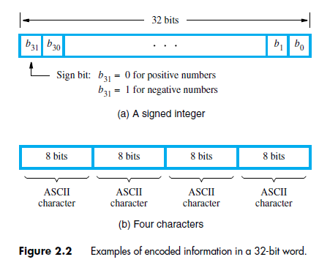
Example of Word

Slide 8
Memory Addresses
Memory can either be retrieved as one word or one byte (8-bit), addresses, however, for each location are needed.
A k-bit address memory has 2^{k} memory locations 0 – 2^{k}-1, memory space.
24-bit memory: 2²⁴ = 16,777,216 = 16M (1M=2²⁰)
32-bit memory: 2³² = 4G (1G=2³⁰)
1K(kilo)=2¹⁰
1T(tera)=2⁴⁰
Byte locations have addresses 0, 1, 2, … For 32 bit word length, successive words addresses are 0, 4, 8,…

Slide 9
Word Alignment
  The addresses that begin at byte addresses in multiples of the number bytes in a Word are said to be aligned in memory
  32-bit word: word addresses: 0, 4, 8,….
  64-bit word: word addresses: 0, 8,16,….

Slide 10
Memory Operation
Load (or Read or Fetch)
  Copy the content. The memory content remains unchanged.
  Address – Load
  Registers can be used
Store (or Write)
  Content of the memory is overwritten
  Address and Data – Store
  Registers can be used

Slide 11
Primitive Operations
A computer must have instructions capable of performing four types of operations
  Data transfers between the memory and the processor registers
  Arithmetic and logic operations on data
  Program sequencing and control
  I/O transfers

Slide 12
Register Transfer
Location can be identified by symbolic name (Loc, R0)
Contents of a location are denoted by placing square brackets around the name of the location (R1←[LOC], R3 ←[R1]+[R2])
For Example in Assembly language
  Move LOC, R1 = R1←[LOC]
  Add R1, R2, R3 = R3 ←[R1]+[R2]

Slide 13
Using CPU Registers
Registers are faster
Shorter instructions
  The number of registers is smaller (e.g. 64 registers need 6 bits)
Potential speedup
Minimize the frequency of memory access

Slide 14
Branching

Slide 15
Condition Codes
Condition code flags
Condition code register / status register
  N (negative)
  Z (zero)
  V (overflow)
  C (carry)
Different flags are affected by different instructions

Slide 16
Addressing Modes
Implied
  “ADD M[AR]” in “One-Address” instruction
Immediate
  Use of a constant in “MOV R1, 6”, i.e. R1 ← 6
Register
  Indicate which register holds the operand
Register Indirect
  Indicate the register that holds the number of the register that holds the operand
    MOV R1, (R2)
Autoincrement / Autodecrement
  Access & update in 1 instr.
Direct Address
  Use the given address to access a memory location

Slide 17
Addressing Modes
Indirect Address
  Indicate the memory location that holds the address of the memory location that holds the data
Relative Address
  EA = PC + Relative Addr
Indexed
  EA = Index Register + Relative Addr
Base Register
  EA = Base Register + Relative Addr

Slide 18
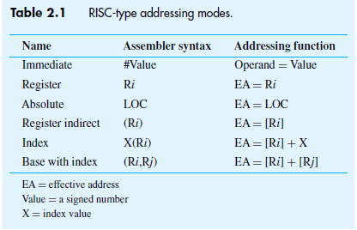
Addressing Modes

Slide 19
Summary
Fetch and Execute
Registers
Memory locations and addresses
Addressing Modes

