Slide 1
Computer Architecture
Lecture 28
Fasih ur Rehman

Slide 2
Last Class
Memories
  Performance Considerations
  Virtual memory

Slide 3
Today’s Agenda
Memories
Virtual memory
  Address Translation
Memory Management

Slide 4
Virtual Memory
Physical memory not as large as address space spanned by processor
  E.g. processor might address 32-bits (4G) but memory may only be 1G
Part of program not in main memory stored on hard disk and brought into main memory (using DMA) as needed
This is done automatically by the OS, application program does not need to be aware of the existence of virtual memory (VM)
Addresses generated by the processor are called virtual or logical addresses
Memory management unit (MMU) translates virtual addresses to physical addresses

Slide 5
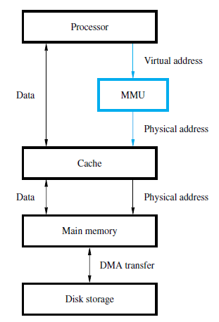
Virtual Memory Organization

Slide 6
Address Translation
Memory divided into pages of fixed size
  A page is a block of words occupying contiguous addresses in MM
  A basic unit of information that is exchanged between MM and secondary storage
  Commonly size ranges from 2KB to 16KB
  Too small means too much time will be spent in getting pages from disk
  Too large means a large portion of the page may not be needed or reference
Processor generates virtual addresses.
  High order bits (most significant bits) are the virtual page number and low order bits (least significant bits) are the offset

Slide 7
Address Translation
Information about where each page is stored is maintained in a software controlled data structure in main memory called the page table
  Starting address of page table is called the page table base register
  Area of the main memory that can hold a page is called page frame
  Address in physical memory is obtained by indexing the virtual page number from the page table base register

Slide 8
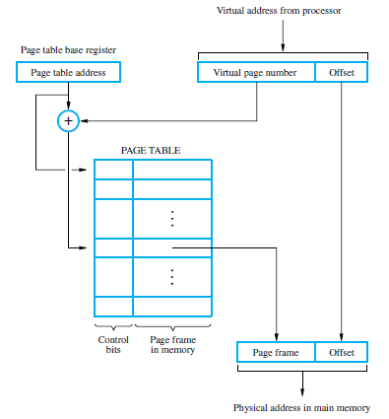
Address Translation
Address of
the page table.
Virtual address = page
number + offset.
PTBR + virtual page number = Entry of the page in the page table.
Starting address of the page
in the main memory.
Starting location of the page.

Slide 9
Page Table
Page table entries (PTE) also include
  Control bits describe status of page
    Whether page is actually in the memory
    Whether the page has been modified
    Does program have read permission
    Does program have write permission

Slide 10
Page Table
Page table is used by Memory Management Unit (MMU) for every read and write request
So where should we place the page table?
  Ideally, MMU will be ideal place for page table.
  Page table size is huge.
  Since MMU is part of the processor this much memory cannot be made part of the MMU
  So page table is implemented on the main memory
To speed up the access, a copy of small portion of the page table can be implemented within the MMU
  This small cached table is called Translation Lookaside Buffer (TLB)
    TLB operates similar to cache memory

Slide 11
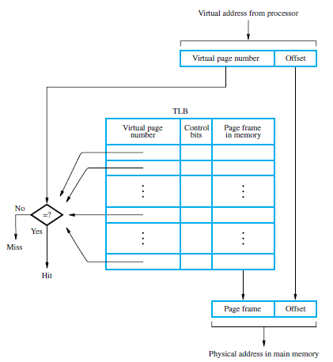
Translation Lookaside Buffer
Associative or set associative scheme normally used
Processor must keep TLB and page table information consistent

Slide 12
Associative Mapped TLB
High-order bits of the virtual address generated by the processor select the virtual page.
These bits are compared to the virtual page numbers in the TLB.
If there is a match, a hit occurs and the corresponding address of the page frame is read.
If there is no match, a miss occurs and the page table within the main memory must be consulted.
Commercial processors use set-associative mapped TLBs.

Slide 13
How VM Works
A page fault is said to occur if a program generates an access to a page that is not in the memory.
  MMU generates exception
  Processing of active task is suspended
  Operating System (OS) take control
  OS transfers the required page to MM from the secondary storage (SS)
  Suspended program gets the control back after the page has been copied to the MM
  Since secondary storage is accessed, the page transfer may cause a significant delay

Slide 14
How VM Works
A page has to be brought in MM from the disk but MM is full
  An approach similar to cache implementation can be used
  Principal of Locality of Reference can be applied here
  Least recently used algorithm can be used here
A page may be modified during its stay in MM
  If such a page (dirty page) is to be replaced
  Write back protocol is used
    Write through protocol will be too slow

Slide 15
Memory Management
OS is responsible for transferring programs and data between MM and SS
OS routines also occupies some of the virtual space called system space
Application program occupies another part of space called user space
Processor uses two states
  Supervisor state
  User state

Slide 16
Memory Management
Supervisor state: only OS routines are executed
User state
  User/Application programs are executed
  Certain privileged instructions can be executed in user state
  Prevents access of other user space

Slide 17
Summary
Virtual Memory
  Address Translation
  Memory Management

