Slide 1
Computer Architecture
Lecture 26
Fasih ur Rehman

Slide 2
Last Class
Memories Cont.
  Speed Size and Cost
  Memory Hierarchy
  Memory Systems

Slide 3
Today’s Agenda
Cache Memories
  Mapping Functions

Slide 4
Mapping Functions
Three types of Mappings
  Direct Mapping
  Associative Mapping
  Set Associative Mapping

Slide 5
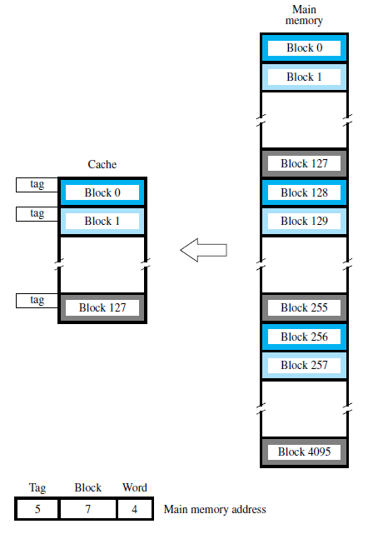
Direct Mapping

Slide 6
Direct Mapping
Memory address divided into 3 fields
  Block determines position of block in cache
  Tag used to keep track of which block is in cache (as many blocks can map to same position in cache)
  Word selects which word of the block to return for a read operation
Given an address t, b, w
  See if it is already in cache by comparing t with the tag in block b
  If not, replace the current block at b with a new one from memory
Simple but not very flexible

Slide 7
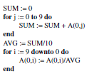
Example
Assume separate instruction and data caches
Cache has space for 8 blocks
Block contains 1 16-bit word
A(4,10) is an array of words located at 7A00- 7A27 in column order
Normalize an array by its average

Slide 8
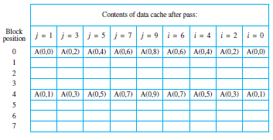
Example (Direct Mapping)
Least significant 3-bits of address determine location in cache
When i=9 and 8, get a cache hit (2 hits in total)
For j loop only 2 out of the 8 cache positions used
Tags not shown but are needed
Very inefficient cache utilization

Slide 9
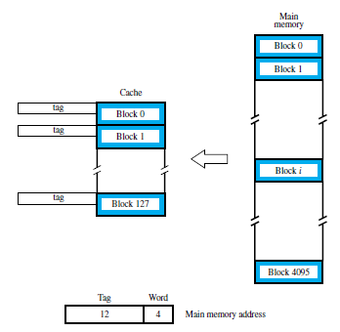
Associative Mapping

Slide 10
Associative Mapping
In direct mapping, the block is restricted to reside in a given position in the cache
Associative mapping allows block to reside in an arbitrary cache location
In this example, all 128 tag entries must be compared with the address Tag in parallel so cost is higher.

Slide 11
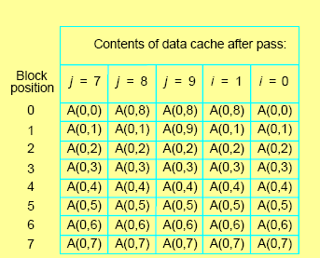
Example
LRU replacement policy
Get hits for i=9,8,..,2
If i loop was a forward one, would get no hits!

Slide 12
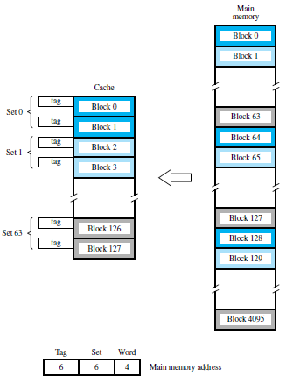
Set Associative Mapping

Slide 13
Set Associative Mapping
Combination of direct and associative
Blocks 0,64,128,…,4032 map to cache set 0 and can occupy either of 2 positions within that set
A cache with k-blocks per set is called a k-way set associative cache

Slide 14
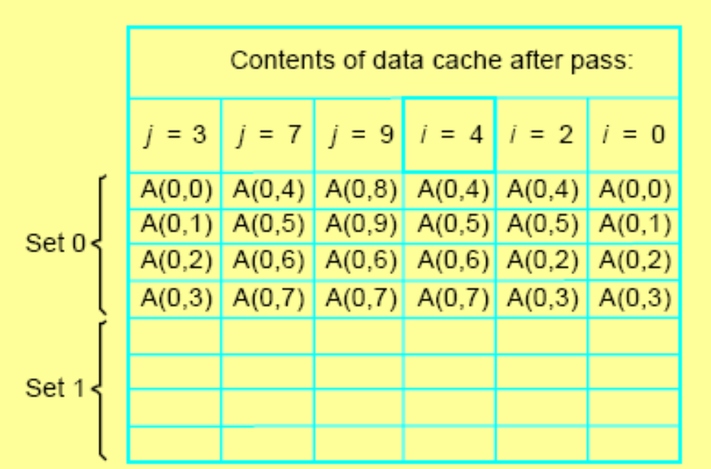
Example
Since all accessed blocks have even addresses, only half the cache is used i.e. they all map to set 1
Get hits for i=9,8,7,6
Random replacement would have better average performance

Slide 15
Replacement Algorithms
Direct mapped cache
  Position of each block fixed, no replacement algorithm needed
Associative and Set associative
  Need to decide which block to replace (keep ones likely to be used in cache)
  One strategy is least recently used (LRU) e.g. for a 4 block cache, use a 2-bit counter. Set =0 for block accessed, other blocks incremented. Block with count=3 replaced upon miss
  Another is random replacement (choose random block). Advantage is that it is easier to implement at high speed

Slide 16
Summary
Cache
  Mapping Functions

