Slide 1
Computer Architecture
Lecture 25
Fasih ur Rehman

Slide 2
Last Class
Memories
  RAMs
  ROMs
    Types

Slide 3
Today’s Agenda
Memories Cont.
  Speed Size and Cost
  Memory Hierarchy
  Memory Systems

Slide 4
Execution
What happens when we try to execute a program
  OS copies the program from hard disk to main memory
  places the address of the first instruction of the program into program counter
  processor then starts executing instructions by fetching them to the processor

Slide 5
Speed Size and Cost
It’s challenging to design a computer system that provides large memory with adequate speed at an affordable cost.
Static RAM’s
  are fast but they are expensive because of their cell complexity.
  So it’s nearly impossible to fabricate large number of cells on a single chip
Dynamic RAMs
  have simple circuits making them cheap
  but are slower
Magnetic Disks are even slower although have huge memories and very cheap

Slide 6
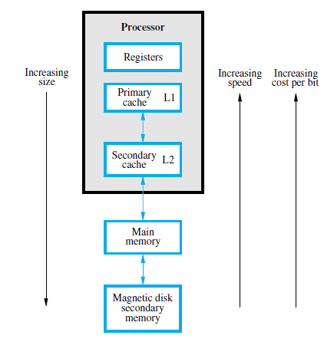
Memory Hierarchy

Slide 7
Memory Hierarchy
Registers are at the top of the memory hierarchy providing fastest access.
Processor cache can be implemented on the processor chip.
  Two levels of cache.
    Level 1 (L1) cache is on the processor chip.
    Level 2 (L2) cache is in between main memory and processor.
Main memory at next level,
  implemented as SIMMs.
  Much larger
  much slower as compared with cache memory.
Magnetic disks (Normally last level).
  Huge amount
  inexpensive storage.

Slide 8
Cache Memories
Processor runs at much faster speed than its main memory (MM)
  Processor will then have to wait for a while data and instruction are read from the memory
  degrades the performance of the computer system
  Speed of MM is bounded by certain constraints
Cache memory uses principal of “Locality of Reference” which makes MM appear (to the processor) faster than it actually is.

Slide 9
Locality of Reference
Temporal (in time)
  When information item (instruction or data) is first needed, brought into cache where it will hopefully be used again
Spatial (in space)
  Rather than a single word, fetch data from adjacent addresses as well.
  Block refers to a set of contiguous addresses of given size (cache block also called cache line)
Need to have a replacement algorithm to decide what to do when cache is full

Slide 10
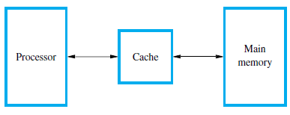
Cache Memories
Cache is transparent to the processor
When processor issues a read request, a block of words (one word at a time) is transferred from MM to cache
Cache has subsequent blocks of word data

Slide 11
Cache Read
Read request
  Contents of a block are read into the cache the first time
  Subsequent accesses are (hopefully) from the cache (called a read hit)
  Number of cache entries is relatively small, need to keep most likely data in cache
  When an un-cached block is required, need to employ a replacement algorithm to remove an old block and to create space for the new

Slide 12
Cache Write
Write operation
Scheme 1
  Cache and memory updated at the same time (write-through)
Scheme 2
  Update cache location and mark as dirty. Main memory updated when cache block is removed (write-back)
Which is simpler? Which has the better performance? Why?
Read misses, read hits, write misses, write hits can occur
Mapping functions determine how addresses are assigned to cache locations

Slide 13
Cache Memories
Only a few blocks can be accommodated in the cache.
  In order to determine which block of MM are in cache, mapping functions are used
  When cache memory is full and more blocks have to be brought in the cache, replacement algorithms are required to determine which block is to be replaced.
  If data is in the cache it is called a read or write hit
  Read Hit
    The is read from the cache
  Write Hit
    Cache has copy of the contents of memory
    Contents of memory and cache may be updated using write through protocol or write back protocol

Slide 14
Cache Miss
Cache miss occurs when data is not present in cache
  Read miss
    blocks are to be transferred to cache from MM
  Write miss
    No problem when using write through protocol
    for write back protocol, the block has to be transferred to the cache an then updated.

Slide 15
Summary
Memories Cont.
  Speed Size and Cost
  Memory Hierarchy
  Memory Systems
    Cache Memories

