Slide 1
Computer Architecture
Lecture 24
Fasih ur Rehman

Slide 2
Last Class
Memories
  Purpose
  Characteristics
  Types

Slide 3
Today’s Agenda
Memories Cont.

Slide 4
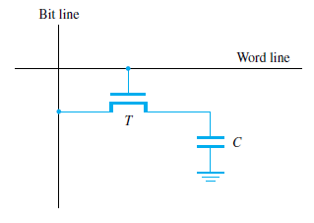
Dynamic RAM’s
  Dynamic RAMs store data as charge on a capacitor. This leaks away with time so must be refreshed. In return for this trouble, the density is much higher. The common type used today is called a synchronous DRAM as it uses a clock.
Do not retain their state indefinitely even if power is kept ON.
Contents must be periodically refreshed.
May be refreshed while being accessed for reading.

Slide 5
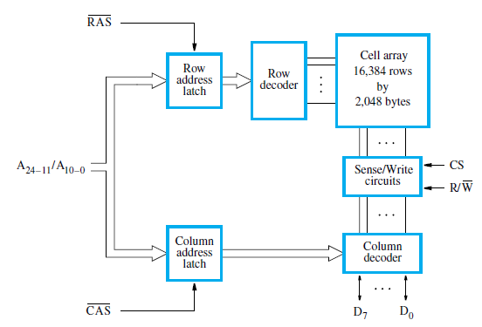
Internal Organization

Slide 6
Fast Page Mode
Allows transfer of block of data
  Consecutive sequence of column addresses can be applied under control signal (CAS)
  Block and page are used for groups of data. Block refers to smaller group while page refers to relatively large group

Slide 7
Synchronous DRAM
Memory operation is synchronized with processor clock.
The outputs of the sense circuits are connected to a latch.
During a Read operation, the contents of the cells in a row are loaded onto the latches.
The contents of the cells are refreshed (without changing) the contents of the latches while refreshing.
Latches hold data that corresponds to the selected columns are transferred to the output.
For a burst mode of operation, successive columns are selected using column address counter and clock. CAS signal need not be generated externally. A new data is placed during raising edge of the clock

Slide 8
Double Data Rate Memories
Memory latency is the time it takes to transfer a word of data to or from memory
Memory bandwidth is the number of bits or bytes that can be transferred in one second.
DDR SDRAMs
  Cell array is organized in two banks
  Double data rate SDRAM transfers data on both clock edges (normal circuits only operate on rising clock edge)

Slide 9
Dynamic RAM’s
Memory modules are used to hold several SDRAM chips and are the standard type used in a computer’s motherboard
  Packaging considerations have led to the development of larger memory units known as SIMMs (Single In-line Memory Modules) and DIMMs (Dual In-line Memory Modules)

Slide 10
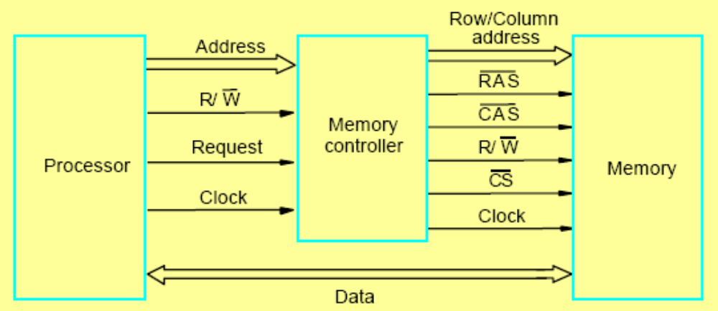
Memory Controller
A memory controller is normally used to interface between DRAM and the processor. Dynamic RAMs have a slightly more complex interface as they multiplex signals in time to reduce pins
SRAM interfaces are simpler and may not need a memory controller

Slide 11
Memory Controller
How to interface memories

Slide 12
Read Only Memories
RAMs are volatile
We need some memory to be retained even if the power is switched off.
  For example, booting a computer
So we need some arrangement or non – volatile memory to store some instructions that need to be executed at start up.
Non – volatile memory is read in a same manner as the RAM and called Read only Memories
  Special writing process is needed

Slide 13
Types of ROMs
ROM
  Data are stored at the time of manufacturing these types of memories.
  Data can then be only read and cannot be modified
Programmable ROM (PROM)
  User is allowed to load data
  Data once inserted cannot be modified
  Expansive

Slide 14
Types of ROMs (Cont.)
Erasable PROM
  User is allowed to load data
  Stored data can be erased and new data can be loaded
  Provides flexibility during development of digital system
  A special EPROM eraser is required to erase the stored data.
  Erasing requires exposure to UV rays
  Has to be removed from the circuit for erasing the data

Slide 15
Types of ROMs (Cont.)
Electrically Erasable PROM
  Removes the disadvantages of EPROM
  Requires only Electrical signal to read or write the data
Flash Memory
  Uses same approach as that of EEPROM
  Read operation is only from one cell while block of data can be written simultaneously.
  Have higher density
  Consumes very little power
  single flash chip has smaller memory so for larger memories, flash cards and flash disks are used

Slide 16
Summary
RAMs
ROMs
  Types

