Slide 1
Computer Architecture
Lecture 23
Fasih ur Rehman

Slide 2
Last Class
Floating point numbers
IEEE Standard
Floating Point Arithmetic

Slide 3
Today’s Agenda
Memories

Slide 4
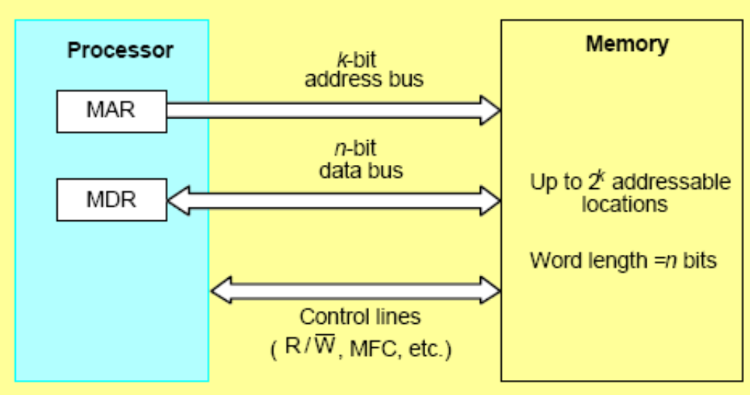
Basic Concepts
Maximum Size
Addressability
Memory Connections

Slide 5
Size
Maximum size of memory determined by addressing scheme
  E.g. 16-bit addresses can only address 216 = 65536 memory locations
  Most machines byte addressable but retrieve/store data in words
  1K = 2¹⁰
  1M=2²⁰
  1G=2³⁰
  1T=2⁴⁰

Slide 6
Characteristics
Measures for the speed of a memory:
  Memory access time: Time between start and finish of a memory request
  Memory cycle time: minimum delay between successive memory operations
A key design issue is to provide a computer system with as large and fast memory as possible, within given cost.
Types
  Volatile and Non – Volatile
  Static or Dynamic

Slide 7
Internal Organization
Each memory cell holds one bit of information.
Memory cells are organized as a two – dimensional array.
Each row is one memory word.
All cells of a row are connected to a common line, known as the “word line”.
Word line is connected to the address decoder.
Sense/write circuits are connected to the data input/output lines of the memory chip.

Slide 8
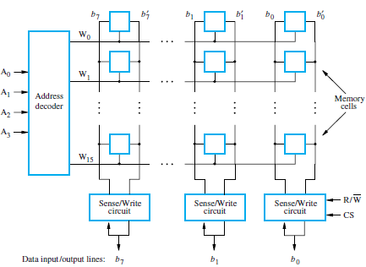
Internal Organization

Slide 9
Random Access Memory
Random access memory (RAM), any location can be accessed with comparable access time (e.g. CD vs. tape drive)
Processor usually runs much faster than main memory
  Small memories fast, large memories slow
  Use a cache memory to store data that is likely to be used

Slide 10
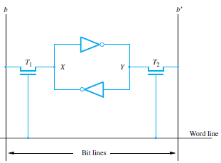
Types of RAM’s
  Static RAM (SRAM) are fast but small
  Basic flip-flop IS implemented by two transistor inverters that are cross connected.
  The cell is connected to one word line and two bits lines by transistors T1 and T2
  The transistors are turned off, when word line is at ground level, and the latch retains its state

Slide 11
Static RAM
Circuits of SRAM are capable of retaining their state as long as the power is applied.
Volatile memory: because contents are lost when power is switched OFF.
Access times of static RAMs are in the range of few nanoseconds.
Costly.

Slide 12
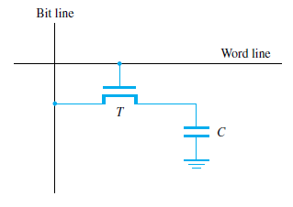
Dynamic RAM’s
  Dynamic RAMs store data as charge on a capacitor. This leaks away with time so must be refreshed. In return for this trouble, the density is much higher. The common type used today is called a synchronous DRAM as it uses a clock.
Do not retain their state indefinitely even if power is kept ON.
Contents must be periodically refreshed.
May be refreshed while being accessed for reading.

Slide 13
Summary
Memories
Types
Interfacing

