Slide 1
Computer Architecture
Lecture 22
Fasih ur Rehman

Slide 2
Last Class
Floating point numbers
IEEE Standard

Slide 3
Today’s Agenda
Floating Point Numbers
  IEEE Standard for representation of Floating Point Numbers
  Floating point Arithmetic

Slide 4
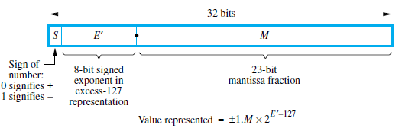
IEEE Standard for Representation

Slide 5

Example

Slide 6
Special Values
S. No | E’ | M | Value
1 | 0000 0000 (0) | 0 | 0
2 | 0000 0000 (0) | ≠ 0 | De normal value
3 | 1111 1111 (255) | 0 | Infinity
4 | 1111 1111 (255) | ≠ 0 | NaN

Slide 7
Special Values
Infinity can positive or negative depending upon sign bit
De normal values are used to allow gradual underflow
  Denormal value is smaller than the smallest value that can be represented
NaN means Not a Number: 0/0 or square root of a negative number

Slide 8
Main Features
Floating point numbers are represented in a normalized form.
MSB of the mantissa is always equal to 1.
We can represent numbers without storing the MSB.
The values of the numbers represented in the IEEE single precision notation are of the form (+,-) 1.M x 2^{(E - 127)}

Slide 9
Addition / Subtraction Rules
Choose the number with the smaller exponent and shift its mantissa right a number of steps equal to the difference in exponents.
Set the exponent of the result equal to the larger exponent.
Perform addition/subtraction on the mantissas and determine the sign of the result.
Normalize the resulting value, if necessary.
3.1415 x 10⁸ + 1.19 x 10⁶ = 3.1415 x 10⁸ + 0.0119 x 10⁸ = 3.1534 x 10⁸

Slide 10
Multiplication Rules
Add the exponents and subtract 127 to maintain the excess-127 representation.
Multiply the mantissas and determine the sign of the result.
Normalize the resulting value, if necessary.

Slide 11
Division Rules
Subtract the exponents and add 127 to maintain the excess-127 representation.
Divide the mantissas and determine the sign of the result.
Normalize the resulting value, if necessary.

Slide 12
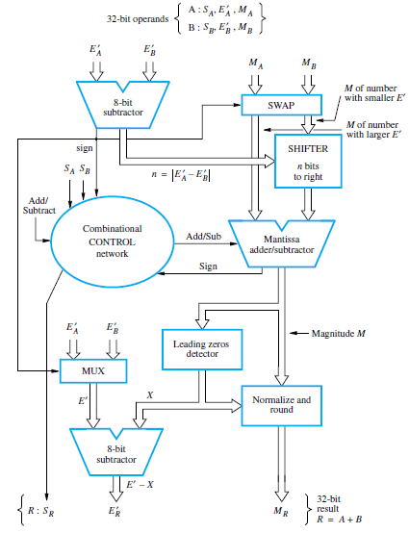
Implementation of Addition

Slide 13
Summary
Floating Point Numbers
  IEEE Standard for representation of Floating Point Numbers
  Arithmetic

