Slide 1
Computer Architecture
Lecture 20
Fasih ur Rehman

Slide 2
Last Class
Fast Multiplication

Slide 3
Today’s Agenda
Integer Division

Slide 4
Integer Division
Longhand Division

Slide 5
Longhand Division Steps
Position the divisor appropriately with respect to the dividend and performs a subtraction.
If the remainder is zero or positive, a quotient bit of 1 is determined, the remainder is extended by another bit of the dividend, the divisor is repositioned, and another subtraction is performed.
If the remainder is negative, a quotient bit of 0 is determined, the dividend is restored by adding back the divisor, and the divisor is repositioned for another subtraction.

Slide 6
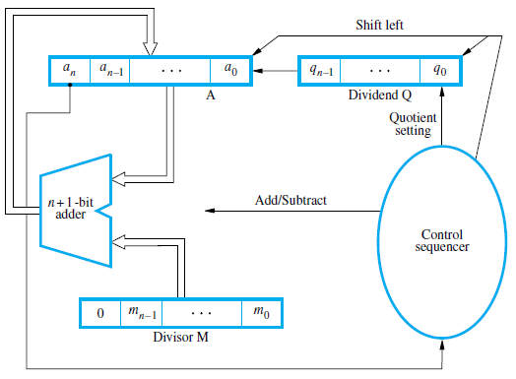
Circuit Arrangement

Slide 7
Restoring Division
Shift A and Q left one binary position
Subtract M from A, and place the answer back in A
If the sign of A is 1 (i. e negative number), set q₀ to 0 and add M back to A (restore A); otherwise, set q₀ to 1
Repeat these steps n times

Slide 8
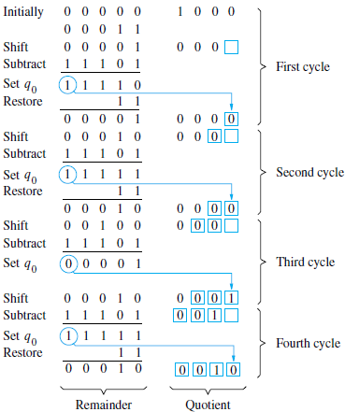

Example (Restoring Division)

Slide 9
Non – Restoring Division
Avoid the need for restoring A after an unsuccessful subtraction.
Any idea?
Step 1: (Repeat n times)
  If the sign of A is 0, shift A and Q left one bit position and subtract M from A; otherwise, shift A and Q left and add M to A.
  Now, if the sign of A is 0, set q₀ to 1; otherwise, set q₀ to 0.
Step2: If the sign of A is 1, add M to A

Slide 10
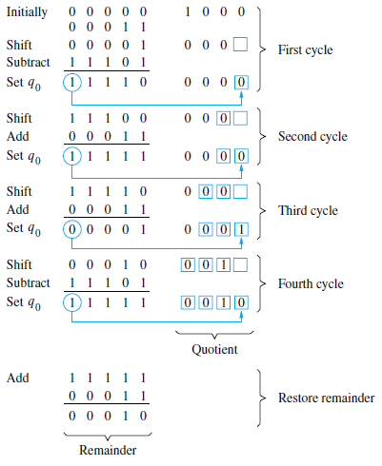
Example (Non – Restoring Division)

Slide 11
Fractions

Slide 12
Summary
Integer Division
Fractions

