Slide 1
Computer Architecture
Lecture 02
Fasih ur Rehman

Slide 2
Last Class
Introduction to the course
Basic functional units of the computer
  Von Neumann Arch
  CPU
    ALU
    Control Unit
  Memory
  I/O
Basic I/O
  Keyboard – monitor interface

Slide 3
Today’s Agenda
Bus Organization
Operational Concepts of a Computer
Software (System/Application)
Caching
Performance

Slide 4

Bus Organization
Interconnects (group of lines) used for communication between the processor, memory and I/O devices
Multiple buses are often used for better performance

Slide 5
Bus
Three types
  Address Bus
  Data Bus
  Control Bus
Bus architecture depends on speed requirements and size etc.
Speed issues
  Devices connected to the bus operate at different speed.
  The speed of bus is limited by the slowest device connected to it, resulting in poor efficiency.
  Buffers used to overcome this problem.
Example
  ISA, EISA, PCI, USB
  what is the word size for each

Slide 6
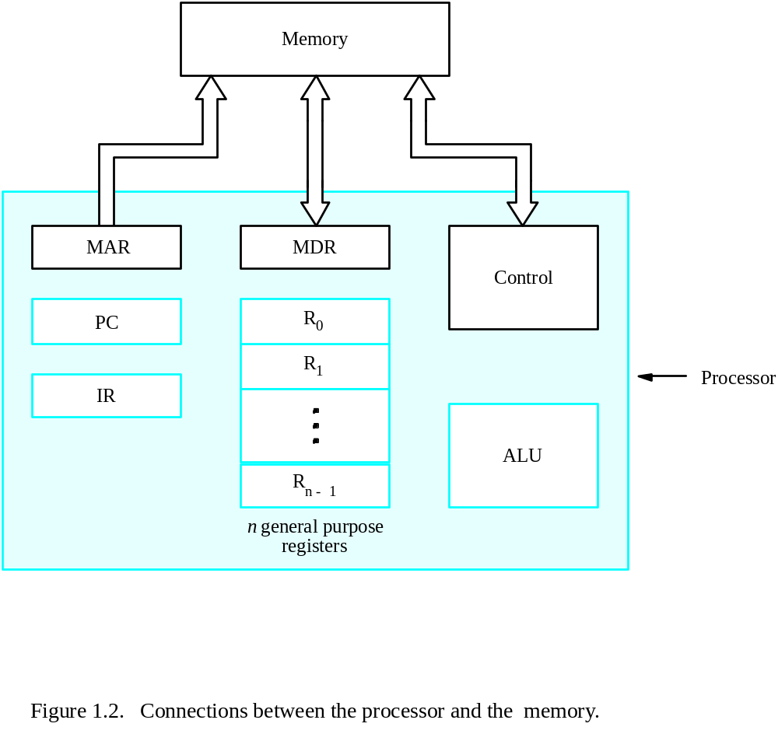
Interconnections

Slide 7
Operational Concepts
Instructions (programs) govern the activities of computer
Appropriate list of instructions is stored in the memory to perform a task
Processor performs the operation of instruction by
  bringing the instruction in to processor
  decoding the instruction
  perform the task
  everything is coordinated by control unit that generates appropriate control and timing signals
All operands (data) are also stored in memory

Slide 8
Example
An Instruction (Add LOCA, R0)
  Add the operand at memory location LOCA to the operand in a register R0 in the processor.
  Place the sum into register R0.
  The original contents of LOCA are preserved.
  The original contents of R0 is overwritten.
  Instruction is fetched from the memory into the processor – the operand at LOCA is fetched and added to the contents of R0 – the resulting sum is stored in register R0.

Slide 9
Software
System software
  Receive and translate user inputs and/or commands
  Stores and retries (data/instructions) from secondary storage
  Executing standard applications e.g. word processors, spreadsheets, compilers, linkers
  Provides interface to I/O units e.g. printer
  An example of system software is the operating system
Application software
  Usually written in high – level languages such as Java, C, C++ or Fortran etc.
  Compiler translates the program to an executable file which runs on the computer.

Slide 10
Performance
The most important measure of a computer is how quickly it can execute programs.
Factors affecting performance
  Hardware design
  Instruction set
  Compiler

Slide 11

Caching
Cache is small on – chip memory
  Faster than RAM
  thus reducing access time

Slide 12
Performance
CPU and a small cache memory can be fabricated on a single integrated circuit chip.
  Speed
  Cost
  Memory management
Main
Cache
memory
memory
Processor
Bus

Slide 13
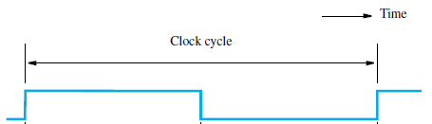
Clock
Each instruction may get divided into many steps, each of executes in one clock cycle.
Hertz – cycles per second

Slide 14
Performance Equation
Performance depends on following factors
  T: processor time required to execute a program that has been prepared in high-level language
  N: number of actual machine language instructions needed to complete the execution (note: loop)
  S: average number of basic steps needed to execute one machine instruction. Each step completes in one clock cycle
  R: clock rate

Slide 15
Performance
Parallelism is another factor that improves performance of a computer system
Parallelism is achieved by
  Pipelining
  Multicore processors
  Multiprocessors

Slide 17
Summary
Bus Organization
Operational Concepts of a Computer
Software (System/Application)
Caching
Performance

