Slide 1
Computer Architecture
Lecture 19
Fasih ur Rehman

Slide 2
Last Class
Signed Multiplication

Slide 3
Today’s Agenda
Fast Multiplication
  Booth’s Algorithm (revisit)
  Fast Algorithm

Slide 4

Booth’s Algorithm
Generally, in the Booth’ s algorithm, -1 times the shifted multiplicand is selected when moving from 0 to 1, and +1 times the shifted multiplicand is selected when moving from 1 to 0, as the multiplier is scanned from right to left.

Slide 5
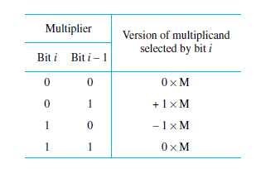
Booth Recoding Table
Thus recoding can be done using following table

Slide 6
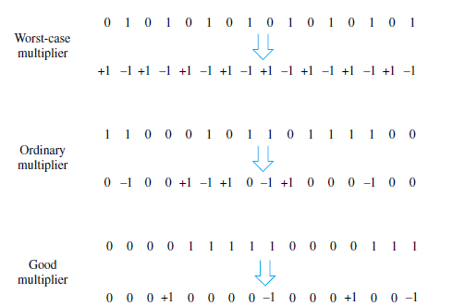
Some Booth Recoded Multipliers

Slide 7
Shift Operations

Slide 8
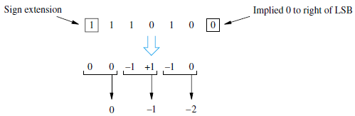
Bit Pair Recoding
A technique that halves maximum number of summands (versions of the multiplicand)

Slide 9
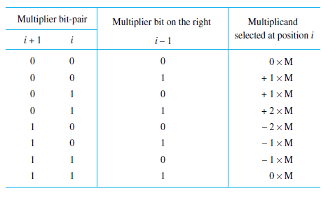
Multiplier Bit Recoding

Slide 10
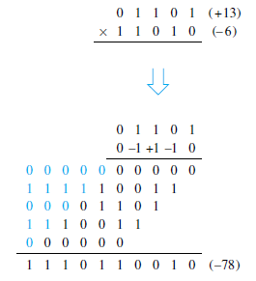
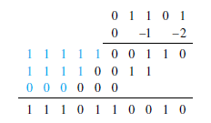
Example

Slide 11
Carry Save Addition of Summands
CSA can be used to speed up addition of the several summands required in multiplication

Slide 12
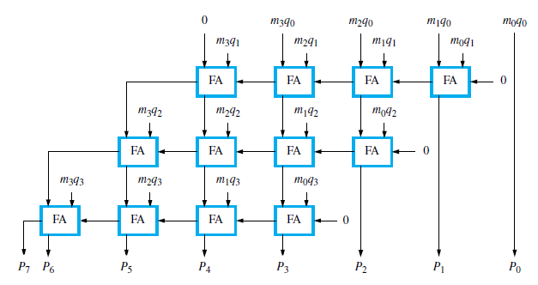
Ripple Carry Array

Slide 13
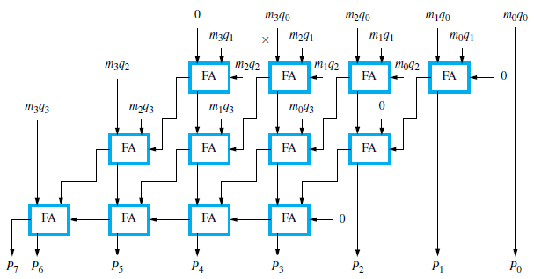
Carry – Save Array

Slide 14
Fast Multiplication
Bit pair recoding reduces summands by a factor of 2
Summands are reduced by carry – save addition
Final product can be generated by using carry lookahead adder

Slide 15
Summary
Multiplication
  Fast algorithm

