Slide 1
Computer Architecture
Lecture 18
Fasih ur Rehman

Slide 2
Last Class
Multiplication
Multipliers
  Array multipliers
  Sequential multipliers

Slide 3
Today’s Agenda
Multiplication
  Sequential Multipliers
  Multiplication of signed numbers

Slide 4
Sequential Multiplication
Multiplication Rules
  If the i^{th} bit of the multiplier is 1, shift the multiplicand and add the shifted multiplicand to the current value of the partial product.
  Multiplicands are left shifted before adding to partial product.
  Equivalently, same result can be achieved by adding “un – shifted” multiplicand to right shifted partial product.

Slide 5
Sequential Multiplication

Slide 6
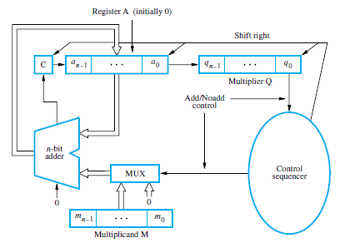
Sequential Multipliers

Slide 7
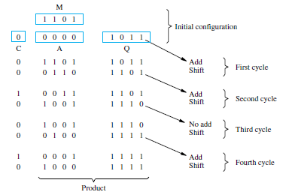
Example

Slide 8
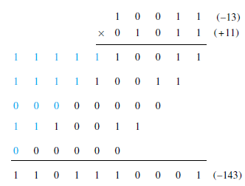
Multiplication of Signed Numbers
Considering 2’s-complement signed operands, what will happen to (-13)×(+11) if following the same method of unsigned multiplication?
  Sign extension is blue

Slide 9
Multiplication (Signed Numbers)
Positive multiplier and negative multiplicand
Hardware
  Array
  Sequential
Can be used if sign extension is augmented in the hardware.
The case of positive multiplicand and negative multiplier can be handled by taking 2’s – complement of multiplier and multiplicand and using above algorithm, as the product will remain unchanged.

Slide 10
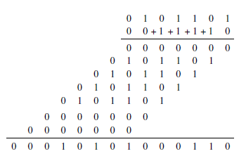
Booth’s Algorithm
Consider in a multiplication, the multiplier is positive 0011110, appropriately shifted versions of the multiplicand are added in a standard procedure.

Slide 11

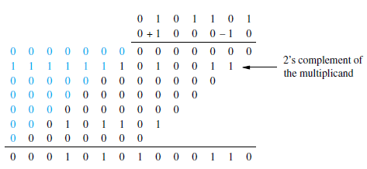
Booth’s Algorithm
We can write multiplier as

Slide 12

Booth’s Algorithm
Generally, in the Booth’ s algoritm, -1 times the shifted multiplicand is selected when moving from 0 to 1, and +1 times the shifted multiplicand is selected when moving from 1 to 0, as the multiplier is scanned from right to left.

Slide 13
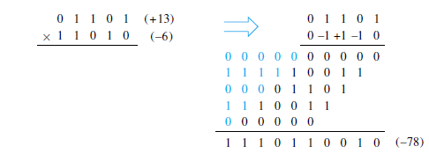
Booth’s Algorithm

Slide 14
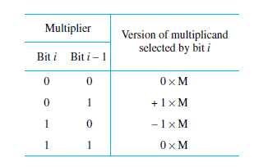
Booth Recoding Table
Thus recoding can be done using following table

Slide 15
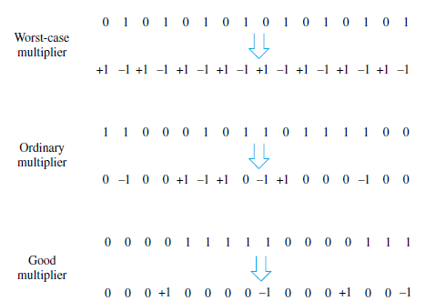
Some Booth Recoded Multipliers

Slide 16
Advantages
Handles both positive and negative numbers uniformly
Achieves some efficiency in terms of number of additions required when multiplier has large blocks of 1’s.

Slide 17
Summary
Multiplication
  Sequential Multipliers
  Multiplication of signed numbers

