Slide 1
Computer Architecture
Lecture 17
Fasih ur Rehman

Slide 2
Last Class
Fast Adders

Slide 3
Today’s Agenda
Multiplication and multipliers

Slide 4
Multiplication

Slide 5
Multiplication (Examples)

Slide 6
Multiplication
At the most, product of 2 n – bit numbers is 2n – bit number at the most
Multiplication of unsigned numbers can be regarded as addition of shifted versions of the multiplicand.
  Partial products are added at the end or
  Partial products will be added at each stage

Slide 7
Implementation Rules (Multiplications)
If the i^{th} bit of the multiplier is 1, shift the multiplicand and add the shifted multiplicand to the current value of the partial product.
Hand over the partial product to the next stage
Value of the partial product at the start stage is 0.

Slide 8
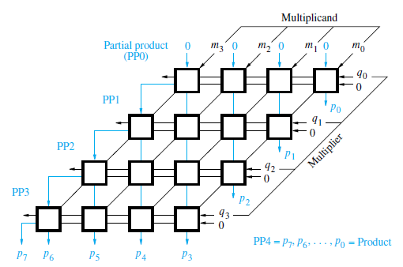
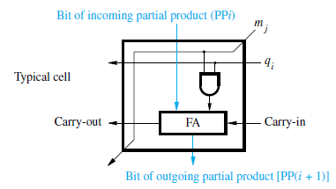
Array Multiplication (Unsigned)

Slide 9
Array Multipliers
These Multipliers are also called combinatorial array multipliers
  Highly Inefficient
  Uses a very high number of gates
  No utility for signed numbers
Solution
  Sequential Multipliers

Slide 10
Summary
Multiplication
Multipliers
  Array multipliers
  Sequential multipliers

