Slide 1
Computer Architecture
Lecture 16
Fasih ur Rehman

Slide 2
Last Class
Overflow
Addition
Adders

Slide 3
Today’s Agenda
Fast Adders
Multiplication and Multipliers

Slide 4
XOR Gate

Slide 5
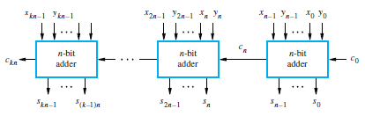
Cascade for k n – bit Adders

Slide 6
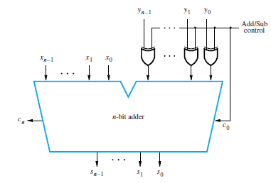
Binary Addition/Subtraction Logic Circuit

Slide 7
Detecting Overflow
Overflows can only occur when both the operands have same sign.
Overflow occurs if the sign bit of the result is different from the sign bits of the operands.
MSB represents the sign.
Overflow can be detected by the following logic expressions:
Overflow = C_{n} C_{n-1}

Slide 8
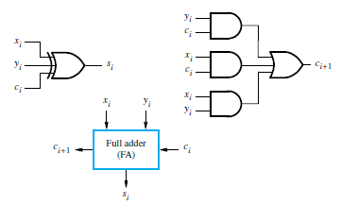
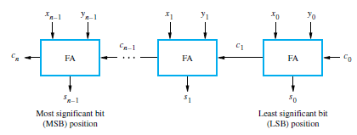
Determination of Delays
Delay is defined as time interval between the instances when o/p appears after the input has been applied.
Delay in the o/p
  Sum is available in 1 gate delay
  Carry is available in 2 gate delays
For n – bit adder
  s_{n-1} is available after 2n-1 gate delays
  c_{n} is available after 2n gate delays.
  Overflow is available after 2n + 2 gate delays

Slide 9
Fast Adders
We know that
Rewriting

Slide 10
Fast Adders
G_{i} and P_{i} are called Generate and Propagate at i^{th} stage.
G_{i} and P_{i} help in evaluating carry based on inputs

Slide 11
Carry Lookahead Adder
All carries can be obtained 3 gate delays after the application of X, Y and c₀ .
  One gate delay for P_{i} and G_{i}
  Two gate delays in the AND-OR circuit for c_{i+1}
All sums can be obtained 1 gate delay after the carries are computed.
Independent of n, n-bit addition requires only 4 gate delays.
This is called Carry Lookahead adder.

Slide 12
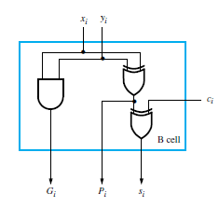
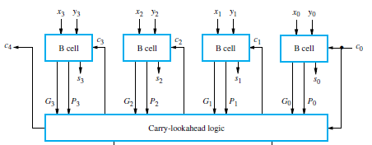
4 – bit Carry Lookahead Adder

Slide 13
Carry Lookahead Adder
All carries can be obtained 3 gate delays after the application of X, Y and c₀ .
  One gate delay for P_{i} and G_{i}
  Two gate delays in the AND-OR circuit for c_{i+1}
All sums can be obtained 1 gate delay after the carries are computed.
n-bit addition requires only 4 gate delays (i. e independent of n).
This is called Carry Lookahead adder.

Slide 14
4 – bit Carry Lookahead Adder

Slide 15
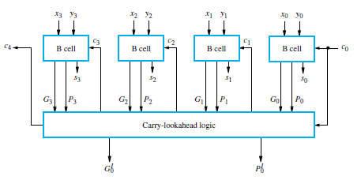
Carry Lookahead Adder

Slide 16
Carry Lookahaed Adder
4 – gate delay n – bit (independent of n) adder looks great but only theoretically as because of fan out constraints
Last Gate (AND or OR) requires a fan in of (n + 1) for an n – bit adder
  thus for n = 4, fan in of 5 will be required which is practical limit.
For inputs larger than 4 bits, 4 – bit carry lookahead adders can be cascaded.
  This adder is called Blocked Lookahead carry

Slide 17
Blocked Carry Lookahead Adder
Carry from a 4 – bit block is given by
Re – writing
Cascading 4 4 – bit adders and c₁₆ can be written as

Slide 18
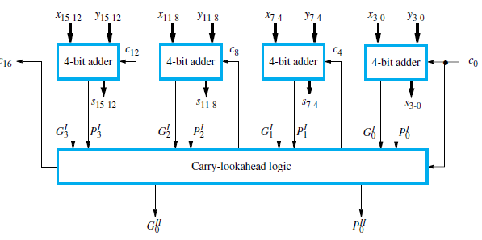
16 – bit Carry Lookahead Adder

Slide 19
16 – bit Carry Lookahead Adder
Inputs x_{i}, y_{i} and c₀
  P_{i} and G_{i} for each stage are available after 1 gate delay
  P^{I} is available after 2 and G^{I} after 3 gate delays.
  All carries are available after 5 gate delays
  C₁₆ is available after 5 gate delays
  s₁₅ is available after 8 (5 + 3) gate delays
    5 delays from 4 – bit lookahead and 3 delays after all inputs are available

Slide 20
Summary
Fast Adders

