Slide 1
Computer Architecture
Lecture 15
Fasih ur Rehman

Slide 2
Last Class
Arithmetic
  Representation
  Signed numbers
  Operations and their implementation

Slide 3
Today’s Agenda
Arithmetic operations

Slide 4
Overflow (Examples)

Slide 5
Overflow
Overflow in case of addition can only occur when both the operands have same sign.
Condition for Overflow
Overflow happens when (at MSB)
Carry in ≠ Carry out
Normally, overflow is referred to ‘V’ flag in status register

Slide 6
Addition/subtraction of signed numbers
x
i
y
i
Carry-in
c
i
Sum
s
i
Carry-out
c
i
+1
0
0
0
0
0
0
0
1
1
0
0
1
0
1
0
0
1
1
0
1
1
0
0
1
0
1
0
1
0
1
1
1
0
0
1
1
1
1
1
1
s
i
=
x
i
y
i
c
i
+
x
i
y
i
c
i
+
x
i
y
i
c
i
+
x
i
y
i
c
i
=
x
i
⊕
y
i
⊕
c
i
c
=
y
i
c
i
+
x
i
c
i
+
x
i
y
i
i
+1
E
xample:
X
7
0
1
1
1
Carry-out
x
i
Carry-in
+
Y
=
+ 6
=
+
0
0
1
1
1
1
0
0
0
c
y
i
c
Z
13
1
1
0
1
i
+1
s
i
i
Legend for stage
i

Slide 7
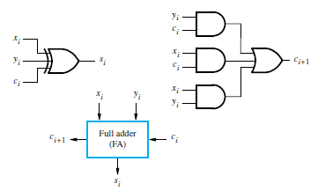
Logic for Single Stage

Slide 8
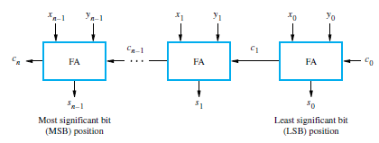
n – bit Ripple Carry Adder

Slide 9
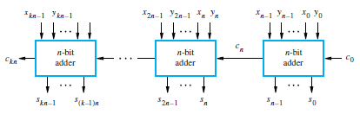
Cascade for k n – bit Adders

Slide 10
Summary
Overflow
Addition
Adders

