Slide 1
Computer Architecture
Lecture 13
Fasih ur Rehman

Slide 2
Last Class
Control Unit
  Hardwired control

Slide 3
Today’s Agenda
Control Unit
  Microprogrammed Control

Slide 4
Overview
In 1951 Maurice Wilkes came up with idea of sequencing of control signals within the computer similar to the sequencing actions required in a regular program.
A stored program to represent the sequences of control signals. Called it microprogramming
Divide machine instructions into sub-instructions (microinstructions) that implement the instruction set of the machine
Full set of microinstructions made up the microprogram

Slide 5
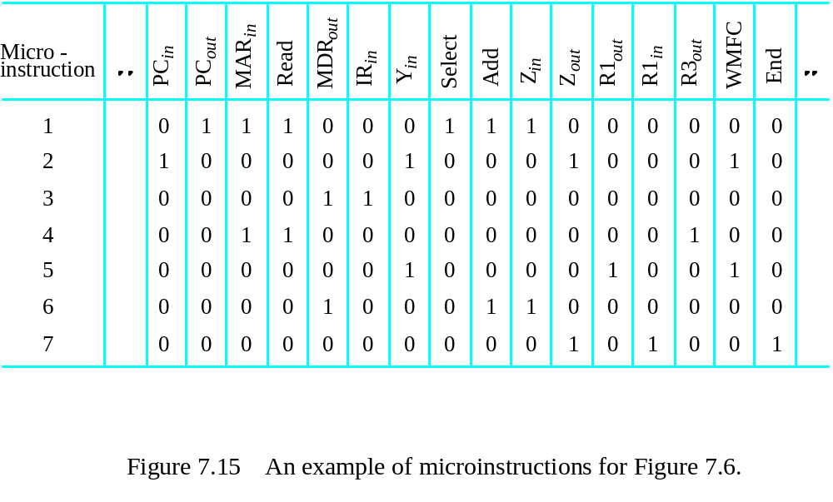
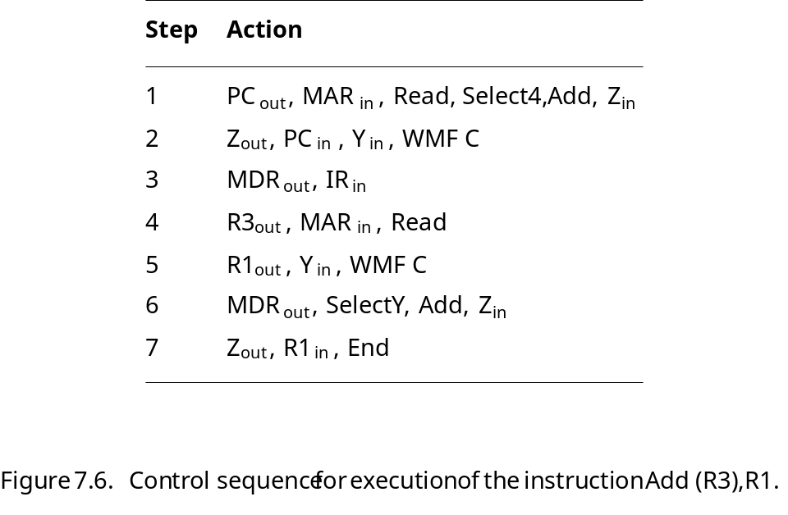
Microprogrammed Control
Control signals are generated by executing a program similar to machine language programs.
Control Word (CW); microroutine; microinstruction

Slide 6
Nomenclature
Control Word: is a word whose each bit represents a control signal
  Each control word is a unique combination of 0’s and 1’s.
  Control word is also called micro instruction
  For example: SelectY = 1 while Select4 = 0
Micro Routine: Collection of control words for a particular machine instruction

Slide 7
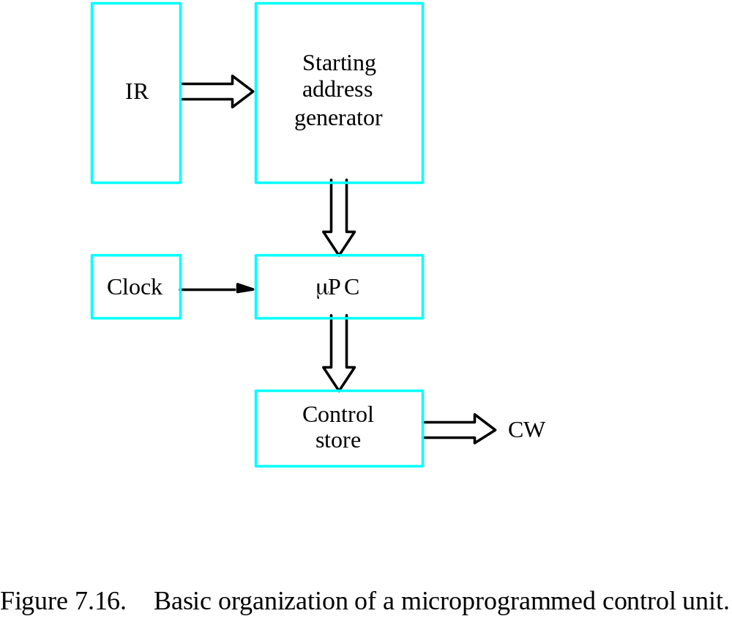
Basic Organization

Slide 8
Microprogrammed Control
Each micro – instruction is stored in a special memory called control store.
Control unit sequentially read that memory and generates control signal
A program counter called micro – programmed counter is used to read control words (micro – instructions) sequentially.
Micro – programmed counter is incremented by each clock cycle
Control signals are thus generated using that particular CW

Slide 9
Micro – programmed Control
A micro-program counter is used to read control words sequentially from control store
Every time new instruction loaded into the IR, output of “Starting Address Generator” loaded into the μPC
μPC automatically incremented by clock causing successive microinstructions to be read from the control store
Control signals delivered to various parts of the processor in the correct sequence
This scheme is not able to change its sequence as a result of other inputs such as the condition code e.g. Branch < 0

Slide 10
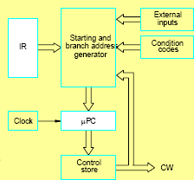
A Better Organization

Slide 11
Microprogrammed control with External Inputs
“Starting and branch address generator”
  Loads new address into μPC when instructed
  Has condition codes and external inputs which can affect μPC
μPC incremented every cycle except
  When new instruction loaded into IR, μPC loaded with starting address of the micro-routine
  For taken branches, μPC updated to branch address
  For End microinstruction, μPC set to 0.

Slide 12
Microinstructions
Microinstructions can simply be structured by assigning one bit position to each control signal.
This is very inefficient, however.
The length can be reduced: most signals are not needed simultaneously, and many signals are mutually exclusive.
All mutually exclusive signals are placed in the same group in binary coding.

Slide 13
Sequencing
If all microprograms require only straightforward sequential execution of microinstructions except for branches, letting a μPC governs the sequencing would be efficient.
Two disadvantages:
  Having a separate microroutine for each machine instruction results in a large total number of microinstructions and a large control store.
  Longer execution time because it takes more time to carry out the required branches.

Slide 14
μbranching in the µP Control Unit
Branch to start of μcode for a specific inst.
Conditional control signals, e.g. CON → PCin
Looping on conditions, e.g. n≠0 → ... Goto6
Conditions will control μbranches instead of being ANDed with control signals
Microbranches are frequent and control store addresses are short, so it is reasonable to have a μbranch address field in every μ instruction

Slide 15
Microinstruction with Next Address Field
The microprogram we discussed requires several branch microinstructions, which perform no useful operation in the datapath.
A powerful alternative approach is to include an address field as a part of every microinstruction to indicate the location of the next microinstruction to be fetched.
Pros: separate branch microinstructions are virtually eliminated; few limitations in assigning addresses to microinstructions.
Cons: additional bits for the address field

Slide 16
Summary
Microprogrammed Control

