Slide 1
Computer Architecture
Lecture 12
Fasih ur Rehman

Slide 2
Last Class
Multiple Bus Organization
Control Unit

Slide 3
Today’s Agenda
Control Unit
  Hardwired Control

Slide 4
Control Unit
Basic Tasks
  To go through a control sequence for each instruction
  To generate appropriate control signals for each task (or control step)
Control unit is driven by the processor clock
Generated Control signal depends on
  The actual step to be executed
  The condition and status flag of the processor
  The actual instruction executed
  Any external signal received (such as interrupts)

Slide 5
Control Unit
To execute instructions, a processor must have arrangement to generate control signals in proper sequence
How control signals can be generated
  Hard-wired Control
  Micro-programmed Control
  Programmable Logic Array

Slide 6
Hardwired Control
A hardwired control is called a finite state machine
  Sequences using a counter and produces control signals at the right time
  Control signals are functions of the IR, external inputs and condition codes
Hardwired system can operate at high speed; but with little flexibility.

Slide 7
Generation of Signals
Each step in sequence of execution is completed in one clock cycle.
A counter (called step counter) is used to keep track of the control steps
Control signals are function of
  Contents of step counter
  Contents of IR
  Condition codes
  External signal (MFC or interrupts etc)

Slide 8
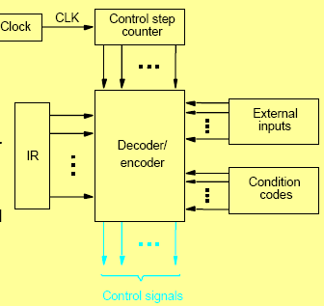
Hardwired Control

Slide 9
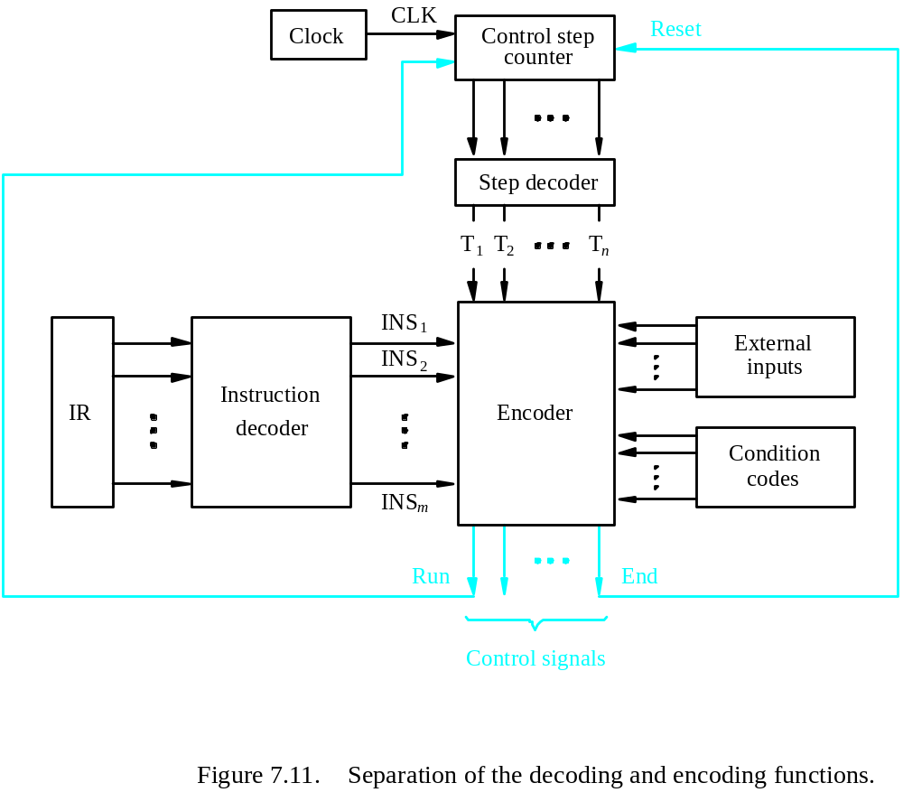
Detailed Diagram

Slide 10
Generation (cont.)
Step decoder provides a separate signal line for each step in the control sequence
The o/p of the instruction decoder comprises separate lines for each machine instruction.
For any instruction loaded in Instruction Register, only one of the output line INS1 – INSm is HIGH (i.e. 1) all other lines will be LOW (i.e. 0)
The decoder inputs are combined to generate individual control signals

Slide 11
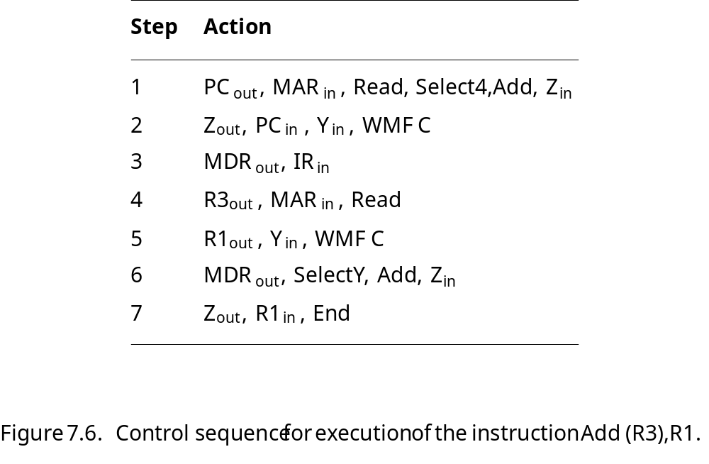
Example (Z_{in})
Z_{in} is implemented by
Z_{in} = T₁ + T₆ • ADD + T₄ • BR + …
This signal is asserted in 1st step, 6th step in Add and 4th step of branch
Step
Action
1
PC
out
,
MAR
in
,
Read,
Select4,
Add,
Z
in
2
Z
out
,
PC
in
,
Y
in
,
WMF
C
3
MDR
out
,
IR
in
4
Offset-field-of-IR
out
,
Add,
Z
in
5
Z
out
,
PC
in
,
End

Slide 12
Example (Z_{in})
Z_{in} = T₁ + T₆ • ADD + T₄ • BR + …

Slide 13
Example (END)
END causes new instruction fetch by resetting control step counter
  RUN = 1 counter increments by one at each clock
  RUN = 0 counter stops counting
    Needed when processor is WMFC signal

Slide 14
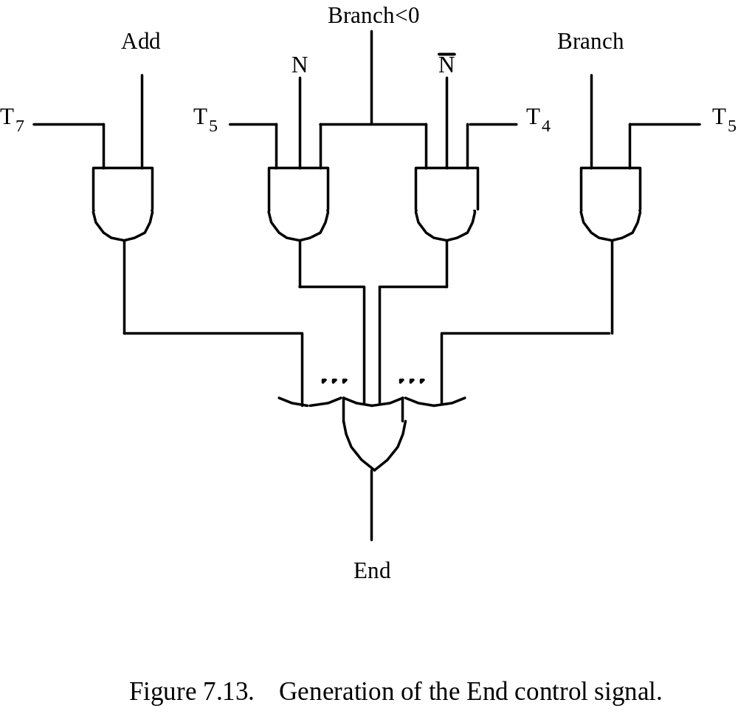
Example (END)
End = T₇ • ADD + T₅ • BR + (T₅ • N + T₄ • N) • BRN +…

Slide 15
Summary
Control Unit
  Hardwired control

