Slide 1
Computer Architecture
Lecture 11
Fasih ur Rehman

Slide 2
Last Class
CPU Architecture and Operation
Execution of Complete Instruction
Execution of Branch Instruction

Slide 3
Branch Instruction
Control sequence for unconditional branch instruction
Step
Action
1
PC
out
,
MAR
in
,
Read,
Select4,
Add,
Z
in
2
Z
out
PC
in
,
Y
in
,
WMF
C
3
MDR
out
IR
in
4
Offset-field-of-IR
out
,
Add,
Z
in
5
Z
out
,
PC
in
,
End

Slide 4
Today’s Agenda
Multiple Bus Architecture
Control Unit Design
  Hardwired Control

Slide 5
Multiple Bus Organization
One disadvantage of our single bus scheme is that only one data item can be transferred over the bus per cycle
A solution is multiple internal buses
All registers combined into a register file with 3 ports
  Why there are 2 outputs?
  What is the input for?
  What does 3 port mean?
Buses A and B allow simultaneous transfer of the two operands for the ALU
  ALU is able to just pass one of its operands to R e.g. R=X
Incrementer unit computes PC+4, means we don’t need the ALU for this
  ALU still has a 4 input for other instructions such as post-increment e.g. writing a block into the memory

Slide 6
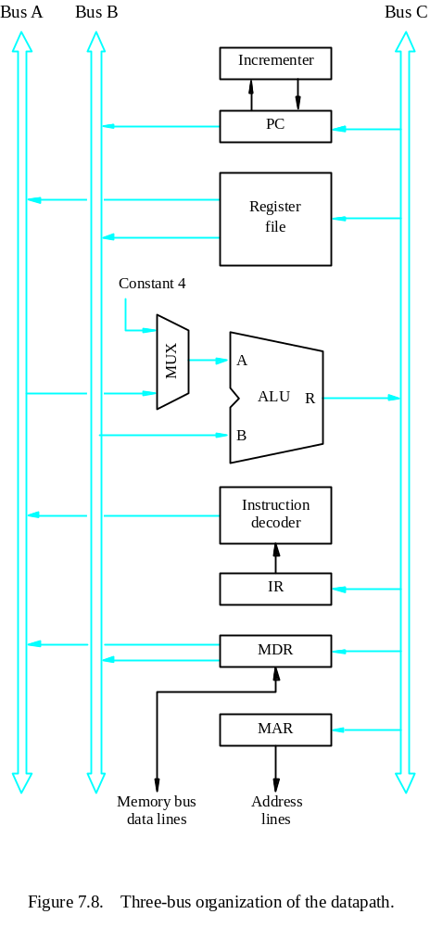
Multiple Bus Organization

Slide 7
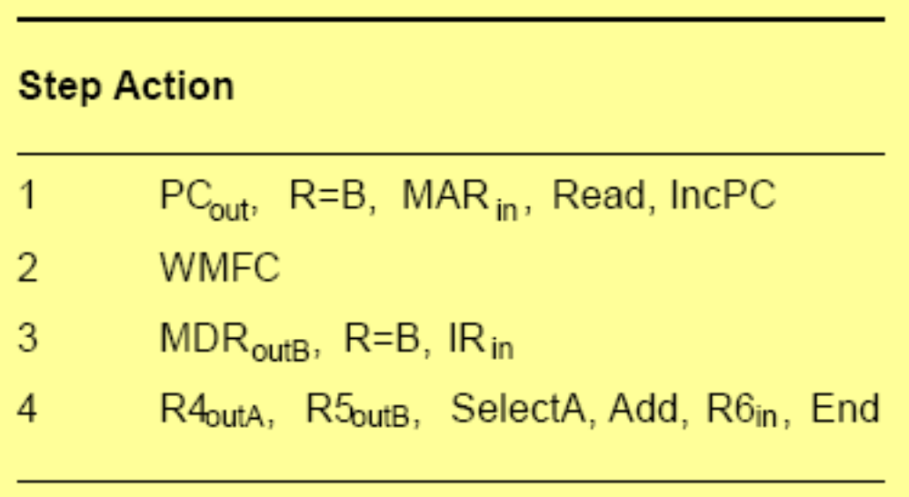
Multiple Bus (Execution)
Control Sequence

Slide 8
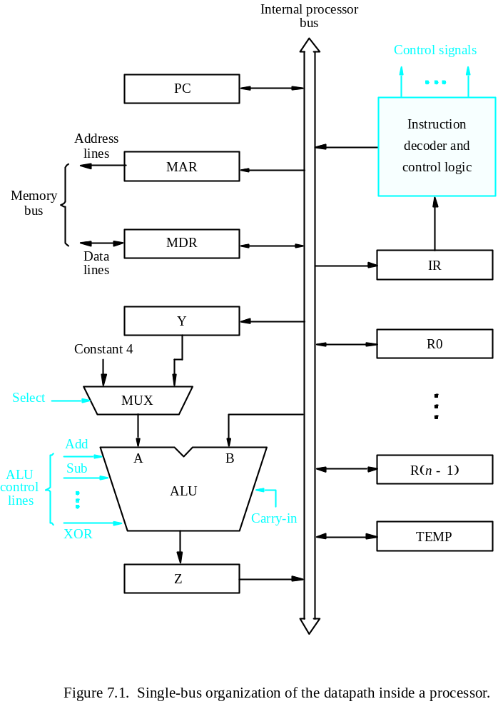
Comparison

Slide 9
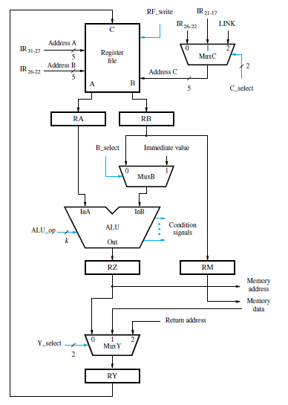
Another Organization

Slide 10
Control Unit Organization
CPU executes sequence of instructions
Each instruction may be executed in several steps
Each step is executed in several micro – operations
Micro operations fall in one of the following
  Register Transfer
  Arithmetic or Logic operations
  Memory read operation
  Memory write operation
To perform micro – operations, at least one control signals has to be generated

Slide 11
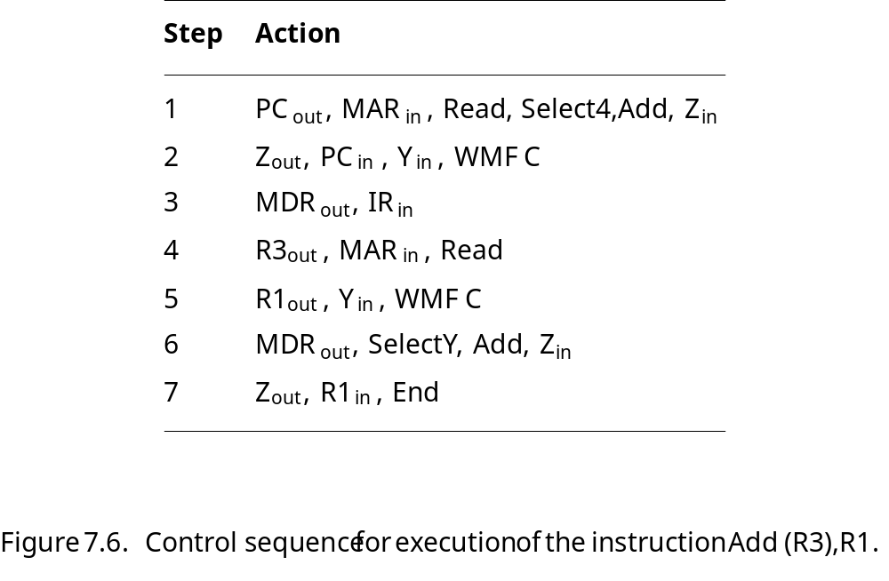
Control Signals
Steps 1 – 3 are common to all instructions and pertain to instruction fetch
If control signal for ‘Read’ is issued, Data will be available in MDR after one additional step
Several micro – operations can be performed in same control step if the don’t conflict.

Slide 12
Control Unit
Basic Tasks
  To go through a control sequence for each instruction
  To generate appropriate control signals for each task (or control step)
Control unit is driven by the processor clock
Generated Control signal depends on
  The actual step to be executed
  The condition and status flag of the processor
  The actual instruction executed
  Any external signal received (such as interrupts)

Slide 13
Control Unit
To execute instructions, a processor must have arrangement to generate control signals in proper sequence
How control signals can be generated
  Hard-wired Control
  Micro-programmed Control
  Programmable Logic Array

Slide 14
Summary
Control Unit
  Hardwired control

