Slide 1
Computer Architecture
Lecture 10
Fasih ur Rehman

Slide 2
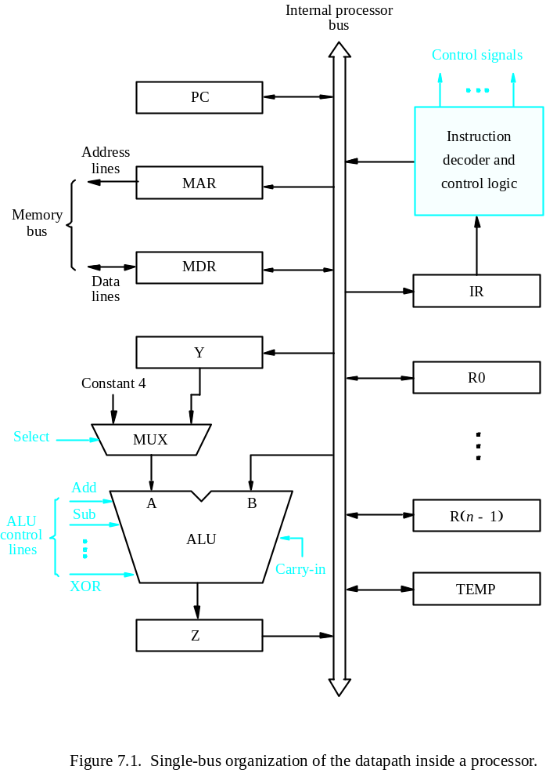
Last Class
Central Processing Unit
  Internal Arch
  Familiarization with the units of CPU
  their functioning
  Memory operations

Slide 3
Today’s Agenda
CPU Architecture and Operation
Execution of Complete Instruction
Execution of Branch Instruction
Multiple Bus Architecture

Slide 4
Register Transfer
Input and output of register Ri controlled via switches Riin and Riout
R4 ← R1: Set R1out to 1 and R4in to 1 (others all 0)
All transfers synchronized to a processor clock
Riout called tri-state buffer
Internal processor
b
us
R
i
in
R
i
R
i
out
Y
in
Y
Constant 4
Select
MUX
A
B
ALU
Z
in
Z
Z
out
Figure 7.2. Input and output gating for the registers in Figure 7.1.

Slide 5
Arithmetic or Logic Operations
The ALU is a combinational circuit that has no internal storage.
ALU gets the two operands from MUX and bus. The result is temporarily stored in register Z.
What is the sequence of operations to add the contents of register R1 to those of R2 and store the result in R3? i. e. R3 ← R1+R2
  R1out, Yin
  R2out, SelectY, Add, Zin
  Zout, R3in

Slide 6
Fetching Word from Memory
MDR, MAR connections to bus controlled as in figure
For Move (R1),R2
  1. MAR←[R1]
  2. Start read on memory bus
  3. Wait for Memory Function Completed (MFC) from memory
  4. Load MDR from bus
  5. R2←[MDR]
Control Signals
  1. R1out, MARin, Read
  2. MDRinE, WMFC (wait for MFC)
  3. MDRout,R2in

Slide 7
Storing a Word in Memory
Move R2,(R1) is similar to the previous example
  1. R1out, MARin
  2. R2out, MDRin, Write
  3. MDRoutE, WMFC

Slide 8
Execution of Complete Instruction
Add (R3), R1
  Fetch the instruction
  Fetch the first operand (the contents of the memory location pointed to by R3)
  Perform the addition
  Load the result into R1

Slide 9
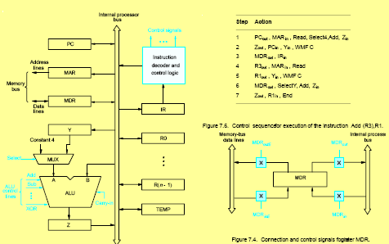
Execution

Slide 10
Execution
Increment PC
  Step 1: PC loaded into MAR, read request to memory, MUX selects 4, added to B (PC) and stored in Z
  Step 2: Z moved to PC while waiting for memory
Memory Fetch
  Step 3: Word fetched from memory and loaded into IR
Instruction Decode
  Step 4: figure out what the instruction should do and set control circuitry for steps 4-7. R3 transferred to MAR and memory read operation initiated
Register Transfer
  Step 5: contents of R1 moved to Y

Slide 11
Execution (Cont.)
Addition
  Step 6: read operation completed and is in MDR as well as B input of ALU. SelectY as second input of ALU and addition performed
Completion
  Step 7: result is transferred to R1, End causes a goto step 1

Slide 12
Execution of Branch Instruction
Steps 1-3, instruction fetch
Step 4: add the offset to the PC
Step 5: update the PC
Now do you understand why the branch offset is calculated from the next address to be executed?
For conditional e.g. branch < 0, step 4 is replaced with
• Offset-field-of-IRout, Add, Zin, If N=0 then End

Slide 13
Branch Instruction
Control sequence for unconditional branch instruction
Step
Action
1
PC
out
,
MAR
in
,
Read,
Select4,
Add,
Z
in
2
Z
out
PC
in
,
Y
in
,
WMF
C
3
MDR
out
IR
in
4
Offset-field-of-IR
out
,
Add,
Z
in
5
Z
out
,
PC
in
,
End

Slide 14
Summary
CPU Architecture and Operation
Execution of Complete Instruction
Execution of Branch Instruction
Multiple Bus Architecture

