Slide 1
Lecture 23
More Sequential Circuits Analysis
Notes:
Give qualifications of instructors:
DAP
teaching computer architecture at Berkeley since 1977
Co-athor of textbook used in class
Best known for being one of pioneers of RISC
currently author of article on future of microprocessors in SciAm Sept 1995
RY
took 152 as student, TAed 152,instructor in 152
undergrad and grad work at Berkeley
joined NextGen to design fact 80x86 microprocessors
one of architects of UltraSPARC fastest SPARC mper shipping this Fall

Slide 2
Analysis of Combinational Vs. Sequential Circuits
Combinational :
Boolean Equations
Truth Table
Output as a function of inputs
Sequential :
State Equations
State Table
State Diagram
Output as a function of input and current state
Next state as a function of inputs and current state.

Slide 3
Analysis of Sequential Circuits
Steps:
  Obtain state equations
    FF input equations
    Output equations
  Fill the state table
    Put all combinations of inputs and current states
    Fill the next state and output
  Draw the state diagram

Slide 5
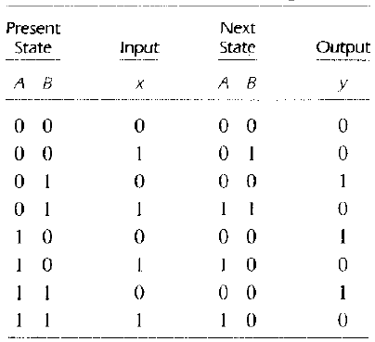
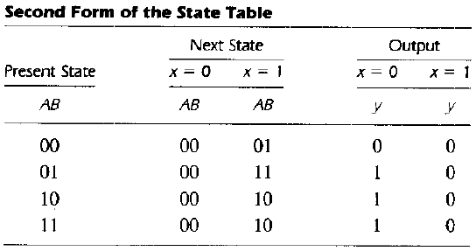
Clocked Sequential Circuit Analysis (State Table)
State Table
  The time sequence of inputs, outputs, and flip-flop states can be enumerated in a state table.
Table consists of four sections labeled present state. input. next state. and output
Derivation of a state table consists of first listing all possible binary combinations of present state and inputs.

Slide 6

Clocked Sequential Circuit Analysis (State Table)
A sequential circuit with m flip-flops and n inputs needs (2^{m+n} -1) rows in the state table.
2 FF and 1 in put so (2³ – 1) = 7, as counting starts from 0 => 0-7 so ABx starts from 000 till 111.

Slide 7
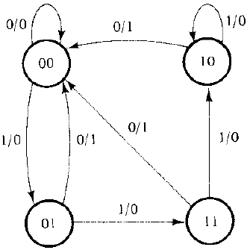
Clocked Sequential Circuit Analysis (State Diagram)
Graphical representation of State Table
State is represented by a circle
Transition between states is indicated by directed lines connecting the circles
1/0, 1/1, 0/0, 0/1 are input/output
A directed line connecting a circle with itself indicates that no change of state occurs
State table is easier to derive from a given logic diagram and the state diagram follows directly from the state table.

Slide 8
Flip Flop Input Functions and Characteristic Tables
knowledge of the type of flip-flops and a list of the Boolean functions of the combinational circuit provide all the information needed to draw the logic diagram of a sequential circuit.
Combinational circuit that generates external outputs is described algebraically by the circuit output functions
the circuit that generates the inputs to flip-flops are described algebraically by a set of Boolean functions called flip-flop input functions
Due to complicated relationship between Flip Flop input and next state
Relationship between the inputs of the flip-flop and the next state is not straightforward.
Characteristic table rather than a state equation is required
Modified form of the characteristic tables is required for sequential circuit analysis

Slide 9
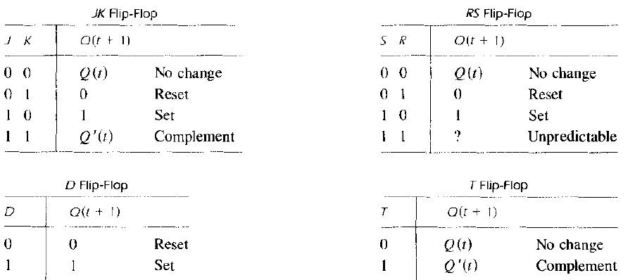
Flip Flop Characteristic Tables
Q(t) refers to the present state prior to the application of a pulse. Q (I + 1) is the next state one clock period later
Clock-pulse input is not listed in the characteristic table, but is implied to occur between time t and t + l

Slide 10
Flip-Flop Characteristic Tables
D | Q(t+1)
0 | 0
1 | 1
D
Q
Reset
Set
Q
J | K | Q(t+1)
0 | 0 | Q(t)
0 | 1 | 0
1 | 0 | 1
1 | 1 | Q’(t)
J
Q
No change
Reset
Set
Toggle
K
Q
T
Q
T | Q(t+1)
0 | Q(t)
1 | Q’(t)
No change
Toggle
Q

Slide 11
Flip-Flop Characteristic Equations
D | Q(t+1)
0 | 0
1 | 1
D
Q
Q(t+1) = D
Q
J | K | Q(t+1)
0 | 0 | Q(t)
0 | 1 | 0
1 | 0 | 1
1 | 1 | Q’(t)
J
Q
Q(t+1) = JQ’ + K’Q
K
Q
T
Q
T | Q(t+1)
0 | Q(t)
1 | Q’(t)
Q(t+1) = T ⊕ Q
Q

Slide 13
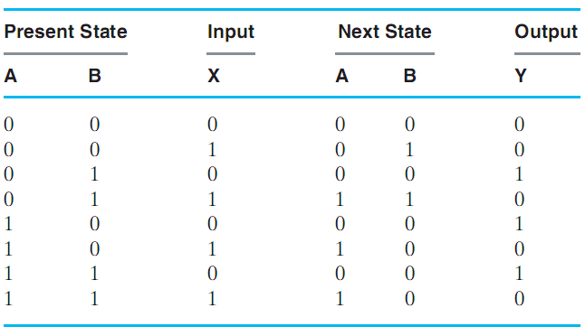
State Table
4 sections

Slide 14
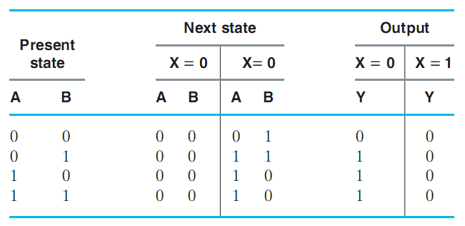
State Table (2-D Form)
1

Slide 15
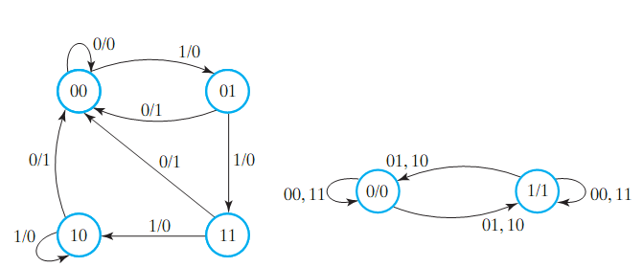
State Diagram
The state diagram is a graphical representation of a state table (provides same information)
Circles are states (FFs), Arrows are transitions between states
Labels of arrows represent inputs and outputs

Slide 17
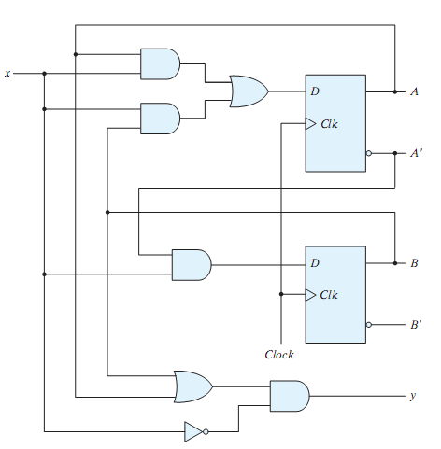
Example 1
Analyze this circuit?
Is this a sequential circuit? Why?
How many inputs?
How many outputs?
How many states?
What type of memory?

Slide 18
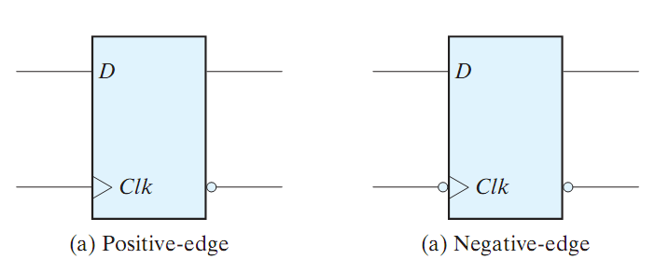
Example 1 (cont.)
D Flip Flop (review)
Characteristic Tables and Equations
Q(t) | D | Q(t+1)
0 | 0 | 0
0 | 1 | 1
1 | 0 | 0
1 | 1 | 1
D | Q(t+1)
0 | 0
1 | 1
Q(t+1) = D

Slide 19
Example 1 (cont.)

Slide 20
Example 1 (cont.)
State equations:
D_{A} = AX + BX
D_{B} = A’ X
Y = (A + B) X’

Slide 21
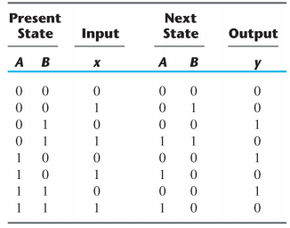
Example 1 (cont.)
State equations:
D_{A} = AX + BX
D_{B} = A’ X
Y = (A + B) X’
State table:

Slide 22
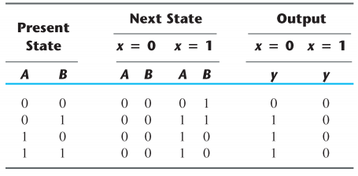
Example 1 (cont.)
State equations:
D_{A} = AX + BX
D_{B} = A’ X
Y = (A + B) X’
State table (2D):

Slide 23
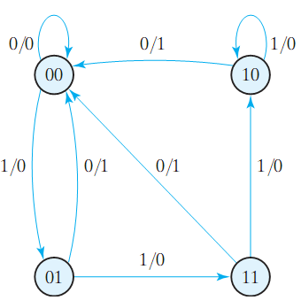
Example 1 (cont.)
State equations:
D_{A} = AX + BX
D_{B} = A’ X
Y = (A + B) X’
State table:
State diagram:

Slide 24
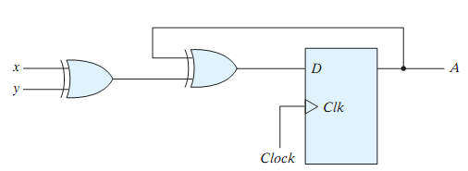
Example 2
Analyze this circuit.
What about the output?
This circuit is an example of a Moore machine (output depends only on current state)
Mealy machines is the other type (output depends on inputs and current states)

Slide 25
Example 2 (cont.)
Equation:
D_{A} = A ⊕ X ⊕ Y

Slide 26
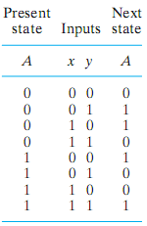
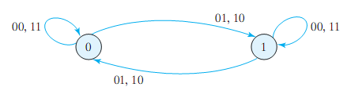
Example 2 (cont.)
Equation:
D_{A} = A ⊕ X ⊕ Y

Slide 27
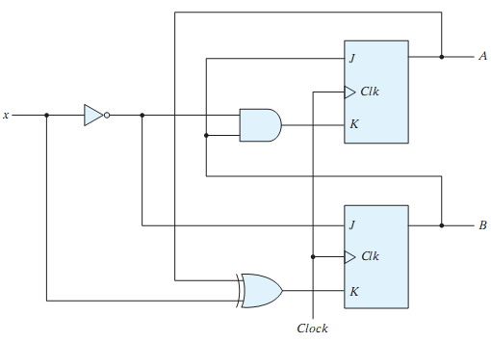
Example 3
Analyze this circuit?
Is this a sequential circuit? Why?
How many inputs?
How many outputs?
How many states?
What type of memory?

Slide 28

Example 3 (cont.)
JK Flip Flop (review)
Characteristic Tables and Equations
J | K | Q(t+1)
0 | 0 | Q(t)
0 | 1 | 0
1 | 0 | 1
1 | 1 | Q’(t)
Q(t+1) = JQ’ + K’Q

Slide 29
Example 3 (cont.)

Slide 30
Example 3 (cont.)
State equations:
J_{A} = B, K_{A} = B X’
J_{B} = X’, K_{B} = A ⊕ X
by substitution:
A = J_{A}A’ + K_{A}’A
= A’ B + A B’ + A X
B = B’ X’ + A B X + A’ B X’

Slide 31
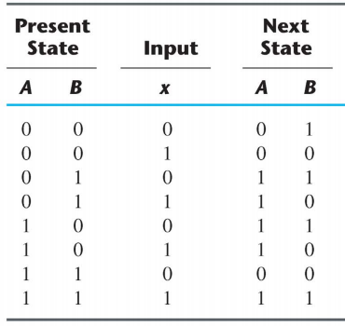
Example 3 (cont.)
State equations:
J_{A} = B, K_{A} = B X’
J_{B} = X’, K_{B} = A ⊕ X
by substitution:
A = J_{A}A’ + K_{A}’A
= A’ B + A B’ + A X
B = B’ X’ + A B X + A’ B X’

Slide 32
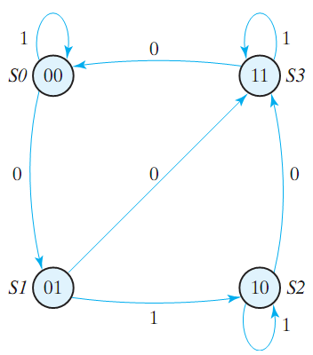
Example 3 (cont.)
State equations:
J_{A} = B, K_{A} = B X’
J_{B} = X’, K_{B} = A ⊕ X
by substitution:
A = J_{A}A’ + K_{A}’A
= A’ B + A B’ + A X
B = B’ X’ + A B X + A’ B X’

Slide 33
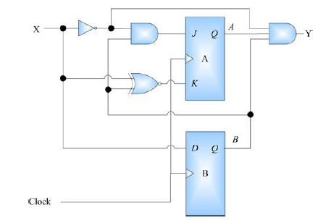
Example 4

Slide 34
Example 4 (cont.)
State equations:
J_{A} = BX’
K_{A} = BX’ + B’X
D_{B} = X
Y = X’AB
by substitution:
A(t+1) = J_{A}A’ + K_{A}’A

Slide 35
Example 4 (cont.)
State equations:
J_{A} = BX’
K_{A} = BX’ + B’X
D_{B} = X
Y = X’AB
by substitution:
A(t+1) = J_{A}A’ + K_{A}’A
Current State |  | Input | Next State |  | Output
A(t) | B(t) | X | A(t+1) | B(t+1) | Y
0 | 0 | 0 | 0 | 0 | 0
0 | 0 | 1 | 0 | 1 | 0
0 | 1 | 0 | 1 | 0 | 0
0 | 1 | 1 | 0 | 1 | 0
1 | 0 | 0 | 0 | 0 | 0
1 | 0 | 1 | 1 | 1 | 0
1 | 1 | 0 | 1 | 0 | 1
1 | 1 | 1 | 0 | 1 | 0

Slide 36
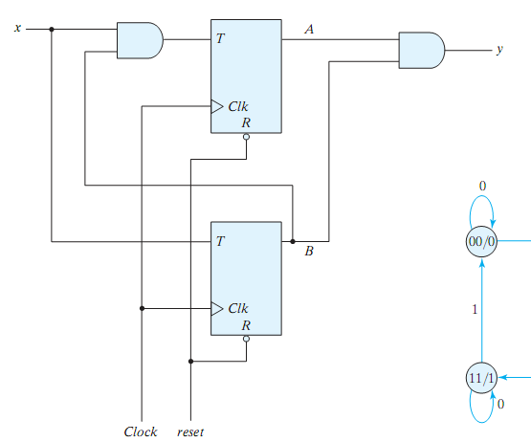
Example 5
Analyze this circuit?
Is this a sequential circuit? Why?
How many inputs?
How many outputs?
How many states?
What type of memory?

Slide 37
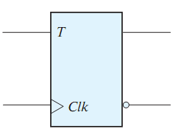
Example 5 (cont.)
T Flip Flop (review)
Characteristic Tables and Equations
T | Q(t+1)
0 | Q(t)
1 | Q’(t)
Q(t+1) = TQ’ + T’Q

Slide 38
Example 5 (cont.)

Slide 39
Example 5 (cont.)
State equations:
T_{A} = BX
T_{B} = X
Y = AB
by substitution:
A(t+1) = T_{A}A’ + T_{A}’A

Slide 40
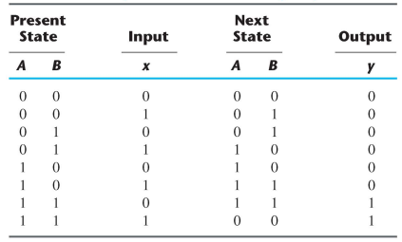
Example 5 (cont.)
State equations:
T_{A} = BX
T_{B} = X
Y = AB
by substitution:
A(t+1) = T_{A}A’ + T_{A}’A

Slide 41
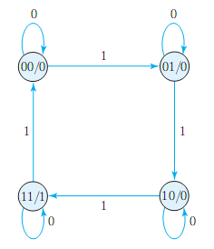
Example 5 (cont.)
State equations:
T_{A} = BX
T_{B} = X
Y = AB
by substitution:
A(t+1) = T_{A}A’ + T_{A}’A
The output depends only on current state.
This is a Moore machine
What does this circuit do?

Slide 42
Mealy vs Moore Finite State Machine (FSM)
Mealy FSM:
Output depends on current state and input
Output is not synchronized with the clock
Moore FSM:
Output depends on current state only
Label form:
  On circle with output included:
    state/output
    Moore type output depends only on state
  On directed arc with the output included:
    input/output
    Mealy type output depends on state and input

Slide 43
Mealy and Moore Models
Customary to distinguish between two models of sequential circuits
General model of a sequential circuit has inputs, outputs, and internal states
Mealy model, the outputs are functions of both the present state and inputs
Moore model, the outputs are a function of the present state only

Slide 44
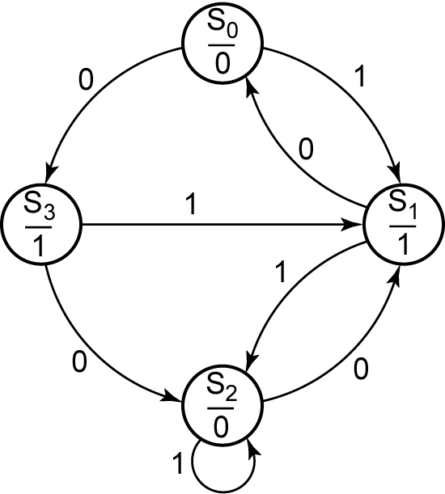
Sequential Circuits: State Diagram
Output depends on current state only
Input
Moore Machine
State
Output
Each node in the graph represents a state in the sequential
circuit.

Slide 45
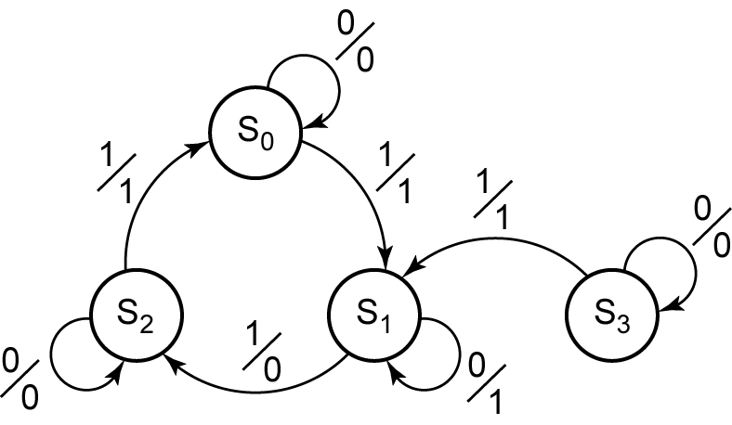
Sequential Circuits: State Diagram
Mealy Machine
Input
State
Output
Output depends on current state and input
Output is not synchronized with the clock
Each node in the graph represents a state in the sequential
circuit.

Slide 46
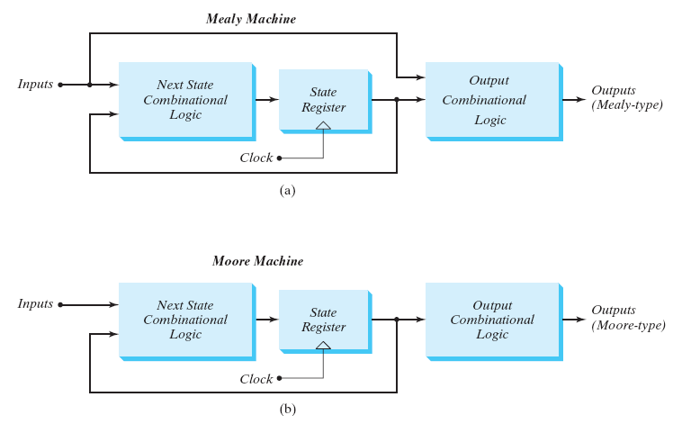
Sequential Circuits: Models

Slide 47
Mealy Machine
Output based on state and present input
Comb.
Logic
Comb.
Logic
Q(t+1)
Flip
Flops
next
state
Q(t)
X(t)
present
state
Y(t)
present
input
clk

Slide 48
Moore Machine
Output based on state only
Comb.
Logic
Comb.
Logic
Q(t+1)
Y(t)
Flip
Flops
next
state
Q(t)
X(t)
present
state
present
input
clk

Slide 49
State Machines in the Text
In the text book (Mano) Mealy machines are focused
Moore machine: outputs only depend on the current state
Outputs cannot change during a clock pulse if the input variables change
Moore Machines usually have more states.
No direct path from inputs to outputs
Can be more reliable

Slide 50
Moore and Mealy Models (Comparison)
Sequential Circuits or Sequential Machines are also called Finite State Machines (FSMs). Two formal models exist:
Moore Model
  Named after E.F. Moore
  Outputs are a function ONLY of states
  Usually specified on the states.
Mealy Model
  Named after G. Mealy
  Outputs are a function of inputs AND states
  Usually specified on the state transition arcs.

Slide 51
Moore and Mealy Example Diagrams
x=1/y=0
x=0/y=0
0
1
Mealy Model State Diagram
maps inputs and state to outputs
Moore Model State Diagram maps states to outputs
x=0/y=0
x=1/y=1
x=0
0/0
x=0
x=1
x=1
x=0
1/0
2/1
x=1

Slide 52
Equivalence of Moore and Mealy machines
Moore and Mealy machines look different
It is always possible to model a Moore machine with a Mealy machine
It is always possible to model a Mealy machine with a Moore machine
x=0
Mealy
Moore
x=1/y=0
0/0
x=0
x=0/y=0
0
1
x=1
x=1
x=0
x=0/y=0
x=1/y=1
1/0
2/1
x=1

Slide 53
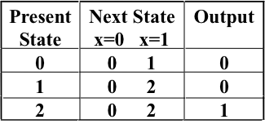
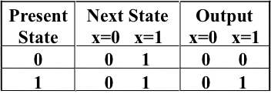
Moore and Mealy Example Tables
Moore Model state table maps state to outputs
Two-Dimensional State Table
Mealy Model state table maps inputs and state to outputs

Slide 54
Mixed Moore and Mealy Outputs
In real designs, some outputs may be Moore type and other outputs may be Mealy type.
  State 00: Moore
  States 01, 10 and 11: Mealy
Simplifies output specification
0
1
00/0
01
0/1
0/1
0/1
1/0
1/0
10
11
1/0

Slide 56
Summary
Discussed More Sequential Circuit Analysis
State Machines Models
Moore and Mealy Model Comparison
Mixed Model
Examples
Thanks

