Slide 1

COMSATS Institute of Information Technology
Virtual campus
Islamabad
Dr. Nasim Zafar
Electronics 1
EEE 231 – BS Electrical Engineering
Fall Semester – 2012

Slide 2
The Diode Circuits:
Lecture No: 9
Contents:
Introduction.
The Ideal Diode.
Terminal Characteristics of Junction Diodes.
Modeling the Diode Forward Characteristics.
Load Line Analysis

Slide 3
References:
Microelectronic Circuits:
Adel S. Sedra and Kenneth C. Smith.
Electronic Devices and Circuit Theory:
Robert Boylestad & Louis Nashelsky ( Prentice Hall )
Electronic Devices :
Thomas L. Floyd ( Prentice Hall )

Slide 4
Introduction:
The simplest and most fundamental nonlinear circuit element is the diode.
Just like a resistor, the diode has two terminals; but unlike the resistor , which has a linear (straight-line) relationship between the current flowing through it and the voltage appearing across it, the diode has a nonlinear
i-v characteristic.
Let us discuss an ideal diode in order to understand the essence of the diode function.
We can then study the real silicon p-n junction diode and explain its current-voltage characteristics.

Slide 5
Introduction:
Applications of the Diode:
One of the important application of a diode is their use in the design of the rectifiers, which converts an ac signal into a dc signal.
We will also briefly discuss some other specialized diodes such as the
light emitting diodes LED’s and photodiodes.

Slide 6
Diode Equation and Models:
In this lecture we will discuss some models for the operation and design of the diode to explain diode characteristics.
We can use these models instead of the diode equation in circuit analysis.
Later on, we will be developing similar models
(or equivalent circuits) to represent the behaviour of transistors when they are used as linear amplifiers.

Slide 7
Modeling The Diode:
The Ideal Diode Model
The Exponential Model
Load Line Analysis
Piecewise-Linear Model

Slide 8
The Diode Models
1. The Ideal Diode Model

Slide 9
The Diode:
P-N Junction Diode Schematic Symbol:
Anode
Cathode
p
n

Slide 10
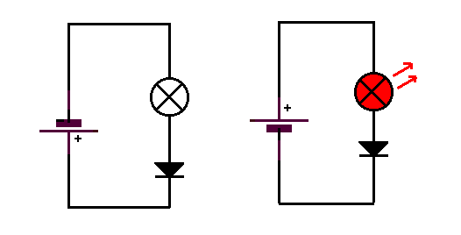
Diode Circuits:
anode
Reversed bias
+
+
Forward bias
-
-
cathode
The left hand diagram shows the reverse biased junction.
No current flows flows.
The other diagram shows forward biased junction.
A current flows.

Slide 11
Forward-biased diode Circuit:

Slide 12
Reverse-biased diode Circuit:

Slide 13
The Ideal Diode Model:
Current-Voltage Characteristic:
The ideal diode the most fundamental nonlinear circuit element. Useful for circuits with more than one diode

Slide 14
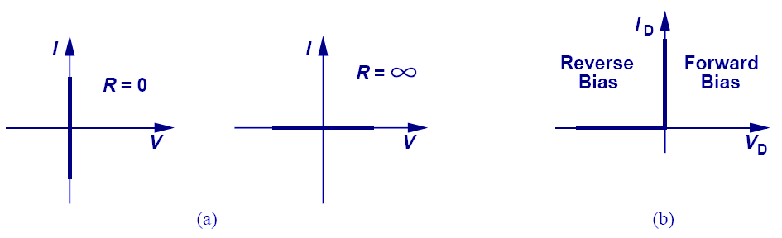
I-V Characteristics of an Ideal Diode
If the voltage across anode and cathode is greater than zero, the resistance of an ideal diode is zero and current becomes infinite.
However, if the voltage is less than zero, the resistance becomes infinite and current is zero.

Slide 15
Effect of V_{F}.
Value | Ideal | Practical
V_{F} | 0 V | 0.7 V
V_{R1} | 5 V | 4.3 V
I | 5 mA | 4.3 mA

Slide 16
Two Modes of Operation: On or Off
Forward Biased Diode:
If a positive voltage is applied to an ideal diode, zero voltage
drop appears across the diode and it behaves as a short circuit. Diodes operated in this mode are called forward biased.
Current must flow in the forward biased diode. A forward-biased diode is said to be turned-on or simply “on”.

Slide 17
Two Modes of Operation: On or Off
Reverse Biased Diode:
When a negative voltage is applied to the p-side of a diode,
no current flows and the diode behaves as an open circuit. Diodes operated in this mode are called reverse biased diodes.
An ideal diode has zero current in the reverse biased mode and is said to be cut-off or off.

Slide 18
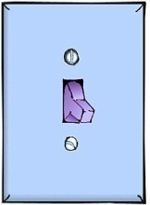
The Ideal Diode Model:
Consider the two modes of operation for an ideal diode,
either “on” or “off”.
It acts as a switch since:
In the ON state it is short circuit.
In the OFF state it is open circuit.
I
OFF
ON
V

Slide 19
Ideal diode characteristics:
 | Forward bias | Reverse Bias
Biasing polarities
Equivalent switch state | ON | OFF
Device resistance | Zero | Infinite
Device current | A-to-K current determined by external resistance and voltage | Zero
A-to-K voltage | Zero | Equal to the applied voltage
(+)
(-)
(-)
(+)
I_{F}

Slide 20
Terminal Characteristics of Junction Diodes
The Forward-Bias Region, V ≥ 0
The Reversed-Bias Region, V ≤ 0

Slide 21
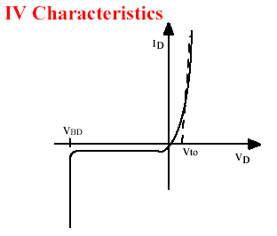
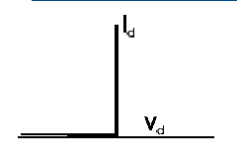
Current-Voltage Characteristic:
Ideal Diode
Real Diode
Positive voltage yields finite current
Negative voltage yields zero current

Slide 22
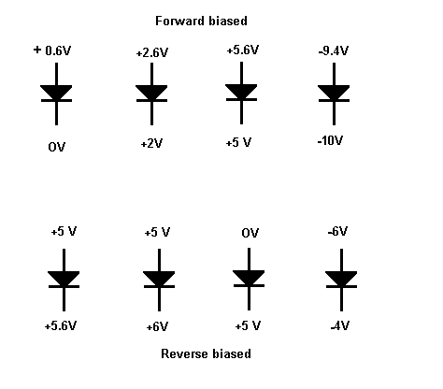
  Diode Voltages:
To forward bias a diode,
the anode must be more positive than the cathode or LESS NEGATIVE.
To reverse bias a diode, the anode must be less positive than the cathode or MORE NEGATIVE.
A conducting diode has about 0.6 volts across if silicon, 0.3 volts if germanium.

Slide 23
Example 1- Forward Biased:

Slide 24
Example 2-Reverse Biased:

Slide 25
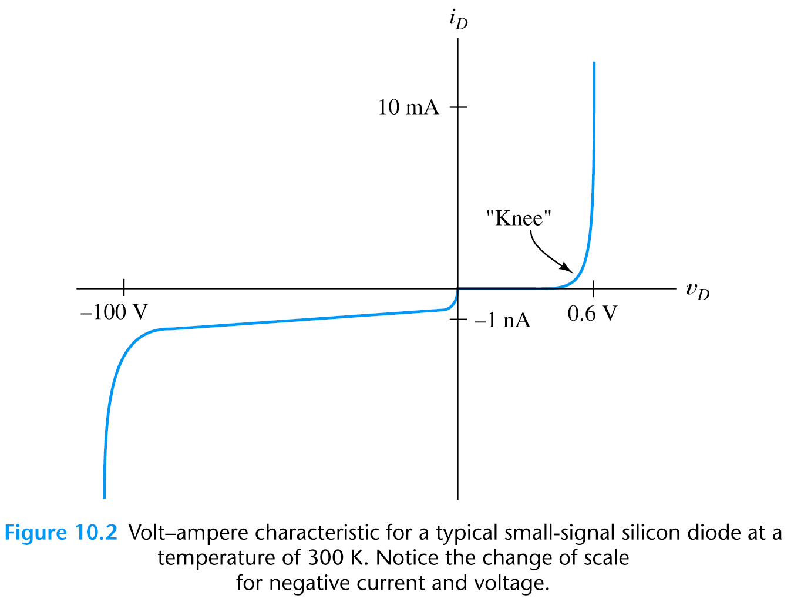
Diode i-v Characteristics: (Ref No. 3)
less than 1mA at 300K
V_{knee}

Slide 26
The Diode Models
2. The Exponential Model

Slide 27
The Exponential Model
Current-Voltage Characteristic:
The general equation linking the diode current I to the applied voltage V is:
V_{T} ~ 26 mV

Slide 28
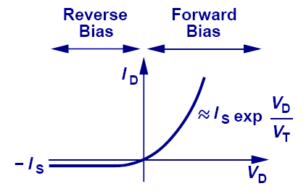
The Exponential Model:
I-V Characteristic of a PN Junction:
Current increases exponentially with applied forward bias, and “saturates” at a relatively small negative current level for reverse bias in a p-n junction.

Slide 29
The Diode Models
3. The Load Line Analysis

Slide 30

The Load Line Analysis of the Diode Circuit:
Graphical Analysis:
Another important concept, that we will need for the transistor analysis, is that of the “Load Line” for a non-linear device.
Graphical analysis is performed by plotting the diode currents (exponential model) and the voltages in a diode circuit on the i-v plane.

Slide 31
The Load Line Analysis:
A sketch of the graphical construction is shown in the next slide.
The curve represents the exponential diode equation and the straight line represent the diode equation obtained from the Kirchoff loop equation. Such a straight line is know as the Load Line.
The load line intersects the diode I-V curve about some operating point of the circuit. This point is also known as the ‘Q’ or quiescent point.
Co-ordinates of Q-point give the values ID, VD.

Slide 32
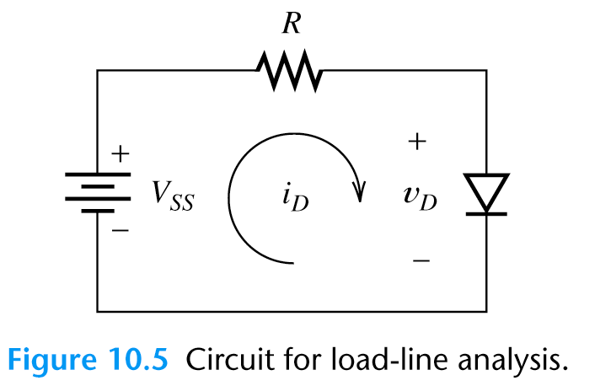
Load Line Analysis:
V_{SS}/R
Slope=-1/R
V_{SS}

Slide 33
Analysis of Diode Circuit:
+
i_{o}
+
Thevenin
equivalent
V_{o}
v_{D}
-
-
i_{D}
KVL
KCL
Their characteristics
intersect

Slide 34
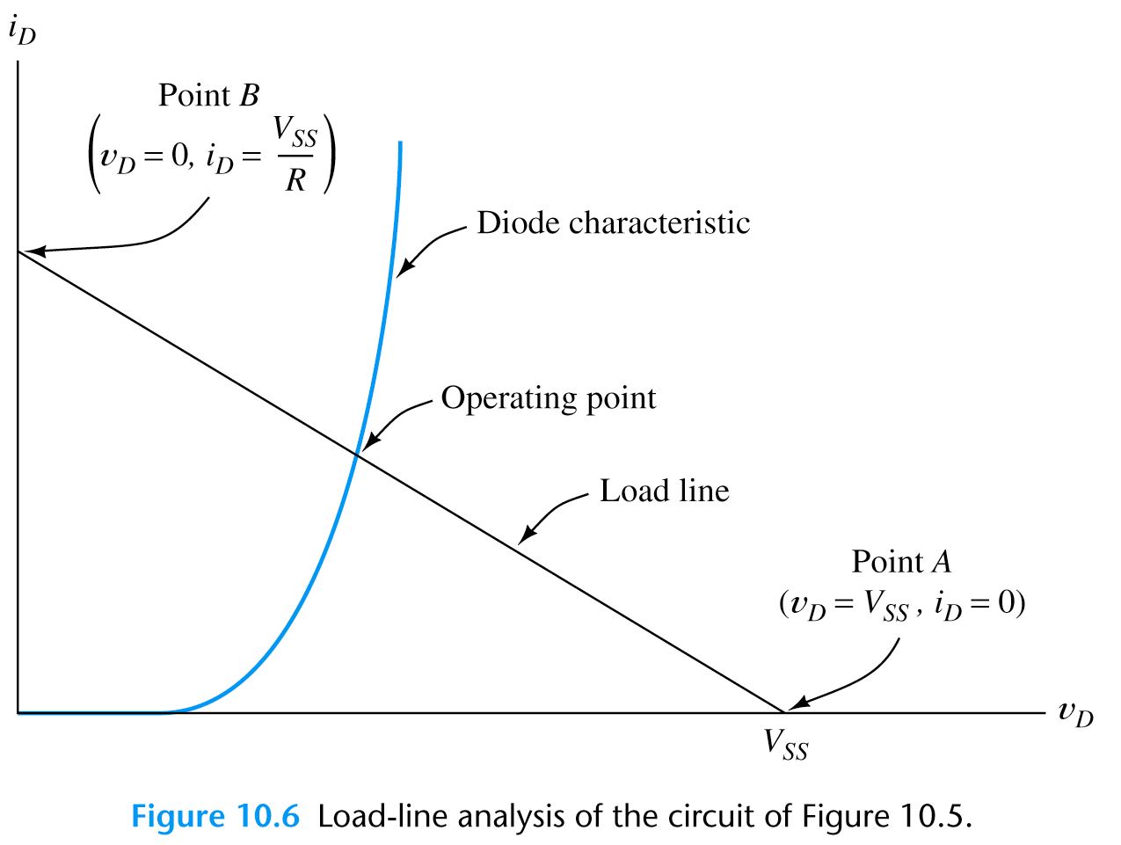
Analysis of Diode Circuit:
V_{SS}/R
Slope=-1/R
VD

Slide 35
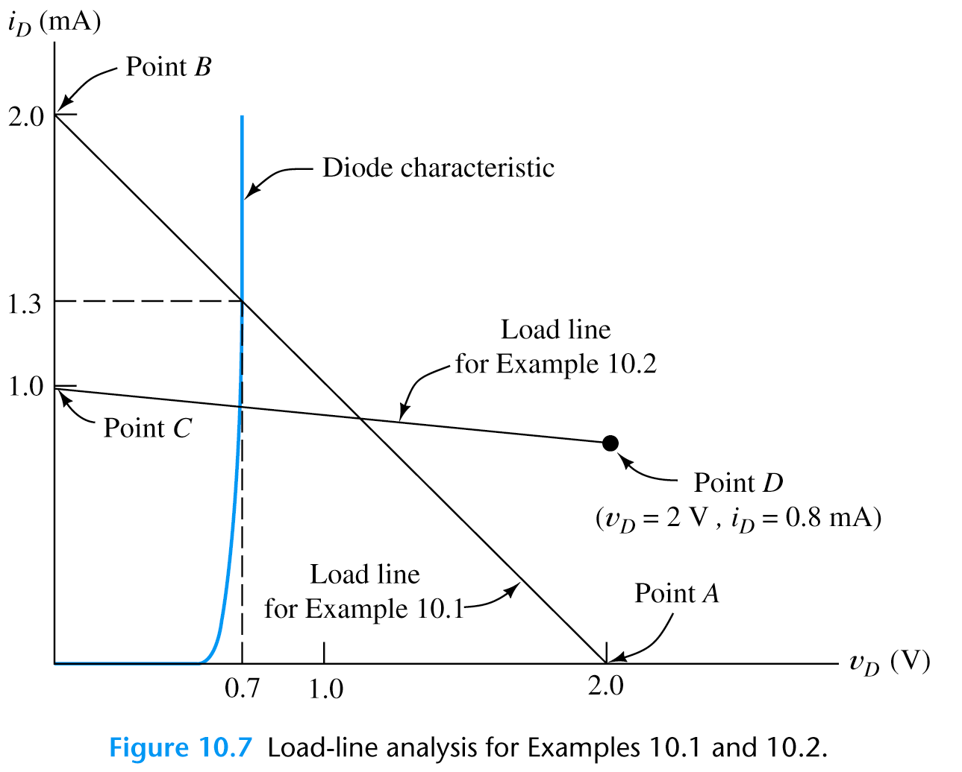
Load-Line Analysis: (Solve a Problem)
If the circuit shown below has: Vss=2V and R=1kΩ. Find the diode voltage
and current at the operating point.
Repeat for:
Vss=10V and R=10k Ω
V_{DQ}=0.68V and i_{DQ}=0.93mA

Slide 36
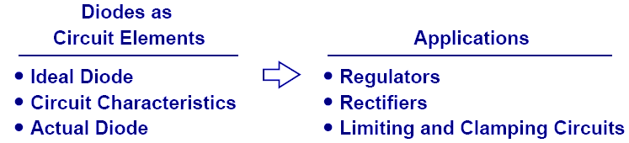
Summary

