Slide 1

COMSATS Institute of Information Technology
Virtual campus
Islamabad
Dr. Nasim Zafar
Electronics 1
EEE 231 – BS Electrical Engineering
Fall Semester – 2012

Slide 2
Junction Break Down
Lecture No: 8
Breakdown Characteristics
* Zener Breakdown
* Avalanche Breakdown

Slide 3
Introduction:
Under normal operation of a diode, an applied reverse bias (voltage) will result in a small current flow through the device.
However, at a particular high voltage, which is called breakdown voltage V_{BD}, large currents start to flow. If there is no current limiting resistor, which is connected in series to the diode, the diode will be destroyed. There are two physical effects which cause this breakdown.

Slide 4
Breakdown Mechanism:
Zener Effect
  Occurs in heavily doping semiconductor
  Breakdown voltage is less than 5V
  Carriers generated by electric field---field ionization
  TC is negative
Avalanche Effect
  Occurs in slightly doping semiconductor
  Breakdown voltage is more than 7V
  Carriers generated by collision
  TC is positive

Slide 5
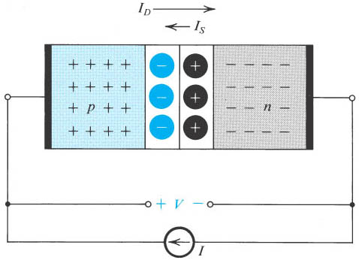
PN Junction Under Forward-Bias Condition:
The pn junction excited by a constant-current source supplying a current I in the forward direction.
The depletion layer narrows and the barrier voltage decreases by V volts, which appears as an external voltage in the forward direction.

Slide 6
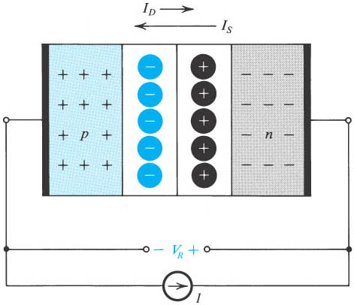
PN Junction Under Reverse-Bias Condition:
The pn junction excited by a constant-current source I in the reverse direction.
To avoid breakdown, I is kept smaller than I_{S}.
Note that the depletion layer widens and the barrier voltage increases by V_{R} volts, which appears between the terminals as a reverse voltage.

Slide 7
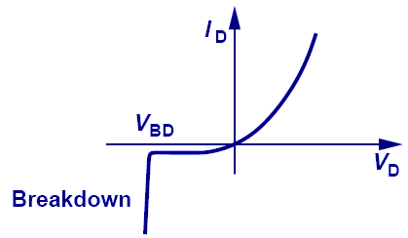
I-V Characteristic of a PN Junction:
As the reverse bias voltage increases, the electric field in the depletion region increases. Eventually, it can become large enough to cause the junction to break down so that a large reverse current flows:
breakdown voltage

Slide 8
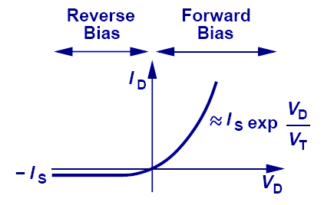
I-V Characteristic of a PN Junction:
Current increases exponentially with applied forward bias voltage, and “saturates” at a relatively small negative current level for reverse bias voltages.
“Ideal diode” equation:

Slide 9
PN Junction Under Reverse-Bias Condition:
I-V characteristic equation:
Where I_{s} is the saturation current, it is proportional to n_{i}² which is a strong function of temperature.
Independent of voltage

Slide 10
Breakdown Voltage V_{BD}
One can determine which mechanism is responsible for the breakdown based on the value of the breakdown voltage V_{BD} :
❖ V_{BD} < 5 V → Tunneling Breakdown
❖ V_{BD} > 6V → Avalanche Breakdown
❖ 4V < V_{BD} < 6V → both tunneling and
avalanche mechanisms are responsible

Slide 11
Energy Band Diagram of a PN Junction

Slide 12
Origin of Current Flow
Forward bias:
Reverse bias:
L_{n}
L_{p}
Reverse saturation current is due to minority carriers being collected over a distance of the order of the diffusion length.

Slide 13
Reverse Saturation Current
The flow of these minorities produces the reverse saturation current but it is independent of applied reverse voltage.
I(current)
Forward Bias
V_{b}
I₀
V(voltage)
V_{B} ; Breakdown voltage
I_{0 ;} Reverse saturation current
Reverse Bias
Drift current

Slide 14
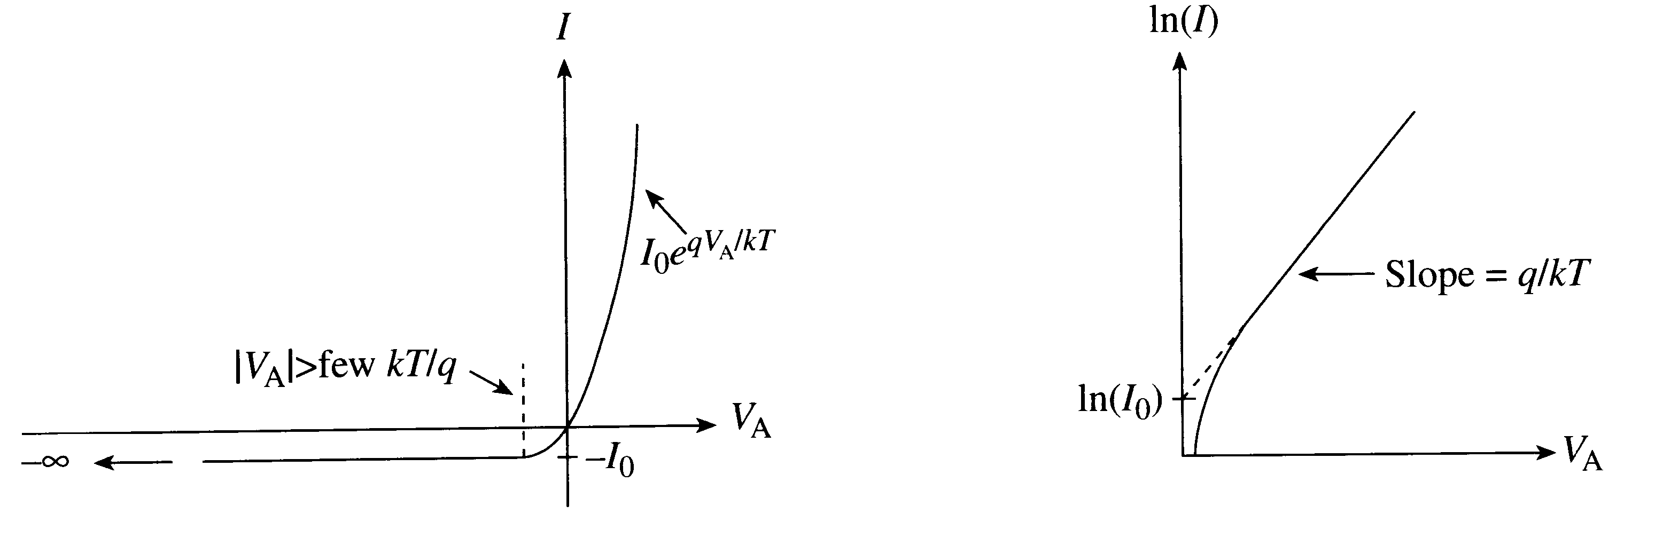
Ideal Diode I-V characteristic

Slide 15
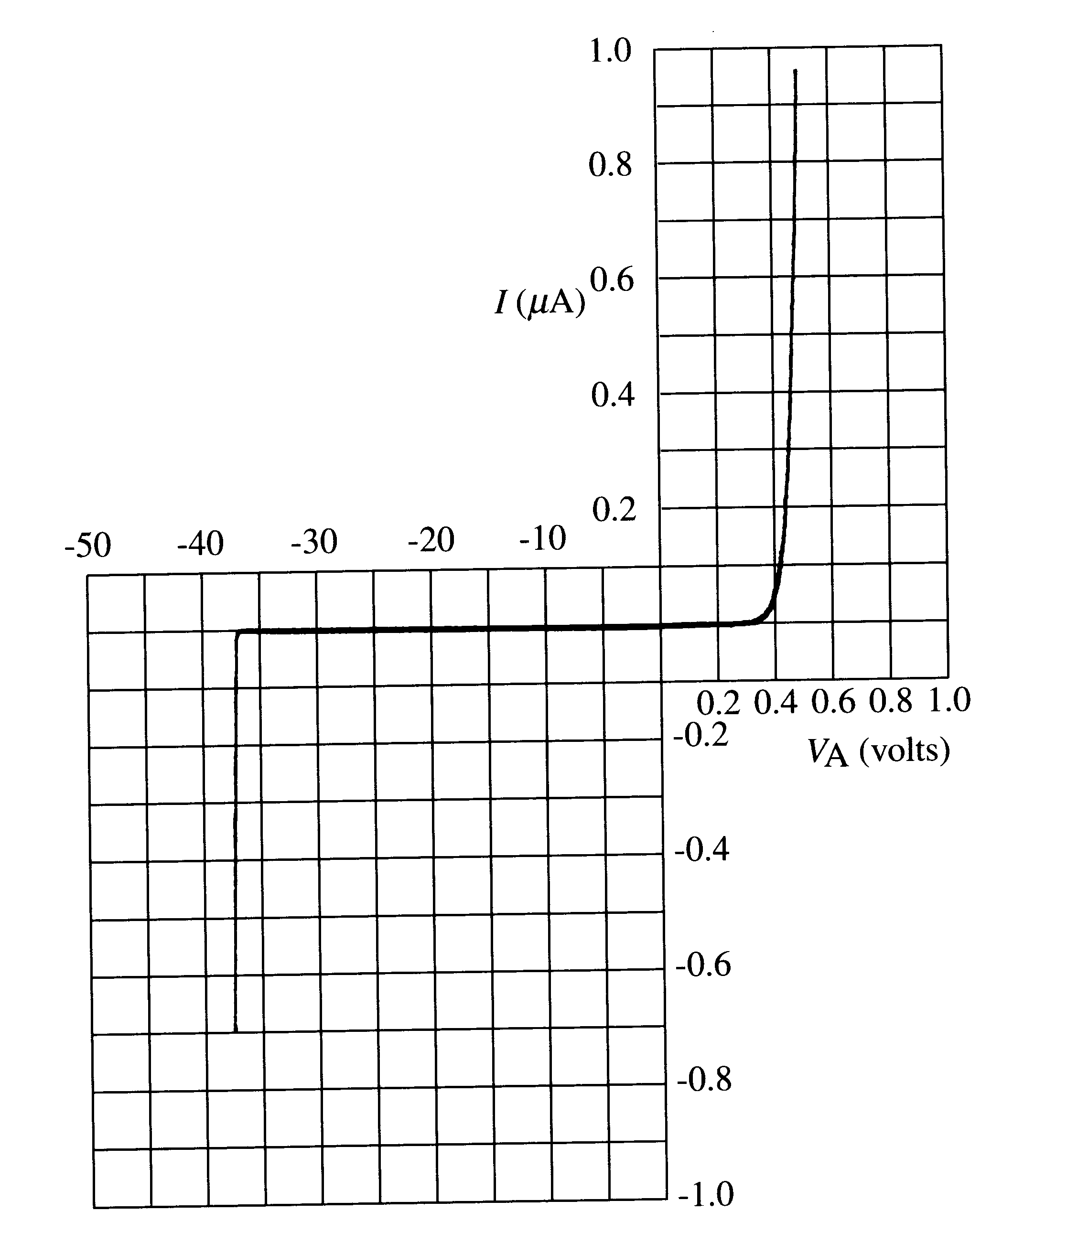
Real Diode I-V characteristic

Slide 16
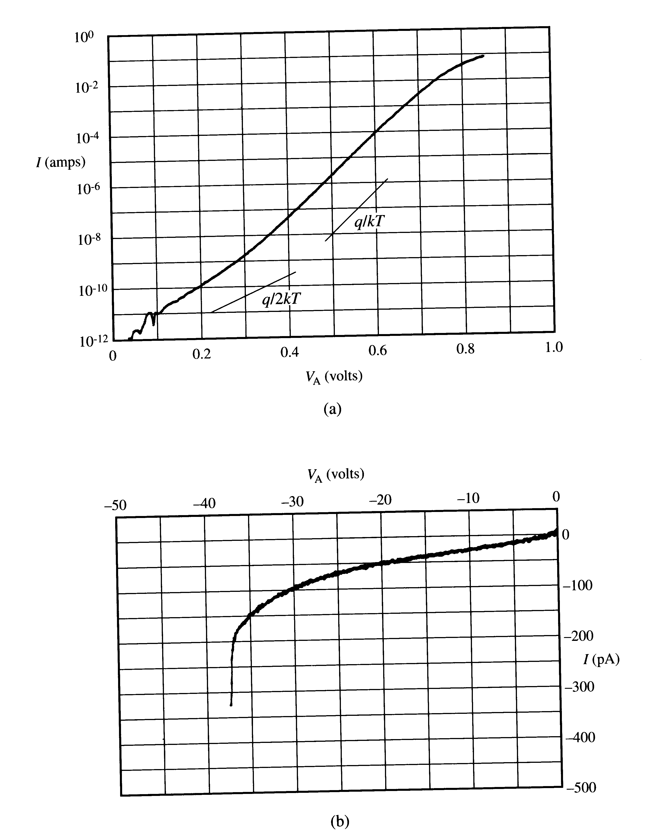
Real Diode – Reverse Current

Slide 17
What’s wrong with this picture?
Reverse Bias:
  Current ~10³ times larger than FB I₀
  Reverse current doesn’t saturate
  Breakdown – large current above VB_{bd}

Slide 18
Avalanche Breakdown

Slide 19
Avalanche Breakdown:
Avalanche breakdown mechanism occurs when electrons and holes moving through the depletion region of a reverse biased PN junction, acquire sufficient energy from the electric field to break a bonds i.e. create electron-hole pairs by colliding with atomic electrons within the depletion region. The electric field in the depletion region of a diode can be very high.
The newly created electrons and holes move in opposite directions due to the electric field present within the depletion region and thereby add to the existing reverse bias current. This is the most important breakdown mechanism in PN junction.

Slide 20
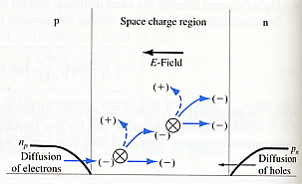
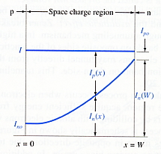
Avalanche Breakdown
Impact Ionization Mechanism
I_{n}(w) = M * I_{no}
Mechanism
Total current during
avalanche multiplication

Slide 21
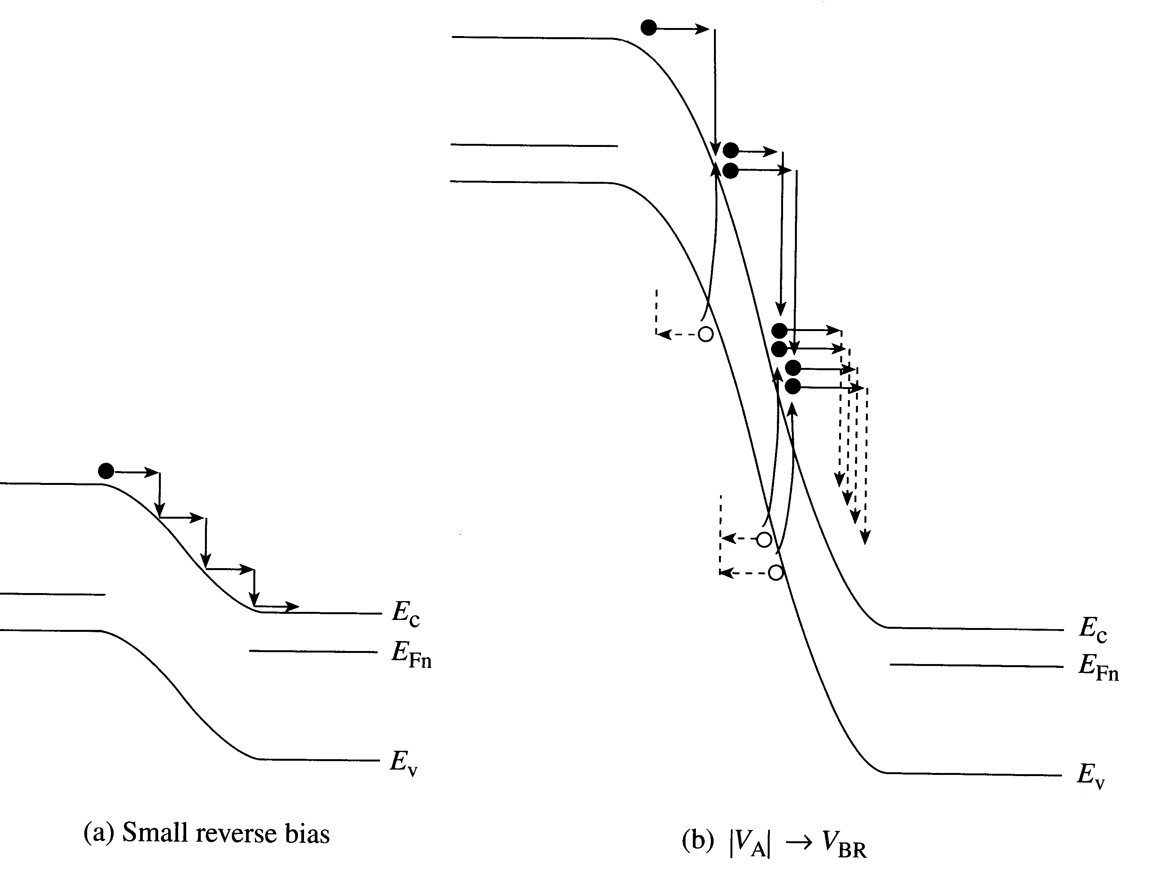

Energy Band diagram; Avalanche Breakdown:
Depletion width larger than mean free path⇒ lots of collisions

Slide 22
Junction Built-In Voltage:
The Junction Built-In Voltage is given as:
  It depends on doping concentration and temperature
  Its TC is negative.

Slide 23
Junction Parameters:
One-sided junctions

Slide 24
Current Density of an Avalanche Process:
dx
Impact ionization initiated by electrons.
Multiplication factors for
electrons and holes:
dx
Impact ionization initiated by holes.

Slide 25
Zener Breakdown

Slide 26
Zener Break Down:
Zener breakdown occurs in heavily doped p-n junctions, with a tunneling mechanism.
The heavy doping makes the depletion layer extremely thin. So thin in fact,
carriers cannot accelerate enough to cause impact ionization.
With the depletion layer so thin, however, quantum mechanical tunneling through the layer occurs causing the reverse current to flow.
In a heavily doped p-n junction the conduction and valance bands on opposite side of the junction become so close during the reverse-bias that the electrons on the p-side can tunnel from directly VB into the CB on the n-side.
The temperature coefficient of the Zener mechanism is negative, the breakdown voltage for a particular diode decreases with increasing temperature.

Slide 27
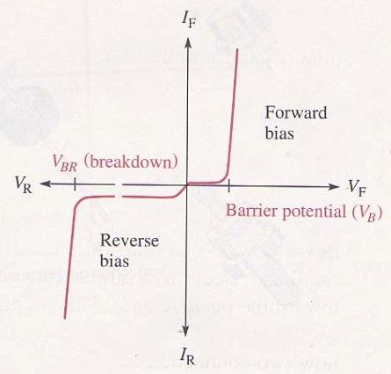
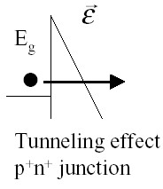
Zener Breakdown Mechanism:
Highly Doped Junction ( narrow W)
Mechanism is termed Tunneling or Zener Breakdown
Zener effect
Doping level > 10¹⁸/Cm³

Slide 28
Tunneling Breakdown:
Tunneling breakdown occurs in heavily-doped p-n junctions in which the depletion region width W is about 10 nm.
Zero-bias band diagram:
Forward-bias band diagram:
E_{Fn}
E_{F}
E_{Fp}
E_{C}
E_{C}
E_{V}
E_{V}
W
W

Slide 29
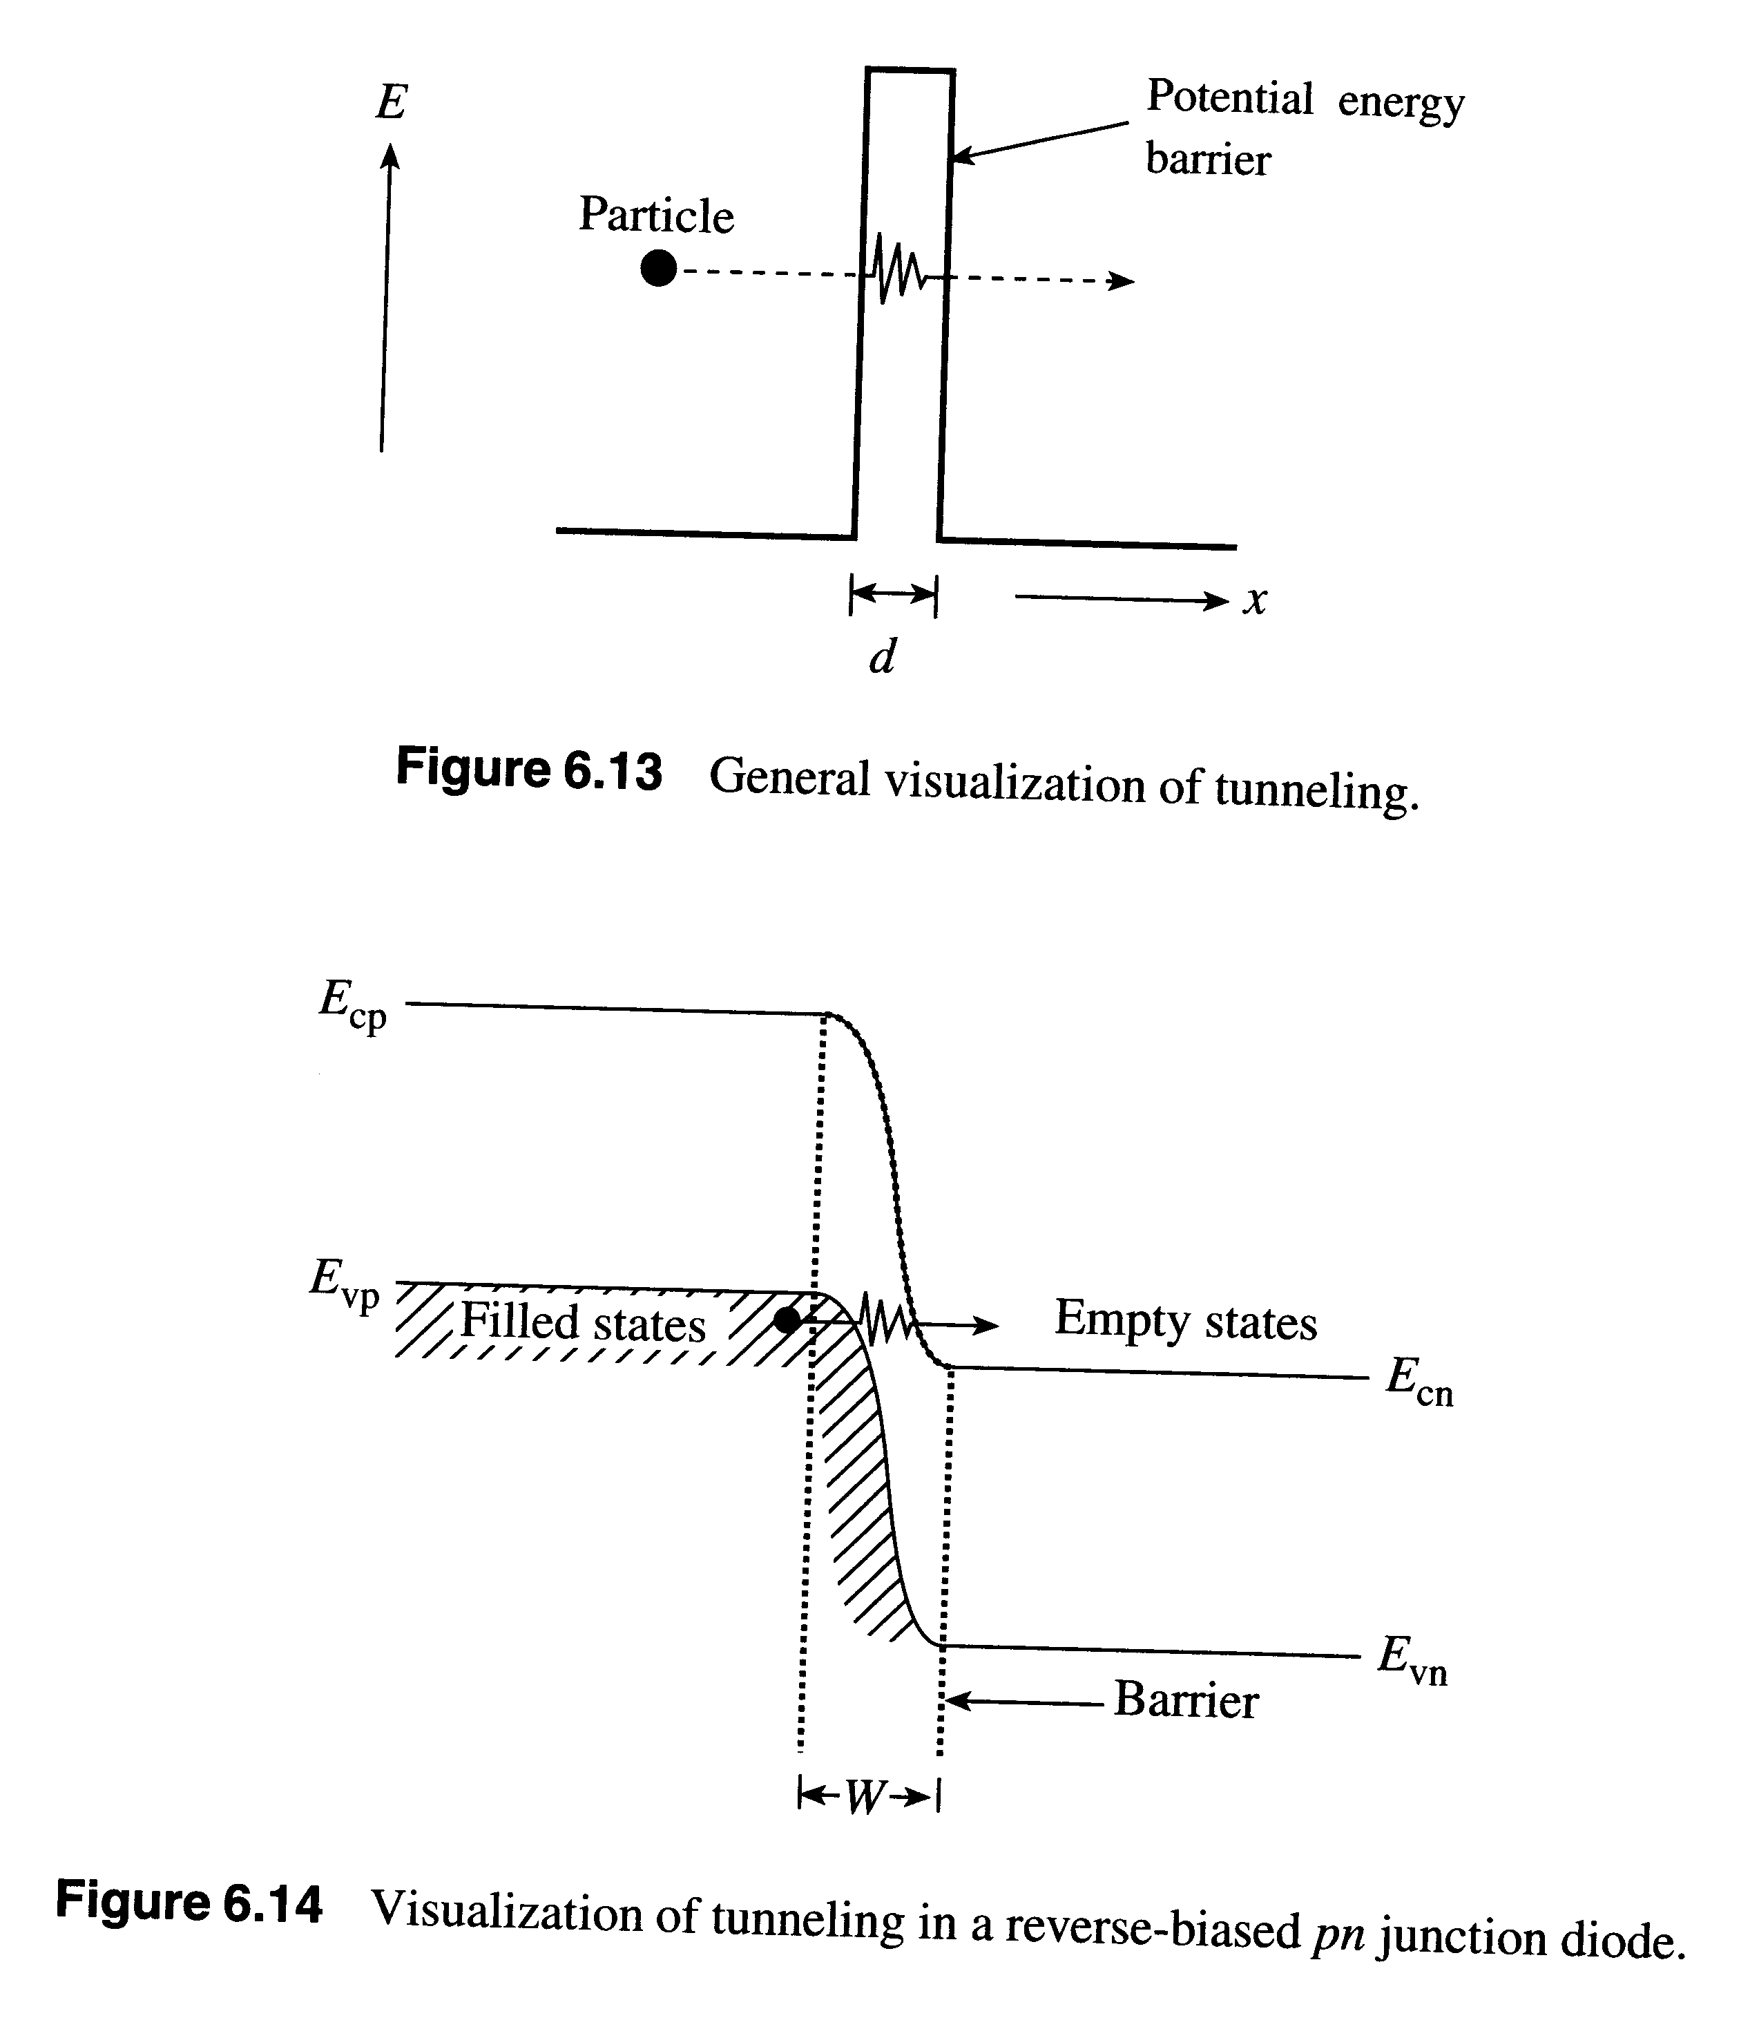
Visualization of Tunneling:
Barrier must be thin: depletion is narrow⇒ doping on both sides must be large
Must have empty states to tunnel into ⇒
V_{bi} + V_{BR} > E_{G}/q

Slide 30
Zener Diode Characteristics

Slide 31
Zener Diode Characteristics:
•The breakdown characteristics of diodes can be tailored by controlling the doping concentration
Heavily doped p⁺ and n⁺ regions result in low breakdown voltage (Zener effect)
Used as reference voltage in voltage regulators
I
V
Region of
operation

Slide 32
Example: Zener diode.
A 1N754A Zener diode has a dc power dissipation rating of 500 mW and a nominal Zener voltage of 6.8 V. What is the value of I_{ZM} for the device?

Slide 33
Summary

