Slide 1

COMSATS Institute of Information Technology
Virtual campus
Islamabad
Dr. Nasim Zafar
Electronics 1
EEE 231 – BS Electrical Engineering
Fall Semester – 2012

Slide 2
I-V Characteristics of PN Junctions
Lecture No: 7

Slide 3
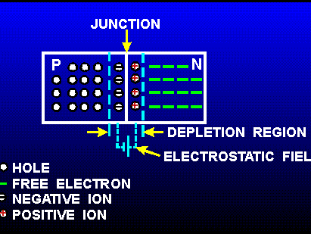
PN Junction

Slide 4
Ideal I-V Characteristics: Assumptions
The space-charge region boundaries represent an a step junction.
The abrupt depletion layer approximation applies.
- abrupt boundaries & neutral outside of the depletion region
No carriers exist in the space-charge region.
In the bulk of the diode outside the depletion region, the semiconductor is neutral.
Diode operation is considered at a temperature at which all impurity atoms are ionized.
Perfect ohmic contacts are made to the ends of the p and n regions.
The Maxwell-Boltzmann approximation applies to carrier statistics.
The Concept of low injection applies.

Slide 5
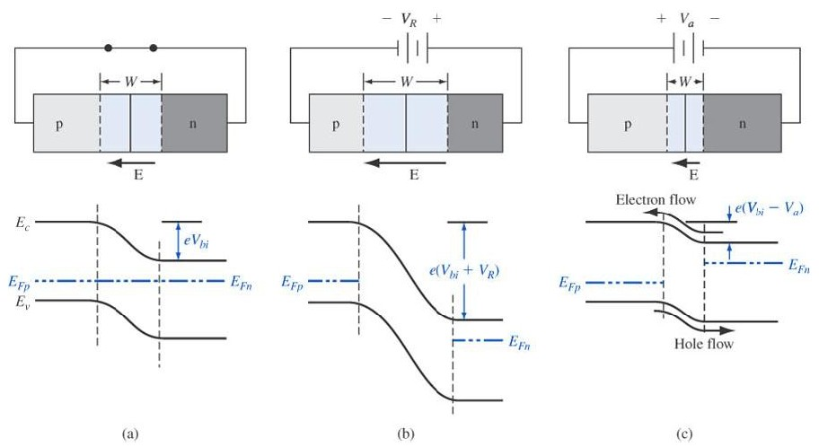
Qualitative Description of Current Flow
Equilibrium
Reverse bias
Forward bias

Slide 6
Current-Voltage Relationship
Quantitative Approach

Slide 7
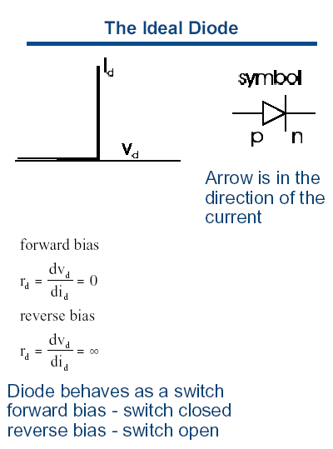
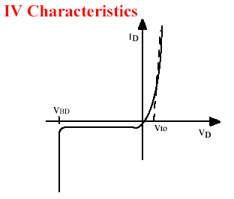
Current-Voltage Characteristics
REAL DIODE
THE IDEAL DIODE
Positive voltage yields finite current
Negative voltage yields zero current

Slide 8
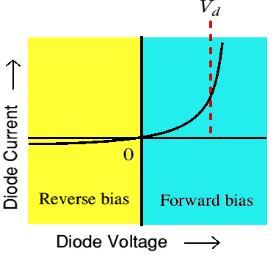
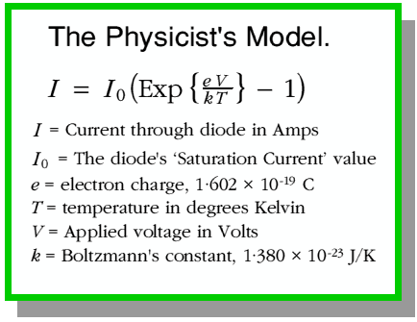
Voltage-Current Characteristics of a P-N Junction

Slide 9
Built-in-Potential

Slide 10

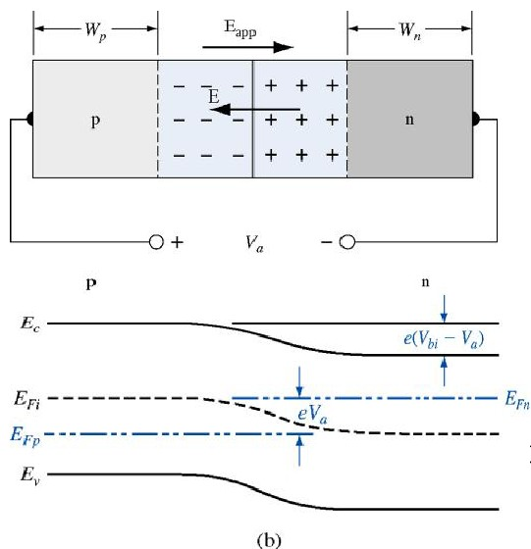
Boundary Conditions:
If forward bias is applied to the PN junction

Slide 11
The Steady state :
• Under the idealized assumptions, no current is generated within the
depletion region; all currents come from the neutral regions.
•In the neutral n region, there is no electric field , thus in the steady-state
the solution of the continuity equation, with the boundary conditions gives:

Slide 12
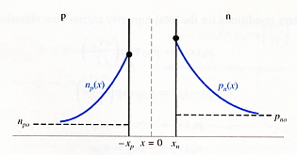
Minority Carrier Distribution
<n-region>
Steady state condition :
Steady state condition :
<p-region>

Slide 13
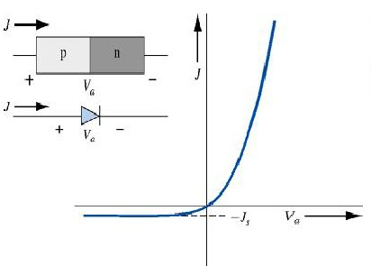
Ideal PN Junction Current

Slide 14
Effect of Temperature on diode Curves:
Doping Levels
Junction Area
The Junction Temperature.
All other factors may be regarded as being constant. However, temperature dependence is very strong.

Slide 15
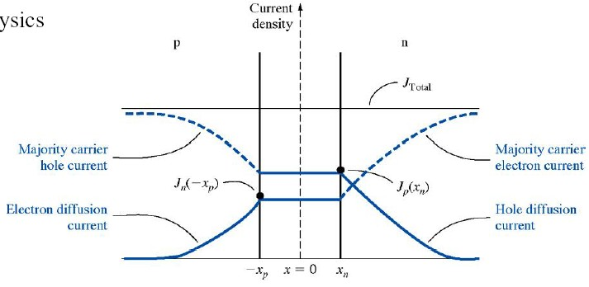
Total PN Junction Current

Slide 16
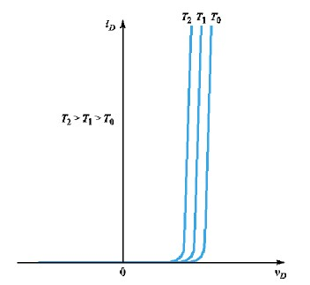
Temperature Effect
Js : strong function of temperature

Slide 17
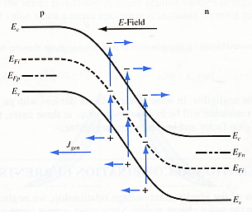
Reverse Bias-Generation Current
Recombination rate of excess carriers
(Shockley-Read-Hall model)
Total reverse bias current density, J_{R}
In depletion region,
n=p=0

Slide 18
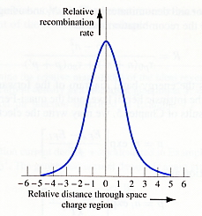
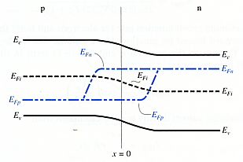
Forward Bias Recombination Current
Recombination rate of excess carriers
(Shockley-Read-Hall model)
R = R_{max} at x=o

Slide 19
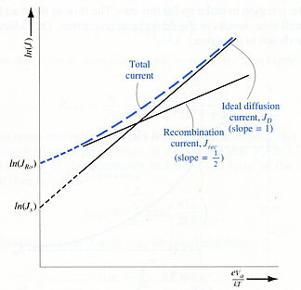
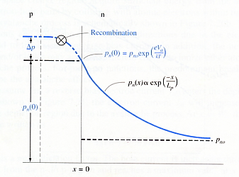
Total Forward Bias Current
Total forward bias current density, J
In general, (n : ideality factor)

Slide 20
SUMMARY

Slide 21
Junction Break Down
Breakdown Characteristics
* Zener Breakdown
* Avalanche Breakdown

Slide 22
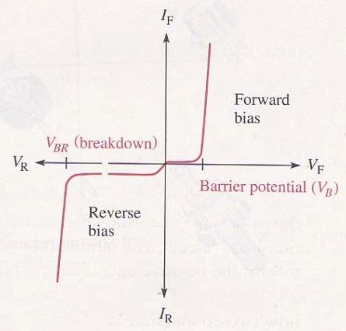
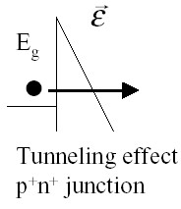
Zener Breakdown
Highly doped junction ( narrow W)
Mechanism is termed tunneling or Zener breakdown
Zener effect
Doping level > 10¹⁸/Cm³

Slide 23
Zener Effect
Zener Break Down: V_{D} <= V_{Z}:
V_{D} = V_{Z}, I_{D} is determined by the circuit.
In case of standard diode the typical values of the break down voltage V_{Z} of the Zener effect -20 ... -100 V
Zener Diode
  Utilization of the Zener effect
  Typical break down values of V_{Z} :-4.5 ... -15 V

Slide 24
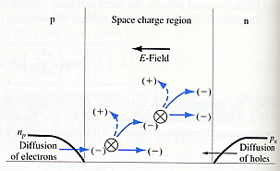
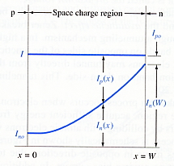
Avalanche Breakdown
Impact Ionization Mechanism
I_{n}(w) = M * I_{no}
Mechanism
Total current during
avalanche multiplication

Slide 25
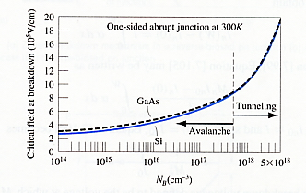
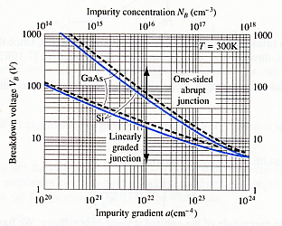
Critical Electric Field & Voltage at Breakdown
The breakdown voltage will decrease
for a linearly graded junction
Critical electric field at breakdown
in a one-sided junction
Total current during
avalanche multiplication

Slide 26
Fig 2.28-30 Zener characteristics.

Slide 27
Fig 2.31 Determining Zener impedance.

Slide 28
Fig 2.32 Zener equivalent circuits.
Ideal: Z_{Z} = 0
Prac.: Z_{Z} > 0

Slide 29
Example 2.13 Zener diode.
A 1N754A Zener diode has a dc power dissipation rating of 500 mW and a nominal Zener voltage of 6.8 V. What is the value of I_{ZM} for the device?

Slide 30
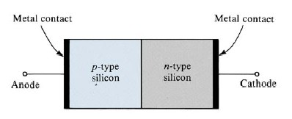
Metal Contacts
<Ohmic contact>
No rectifying action.
The current can flow in both direction
<Schottky contact>
The difference of carrier concentrations
of the two materials at the contact.
A barrier potential exists.
rectifying action occurs.
Mostly used in switching circuits.
(turn on/off switches)

Slide 31
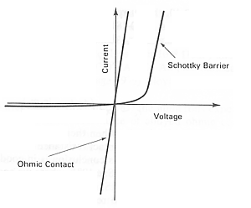
Metal Contacts I-V Characteristics

Slide 32
LED
Light emitting diode, made from GaAs
  V_{F}=1.6 V
  I_{F} >= 6 mA

Slide 33
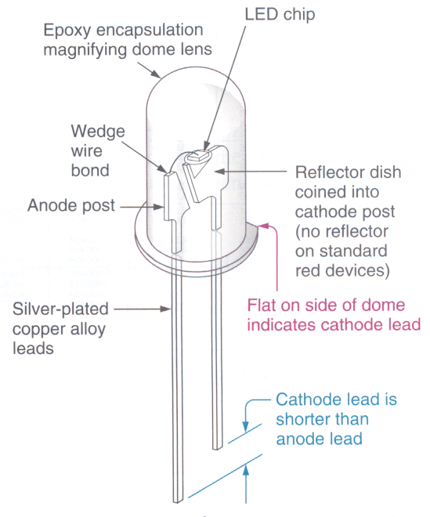
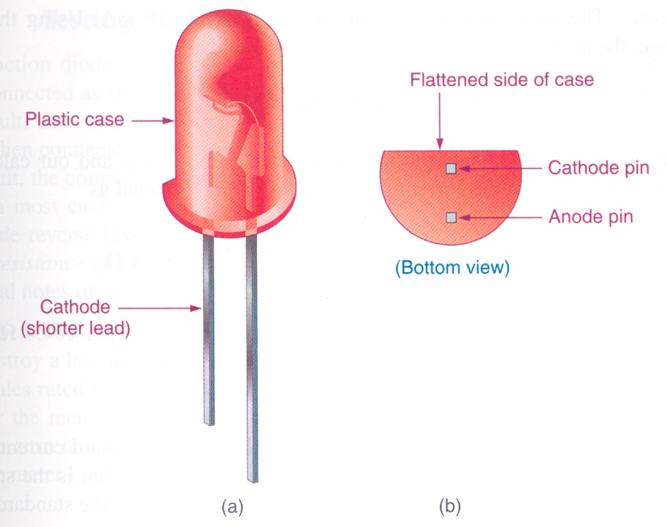
Fig 2.35-37 Light emitting diodes.
LED symbol

Slide 34
Table 2.4 Common LEDs.
Elements | Forward voltage (V_{F}) | Color Emitted
GaAs | 1.5 V @ I_{F} = 20 mA | Infrared (invisible)
AlGaAs | 1.8 V @ I_{F} = 20 mA | Red
GaP | 2.4 V @ I_{F} = 20 mA | Green
AlGaInP | 2.0 V @ I_{F} = 20 mA | Amber (yellow)
AlGaInN | 3.6 V @ I_{F} = 20 mA | Blue

Slide 35
Fig 2.38 A LED needs a current-limiting resistor.

Slide 36
Fig 2.39 Multicolor LED.

Slide 37
Fig 2.43 Common diodes.
 | Rectifier | Zener | LED
Schematic symbol
Bias for normal operation | Switched back and forth between forward and reverse. | Reverse | Forward
Normal V_{F} | Si: V_{F} = 0.7 V Ge: V_{F} = 0.3 V | V_{F} = 0.7 V (not normally operated)
Normal V_{R} | Equal to applied voltage. | Equal to V_{Z}. | Equal to applied voltage.
Primary factors to consider for device substitution | I₀ and V_{RRM} ratings. | P_{D(max)} and V_{Z} ratings. | V_{F(min)}, I_{F(max)}, and V_{BR}

