Slide 1

COMSATS Institute of Information Technology
Virtual campus
Islamabad
Dr. Nasim Zafar
Electronics 1
EEE 231 – BS Electrical Engineering
Fall Semester – 2012

Slide 2
    Revision:
1. Semiconductor Materials:
 Elemental semiconductors
 Intrinsic and Extrinsic Semiconductor
 Compound semiconductors
III – V Gap, GaAs
II – V e.g ZnS, CdTe
 Mixed or Tertiary Compounds
e.g. GaAsP
2. Applications:
Si ⇒ diodes, rectifiers, transistors and integrated circuits etc
GaAs, GaP ⇒ emission and absorption of light
ZnS ⇒ fluorescent materials

Slide 3
    Revision:
3. The Band Theory of Solids
Quantum Mechanics ⇒ discrete energy levels
  S¹ – P³ – model for four valency
  Si – atom in the diamond lattice ⇒ four nearest neighbors
  Sharing of four electrons ⇒ S¹ – P³ – level, the covalent bonding!
Pauli’s Exclusion principle for overlapping S¹ – P³ electron wave functions ⇒ Bands

Slide 4
Revision:
4. Band Gap and Material Classification
      Insulators ⇒ E_{g}: 5 – 8 eV
      Semiconductor ⇒ E_{g}: 0.66 eV – 2/3 eV
      Metals ⇒ overlapping
The classification takes into account
    Electronic configuration
    Energy Band-gap
    Examples:
Wide: E_{g} ≅ 5 eV (diamond)
E_{g} ~ 8 eV (SiO₂)
Narrow: E_{g} = Si = 1.12, GaAs = 1.42

Slide 5
5. Charge Carriers in Semiconductors
Electrons and Holes in Semiconductors
    Intrinsic Materials
    Doped – Extrinsic Materials
    Effective Mass
⇒ Hydrogenic Model:

Slide 6
Lecture No: 6
P-N Junction - Semiconductor Diodes

Slide 7
Outcome:
Upon completion of this topic on P-N Junctions, you will be able to appreciate:
Knowledge of the formation of p-n junctions to explain the diode operation
and to draw its I-V characteristics. so that you can draw the band diagram to
explain their I-V characteristics and functionalities.
Diode break down mechanisms; including the Avalanche breakdown and
Zenor break down; The Zener Diodes.
Understanding of the operation mechanism of solar cells, LEDs, lasers and FETs.

Slide 8
Semiconductor Devices:
Semiconductor devices are electronic components that use the electronic
properties of semiconductor materials, principally ; silicon, germanium,
and gallium arsenide.
Semiconductor devices include various types of Semiconductor Diodes,
Solar Cells, light-emitting diodes LEDs. Bipolar Junction Transistors.
Silicon controlled rectifier, digital and analog integrated circuits.
Solar Photovoltaic panels are large semiconductor devices that directly convert
light energy into electrical energy.

Slide 9
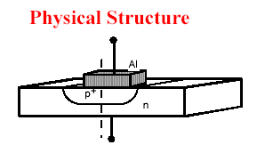
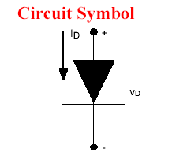
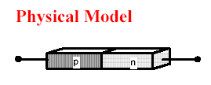
THE P-N JUNCTION

Slide 10
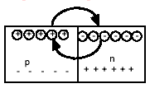
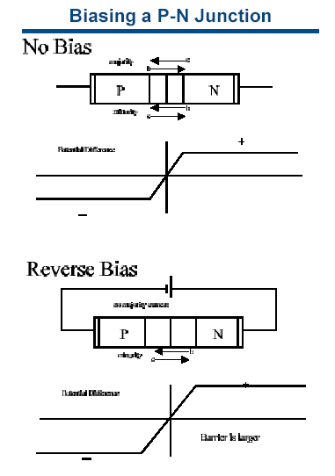

The P-N Junction
↓
The “potential” or voltage across the silicon changes in the depletion region and goes from + in the n region to – in the p region

Slide 11
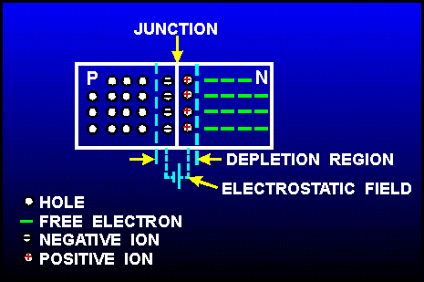

Slide 12
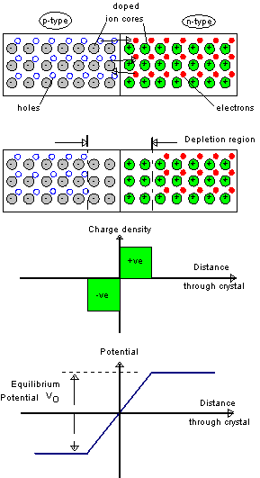
The P-N Junction
Formation of depletion region in PN Junction

Slide 13
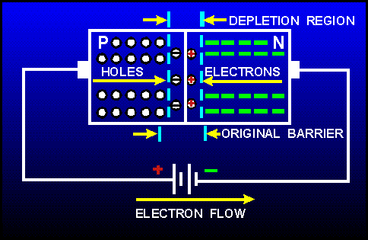

Slide 14
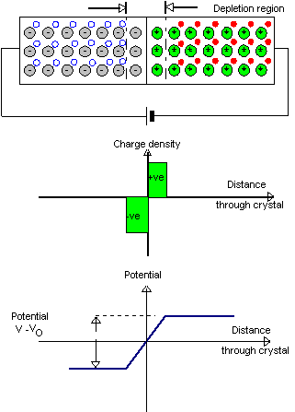
Forward Biased P N-Junction
Depletion Region and Potential Barrier Reduces

Slide 15
Biased P-N Junction
  Biased P-N Junction, i.e. P-N Junction with voltage applied across it
  Forward Biased: p-side more positive than n-side;
  Reverse Biased: n-side more positive than p-side;
  Forward Biased Diode:
    the direction of the electric field is from p-side towards n-side
    ⇒ p-type charge carriers (positive holes) in p-side are pushed towards and across the p-n boundary,
    n-type carriers (negative electrons) in n-side are pushed towards and across n-p boundary ⇒ current flows across p-n boundary

Slide 16
Introduction:
Semiconductor Electronics owes its rapid development to the P-N junctions. P-N
junction is the most elementary structure used in semiconductor devices and
microelectronics and opto-electronics. The most common junctions that occur in micro
electronics are the P-N junctions and the metal-semiconductor junctions.
Junctions are also made of different (not similar) semiconductor materials or compound semiconductor materials. This class of devices is called the heterojunctions; they are important in special applications such as high speed and photonic devices. There is , of course, an enormous choice available for semiconductor materials and compound semiconductors that can be joined/used. A major requirement is that the dissimilar materials must fit each other; the crystal structure in some way should be continuous. Intensive research is on and there are attempts to combine silicon technology with other semiconductor materials.

Slide 17
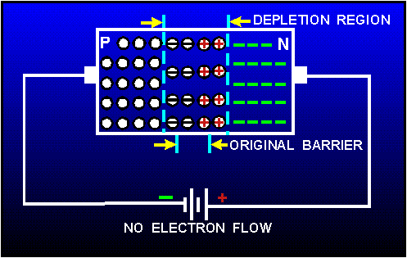
Reverse biased diode
  reverse biased diode: applied voltage makes n-side more positive than p-side ⇒ electric field direction is from n-side towards p-side ⇒ pushes charge carriers away from the p-n boundary ⇒ depletion region widens, and no current flows
  diode only conducts when positive voltage applied to p-side and negative voltage to n-side
  diodes used in “rectifiers”, to convert ac voltage to dc.

Slide 18
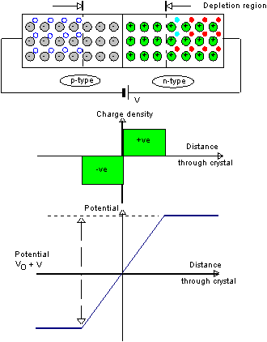
Reverse biased diode
Depletion region becomes wider, barrier potential higher

Slide 19
P-N Junctions - Semiconductor Diodes:
Introduction
Fabrication Techniques
Equilibrium & Non-Equilibrium Conditions:
• Forward and
• Reverse Biased Junctions
Current-Voltage (I-V ) Characteristics

Slide 20
Introduction:
    p-n junction = semiconductor in which impurity changes abruptly from p-type to n-type ;
    “diffusion” = movement due to difference in concentration, from higher to lower concentration;
    in absence of electric field across the junction, holes “diffuse” towards and across boundary into n-type and capture electrons;
    electrons diffuse across boundary, fall into holes (“recombination of majority carriers”); ⇒ formation of a “depletion region” (= region without free charge carriers) around the boundary;
    charged ions are left behind (cannot move):
      negative ions left on p-side ⇒ net negative charge on p-side of the junction;
      positive ions left on n-side ⇒ net positive charge on n-side of the junction
      ⇒ electric field across junction which prevents further diffusion

Slide 21
Fabrication Techniques:
Epitaxial Growth Technique
Diffusion Method
Ion Implant

Slide 22
Epitaxial Growth of Silicon
Epitaxy grows additional silicon on top of existing silicon (substrate)
  uses chemical vapor deposition
  new silicon has same crystal structure as original
Silicon is placed in chamber at high temperature
  1200 º C (2150 º F)
Appropriate gases are fed into the chamber
  other gases add impurities to the mix
Can grow n type, then switch to
p type very quickly

Slide 23
Diffusion Method
It is also possible to introduce dopants into silicon by heating them so they diffuse into the silicon
High temperatures cause diffusion
Can be done with constant concentration in atmosphere
Or with constant number of atoms per unit area
Diffusion causes spreading of doped areas
top
side

Slide 24
Ion Implantation of Dopants
One way to reduce the spreading found with diffusion is to use ion implantation:
  also gives better uniformity of dopant
  yields faster devices
  lower temperature process
Ions are accelerated from 5 Kev to 10 Mev and directed at silicon
  higher energy gives greater depth penetration
  total dose is measured by flux
    number of ions per cm²
    typically 10¹² per cm² - 10¹⁶ per cm²
Flux is over entire surface of silicon

Slide 25
I-V Characteristics of PN Junctions
Diode characteristics
* Forward bias current
* Reverse bias current

Slide 26
Ideal I-V Characteristics
The abrupt depletion layer approximation applies.
- abrupt boundaries & neutral outside of the depletion region
2) The Maxwell-Boltzmann approximation applies.
3) The Concept of low injection applies.

Slide 27
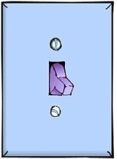
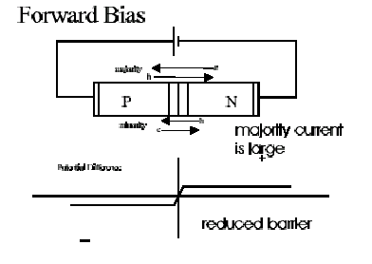
Biasing the P-N Junction
THINK OF THE DIODE
AS A SWITCH
Forward Bias
Applies - voltage to the n region and + voltage to the p region
CURRENT!
Reverse Bias
Applies + voltage to n region and – voltage to p region
NO CURRENT

Slide 28
Depletion region, Space-Charge Region:
Region of charges left behind: The diffusion of electrons and holes, mobile charge carriers, creates ionized impurity across
the p n junction.
• Region is totally depleted of mobile charges - depletion region
• The space charge in this region is determined mainly by the ionized acceptors (- q NA) and the ionized donors (+qND).
• Electric field forms due to fixed charges in the depletion region
(Built-in-Potential).
•Depletion region has high resistance due to lack of mobile charges.

Slide 29
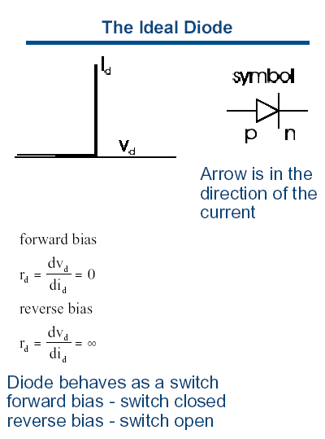
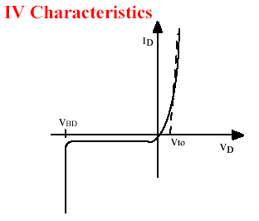
Current-Voltage Characteristics
REAL DIODE
THE IDEAL DIODE
Positive voltage yields finite current
Negative voltage yields zero current

Slide 30
Various Current Components
V_{A} = 0
V_{A} > 0
V_{A} < 0
E
E
E
p
n
p n
Hole diffusion current
Hole diffusion current
Hole diffusion current
Hole drift current
Hole drift current
Hole drift current
Electron diffusion current
Electron diffusion current
Electron diffusion current
Electron drift current
Electron drift current
Electron drift current

Slide 31
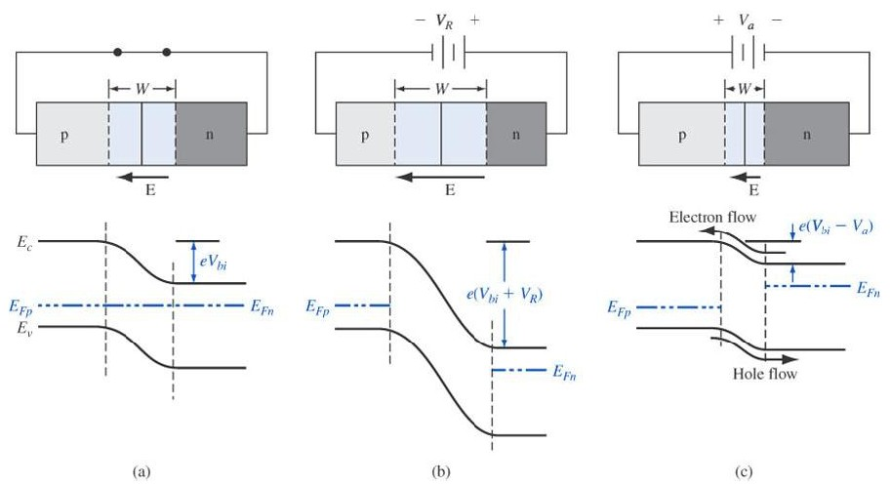
Qualitative Description of Current Flow
Equilibrium
Reverse bias
Forward bias

Slide 32
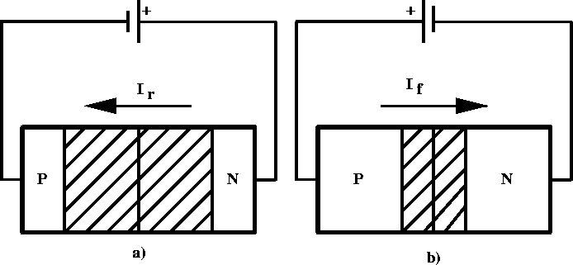
P-N Junction–Forward Bias
positive voltage placed on p-type material
holes in p-type move away from positive terminal, electrons in n-type move further from negative terminal
depletion region becomes smaller - resistance of device decreases
voltage increased until critical voltage is reached, depletion region disappears, current can flow freely

Slide 33
P-N Junction–Reverse Bias
positive voltage placed on n-type material
electrons in n-type move closer to positive terminal, holes in p-type move closer to negative terminal
width of depletion region increases
allowed current is essentially zero (small “drift” current)

Slide 34
Forward Biased Junctions
Effects of Forward Bias on Diffusion Current:
When the forward-bias-voltage of the diode is increased, the barrier
for electron and hole diffusion current decreases linearly.
Since the carrier concentration decreases exponentially with
energy in both bands, diffusion current increases exponentially as the
barrier is reduced.
As the reverse-bias-voltage is increased, the diffusion current decrease
rapidly to zero, since the fall-off in current is exponential.

Slide 35
Reverse Biased Junction
Effect of Reverse Bias on Drift current
When the reverse-bias-voltage is increased, the net electric field
increases, but drift current does not change.
In this case, drift current is limited NOT by HOW FAST carriers are
swept across the depletion layer, but rather HOW OFTEN.
The number of carriers drifting across the depletion layer is small
because the number of minority carriers that diffuse towards the
edge of the depletion layer is small.
To a first approximation, the drift current does not change with the
applied voltage.

Slide 36
Current-Voltage Relationship
Quantitative Approach

Slide 37
Application of PN Junctions
BJT (Bipolar Junction Transistor)
HBT (Heterojunction Bipolar Transistor)
Rectifiers
P
N
J
U
N
C
T
I
O
N
Switching diode
Junction diode
Breakdown diode
Varactor diode
Tunnel diode
PN Junction diode
Solar cell
Photo-diode
Photodetector
Light Emitting diode & Laser Diode
JFET
FET (Field Effect Transistor)
MOSFET - memory
MESFET - HEMT

Slide 38
Summary:
Semiconductor Devices:
Semiconductor Diodes,
Solar Cells, LEDs. Bipolar Junction Transistors.
Solar Photovoltaic
Biased P-N Junction:
  Forward Biased: p-side more positive than n-side;
  Reverse Biased: n-side more positive than p-side;
Fabrication Techniques:
Epitaxial Growth Technique
Diffusion Method
Ion Implant
Current-Voltage Relationship

Slide 39
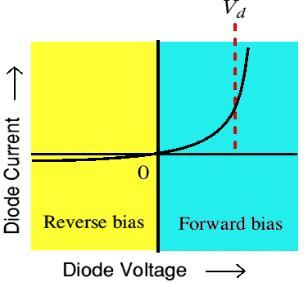
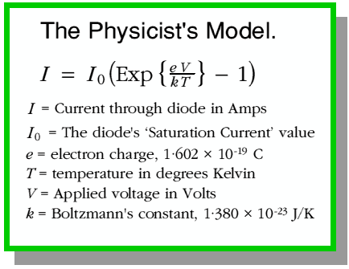
P-N Junction I-V characteristics
Voltage-Current relationship for a p-n junction (diode)

Slide 40
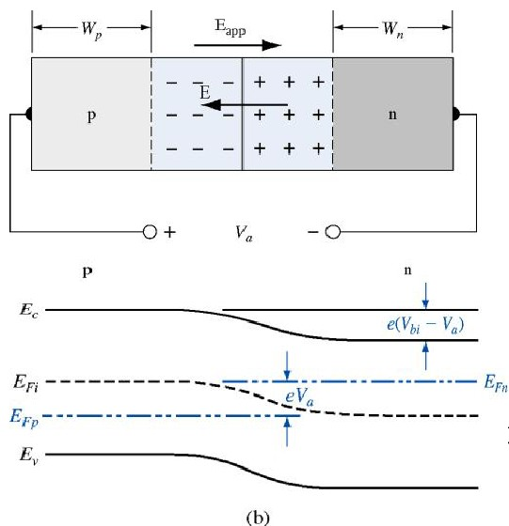
Boundary Conditions:
If forward bias is applied to the PN junction

Slide 41
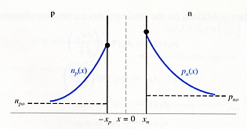
Minority Carrier Distribution
Steady state condition :
<n-region>
Steady state condition :
<p-region>

Slide 42
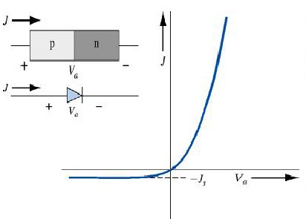
Ideal PN Junction Current

Slide 43
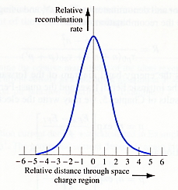
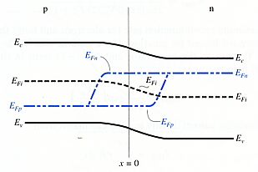
Forward Bias Recombination Current
Recombination rate of excess carriers
(Shockley-Read-Hall model)
R = R_{max} at x=o

Slide 44

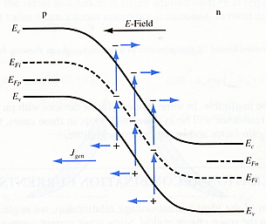
Reverse Bias-Generation Current
Recombination rate of excess carriers
(Shockley-Read-Hall model)
Total reverse bias current density, J_{R}
In depletion region,
n=p=0

Slide 45
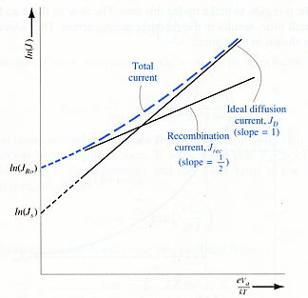
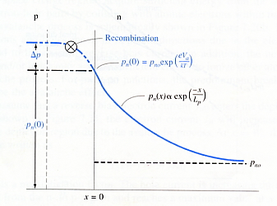
Total Forward Bias Current
Total forward bias current density, J
In general, (n : ideality factor)

Slide 46
Application of PN Junctions
BJT (Bipolar Junction Transistor)
HBT (Heterojunction Bipolar Transistor)
Rectifiers
P
N
J
U
N
C
T
I
O
N
Switching diode
Junction diode
Breakdown diode
Varactor diode
Tunnel diode
PN Junction diode
Solar cell
Photo-diode
Photodetector
Light Emitting diode & Laser Diode
JFET
FET (Field Effect Transistor)
MOSFET - memory
MESFET - HEMT

Slide 47
Summary:
Semiconductor Devices:
Semiconductor Diodes,
Solar Cells, LEDs. Bipolar Junction Transistors.
Solar Photovoltaic
Biased P-N Junction:
  Forward Biased: p-side more positive than n-side;
  Reverse Biased: n-side more positive than p-side;
Fabrication Techniques:
Epitaxial Growth Technique
Diffusion Method
Ion Implant
Current-Voltage Relationship

