Slide 1

COMSATS Institute of Information Technology
Virtual campus
Islamabad
Dr. Nasim Zafar
Electronics 1
EEE 231 – BS Electrical Engineering
Fall Semester – 2012

Slide 2
Carrier Transport in Semiconductors
Lecture No: 4
  Drift and Mobility
  Conductivity and Resistance
  Continuity Equations
  Einstein Relation

Slide 3
Introduction:
In the first few lectures we discussed and calculated the
equilibrium distribution of charges in a semiconductor.
n.p = n_{i}², n ~ N_{D} for n-type
last lecture showed how the system tries to restore itself
back to equilibrium when perturbed, through R- G processes.
R = (n p - n_{i}²)/[t_{p}(n+n₁) + t_{n}(p+p₁)]
In this lecture we will explore the processes that drive the system
away from equilibrium.

Slide 4
Introduction:
The carrier transport or the mechanisms which cause charges to move in semiconductors can be classified into two categories. Both these mechanisms will be discuss in this lecture.
The two mechanisms are:
Drift: Drift-Motion under an applied electric field.
diffusion: Diffusion-Motion due to the concentration gradient of the charges.
An applied electric field will cause drift, while thermal motion and the carrier concentration gradient will cause diffusion.

Slide 5
The Drift Motion

Slide 6
An Applied Electric Field Across: n-type Si
V
-
+
n – type Si
e⁻
Electric field
Electron movement
Current flow
Current carriers are mostly electrons.

Slide 7
An Applied Electric Field Across: P-type Si
V
-
+
p– type Si
hole
Electric field
Hole movement
Current flow
Current carriers are mostly holes.

Slide 8
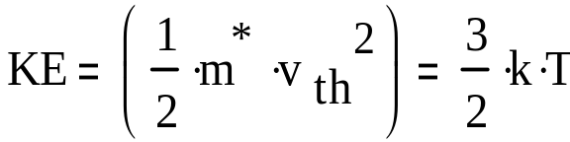
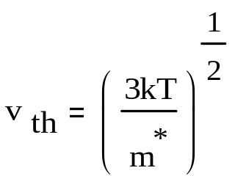
The Thermal Velocity:
For free charge carriers the thermal energy and the thermal velocity is given by:
From classical thermal physics,
or
≈ 10⁷ cm/s in Si
where v_{th} is the thermal velocity, which is the average velocity
of carriers due to thermal excitation.

Slide 9
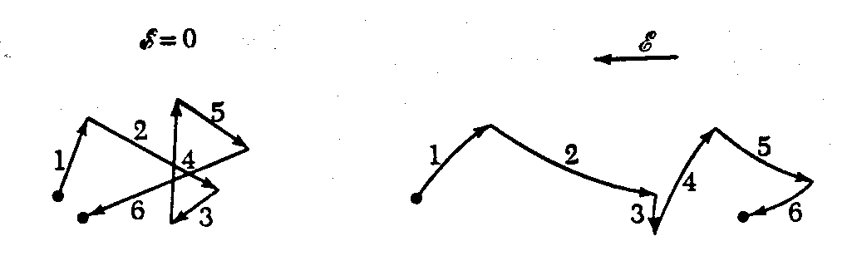
The Concept of Drift-under an applied Electric Field:
Random scattering
events (R-G centers)
The electric field gives a net
drift, superposed on top

Slide 10
The Concept of Drift-under an Electric Field:
If an electric field, E_{x}, is applied along the x-direction to the
Si sample, each electron will experience a net force -qE_{x} from
the field, given by:
This force may be insufficient to alter, appreciably, the
random thermal motion of an individual electron, however, there is a net motion of the group in the x-direction.
When electrons collide with the lattice and impurity atoms, there is a loss of energy associated with them.

Slide 11
Scattering Processes
Phonon Scattering
Ionized Impurity Scattering
Neutral Atom/Defect Scattering
Carrier-Carrier Scattering

Slide 12
Drift Velocity and Mobility:
Net carrier velocity in an applied field is the drift velocity v_{d}
Drift velocity = Acceleration x Mean free time
Force is due to the applied field, F=qE

Slide 13
Carrier Mobility :
is a proportionality factor and is defined as mobility
of the charge carriers.
  So is a measure of how easily charge carriers move under the influence of an applied field or determines how mobile the charge carriers are.

Slide 14
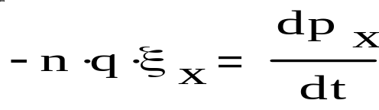
The Concept of Drift Motion and Drift Current:
The force exerted by the field, on n electrons/cm³ is:
(where p_{x} , momentum of the group)
Is this a continuous acceleration of
electrons in the–x direction?
The drift motion of these electrons, gives a drift current
drift current
number of charge carriers per unit volume
drift velocity of charge carrier
area of the semiconductor
charge of t he electron

Slide 15
Carrier Mobility
Thus:

Slide 16
Carrier Mobility :
There are the two basic types of scattering mechanisms that hinder mobility. Thus the mobility has two components:
Impurity interaction component
Lattice interaction component

Slide 17
Lets Solve a Problem:
Calculate the velocity of an electron in an n-type silicon sample due to its thermal energy at room temperature.
and due to the application of an electric field of 1000 V/m across the
Silicon sample.

Slide 18
Temperature Dependence
of Mobility

Slide 19

Variation of mobility with temperature
At high temperatures
component becomes significant.
decreases when temperature increases.
C₁ is a constant.
It is called as a power law.
Carriers are more likely scattered by the lattice atoms.

Slide 20
Variation of mobility with temperature
At low temperatures
component is significant.
decreases when temperature decreases.
C₂ is a constant.

Slide 21
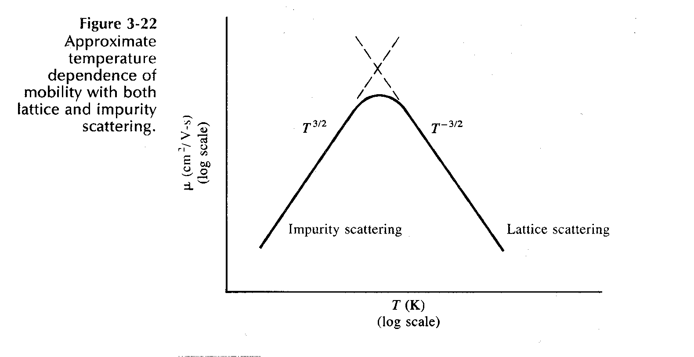
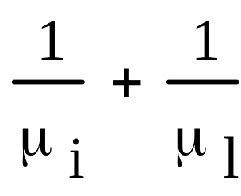
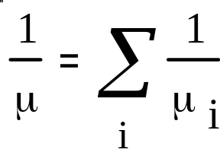
Mobility and Scattering: Lattice and Impurity
Lattice vibrations: due to temperature.
Ionized impurity scattering: slow moving carriers are easily affected by a charged ion.
Net Mobility
~

Slide 22
Temperature Dependence of Mobility
T
T
High temperature
Low temperature
Peak depends on the density of impurities
ln( T )

Slide 23
Current Density
and
Conductivity

Slide 24
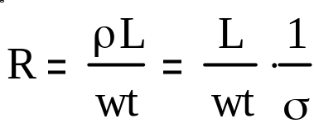
Conductivity and Resistance
The semiconductor bar contains both electrons and holes, the conductivity is given by
The resistance of the bar is given by:
Where ρ is the resistivity
Electric field
Current
Hole motion
Electron motion
I
Electron motion

Slide 25
Ohm’s Law
drift
J_{n} = E/ρ_{n}
drift
J_{p} = E/ρ_{p}
L
E = V/L
I = JA = V/R
R = ρ L/A (Ohms)
A
V

Slide 26
Current Density and Conductivity
In a semiconductors, both electrons and holes conduct current:
The conductivity is:
  Unit: mho/cm

Slide 27
Resistivity and Conductivity
drift
J_{n} = σ_{n}E
ρ = 1/σ
drift
J_{p} = σ_{p}E
  Unit: ohm-cm
σ_{n} = nqμ_{n} = nq²τ_{n}/m_{n}*
σ_{p} = pqμ_{p} = pq²τ_{p}/m_{p}*
σ = σ_{n} + σ_{p}

Slide 28
Mobility and Drift Current
drift
J_{n} = qnv = qnμ_{n}E
(A/cm²)
drift
J_{p} = qpv = qpμ_{p}E
μ_{n} = qτ_{n}/m_{n}*
μ_{p} = qτ_{p}/m_{p}*

Slide 29
Summary
The peak of the mobility curve depends on the number density of
ionized impurities.
Highly doped samples will therefore cause more scattering,
and have a lower mobility, than low doped samples.
Mobility and resistivity depend on the material properties
like m* and sample properties (e.g. N_{T}, which determines τ).
This fact is used in high speed devices called High Electron
Mobility Transistors (HEMTs) where electrons are made to
move in undoped material, with the resulting high
carrier mobilities!

