Slide 1

COMSATS Institute of Information Technology
Virtual campus
Islamabad
Dr. Nasim Zafar
Electronics 1 - EEE 231
Fall Semester – 2012

Slide 2

Summary

Slide 3
Lecture No. 32
Contents:
Introduction to Semiconductor Materials
Summary of Basic semiconductor devices
Basics of IC processing

Slide 4
References
Microelectronic Circuits:
Adel S. Sedra and Kenneth C. Smith.
Electronic Devices :
Thomas L. Floyd ( Prentice Hall ).
Integrated Electronics
Jacob Millman and Christos Halkias (McGraw-Hill).
Electronic Devices and Circuit Theory:
Robert Boylestad & Louis Nashelsky ( Prentice Hall ).
Introductory Electronic Devices and Circuits:
Robert T. Paynter.

Slide 5
Introduction
From Discrete to Integrated!
In 1954, Texas Instruments produced the first commercial silicon transistor.
Before the invention of the integrated circuits, electronic equipment was composed of discrete components such as transistors, resistors, and capacitors. These components, often simply called “discrete”, were manufactured separately and were wired or soldered together onto circuit boards.
This took up a lot of room and were expensive and cumbersome to assemble,

Slide 6
Active Electronic Components
An active electronic component either amplifies or switches.
  The most common active components are diodes and transistors.
  Both diodes and transistors are easy to make with semiconductors.
With semiconductor materials, it is possible to create complete circuits of active and/or passive components wired together.

Slide 7

Integrated Circuits
Integrated circuits (ICs) are semiconductor devices that are complete circuits made up of transistors, diodes, capacitors, resistors and inductors.
The complete circuit is made on a single piece of silicon called a chip.
Any circuit from a simple amplifier to a quad core microprocessor used in a PC can be made.

Slide 8
Introduction to Semiconductor Materials
Semiconductors are the materials with conductivity between conductor and insulator.
Its conductivity can be controlled by dopant concentration and applied voltage.
Elemental Semiconductors: Silicon and Germanium.
Compound Semiconductors:
  SiGe, SiC
  GaAs, InP, etc..

Slide 9
Introduction to Semiconductor Materials
Boron doped semiconductor is p-type, majority carriers are holes.
P, As, or Sb doped semiconductor is n-type, the majority carriers are electrons.
Higher dopant concentration, lower resistivity.
At the same dopant concentration, n-type has lower resistivity than p-type.

Slide 10
Energy Band Structure of an Atom
Valence shells
Conducting band, E_{c}
Nuclei
Band gap, E_{g}
Valence band, E_{v}

Slide 11
Energy Bands and Band Gap in Solids
E_{g} = 1.1 eV
E_{g} = 8 eV
Aluminum
2.7 μΩ•cm
Sodium
4.7 μΩ•cm
Silicon
~ 10¹⁰ μΩ•cm
Silicon dioxide
> 10²⁰ μΩ•cm
Conductors
Semiconductor
Insulator

Slide 12
Carrier Concentration and Mobility
Higher dopant concentration, more carriers: electrons or holes.
Electron mobility higher than holes.
Higher conductivity, lower resistivity.
N-type silicon has lower resistivity than p-type silicon at the same dopant concentration.

Slide 13
Silicon
Abundant, inexpensive
Thermal stability
Silicon dioxide is a strong dielectric and relatively easy to form
Silicon dioxide can be used as diffusion doping mask

Slide 14
    Summary-Semiconductor Materials
Semiconductor Materials:
• Elemental semiconductors
• Intrinsic and Extrinsic Semiconductor
• Compound semiconductors
III – V Gap, GaAs
II – V e.g ZnS, CdTe
• Mixed or Tertiary Compounds
e.g. GaAsP
Applications:
Si ⇒ diodes, rectifiers, transistors and integrated circuits etc
GaAs, GaP ⇒ emission and absorption of light
ZnS ⇒ fluorescent materials

Slide 15
Summary of Semiconductor Devices

Slide 16
Summary of Semiconductor Devices
Diodes, BJTs and FETs are nonlinear devices made of semiconductors, mostly silicon.
Diodes:
  A diode allows current to flow in the forward direction and hence can perform functions such as rectification, demodulation/detection, switch etc.
  The reverse current may become dramatically large at breakdown, such phenomena can be used as voltage regulator .

Slide 17
Summary of Semiconductor Devices
Bipolar Junction Transistors:
  A BJT has three terminals: base, emitter and collector.
  The collector current is controlled by voltage/ current on the base-emitter junction and is almost independent on collector voltage.
  It can perform functions such as amplification and switch, etc.
  A BJT should be properly biased for normal operation.
  There are three basic configurations, each has different. performance (input/output resistance, gain, high frequency response, etc.).

Slide 18
Basic Devices:
Diode: P-N Junction
Bipolar Junction Transistor: BJT
MOS Transistor

Slide 19
The Diode
Anode
Cathode

Slide 20
The Diode
P-N Junction Diode Schematic Symbol:
Anode
Cathode
p
n

Slide 21
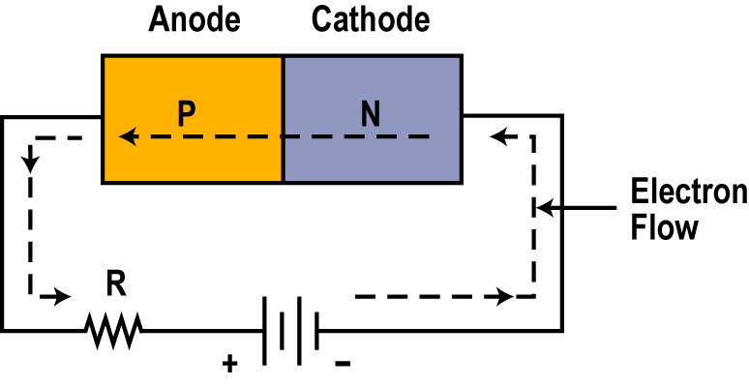
Biasing a PN Junction
For current flow in a PN junction or diode, we have to apply an external voltage called Bias.
With this connection, current only flows freely from cathode across the junction to the anode.
we’d say the switch is closed when electrons can flow through the diode.
Note: The current flow may be so high that an external resistance R is usually needed to minimize the current flow to a level a diode can withstand.
This arrangement is called forward bias.

Slide 22
Forward-Biased Diode Circuit

Slide 23
Reverse-Biased Diode Circuit

Slide 24
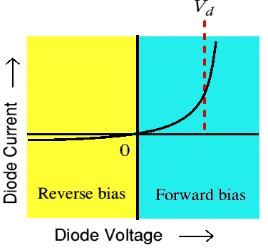
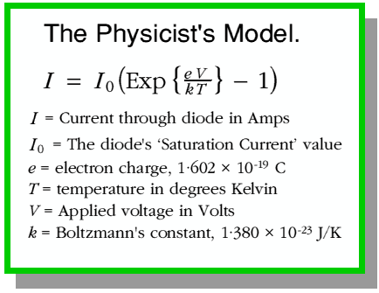
Diode I-V characteristics
Voltage-Current relationship for a p-n junction (diode)

Slide 25
Complete: Model Diode Curve
Forward operating region
Reverse operating region (also called the reverse breakdown region)

Slide 26
Ideal diode characteristics
 | Forward bias | Reverse Bias
Biasing polarities
Equivalent switch state | ON | OFF
Device resistance | Zero | Infinite
Device current | A-to-K current determined by external resistance and voltage | Zero
A-to-K voltage | Zero | Equal to the applied voltage
(+)
(-)
(-)
(+)
I_{F}

Slide 27
Diode Capacitance:

Slide 28
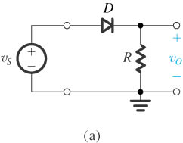
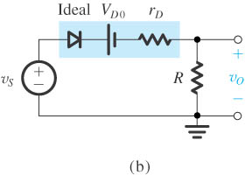
Half-Wave Rectifier Circuit:
  Half-Wave Rectifier Circuit
  Equivalent Circuit of the half-wave rectifier with the diode replaced with its barrier potential-plus-resistance model.

Slide 29
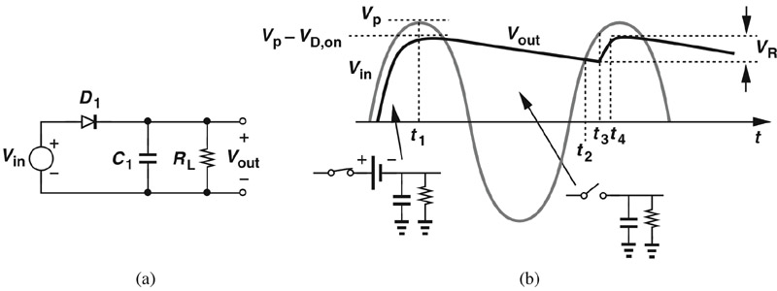
c03f34
Half-Wave Rectifier with Capacitor + Load Resistor
T_{in}
A path is available for capacitor to discharge.
Therefore, V_{out} will not be constant and a ripple exists.
Cause of ripple:

Slide 30
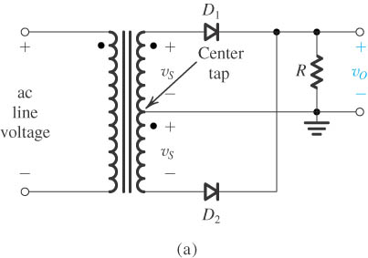
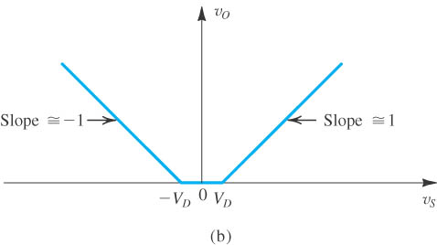
Full-Wave Rectifier
Circuit.
Transfer characteristic assuming a constant-voltage-drop model for the diodes.

Slide 31
Applications of PN Junction
BJT (Bipolar Junction Transistor)
HBT (Heterojunction Bipolar Transistor)
Rectifiers
P
N
J
U
N
C
T
I
O
N
Switching diode
Junction diode
Breakdown diode
Varactor diode
Tunnel diode
PN Junction diode
Solar cell
Photo-diode
Photodetector
Light Emitting diode & Laser Diode
JFET
FET (Field Effect Transistor)
MOSFET - memory
MESFET - HEMT

Slide 32
Common Applications of Diodes
 | Rectifier | Zener | LED
Schematic symbol
Bias for normal operation | Switched back and forth between forward and reverse. | Reverse | Forward
Normal V_{F} | Si: V_{F} = 0.7 V Ge: V_{F} = 0.3 V | V_{F} = 0.7 V (not normally operated)
Normal V_{R} | Equal to applied voltage. | Equal to V_{Z}. | Equal to applied voltage.
Primary factors to consider for device substitution | I₀ and V_{RRM} ratings. | P_{D(max)} and V_{Z} ratings. | V_{F(min)}, I_{F(max)}, and V_{BR}

Slide 33
Transistor Types
MOS - Metal Oxide Semiconductor
FET - Field Effect Transistor
BJT - Bipolar Junction Transistor
◄

Slide 34
The Bipolar Junction Transistor BJT
C
B
E

Slide 35
Bipolar Junction Transistor-BJT
PNP or NPN
Switch
Amplifier
Analog circuit
Fast, high power device

Slide 36
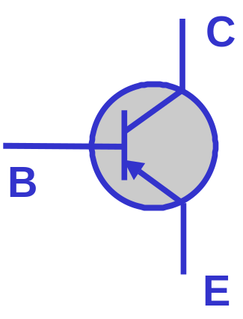
NPN and PNP Transistors
B
E
C
N
P
N
B
E
C
P
N
P

Slide 37
Transistor Biasing Configurations:
Common-Base Configuration (CB) :
input = V_{EB} & I_{E} ; output = V_{CB} & I_{C}
2. Common-Emitter Configuration (CE):
input = V_{BE} & I_{B} ; output = V_{CE} & I_{C}
Common-Collector Configuration (CC):
input = V_{BC} & I_{B} ; output = V_{EC} & I_{E}

Slide 38
Operation Modes:
Active:
  Most importance mode, e.g. for amplifier operation.
  The region where current curves are practically flat.
Saturation:
  Barrier potential of the junctions cancel each other out causing a virtual short.
  Ideal transistor behaves like a closed switch.
Cutoff:
  Current reduced to zero
  Ideal transistor behaves like an open switch.

Slide 39
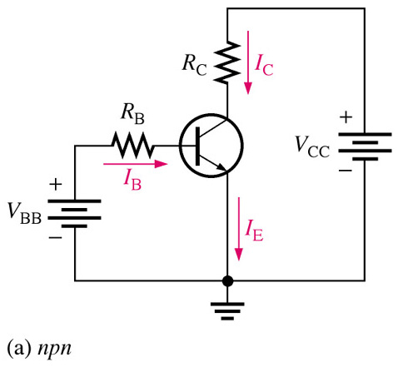
Basic Transistor Operation
Consider this circuit as two separate circuits:
The Base-Emitter Circuit
The Collector-Emitter Circuit
The amount of current flow in the base-emitter circuit controls the amount of current that flows in the collector circuit.
Small changes in base-emitter current yields a large change in collector-current.
Notes:
Fig 4-6a

Slide 40
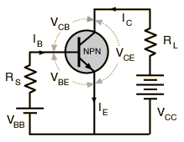
BJT-Current and Voltage Analysis
For all circuits: Assume the NPN transistor operates in the linear region:
        write B-E voltage loop
        write C-E voltage loop
When the base-emitter junction, in an NPN transistor is forward biased,
it is like a forward biased diode and has a forward-voltage drop of:
V_{BE} = 0.7 V
NPN

Slide 41
BJT-Current and Voltage Analysis
Input Circuit: Forward Biased E-B Junction.
Since the emitter is grounded, by Kirchhoff’s voltage law, the voltages
in the input circuit are:
V_{BB} = V_{RS} + V_{BE}
V_{RS} = V_{BB} -- V_{BE}
Using Ohm’s law:
V_{RS} = I_{B} R_{S}
I_{B} R_{S} = V_{BB} -- V_{BE}
I_{B} = (V_{BB} – V_{BE})/R_{S}
NPN

Slide 42
BJT-Current and Voltage Analysis
Output Circuit: Reverse Biased B-C Junction.
Using Kirchhoff’s voltage law, the voltages in the Output Circuit are:
V_{CC} = V_{CE} + V_{RL}
V_{CE} = V_{CC} -- V_{RL}
The voltage drop across R_{L} is:
V_{RL} = I_{C} R_{L}
The collector voltage is:
V_{CE} = V_{CC} -- I_{C} R_{L}

Slide 43
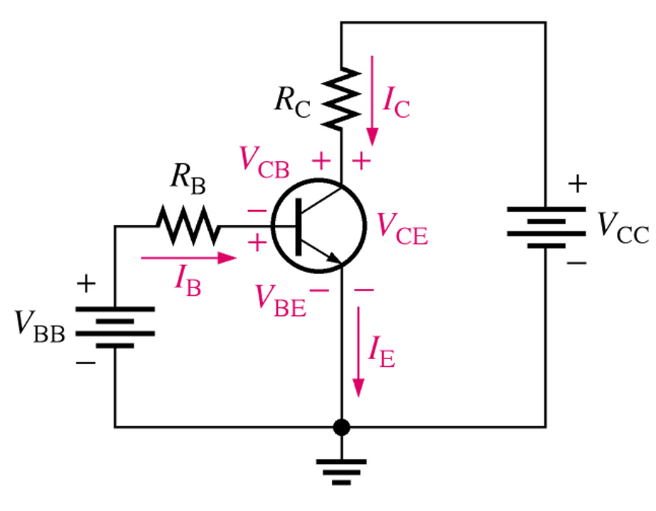
DC Analysis of Transistor Circuits
Kirchhoff’s voltage law:
In the Base Circuit:
V_{BB} is distributed across the base-emitter junction and R_{B}
In the collector circuit:
We determine that V_{CC} is distributed proportionally across R_{C} and the transistor, V_{CE}.
Notes:
Fig 4-7

Slide 44
DC-Current Gain Parameters
DC Beta (_{dc}) and DC Alpha (α_{dc} ):
Two quantities of great importance in the characterization of the transistors are:
common-base current gain α .
common-emitter current gain .
 = Common-emitter current gain
α = Common-base current gain

Slide 45
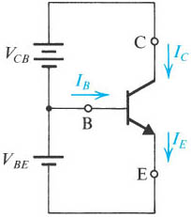
BJT-Current Gain Parameters
α = Common-Base Current Gain (typical 0.99)

Slide 46
BJT-Current Gain Parameters
 = Common-emitter current gain (10-1000; typical 50-200)

Slide 47
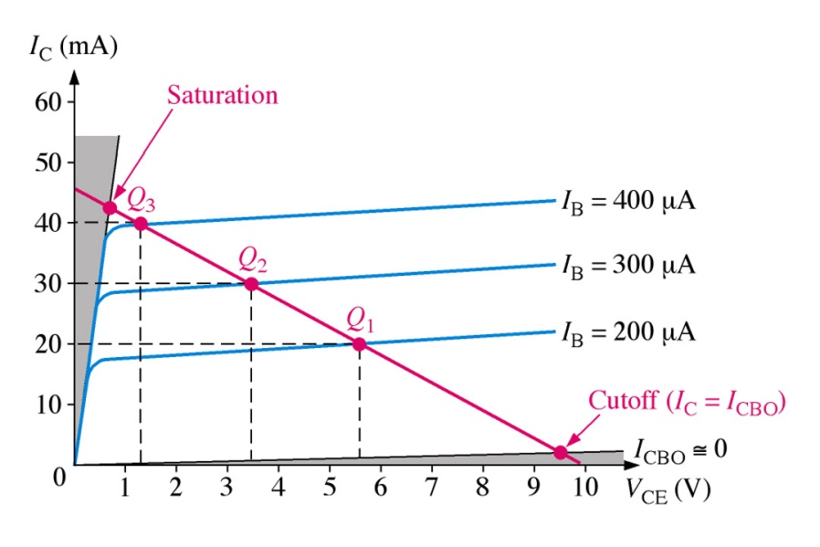
Modes of BJT Operation
Active: BJT acts like an amplifier (most common use).
Saturation: BJT acts like a short circuit.
Cutoff: BJT acts like an open circuit.
Notes:
Fig 5-2a & Fig 5-4

Slide 48
Modes of BJT Operation:
Active Region: Region where current curves are practically flat.
In Active Region, the transistor is on. The collector current is proportional to and controlled by the base current I_{C} (I_{C} = βI_{B}) and relatively insensitive to V_{CE}.
In this region the transistor can be used as an amplifier.
Cutoff Region: Current reduced to zero.
  The transistor is off. There is no conduction between the collector and the emitter. (I_{B} = 0 therefore I_{C} = 0).
  ‏Equivalent to an off-state and the transistor behaves like an open switch. Low current flow, High Voltage.

Slide 49
Modes of BJT Operation:
Saturation Region:
  In Saturation region: The transistor is on. The collector current varies very little with a change in the base current in the saturation region.
  The output voltage V_{CE} is small, a few tenths of a volt.
  The collector current is strongly dependent on V_{CE} unlike in the active region.
  Ideal transistor behaves like a closed switch.

Slide 50
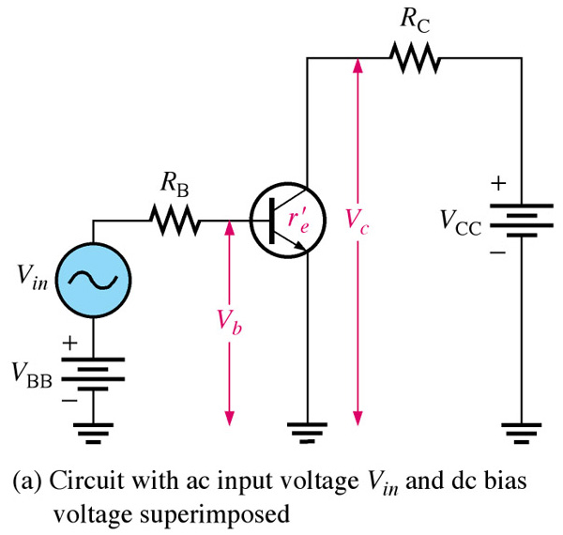
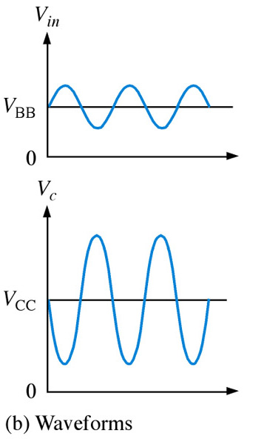
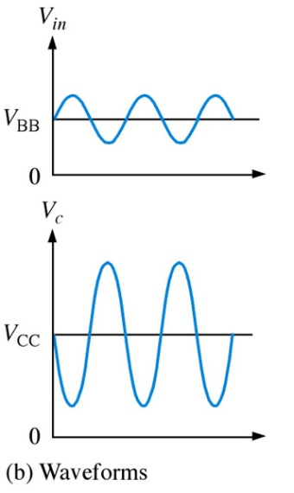
Common-Emitter Amplifier Circuit
The common-emitter amplifier exhibits high voltage and current gain.
The output signal is 180º out of phase with the input.
Notes:
Fig. 6-8 ce amp

Slide 51
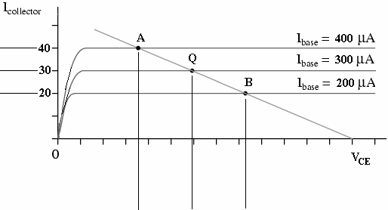

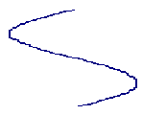
Characteristic Curves with DC Load Line
Active Region:
Q-point, and current gain.
Point A corresponds to the positive peak.
Point B corresponds to the negative peak.

Slide 52


Signals: Analog vs. Digital
f(t)
g(t)
t
t
Analog: Analogous to some physical
quantity
Digital: can be represented using
a finite number of digits

Slide 53
  Transistor Biasing Circuits:
Biasing - Circuit Configurations:
  1. Fixed-Biased Transistor Circuits.
  2. Fixed-Biased with Emitter Resistance Circuits.
  3. Voltage-Divider-Biased Transistor Circuits.

Slide 54
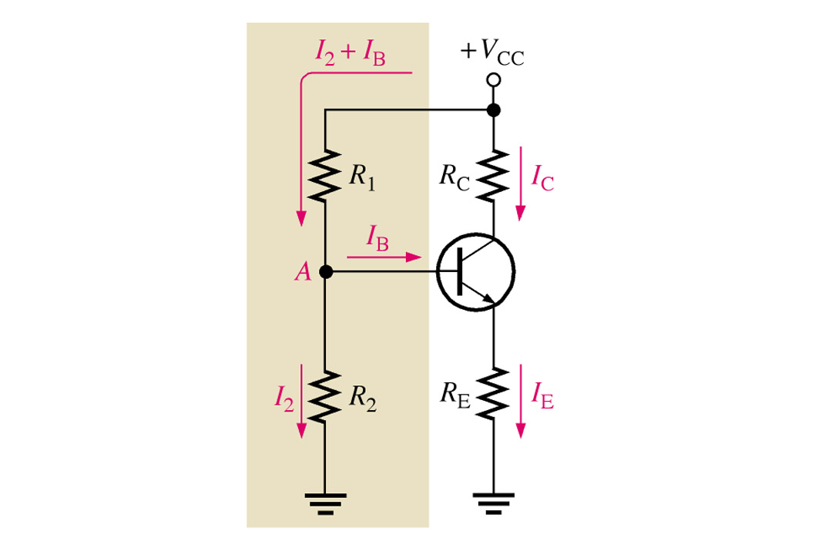
3. Voltage-Divider-Bias Circuits:
Voltage-divider biasing circuit is the most widely used type of transistor biasing circuit.
Only one power supply is needed.
and voltage-divider bias is more stable (β independent) than other bias types.
Notes:
Fig 5-9 Voltage-Div. Bias

Slide 55
Summary of Semiconductor Devices
MOSFETs
D
G
B
S

Slide 56
MOSFET Transistor
Metal-oxide-semiconductor.
Also called MOSFET (MOS Field Effect Transistor)
Simple, symmetric structure.
Switch, good for digital, logic circuit.
Most commonly used devices in the semiconductor industry.

Slide 57
MOSFET Transistor
MOSFETs dominated IC industry since 1980s
Three kinds IC chips microprocessor, memory, and ASIC
Advantages of CMOS: low power, high temperature stability, high noise immunity, and clocking simplicity

Slide 58
MOSFET-Basic Circuits
NMOS
PMOS
CMOS

Slide 59
MOSFET-Structure
Gate: metal or heavily doped poly-Si
G
Body
B
Source
S
Drain
D
(bulk or
substrate)
I_{G}=0
y
I_{D}=I_{S}
I_{S}
Metal
oxide
p
n+
n+
x
W
L

Slide 60
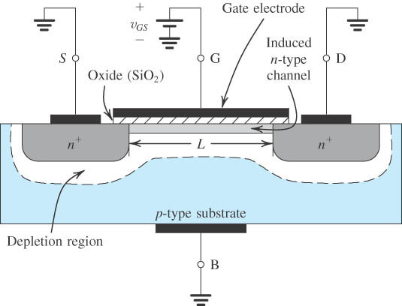
An Induced N-Channel
Figure 4.2: The Enhancement-Type NMOSFET Transistor . A positive voltage applied to the gate. An n channel is induced at the top of the substrate beneath the gate.

Slide 61
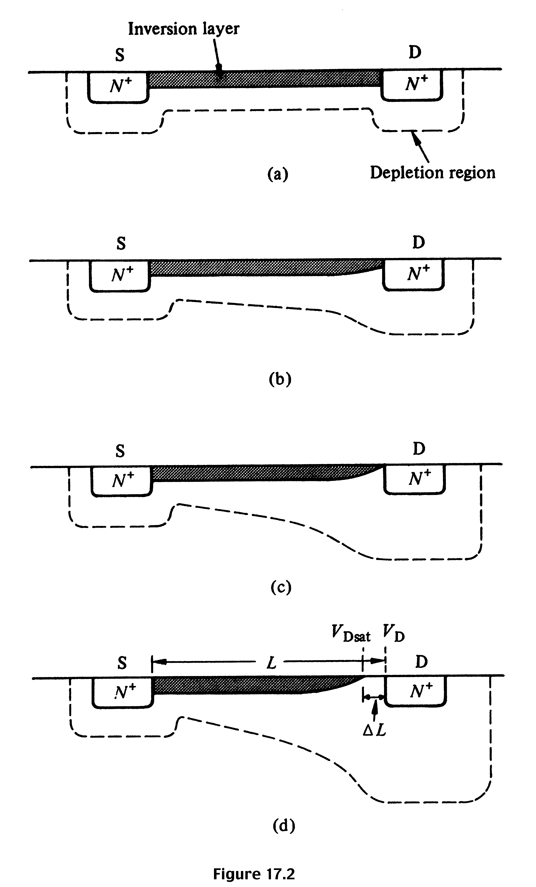
Summary: NMOS Operation
V_{G} > V_{T} ; V_{DS} ≈ 0
I_{D} increases with V_{DS}
V_{G} > V_{T}; V_{DS} small, > 0
I_{D} increases with V_{DS} , but rate of increase decreases.
V_{G} > V_{T}; V_{DS} ≈ pinch-off
I_{D} reaches a saturation value, I_{D,sat} The V_{DS} value is called V_{DS,sat}
V_{G} > V_{T}; V_{DS} > V_{DS,sat}
I_{D} does not increase further, saturation region.

Slide 62
NMOSFET
Faster than PMOS
Used for digital logic devices in 1970s and 1980s
Electronic watches and hand-hold calculators
Replaced by CMOS after the 1980s

Slide 63
CMOSFET
Most commonly used circuit in IC chip since 1980s
Low power consumption
High temperature stability
High noise immunity
Symmetric design

Slide 64
Summary
As the microelectronics develops, more and more functions are fulfilled by IC chips.
The discrete devices and circuits, however, are still very important not only for practical applications, but also for better understanding and design of LSICs.
Quantitative calculation is sometimes complicated but not difficult.
As long as we know the parameter definitions clearly, results can be derived KCL, KVL, etc.

Slide 65

Thank You

