Slide 1

COMSATS Institute of Information Technology
Virtual campus
Islamabad
Dr. Nasim Zafar
Electronics 1 - EEE 231
Fall Semester – 2012

Slide 2
Lecture No. 31
Biasing in MOS Amplifier Circuits
and
Single-Stage MOS Amplifiers

Slide 3
Biasing in MOS Amplifier Circuits
Lecture No. 31
Contents:
Voltage biasing scheme
  Biasing by fixing voltage
  Biasing with feedback resistor
Current-source biasing scheme

Slide 4
Lecture No. 31
Biasing in MOS Amplifier Circuits
Reference:
Chapter 4.5
Microelectronic Circuits
Adel S. Sedra and Kenneth C. Smith.

Slide 5
Introduction
An essential step in the design of a MOSFET amplifier circuit is the establishment of an appropriate dc operating point for the transistor.
This is the step known as biasing or bias design.

Slide 6
Biasing by Fixing V_{GS}
The most straightforward approach to biasing a MOSFET is to fix its gate-to-source voltage V_{GS} to the value required to provide the desired I_{D}.
I_{D} = ¹/₂k_{n}’(W/L)(V_{GS}-V_{T})² (4.20)
However, Biasing by fixing V_{GS} is not a good technique.

Slide 7
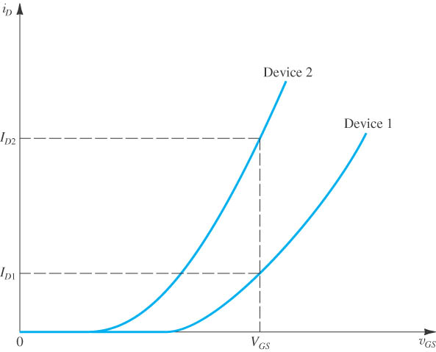
Disadvantages of fixed biasing
The use of fixed bias (constant V_{GS}) can result in a large variability in the value of I_{D}.
  Fixing biasing may result in large I_{D} variability due to deviation in device performance
Current becomes temperature dependent
Thus, Unsuitable biasing method

Slide 8
Biasing using a Fixed Voltage at the Gate and a Resistance in the Source
An excellent biasing technique for discrete MOSFET circuits consists of fixing the dc voltage at the gate, V_{G}, and connecting a resistance in the source lead, as shown in Fig.4.30(a). For this circuit we
V_{G}=V_{GS}+R_{S} I_{D} (4.46)
Resistor Rs provides negative feedback, which acts to stabilize the value of the bias current I_{D}.
Rs gives it the name degeneration resistance.

Slide 9
Biasing using a Fixed Voltage at the Gate , V_{G} and a Resistance in the Source
Figure 4.30(b) provides a graphical illustration of the effectiveness of this biasing scheme.
The intersection of this straight line with the i_{D}-V_{GS} characteristic curve, provides the coordinates (I_{D} and V_{GS}), of the bias point.
compared to the case of fixed V_{GS}, here the variability in I_{D} is much smaller.
Two possible practical discrete implementations of this bias scheme are shown in Fig. 4.30(c) and (e).

Slide 10
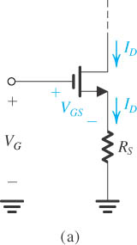
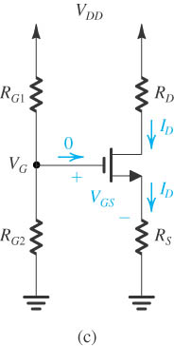
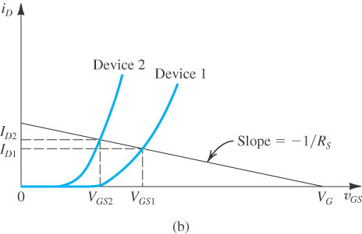
Biasing using a fixed voltage at the gate, and a resistance in the source
Figure 4.30:
(a) The basic arrangement;
(b) Reduced variability in I_{D};
(c) Practical implementation using a single supply;

Slide 11
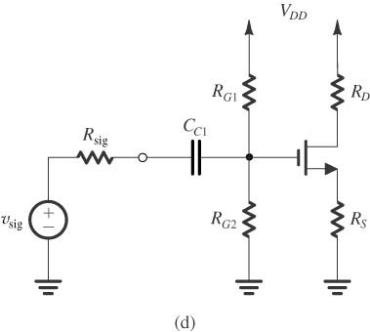
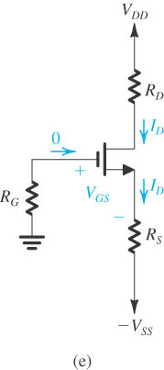
Biasing using a fixed voltage at the gate, and a resistance in the source
(d) Coupling of a signal source to the gate using a capacitor C_{C1}
(e) practical implementation using two supplies.

Slide 12
Biasing Using a Drain-to-Gate Feedback Resistor
In Fig. 4.32, the large feedback resistance R_{G}(usually in the MΩ range) forces the dc voltage at the gate to be equal to that at the drain (because I_{G}=0). Thus we can write:
V_{GS} = V_{DS} = V_{DD}-R_{D} I_{D}
V_{DD} = V_{GS} + R_{D} I_{D} (4.49)
which is identical in form to Eq. (4.46).
V_{G}=V_{GS}+R_{S} I_{D} (4.46)

Slide 13
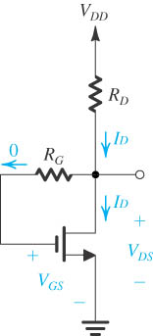
Biasing the MOSFET using a large Drain-to-Gate Feedback Resistance, R_{G}
Figure 4.32: Biasing the MOSFET using a large drain-to-gate feedback resistance, R_{G}.

Slide 14
Biasing the MOSFET using a constant-Current Source I.
The most effective scheme for biasing a MOSFET amplifier is that using a constant-current source.
Figure 4.33(a) shows such an arrangement applied to a discrete MOSFET.
A circuit for implementing the constant-current source I is shown in Fig. 4.33(b).
This circuit, known as a current mirror, is very popular in the design of IC MOS amplifiers.

Slide 15
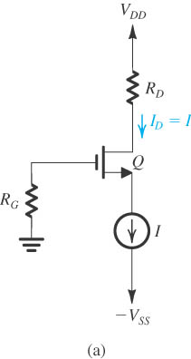
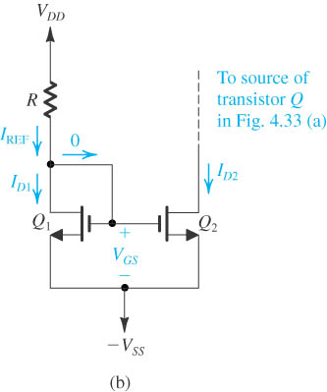
Biasing the MOSFET using a constant-Current Source I.
Figure 4.33
Biasing the MOSFET using a constant-current source I.
Implementation of the constant-current source I using a current mirror.

Slide 16
Single-Stage MOS Amplifiers
Lecture No. 31
Contents:
Basic structure
Characteristic parameters
Three configurations:
  Common-source configuration
  Common-drain configuration
  Common-gate configuration

Slide 17
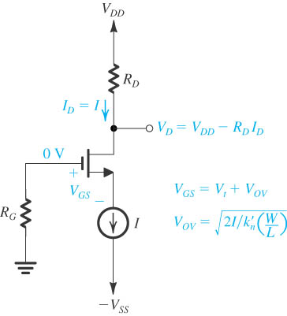
Basic Structure of the Circuit
Basic structure of the circuit used to realize single-stage discrete-circuit MOS amplifier configurations.

Slide 18
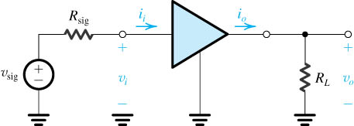
Characteristic Parameters of Amplifier
This is the two-port network of amplifier.
Voltage signal source.
Output signal is obtained from the load resistor.

Slide 19
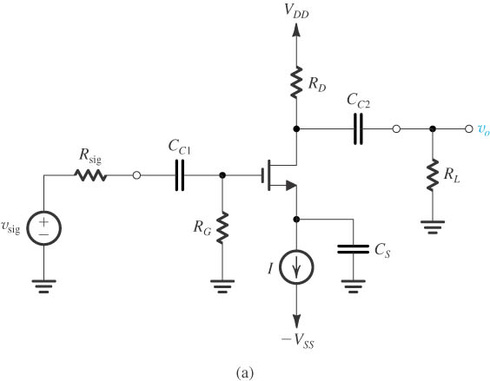
The Common-Source (CS) Amplifier
Common-source amplifier based on the circuit of basic structure.
Biasing with constant-current source.
C_{C1} And C_{C2} are coupling capacitors.
C_{S} is the bypass capacitor.

Slide 20
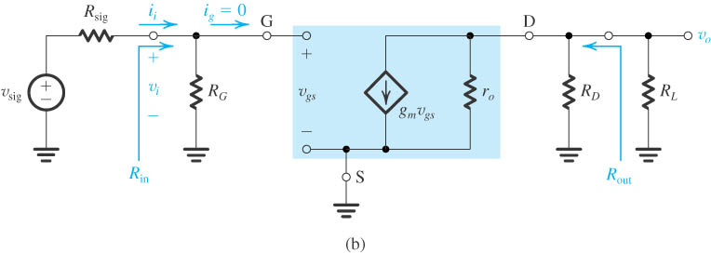
Equivalent Circuit of the CS Amplifier

Slide 21
Summary of CS Amplifier
Very high input resistance
Moderately high voltage gain
Relatively high output resistance

Slide 22
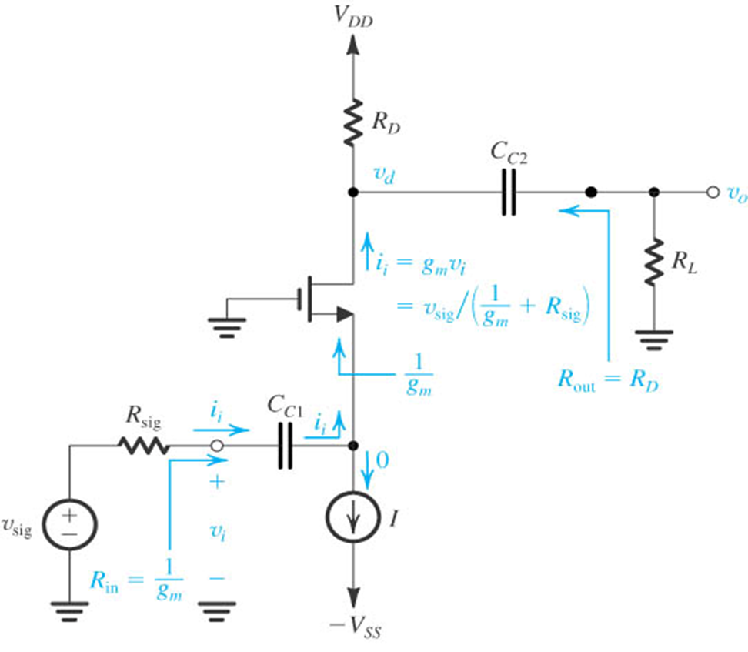
The Common-Gate Amplifier Circuit
Biasing with constant current source I
Input signal v_{sig} is applied to the source
Output is taken at the drain
Gate is signal grounded
C_{C1} and C_{C2} are coupling capacitors

Slide 23
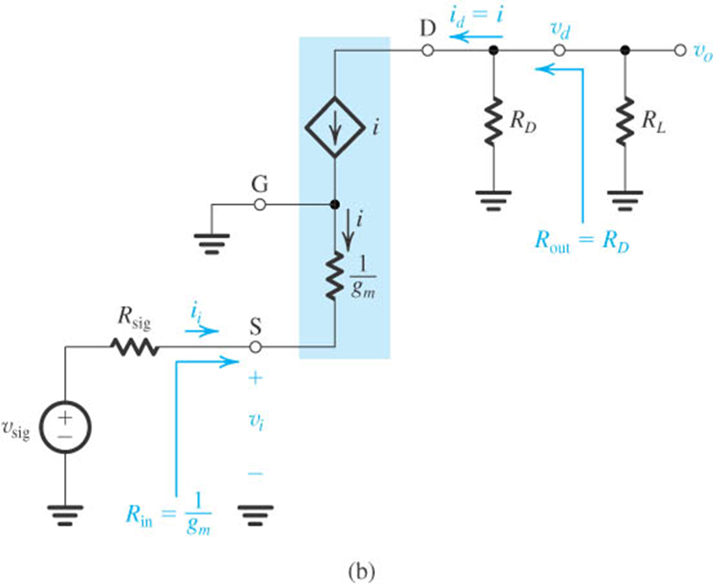
The Common-Gate Amplifier
A small-signal equivalent circuit of the amplifier in fig. (a).
T model is used in preference to the π model
Neglecting r_{o}

Slide 24
Summary of CG Amplifier
Noninverting amplifier.
Low input resistance.
Has nearly identical voltage gain of CS amplifier, but the overall voltage gain is smaller by the factor (1+g_{m}R_{sig}）.
Relatively high output resistance.
Current follower.
Superior high-frequency performance.

Slide 25
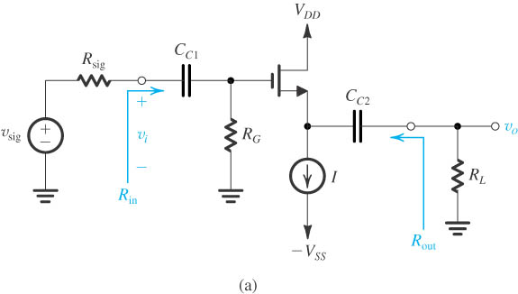
The Common-Drain or Source-Follower Amplifier
Biasing with current source
Input signal is applied to gate, output signal is taken at the source.

Slide 26
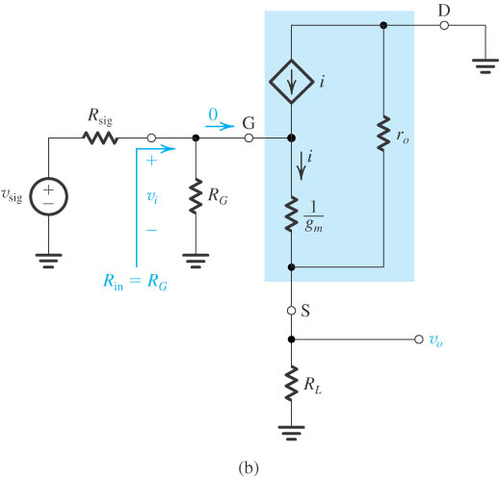
The Common-Drain or Source-Follower Amplifier
Small-signal equivalent-circuit model
T model makes analysis simpler
Drain is signal grounded

Slide 27
Summary of CD or Source-Follow Amplifier
Very high input resistance
Voltage gain is less than but close to unity
Relatively low output resistance
Voltage buffer amplifier
Power amplifier

Slide 28
Advancements and Limitations of the MOSFET
The explosion of digital technologies has pushed the advancement of MOSFET technologies faster than any other Si transistor. This has happened due to the MOSFET being the prime building block of CMOS digital logic circuits.
CMOS circuits are advantageous because they allow virtually no current to pass through and thus consume very little power. This is done by wiring every PMOSFET with a NMOSFET in a way such that whenever one is conducting, the other is not. This not only conserves energy but also helps to reduce heat dissipation which otherwise would cause the circuit to fail.

Slide 29
Advancements and Limitations of the MOSFET
Overheating is very much a concern when considering today's integrated circuits contain millions of transistors in a relatively small space.
The MOSFET has become increasingly smaller in the last couple decades, today's MOSFETS used in ICs have a channel length of about 100 nanometres. Smaller MOSFETs result in more transistors per chip, thus either increasing the processing power per chip or reducing the cost per chip.

Slide 30
Advancements and Limitations of the MOSFET
Recently, the small size of MOSFETs has created operational problems as producing such tiny transistors is an enormous challenge, often limited by advances in semiconductor device fabrication. Also due the small size, the amount of voltage that can be applied has to be reduced to keep the device stable.

Slide 31
Advancements and Limitations of the MOSFET
Due to these reduced threshold voltages, when the transistor is turned off it will still conduct a small amount of current. This is due to a weak inversion layer which consumes power when the transistor is off, called the sub threshold leakage. Previously this was a non-issue with larger transistors, however in the smaller devices of today, the sub threshold leakage can result in 50% of the total power consumption of the transistor.

