Slide 1

COMSATS Institute of Information Technology
Virtual campus
Islamabad
Dr. Nasim Zafar
Electronics 1 - EEE 231
Fall Semester – 2012

Slide 2
DC Analysis of MOSFET and
MOSFET as an Amplifier
Lecture No. 30
Contents:
MOSFET Circuits at DC
MOSFET as an Amplifier and as a Switch
Large –Signal Operation-The Transfer Characteristic
Graphical Derivation of the Transfer Characteristic
Operation as a Linear Amplifier
Operation as a Switch

Slide 3
Lecture No. 30
DC Analysis of MOSFET
Reference:
Chapter 4.3
Microelectronic Circuits
Adel S. Sedra and Kenneth C. Smith.

Slide 4
MOSFET Circuit at DC
Assuming device operates in saturation thus i_{D} satisfies with i_{D}~v_{GS} equation.
According to biasing method, write voltage loop equation.
Combining above two equations and solve these equations.
Usually we can get two value of v_{GS}, only the one of two has physical meaning.

Slide 5
MOSFET Circuit at DC
5. Checking the value of v_{DS}
  if v_{DS}≥v_{GS}-V_{t}, the assuming is correct.
  if v_{DS}≤v_{GS}-V_{t}, the assuming is not correct.
  We shall use triode region equation to solve the problem again.

Slide 6
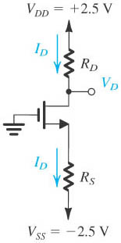
Example 4.2: of DC Analysis
The NMOS transistor is operating in the saturation region due to

Slide 7
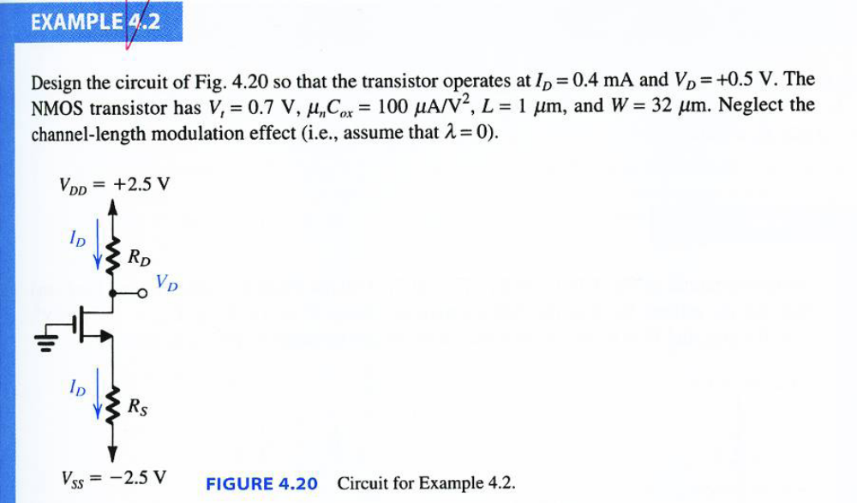
DC Analysis of MOSFET
Example 4.2

Slide 8
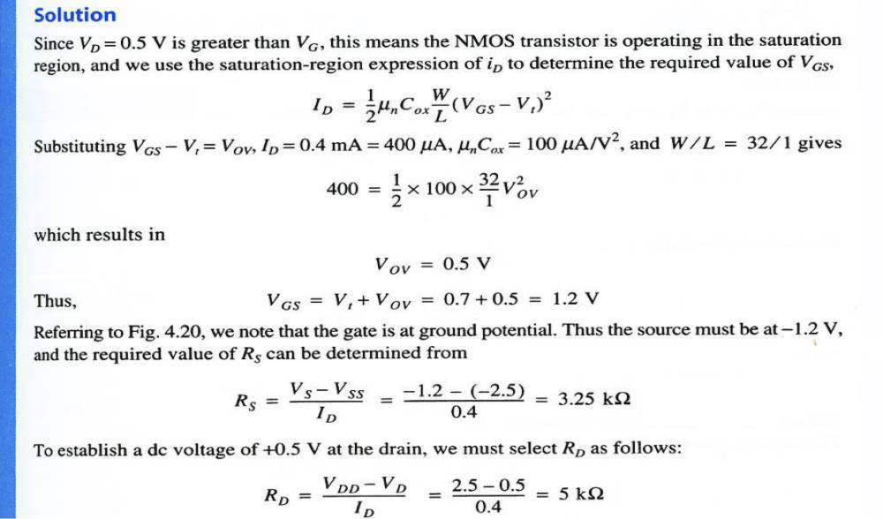
DC Analysis of MOSFET
Example 4.2

Slide 9
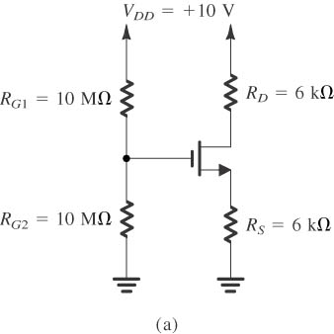
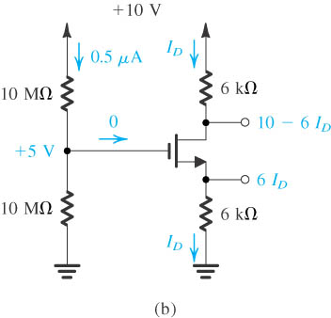
Example 4.5: of DC Analysis
Assuming the MOSFET operates in the saturation region
Checking the validity of the assumption
If not valid, solve the problem again for triode region

Slide 10
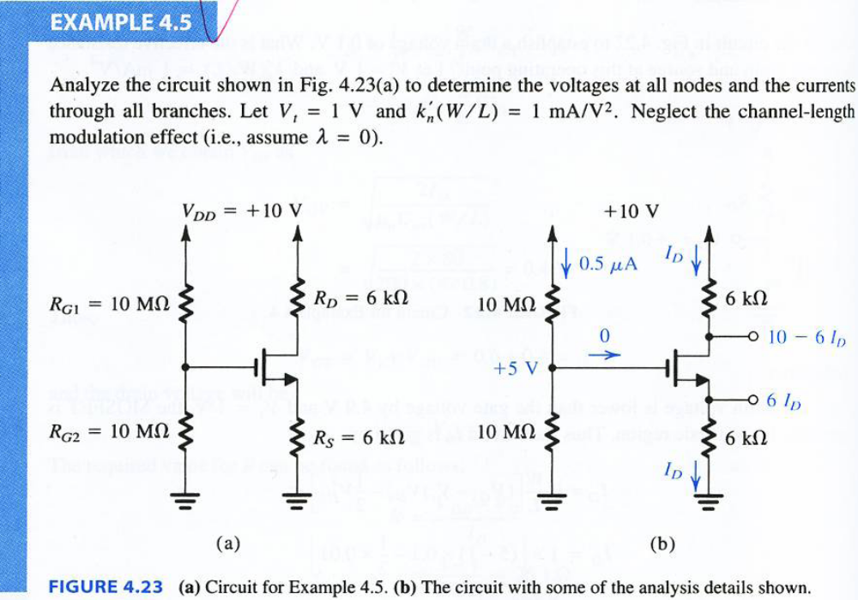
Example 4.5: of DC Analysis

Slide 11
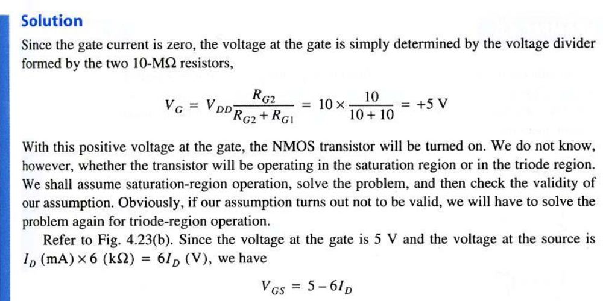
Example 4.5: of DC Analysis

Slide 12
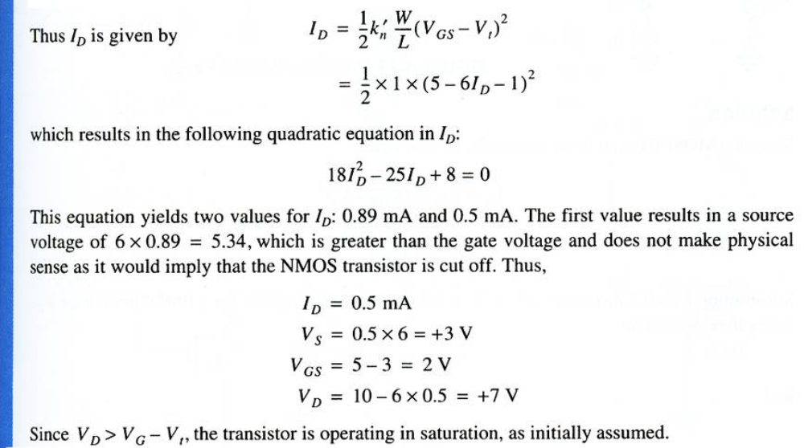
Example 4.5: of DC Analysis

Slide 13
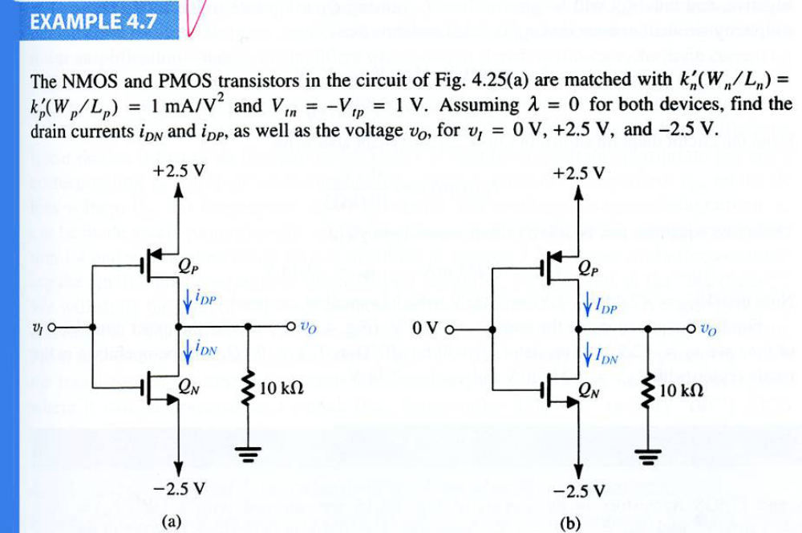
Example 4.7: of DC Analysis

Slide 14
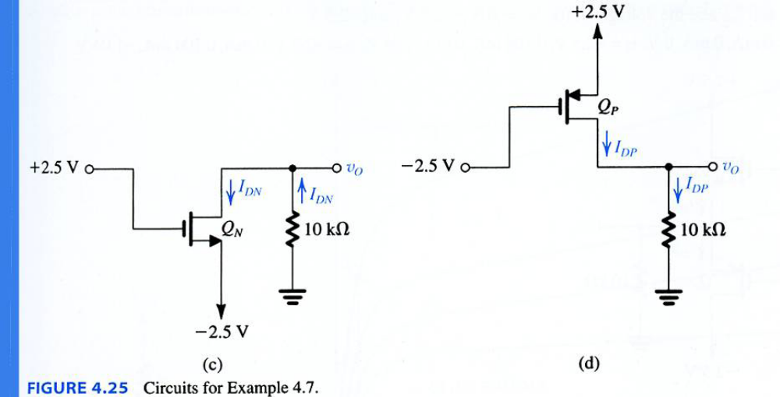
Example 4.7: of DC Analysis

Slide 15
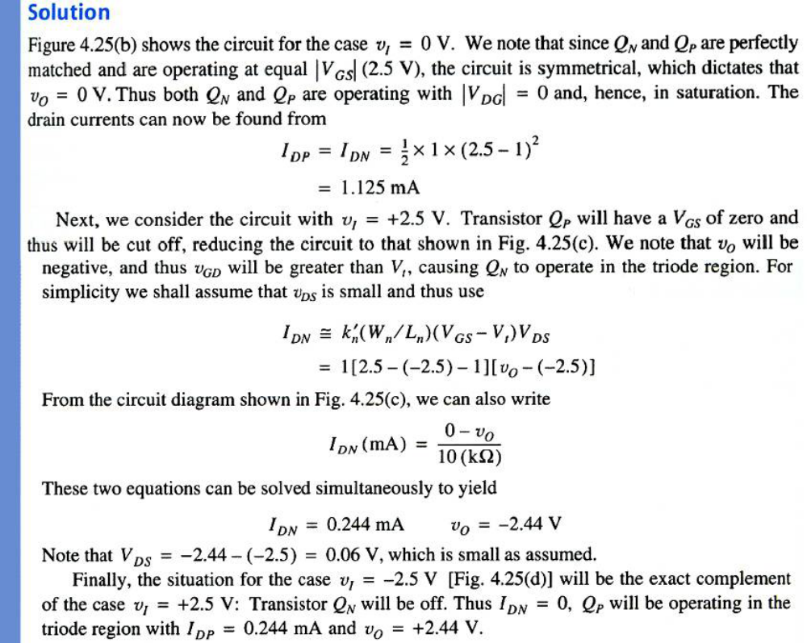

Slide 16
Lecture No. 30
MOSFET as an Amplifier
and as a Switch
Reference:
Chapter 4.4
Microelectronic Circuits
Adel S. Sedra and Kenneth C. Smith.

Slide 17
MOSFET as an Amplifier
Introduction
In this lecture we will study the use of the MOSFET for the design of amplifier circuits.
The basis for this important MOSFET application is that in the “saturation region”, the MOSFET acts as a voltage-controlled current source.
Changes in the gate voltage v_{GS} give rise to changes in drain current i_{D}.
Thus, the MOSFET operating in the saturation mode can be used to implement a “transconductance amplifier”.

Slide 18
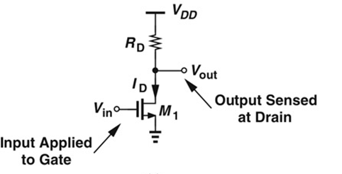
Transconductance
Analog applications:
How does i_{DS} respond to changes in V_{GS}?

Slide 19
Transconductance
For MOSFETs, transconductance is the change in the drain current divided by the small change in the gate-source voltage with a constant drain-source voltage. Typical values of g_{m} for a small-signal MOSFET transistor are 1 to 30 millisiemens.
The transconductance for the MOSFET can be expressed as:
    Gm = 2I_{D}/ V_{eff}.
where I_{D} is the DC drain current, and V_{eff} is the effective voltage, which is the difference between the bias point and the threshold voltage (i.e., V_{eff} := V_{GS} - V_{th}).

Slide 20
MOSFET as an Amplifier
Introduction (contd.)
In the Saturation region, the i_{D}-V_{DS} characteristics can be described by the following equation:
I_{D} = ¹/₂k_{n}’(W/L)(V_{GS}-V_{T})² (4.20)
However, since we are interested in linear amplification- that is, in amplifiers whose output signal (the drain current) is linearly related to their input signal (the gate voltage), we will have to find a way around the highly non-linear (square law) relationship of i_{D} to v_{GS}.

Slide 21
MOSFET as an Amplifier
Introduction (contd.)
The technique utilized to get a linear amplifier from a fundamentally non-linear device is to use a DC biasing for the MOSFET and to operate at a certain appropriate V_{GS} and a corresponding I_{D} and then superimposing the voltage signal, v_{gs}, to be amplified on the dc bias voltage V_{GS.}
This technique requires a small v_{gs .}
However, first, we will discuss the large signal operation of a MOSFET amplifier. We will do this by deriving the voltage transfer characteristic of a commonly used MOSFET amplifier circuit.
From the voltage transfer characteristic we will be able to see the region over which the transistor can be biased to operate as a small-signal amplifier.

Slide 22
MOSFET as an Amplifier and as a Switch
Large-Signal Operation-The Transfer Characteristics:
Figure 4.26(a): Shows the basic structure (skeleton) of the most commonly used MOSFET amplifier, the common-source (CS) circuit or ground-source.
Figure 4.26(b): Illustrates the graphical construction to determine the transfer characteristic of the amplifier circuit shown in (a).
Figure 4.26(c): Transfer characteristics showing the operation as an amplifier biased at point Q.

Slide 23
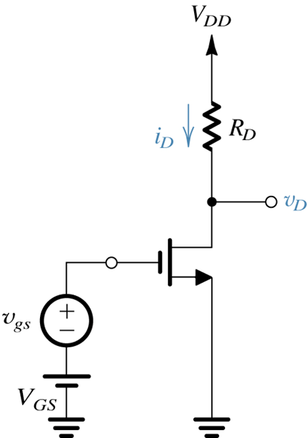

MOSFET as an Amplifier and as a Switch
Fig. 4.26 (a): Conceptual circuit for the operation of MOSFET as an amplifier.

Slide 24
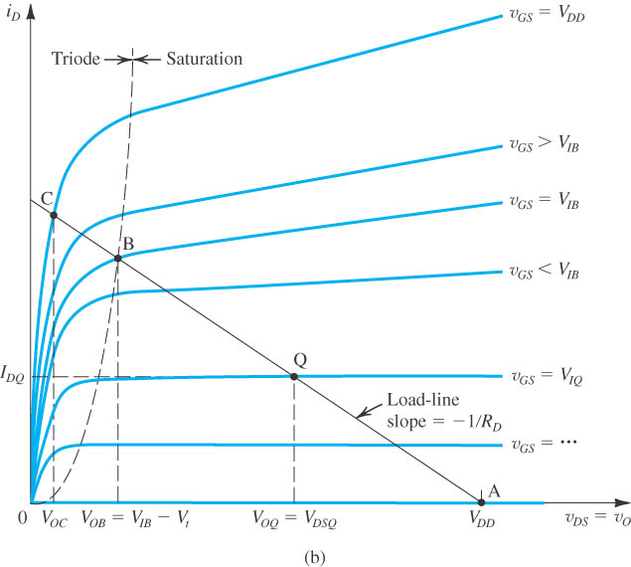
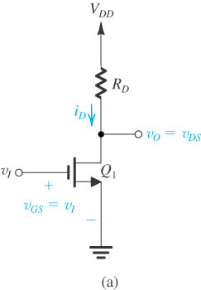
The MOSFET as an amplifier
Basic structure of the common-source amplifier
Fig. 4.26 (b): Graph determining the transfer characteristic of the amplifier

Slide 25
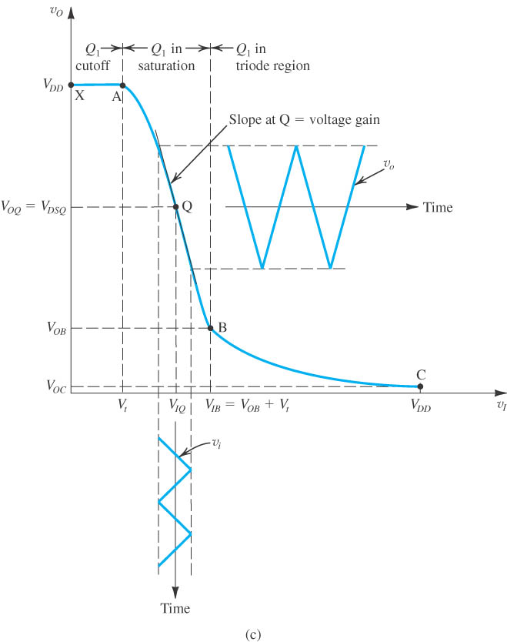
s an The MOSFET as an amplifier
Transfer characteristic showing operation as an amplifier biased at point Q.
Three segments:
  XA---the cutoff region segment
  AQB---the saturation region segment
  BC---the triode region segment
v_{o}
Time
v_{I}
Fig. 4.26 (c):
v_{i}
Time

Slide 26
Saturation region
Biased voltage:
The channel is pinched off.
Drain current is controlled only by v_{GS}
Drain current is independent of v_{DS} and behaves as an ideal current source.

Slide 27
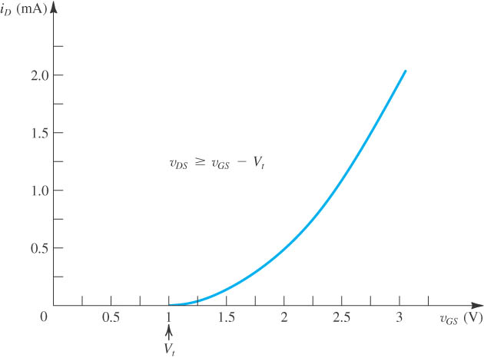
Saturation region
The i_{D}–v_{GS} characteristic for an enhancement-type NMOS transistor in saturation
V_{t} = 1 V,
k’_{n} W/L = 1.0 mA/V²
Square law of i_{D}–v_{GS} characteristic curve.

Slide 28

Recap : Transfer Function

Slide 29
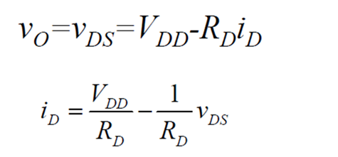
Large-Signal Operation-
The Transfer Characteristics
The basic control action of the MOSFET is that changes in v_{GS} (here, changes in v_{I} as v_{GS} = v_{I}) give rise to changes in i_{D}, we are using a resistor R_{D} to obtain an output voltage vo .
(4.37)

Slide 30
Graphical Derivation of the
Transfer Characteristics
Figure 4.26(b) shows a sketch of MOSFETs i_{D}-v_{DS} characteristic curves superimposed on which is a straight line representing the i_{D}-v_{DS} relationship of Eq.(4.37). The straight line in Fig.4.26(b) is known as the load line.
The graphical construction of Figure 4.26(b) can now be used to determine vo (v_{DS})for each given value of v_{I} (v_{GS}=v_{I} ).
For any given value of vI, we locate the corresponding i_{D}-v_{DS} curve and find vo from the point of intersection of this curve with the load line.

Slide 31
The MOSFET as an amplifier
Basic structure of the common-source amplifier
Fig. 4.26 (b): Graph determining the transfer characteristic of the amplifier

Slide 32
Graphical Derivation of the
Transfer Characteristics
Qualitatively, The circuit works as follows:
Since v_{GS}=v_{I}, we see that for v_{I}<Vt, the transistor will be cut off, i_{D} will be zero, and vo=v_{GS}=V_{DD}. Operation will be at the point labeled A.
As v_{I} exceeds Vt, the transistor turns on, i_{D} increases, and vo decreases. Since vo will initially be high, the transistor will be operating in the saturation region. This corresponds to points along the segment of the load line from A to B.
We can determine a point of operation, called Q-point.
It is obtained for V_{GS}=V_{IQ} and has the coordinates V_{OQ}=V_{DSQ} and I_{DQ.}

Slide 33
Graphical Derivation of the
Transfer Characteristics
Saturation-region operation continues until Vo decreases to the point that it is below v_{i} by Vt volts.
At this point v_{DS}=v_{GS}-Vt, and the MOSEFT enters its triode region of operation. This is indicate in Fig.4.26(b) by point B.
Point B is defined by:
V_{OB}=V_{IB}-Vt
For V_{I}> V_{IB}, the transistor is driven deeper into the triode region. The output voltage decreases slowly towards zero.
Point C is obtained for v_{I}= V_{DD}

Slide 34
Operation as a Linear Amplifier
To operate the MOSFET as an amplifier we make use of the saturation-mode segment of the transfer curve.
The device is biased at a point located somewhere close to the middle of the curve; point Q, called the quiescent point.
The voltage signal to be amplified vi is then superimposed on the dc voltage V_{IQ} as shown in the next slide, Fig.4.26(c).

Slide 35
Transfer Characteristic
Fig. 4.26 (c): Transfer characteristic showing operation as an amplifier biased at point Q.
Notes:
sedr42021_0426c.jpg

Slide 36
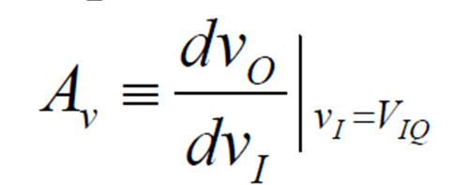
Operation as a Linear Amplifier
The amplifier will be very linear, and v_{o} will have the same waveform as v_{i} except that it will be larger by a factor equal to the voltage gain of the amplifier at Q:
The voltage gain is equal to the slope of the transfer curve at the bias point Q.
Observe that the slope is negative, and thus the basic CS amplifier is inverting.

Slide 37
MOSFET Operation as a Switch
When MOSFET is used as a switch, it is operated at the extreme points of the transfer curve (Slide 35).
Specifically, the device is turned off by keeping v_{I}< Vt resulting in operation somewhere on the segment XA with vo=V_{DD}.
The switch is turned on by applying a voltage close to V_{DD}, resulting in operation close to point C with vo very small (at C, vo=Voc).
The common-source MOS circuit can be used as a logic inverter with the “low” voltage level close to 0 V and the “high” level close to V_{DD}.

