Slide 1

COMSATS Institute of Information Technology
Virtual campus
Islamabad
Dr. Nasim Zafar
Electronics 1
EEE 231 – BS Electrical Engineering
Fall Semester – 2012

Slide 2
Generation and Recombination
Lecture No: 3
      Generation
and
Recombination

Slide 3
Generation- Processes:
  Thermal Generation/excitation.
  Optical Generation/excitation.
  Particle Bombardment and other External Sources

Slide 4
Equilibrium and Generation/Recombination:
So far, we have discussed the charge distributions in thermal equilibrium: The end result was np = n_{i}²
When the system is perturbed, the system tries to restore
itself towards equilibrium through recombination-generation.
• We will calculate the steady-state rates.
This rate will be proportional to the deviation from
equilibrium, R = A(np-n_{i}²).

Slide 5
Generation and Recombination:
In semiconductors, carrier generation and recombination are processes by which “mobile” charge carriers (electrons and holes) are produced and eliminated.
Charge carrier generation and recombination processes are fundamental to the operation of many optoelectronic semiconductor devices, such as:
Photo Diodes
LEDs and Laser Diodes.
They are also critical to a full analysis of PN junctions devices such as Bipolar Junction Transistors et.

Slide 6
Generation and Recombination:
Generation = break up of covalent bonds to form electrons and holes; Electron-Hole Pair generation.
  Electron-Hole Pair generation requires energy in the following forms:
  Thermal Energy ( thermal generation/excitation)
  Optical (optical generation/excitation)
  or other external sources ( e.g. particle bombardment).
Recombination = formation of bonds by bringing together electron and holes
  Releases energy in thermal or optical form
  A recombination event requires 1 electron + 1 hole

Slide 7
Band Gap and Generation/Recombination:
The ease with which electrons in a semiconductor can be excited
from the valence band to the conduction band depends on the
band gap, and it is this energy gap that serves as an arbitrary dividing line
(≅ 5 eV) between the semiconductors and insulators.
In terms of covalent bonds, an electron moves by hopping to a neighboring bond. Because of the Pauli exclusion principle it has to be lifted into the higher anti-bonding state of that bond. In the picture of delocalized states, for example in one dimension - that is in a nanowire, for every energy there is a state with electrons flowing in one direction and one state for the electrons flowing in the other.

Slide 8
Generation and Recombination of electron-hole pairs
E(x)
conduction band
E_{C}
energy
-
-
E_{V}
+
+
energy
valence band
x

Slide 9
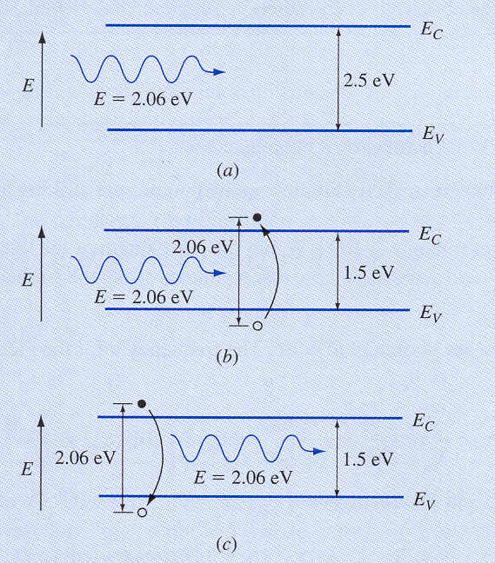


Slide 10
Recombination:
Recombination is the opposite of generation, which means this isn't a good thing for PV cells, leading to voltage and current loss.
Recombination is most common when impurities or defects are present in the crystal structure, and also at the surface of the semiconductor. In the latter case energy levels may be introduced inside the energy gap, which encourages electrons to fall back into the valence band and recombine with holes.
In the recombination process energy is released in one of the following ways:
Non-radiative recombination - phonons, lattice vibrations
Radiative recombination - photons, light or EM-waves
Auger recombination - which is releasing kinetic energy to another free carrier

Slide 11
Recombination:
The non-radiative recombination is due to the imperfect material (impurities or crystal lattice defects).
Radiative and Auger recombination, these we call unavoidable processes. These two are recombination, due to essential physical processes and release energy larger than the band gap.

Slide 12
The transition that involves phonons without producing photons are called nonradiative (radiationless) transitions.
These transitions are observed in an indirect band gap ssemiconductors and result in inefficient photon emission.
So in order to have efficient LED’s and LASER’s, one should choose materials having direct band gaps such as compound s/c’s of GaAs, AlGaAs, etc…

Slide 13
Direct Band-to-Band Recombination
hν
hν
Energy Band Diagram
Applications: Lasers, LEDs.

Slide 14
Direct Band-to-Band Recombination
When an electron from the CB recombines with a hole in the VB, a photon is emitted.
The energy of the photon will be of
the order of Eg.
If this happens in a direct band-gap semiconductor, it forms the basis for LED’s and LASERS.
Conduction Band
e⁻
photon
+
Valance Band

Slide 15
For an indirect-band gap material; the minimum of the CB and maximum of the VB lie at different k-values.
When an e⁻ and hole recombine in an indirect-band gap s/c, phonons must be involved to conserve momentum.
Indirect-band gap s/c’s (e.g. Si and Ge)
E
CB
Phonon
e⁻
Atoms vibrate about their mean position at a finite temperature.These vibrations produce vibrational waves inside the crystal.
Phonons are the quanta of these vibrational waves. Phonons travel with a velocity of sound .
Their wavelength is determined by the crystal lattice constant. Phonons can only exist inside the crystal.
Eg
k
+
VB

Slide 16
Direct and indirect-band gap materials :
Direct-band gap s/c’s (e.g. GaAs, InP)
E
For a direct-band gap material, the minimum of the conduction band and maximum of the valance band lies at the same momentum, k, values.
When an electron sitting at the bottom of the CB recombines with a hole sitting at the top of the VB, there will be no change in momentum values.
Energy is conserved by means of emitting a photon, such transitions are called as radiative transitions.
CB
e⁻
k
+
VB

Slide 17
Generation Processes
Band-to-Band
R-G Center
Impact Ionization

Slide 18
Recombination Processes
Direct
R-G Center
Auger
Recombination in Si is primarily via R-G centers

Slide 19
CALCULATION
For GaAs, calculate a typical (band gap) photon energy and momentum , and compare this with a typical phonon energy and momentum that might be expected with this material.
photon
Phonon
E(phonon) = h = hv_{s} / λ
= hv_{s} / a0
λ (phonon) ~a0 = lattice constant =5.65x10⁻¹⁰ m
Vs= 5x10³ m/sec ( velocity of sound)
E(phonon) = hv_{s} / a₀ =0.037 eV
P(phonon)= h / λ = h / a₀ = 1.17x10⁻²⁴ kg-m/sec
E(photon) = Eg(GaAs) = 1.43 ev
E(photon) = h = hc / λ
c= 3x10⁸ m/sec
P = h / λ h=6.63x10⁻³⁴ J-sec
λ (photon)= 1.24 / 1.43 = 0.88 μm
P(photon) = h / λ = 7.53 x 10⁻²⁸ kg-m/sec

Slide 20
Photon energy = 1.43 eV
Phonon energy = 37 meV
Photon momentum = 7.53 x 10⁻²⁸ kg-m/sec
Phonon momentum = 1.17 x 10⁻²⁴ kg-m/sec
Photons carry large energies but negligible amount of momentum.
On the other hand, phonons carry very little energy but significant
amount of momentum.

Slide 21
Photo Generation:
Another important generation process in device operation is
photo generation
If the photon energy (hν) is greater than the band gap energy,
then the light will be absorbed thereby creating electron-hole pairs
hν
E_{g}
Notes:
Photo-Generation

Slide 22
Light Absorption and Transmittance
Consider a slab of semiconductor of thickness l.
l
hν
hν
I₀
I_{t}
semiconductor
x
0 l
I_{t} = I₀ exp (−αl )
where I₀ is light intensity at x = 0 and I_{t} is light intensity at x = l.

Slide 23
Photo-generation
The intensity of monochromatic light that passes through a material is given by: I = I₀ exp(− α x) where I₀ is the light intensity just inside the material at
x = 0, and α is the absorption coefficient. Note that α is material dependent
and is a strong function of λ.
Since photo-generation creates electrons and holes in pairs
and each photon creates one e-h pair, we can write:
where G_{L0} is the photo-generation rate [# / (cm³ s)] at x = 0
Question: What happens if the energy of photons is less than
the band gap energy?

Slide 24
Some Calculations!!
Thermal Energy
Thermal energy = k x T = 1.38 x 10⁻²³ J/K x 300 K =25 meV
Although the thermal energy at room temperature, RT, is very small,
i.e. 25 meV, a few electrons can be promoted to the Cconduction Band.
Electrons can be promoted to the CB by means of thermal energy.
Excitation rate = constant x exp(-Eg / kT)
Excitation rate is a strong function of temperature.

Slide 25
Electromagnetic Radiation:
h = 6.62 x 10⁻³⁴ J-s
c = 3 x 10⁸ m/s
1 eV=1.6x10⁻¹⁹ J
Near
infrared
To excite electrons from VB to CB Silicon , the wavelength of the photons must 1.1 μm or less

Slide 26
Summary
Generation and recombination (R-G) processes affect carrier concentrations as a function of time, and thereby current flow
  Generation rate is enhanced by deep (near midgap) states associated with defects or impurities, and also by high electric field
  Recombination in Si is primarily via R-G centers
The characteristic constant for (indirect) R-G is the minority carrier lifetime:
Generally, the net recombination rate is proportional to

