Slide 1

COMSATS Institute of Information Technology
Virtual campus
Islamabad
Dr. Nasim Zafar
Electronics 1 - EEE 231
Fall Semester – 2012

Slide 2
Current -Voltage Characteristics
I-V Characteristics
Lecture No. 29
Contents:
Qualitative theory of operation
Quantitative I_{D}-versus-V_{DS} characteristics
Large-signal equivalent circuits.

Slide 3
Lecture No. 29
Current-Voltage Characteristics
Reference:
Chapter-4.2
Microelectronic Circuits
Adel S. Sedra and Kenneth C. Smith.

Slide 4
Circuit Symbol (NMOS)
Enhancement-Type:
D
I_{D}= I_{S}
G
B
I_{G}= 0
G-Gate
D-Drain
S-Source
B-Substrate or Body
I_{S}
S

Slide 5
Circuit Symbol (NMOS)
Enhancement-Type
The spacing between the two vertical lines that represent the gate and the channel, indicates the fact the gate electrode is insulated from the body of the device.
The drain is always positive relative to the source in an n-channel FET.

Slide 6
Qualitative Theory of Operation
Modes of MOSFET Operation

Slide 7
Modes of MOSFET Operation
MOSFET can be categorized into three modes of operation, depending on V_{GS}:
V_{GS} < Vt: The cut-off Mode
V_{GS} > Vt and V_{DS} < (V_{GS} − Vt): The Linear Region
V_{GS} > Vt and V_{DS} > V_{GS} − Vt: The Saturation Mode

Slide 8
MOSFET-Structure
Enhancement Type-NMOSFET
Gate: metal or heavily doped poly-Si
G
(bulk or
substrate)
Body
B
Source
S
I_{G}=0
Drain
D
y
I_{D}=I_{S}
I_{S}
metal
oxide
p
n+
n+
x
W
L

Slide 9
V_{GS}<0 n⁺p n⁺ Structure → I_{D} ~ 0
Gate
G
body
B
Source
S
Drain
D
-
+
V_{D}=V_{s}
n++
oxide
p
n+
n+
W
L

Slide 10
V_{GS} < Vt
The Cut-off Mode:
n⁺-depletion-n⁺ structure → I_{D} ~ 0
gate
G
body
B
source
S
drain
D
-
+
V_{D}=V_{s}
+++
n++
oxide
p
n+
n+
W
L

Slide 11
V_{GS} > V_{T}
The Linear Mode of Operation:
n⁺-n-n⁺ structure → inversion
gate
G
body
B
source
S
drain
D
-
+
V_{D}=V_{s}
V_{GS} > V_{T}
+++
+++
+++
n++
oxide
p
n+
- - - - -
n+
W
L

Slide 12
Quantitative I_{D}-versus-V_{DS} Relationships

Slide 13
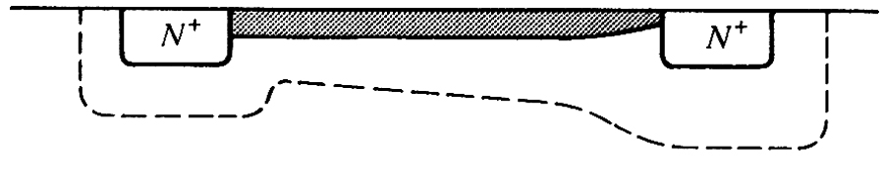
Quantitative I_{D}-V_{DS} Relationships
G (V_{G})
S
D (V_{DS})
Q_{N} = inversion layer charge
For V_{G} < V_{T}, Inversion layer charge is zero (Slide11).
For V_{G} > V_{T}, Q_{n}(y) = − Q_{G} = − C_{ox} (V_{G} − V− V_{T}) (Slide12)

Slide 14
Quantitative I_{D}-V_{DS} Relationships
In the MOSFET, the gate and the channel region form a parallel-plate capacitor for which the oxide layer serves as a dielectric.
If the capacitance per unit gate area is denoted C_{ox} and the thickness of the oxide layer is t_{ox}, then
C_{ox}=ε_{ox}/ t_{ox} (4.2)
Where ε_{ox} is the permittivity of the silicon oxide
ε= 3.9 ε₀= 3.9×8.854×10⁻¹²= 3.45×10⁻¹¹F/m

Slide 15
Quantitative I_{D}-V_{DS} Relationships
Current and Current Density:
In general, J_{n}= q μ_{n} n E , for the drift current
Here, current I_{D} is the same everywhere, but J_{n} (current density) can vary from position to position.
since
Let “φ ” be the potential along the channel

Slide 16
Quantitative I_{D}-V_{DS} Relationships
Current and Current Density:
To find current, we have to multiply the above with area, but J_{ny},
n, etc. are functions of x and z. Hence,
Integrating the above equation, and noting that I_{D} is constant, we get
Since we know expression for Q_{n}(y) in
terms of φ, we can integrate this to get I_{D}

Slide 17
Quantitative I_{D}-V_{DS} Relationships
Current and Current Density:
;
I_{D} will increase as V_{DS} is increased, but when V_{G} – V_{DS} = V_{T}, pinch-off of channel occurs, and current saturates when V_{DS} is increased further. This value of V_{DS} is called V_{DS,sat}. i.e., V_{DS,sat} = V_{G} – V_{T} and the current when V_{DS}= V_{DS,sat} is called I_{DS,sat}.
;
Here, C_{ox} is the oxide capacitance per unit area, C_{ox} = ε_{ox} / x_{ox}

Slide 18
Current-Voltage Characteristics

Slide 19
Current-Voltage Characteristics
I_{DS}
D
B
C
A
V_{DS}
Notes:
Analysis
MOSFET IV Characteristics {I_{DS}, V_{GS}, V_{DS}}
Simplifications
Source and bulk are grounded
Channel mobility is less than substrate mobility
Increased carrier scattering at surface!
Assume
Distinctive Regions of Characteristic
A: Low V_{DS}
B: Intermediate V_{DS}
C: Large V_{DS}
D: Very Large V_{DS}

Slide 20
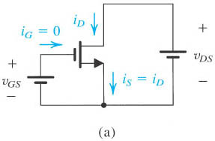
The i_{D}-V_{DS} Characteristics
Figure 4.11(a) shows an n-channel enhancement-type MOSFET with voltages V_{GS} and V_{DS} applied and with the normal directions of current flow indicated.
Fig. 4.11 (a): An n-channel enhancement type MOSFET

Slide 21
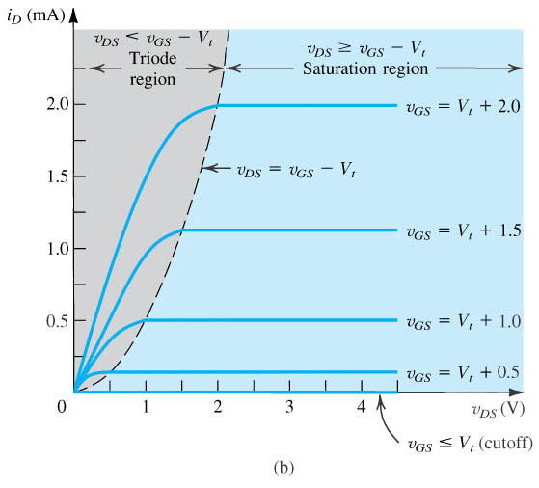
The i_{D}-V_{DS} Characteristics
Figure 4.11 (b) shows a typical set of i_{D}-V_{DS} Characteristics.
The i_{D}–v_{DS} Characteristics for a MOSFET Device with k’n(W/L) = 1.0 mA/V2.

Slide 22
The i_{D}-V_{DS} Characteristics
Current-Voltage characteristics of Fig. 4.11 (b) show that there are three distinct regions of operation:
The Cutoff Region,
The Triode Region, and
The Saturation Region.

Slide 23
The i_{D}-V_{DS} Characteristics
The iD–vDS Characteristics for a MOSFET Device.
Notes:
sedr42021_0411a.jpg

Slide 24
The i_{D}-V_{DS} Characteristics
Saturation Region:
The saturation region is used if the MOSFET is to operate as an amplifier.
Cutoff and Triode Regions:
For operation as a switch, the cut-off and triode regions are utilized.

Slide 25
Operation in the Triode Region
To operate the MOSFET in the triode region we must first induce a channel:
V_{GS}≧Vt (Induced channel)
V_{DS}＜V_{GS} – Vt (Continuous Channel)
The n-channel enhancement-type MOSFET operates in the triode region when V_{GS} is greater than Vt and the drain voltage is lower than the gate voltage by at least Vt volts.

Slide 26
The i_{D}-V_{DS} Characteristics
The Triode Mode:
In the triode region, the i_{D}-V_{DS} characteristics can be described by the following equation:
I_{D} = k_{n}’(W/L)[(V_{GS}-V_{T})V_{DS} - ¹/₂V_{DS}²] (4.11)
Where kn’= μ_{n}C_{ox} is the process transcondctance parameter, its value is determined by the fabrication technology

Slide 27
The i_{D}-V_{DS} Characteristics
The Triode Mode:
If V_{DS} is sufficiently small
I_{D} = k_{n}’(W/L)[(V_{GS}-V_{T})V_{DS}] (4.12)
This linear relationship represents the operation of the MOSFET as a linear resistance r_{DS} whose value is controlled by V_{GS.}

Slide 28
Operation in the Saturation Region
To operate the MOSFET in the Saturation Region we must first induce a channel.
v_{GS}≧ Vt (Induced channel) (4.16)
v_{GD}≦ Vt (Pinched-off channel) (4.17)
v_{DS}≧ v_{GS}-Vt (Pinched-off channel) (4.18)
The n-channel enhancement-type MOSFET operates in the saturation region when v_{GS} is greater than Vt and the drain voltage does not fall below the gate voltage by more than Vt.
The boundary between the triode region and the saturation region is characterized by
v_{DS}= v_{GS}-V_{t} (Boundary) (4.19)

Slide 29

The i_{D}-V_{DS} Relationship
Saturation Mode
In the Saturation region, the i_{D}-V_{DS} characteristics can be described by eq. (4. 20):

Slide 30
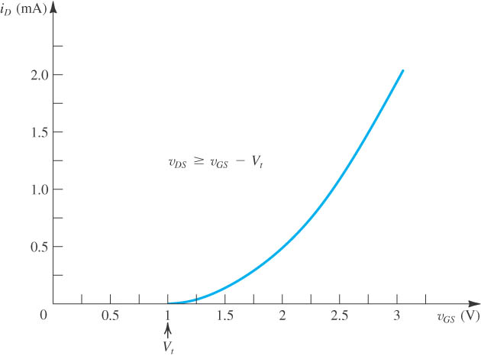
The iD–vGS characteristic
The i_{D}–v_{GS} Characteristic for an NMOS Transistor in Saturation

Slide 31
Summary: MOSFET I-V Equations
The Cut-off Region: V_{GS}< V_{T}
I_{D} = I_{S} = 0
The Triode Region: V_{GS}>V_{T} and V_{DS} < V_{GS}-V_{T}
I_{D} = k_{n}’(W/L)[(V_{GS}-V_{T})V_{DS} - ¹/₂V_{DS}²]
The Saturation Region: V_{GS}>V_{T} and V_{DS} > V_{GS}-V_{T}
I_{D} = ¹/₂k_{n}’(W/L)(V_{GS}-V_{T})²

Slide 32
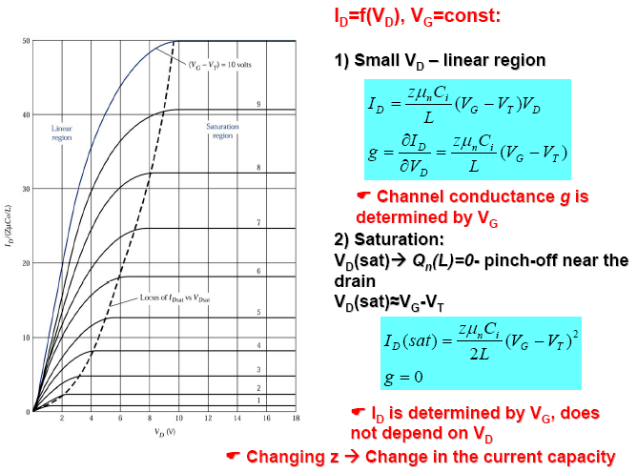
Output Characteristics of MOSFET

Slide 33
Large-Signal Equivalent-Circuit Model
In saturate mode, MOSFET provides a drain current whose value is independent of the drain-voltage V_{DS} and is determined by the gate-voltage V_{GS}
Thus, the Saturated MOSFET behaves as an ideal current source whose value is controlled by V_{GS} according to the nonlinear relationship in Eq. (4.20).
Figure 4.13 shows a circuit representation of this view of MOSFET operation in the saturation region. Note that this is a large-signal equivalent-circuit model.

Slide 34
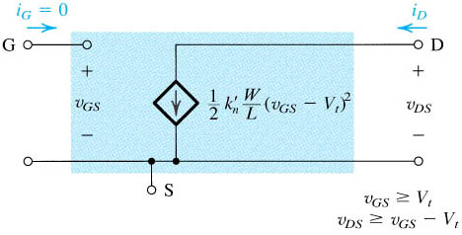
Large-signal equivalent-circuit model of an n-channel MOSFET operating in the saturation region.
Notes:
sedr42021_0413.jpg

Slide 35
MOSFET Summary

Slide 36
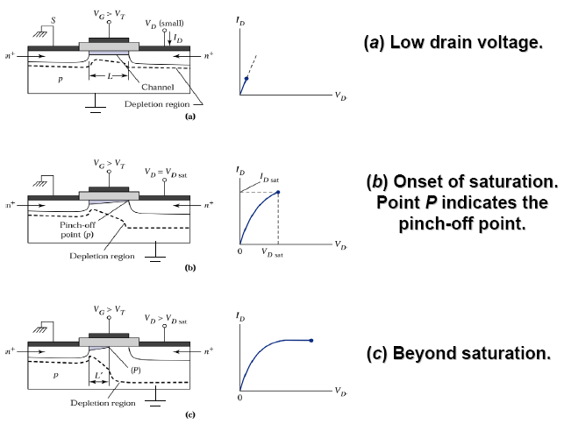
I-V Characteristics of MOSFET

Slide 37
MOSFET: Summary
A majority-carrier device: fast switching speed
Typical switching frequencies: tens and hundreds of kHz
On-resistance increases rapidly with rated blocking voltage
The device of choice for blocking voltages less than 500V
1000V devices are available, but are useful only at low power levels (100W)

Slide 38
MOSFET Summary
      Importance for LSI/VLSI
      Low fabrication cost
      Small size
      Low power consumption
    Applications
      Microprocessors
      Memories
      Power Devices
    Basic Properties
      Unipolar device
      Very high input impedance
      Capable of power gain
      3/4 terminal device, G, S, D, B
      Two possible channel types: n-channel; p-channel

Slide 39
MOSFET: Merits/ Demerits
Advantages
Voltage controlled device
Low gate losses
Parameters are less sensitive to junction temperature
No need for negative voltage during turnoff
Limitations
One disadvantage of MOSFET devices is their extreme sensitivity to electrostatic discharge (ESD) due to their insulated gate-source regions.
The SiO₂ insulating layer is extremely thin and can be easily punctured by an electrostatic discharge.
High-on-state drop as high as 10V
Lower off-state voltage capability
Unipolar voltage device.

