Slide 1

COMSATS Institute of Information Technology
Virtual campus
Islamabad
Dr. Nasim Zafar
Electronics 1 - EEE 231
Fall Semester – 2012

Slide 2
MOS Field-Effect Transistors
MOSFETs
Lecture No. 28
Contents:
Qualitative Operation of MOSFET
Quantitative Operation of MOSFET
  Operation with Applied Gate Voltage
  Applied Gate and Drain Voltages
  Modes of MOSFET Operation
The i_{D}–V_{DS} Characteristics

Slide 3
Lecture No. 28
MOS Field-Effect Transistors
MOSFETs
Reference:
Chapter-4.1
Microelectronic Circuits
Adel S. Sedra and Kenneth C. Smith.

Slide 4

MOSFET-Operation

Slide 5

N-Channel MOSFET Operation
Source
Gate
Drain
Gate Oxide
n⁺
L
p-Si
Gate Length
Bulk (Substrate)
Current flows through the Channel, between Source and Drain and is controlled by the Gate Voltage.
Notes:
Structure
p-type Silicon substrate
n⁺ ion implanted source and drain regions
High quality (thin) gate oxide (dry process)
Overlaps slightly source and drain regions
Thick field oxide
Protection + carries contact tracks
Channel
Region between source and drain and under gate.
Enhancement Mode MOSFET
n-channel with V_{G}>V_{T}
Semiconductors: Si; Ge; GaAs
Insulators: SiO₃; Si₃N₄; Al₂O₃
Most Important Combination: Si/SiO₂
Typical Dimensions
Long channel MOSFET
L>>W_{S}, W_{D}
L ~ 5μm
Oxide Thickness
50-100nm

Slide 6
N-Channel MOSFET Operation
S
G
D
Gate Oxide
n⁺
L
VGS - applied (positive)
Both VGS and VDS - applied (positive)
Gate Length
p-Si
(Substrate)
The applied positive gate voltage controls the current flow between source and drain.
Notes:
Structure
p-type Silicon substrate
n⁺ ion implanted source and drain regions
High quality (thin) gate oxide (dry process)
Overlaps slightly source and drain regions
Thick field oxide
Protection + carries contact tracks
Channel
Region between source and drain and under gate.
Enhancement Mode MOSFET
n-channel with V_{G}>V_{T}
Semiconductors: Si; Ge; GaAs
Insulators: SiO₃; Si₃N₄; Al₂O₃
Most Important Combination: Si/SiO₂
Typical Dimensions
Long channel MOSFET
L>>W_{S}, W_{D}
L ~ 5μm
Oxide Thickness
50-100nm

Slide 7
MOSFET-Operation
Operation with No Gate Voltage:
(1) V_{GS} = 0, and V_{S} = V_{D} =0
With no voltage applied to the gate, two back-to-back diodes exist in series between drain and source.
No current flows even if v_{DS} is applied. These back-to-back diodes prevent current conduction from drain to source.
In fact, the path between drain and source has a very high resistance (of the order of 10¹²Ω).

Slide 8
MOSFET-Operation (contd.)
Operation with Applied Gate Voltage:
Formation of n-Channel for Current Flow:
(2) V_{GS} > 0, and V_{S} = V_{D} =0
A positive voltage is applied to the gate. We have grounded the source and the drain initially (Slide 10-a). Since the source is grounded, the gate voltage appears between gate and source and thus is denoted as V_{GS} . An electric field is created vertically through the oxide.
Formation of an N-Channel is shown in Slide 11– Fig.4.2.

Slide 9
MOSFET-Operation (contd.)
Operation with Applied Gate Voltage:
(2) V_{GS} > 0, and V_{S} = V_{D} =0
First, the holes are repelled by the positive gate voltage, leaving behind negative acceptor ions and forming a depletion region (Slide 10-b).
The positive gate voltage also attracts the minority electrons from the p-type substrate. Due to this electron accumulation under the gate, an n - region is created, and connects the source and drain regions, as indicated in Slide 10-c.Thus an “n-channel is induced “ – N-channel MOSET (NMOSFET)

Slide 10
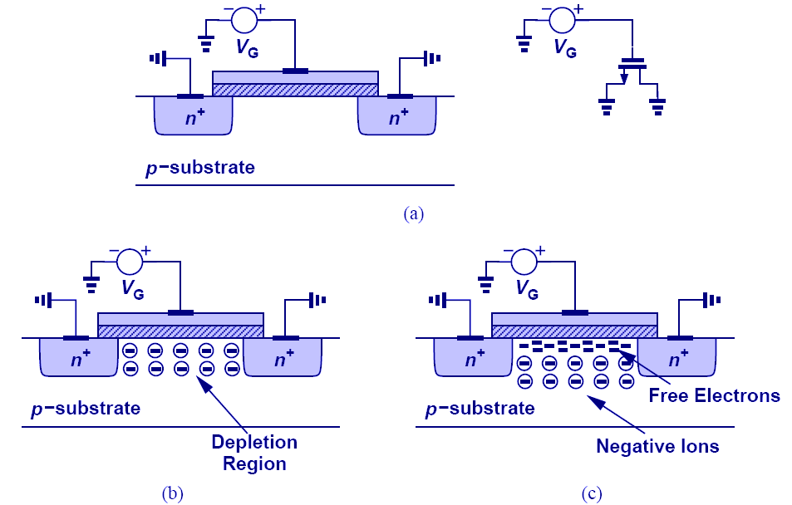
Formation of Channel for Current Flow:

Slide 11
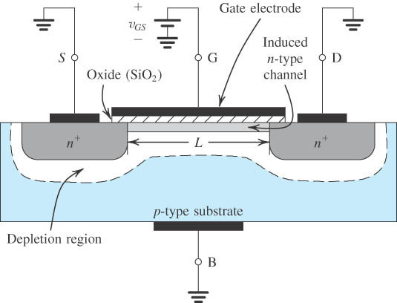
An Induced N-Channel
Figure 4.2: The Enhancement-Type NMOSFET Transistor . A positive voltage applied to the gate. An n channel is induced at the top of the substrate beneath the gate.

Slide 12
MOSFET-Operation (contd.)
Applying a Small V_{DS}
(3) V_{GS} > 0 and V_{DS} –Small (~ 50 mV):
We now apply a small positive voltage V_{DS} between drain and source, as shown in Fig. 4.3.
The voltage V_{DS} causes a current i_{D} to flow through the induced n-channel. Current is carried by free electrons traveling from source to drain.
Magnitude of i_{D} depends on the density of electrons in the channel, which in turn depends on the magnitude of V_{GS}.

Slide 13
MOSFET-Operation
Applied Gate and Drain Voltages:
(3) V_{GS} > 0 and V_{DS} –Small (~ 50 mV):
The value of V_{GS} at which a sufficient number of mobile electrons accumulate in the channel region to form a conducting channel is called the threshold voltage “Vt”
For n-channel Vt is positive and has a range of 0.5 V to 1 V.

Slide 14
The Enhancement-Type NMOSFET
Enhancement-Type N Channel MOSFET:
Increasing V_{GS} above the threshold voltage Vt, enhances the
channel width, hence the name enhancement-mode operation.
The devices is termed as enhancement type MOSFET.
Finally, we note that the current that leaves the source terminal (i_{S}) is equal to the current that enters the drain terminal (i_{D}), and the gate current i_{G}= 0.

Slide 15
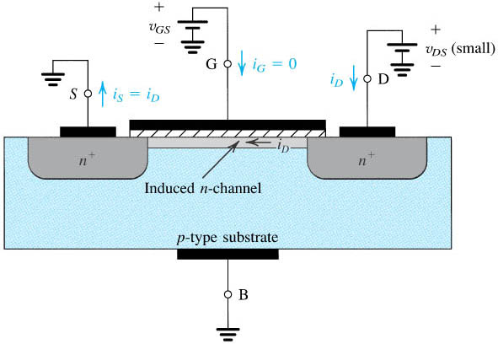
NMOS with V_{GS} > V_{t} and a small V_{DS} applied.
Figure 4.3: The device acts as a resistance whose value is determined by V_{GS}. Specifically, the channel conductance is proportional to V_{GS} – Vt’ and thus iD is proportional to (V_{GS} – Vt) V_{DS}.
Notes:
sedr42021_0403.jpg

Slide 16
MOSFET
Modes of Operation

Slide 17
Modes of MOSFET Operation
MOSFET can be categorized into three separate modes when in operation, depending on V_{GS}:
V_{GS} < Vt: The cut-off Mode
V_{GS} > Vt and V_{DS} < (V_{GS} − Vt): The Linear Region
V_{GS} > Vt and V_{DS} > V_{GS} − Vt: The Saturation Mode

Slide 18
Modes of MOSFET Operation
1. V_{GS} < Vt: The cut-off Mode
The first is the sub-threshold or cut-off mode; VGS < Vt:
where Vt is the threshold voltage. In this mode the device is essentially off, and in the ideal case there is no current flowing through the device.
For n-channel Vt is positive and has a range of 0.5 V to 1 V.

Slide 19
Modes of MOSFET-Operation (contd.)
(2) V_{GS} > Vt and V_{DS} < (V_{GS} − Vt): The Linear Region
When V_{GS} > V_{t} more electrons are attracted into the channel.
  i_{D} current increases, conductance of the channel increases.
  equivalently, resistance reduces.
  The conductance of the channel is proportional to excess gate voltage (v_{GS}-Vt).
  The current i_{D} will be proportional to (v_{GS}-Vt) and, of course, to the voltage v_{DS} that causes i_{D} to flow
  Figure 4.4 shows a relation between i_{D} versus V_{DS} for various values of V_{GS}. In this mode, MOSFET operates as a linear resistance whose value is controlled by v_{GS}.

Slide 20
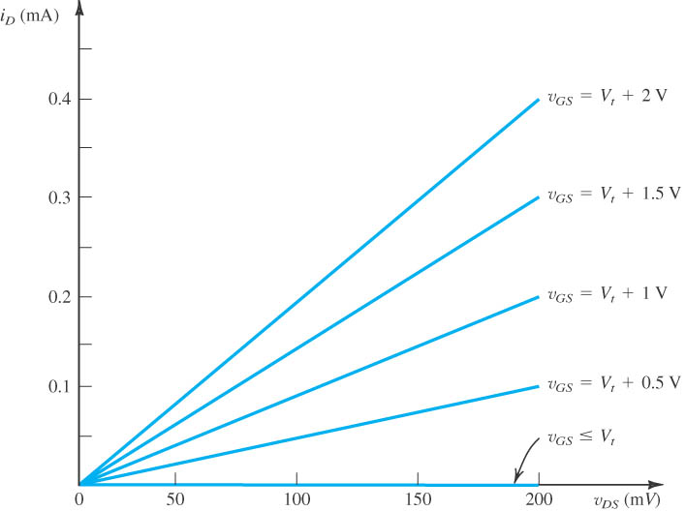
The i_{D}–V_{DS} Characteristics-(Small V_{DS})
Figure 4.4: When the voltage applied between drain and source, V_{DS}, is kept small. The device operates as a linear resistor whose value is controlled by V_{GS.}
Notes:
sedr42021_0404.jpg

Slide 21
Operation of NMOS as V_{DS} is Increased.
Along the channel from source to drain, the voltage (measured relative to the source) increases from 0 to V_{DS.}
Thus the voltage between gate and points along the channel decreases from V_{GS} at the source end to V_{GS}–V_{DS} at the drain end.
Since the channel depth depends on this voltage, we find that the channel is no longer of uniform depth. It will be tapered as shown in Figure 4.5.

Slide 22
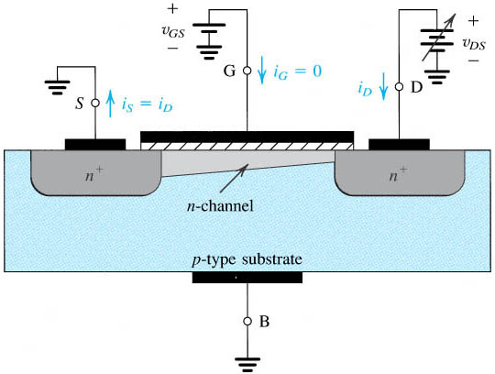
Operation of NMOS as V_{DS} is Increased.
Figure 4.5: The induced channel acquires a tapered shape. Its resistance increases as V_{DS} is increased. Here, V_{GS} is kept constant at a value > Vt.

Slide 23
Operation of NMOS as V_{DS} is Increased.
When V_{DS}is increased to the value that reduces the voltage between gate and channel at the drain end to Vt, i.e., V_{GD}= Vt .
V_{GS}–V_{DS}= Vt or
V_{DS}= V_{GS}–Vt
The channel depth at the drain end decreases to almost zero, and the channel is said to be pinched off.

Slide 24
Operation of NMOS as V_{DS} is Increased.
At the value reached for V_{DS}= V_{GS}–Vt. The drain current thus saturates at this value, and the MOSFET is said to have entered the saturation region of operation.
V_{DSsat} = V_{GS}–Vt
The region of the i_{D}–V_{DS} characteristic obtained for v_{DS}< v_{DSsat} is called the triode region.

Slide 25
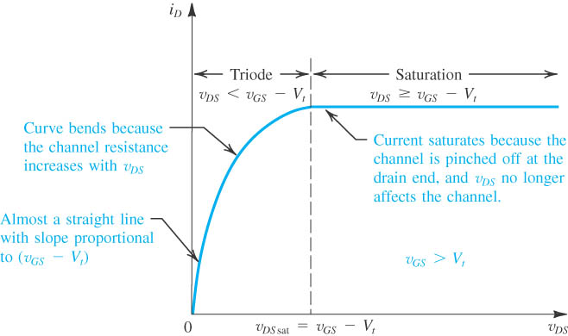
Figure 4.6: The drain current iD versus the drain-source voltage V_{DS} for an NMOS transistor operated with V_{GS} > Vt.
Notes:
sedr42021_0406.jpg

Slide 26
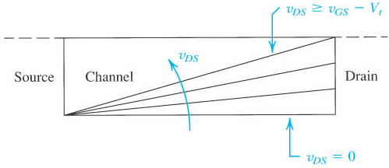
Effects of V_{DS} on Channel Shape
Figure4.7: Increasing V_{DS} causes the channel to acquire a tapered shape. Eventually, as v_{DS} reaches v_{GS} – Vt the channel is pinched off at the drain end. Increasing V_{DS} above V_{GS} – Vt has little effect (theoretically, no effect) on the channel’s shape.

Slide 27
Summary: NMOS Operation
The MOSFET can be categorized into three separate modes when in operation:
V_{GS} < Vt: The cut-off Mode
The first is the sub-threshold or cut-off mode; VGS < Vt:
where Vt is the threshold voltage. In this mode the device is essentially off, and in the ideal case there is no current flowing through the device.
V_{GS} > Vt and V_{DS} < (V_{GS} − Vt): The Linear Region
The second mode of operation is the linear region when VGS > Vt and
VDS < VGS − Vt. Essentially, the MOSFET operates similar to a resistor in this mode, with a linear relation between voltage and current.

Slide 28
Summary: NMOS Operation
V_{GS} > Vt and V_{DS} > V_{GS} − Vt: The Saturation Mode
The saturation mode occurs when VGS > Vt and VDS > VGS − Vt. In this mode the switch is on and conducting, however since drain voltage is higher than the gate voltage, part of the channel is turned off. This mode corresponds to the region to the right of the dotted line, which is called the pinch-off voltage. Pinch-off occurs when the MOSFET stops operating in the linear region and saturation occurs.
In digital circuits MOSFETS are only operated in the linear mode, while the saturation region is reserved for analogue circuits.

Slide 29
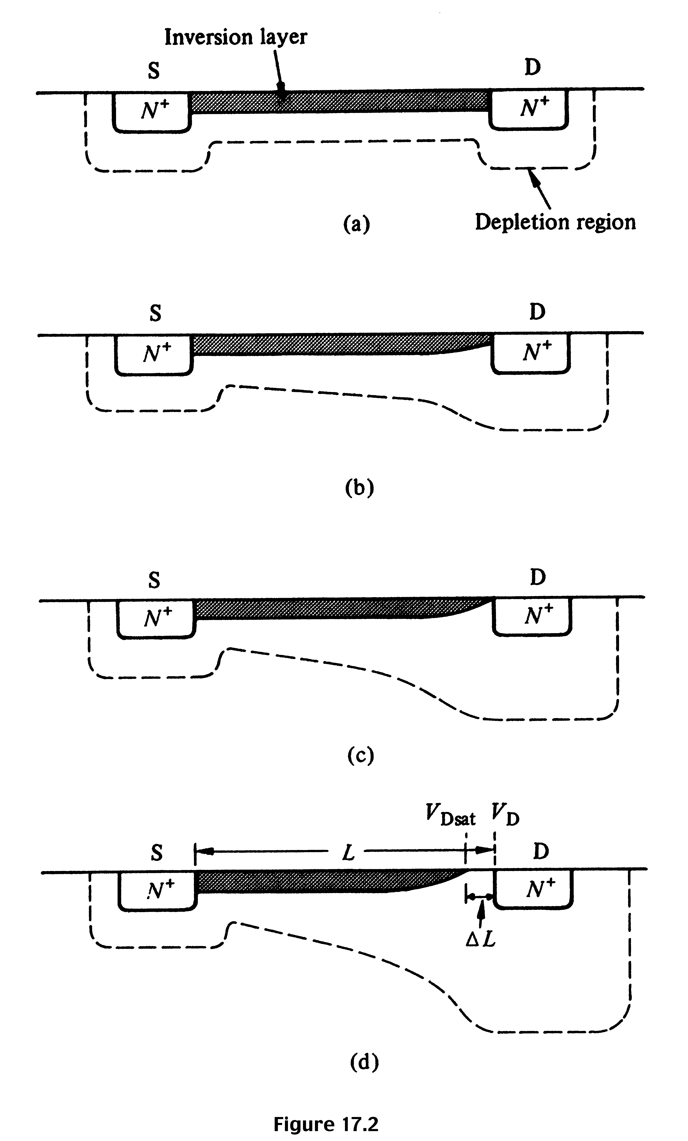
Summary: NMOS Operation
V_{G} > V_{T} ; V_{DS} ≈ 0
I_{D} increases with V_{DS}
V_{G} > V_{T}; V_{DS} small, > 0
I_{D} increases with V_{DS} , but rate of increase decreases.
V_{G} > V_{T}; V_{DS} ≈ pinch-off
I_{D} reaches a saturation value, I_{D,sat} The V_{DS} value is called V_{DS,sat}
V_{G} > V_{T}; V_{DS} > V_{DS,sat}
I_{D} does not increase further, saturation region.

Slide 30
MOSFET
Derivation of the i_{D}-V_{DS} Relationship

Slide 31
Derivation of the i_{D}-V_{DS} Relationship
In the MOSFET, the gate and the channel region form a parallel-plate capacitor for which the oxide layer serves as a dielectric.
If the capacitance per unit gate area is denoted C_{ox} and the thickness of the oxide layer is t_{ox}, then
C_{ox}=ε_{ox}/ t_{ox} (4.2)
Where ε_{ox} is the permittivity of the silicon oxide
ε= 3.9 ε₀= 3.9×8.854×10⁻¹²= 3.45×10⁻¹¹F/m

Slide 32
NMOS with V_{GS} > V_{t} and a small V_{DS} applied.
Figure 4.3: The device acts as a resistance whose value is determined by V_{GS}. Specifically, the channel conductance is proportional to V_{GS} – Vt’ and thus iD is proportional to (V_{GS} – Vt) V_{DS}.
Notes:
sedr42021_0403.jpg

Slide 33
Operation of NMOS as V_{DS} is Increased.
Figure 4.5: The induced channel acquires a tapered shape. Its resistance increases as V_{DS} is increased. Here, V_{GS} is kept constant at a value > Vt.

Slide 34
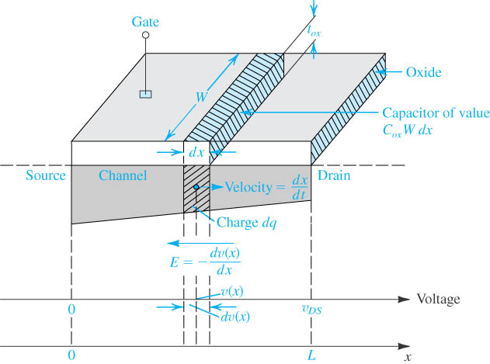
Derivation of the iD–vDS Relationship
Notes:
sedr42021_0408.jpg

Slide 35
Figure 4.6: The drain current iD versus the drain-source voltage V_{DS} for an NMOS transistor operated with V_{GS} > Vt.
Notes:
sedr42021_0406.jpg

Slide 36

The i_{D}-V_{DS} Relationship
The expression for the i_{D} V_{DS} characteristic in the Saturation Region is given by:

Slide 37
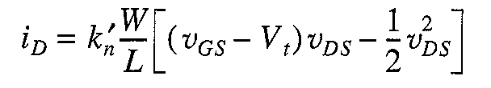
The i_{D}-V_{DS} Relationship
The Triode Mode:
Saturation Mode

Slide 38
The Drain Current i_{D}
The drain current is proportional to the ratio of the channel width W to the channel length L, known as the aspect ratio of the MOSFET.•
For a given fabrication process, however, there is a minimum channel length, Lmin.
MOS technology is a 0.13-μm process, meaning that for this process the minimum channel length possible is 0.13 μm.
t_{ox}= 2nm.

Slide 39

Summary
The i_{D} – v_{DS} Characteristics
Modes of operation
  Cutoff
  Triode (Saturation in BJT)
  Saturation ( Active in BJT)

Slide 40
Summary
The Drain Current i_{D}
Directly Proportional to:
  Mobility of Electrons in the channel μ_{n} (μm²/V)
  Gate Capacitance per unit gate area C_{ox} (μF/ μm)
  Width of the substrate (μm)
  Gate-Source Voltage v_{GS} (Volts)
  Drain-Source Voltage v _{DS} (Volts)
Indirectly Proportional to:
  Length of the channel (μm)

Slide 41
The p-Channel MOSFET
A p-channel enhancement-type MOSFET (PMOS transistor), fabricated on an n-type with p+ regions for the drain and source, has holes as charge carriers.
The device operates in the same manner as the n-channel device except that V_{GS} and V_{DS} are negative and the threshold voltage Vt is negative.
Also, the current i_{D} enters the source terminal and leaves through the drain terminal.
NMOS devices can be made smaller and thus operate faster, and because NMOS historically required lower supply voltages than PMOS.

Slide 42
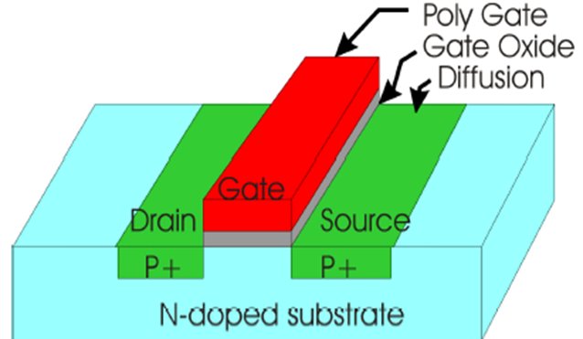
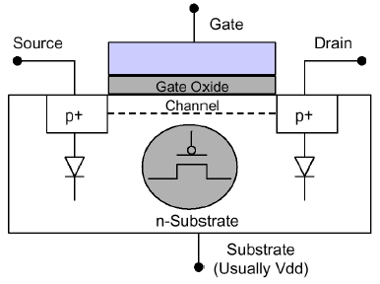
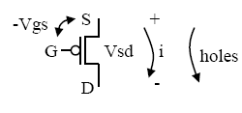
The p-Channel MOSFET

Slide 43
Complementary MOS or CMOS
As the name implies, complementary MOS technology employs MOS transistors of both polarities.
CMOS is the most widely used of all the IC technologies.
Figure 4.9 shows cross-section of a CMOS chip illustrating how the PMOS and NMOS transistors are fabricated. Observe that while the NMOS transistor is implemented directly in the p-type substrate, the PMOS transistor is fabricated in a specially created n region, known as an n-well.

Slide 44
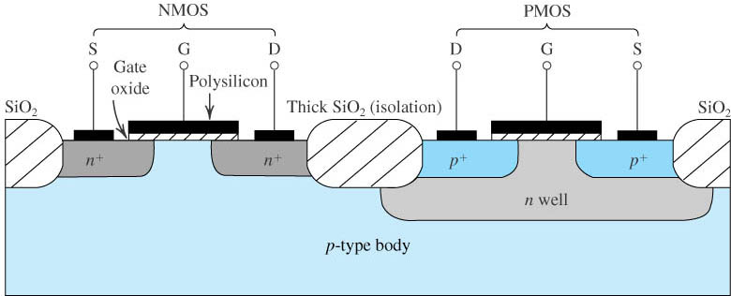
Complementary MOS or CMOS
Figure 4.9: Cross-section of a CMOS integrated circuit. Note that the PMOS transistor is formed in a separate n-type region, known as an n well.
Notes:
sedr42021_0409.jpg

