Slide 1

COMSATS Institute of Information Technology
Virtual campus
Islamabad
Dr. Nasim Zafar
Electronics 1 - EEE 231
Fall Semester – 2012

Slide 2
MOS Field-Effect Transistors
MOSFETs
Lecture No. 27
Contents:
Introduction
The Basic Structure of MOSFET
Qualitative Operation of MOSFET
  Operation with Gate-Voltage V_{G}=0
  Channel for Current Flow
  Applying a Small V_{DS}
  Operation as V_{DS} is Increased

Slide 3
Lecture No. 27
MOS Field-Effect Transistors
MOSFETs
Reference:
Chapter-4.1
Microelectronic Circuits
Adel S. Sedra and Kenneth C. Smith.

Slide 4
Different Types of FETs
Junction FET (JFET)
Metal-Oxide-Semiconductor FET (MOSFET)
Metal-Semiconductor FET (MESFET)

Slide 5
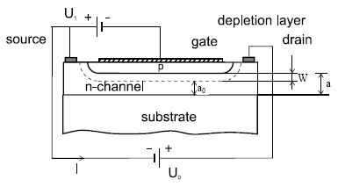
Different Types of FETs
Junction FET (JFET)
The gate-channel insulator is the DEPLETION REGION, and is the same material as the channel.

Slide 6
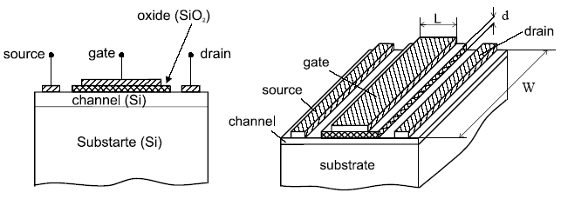
Different Types of FETs
Metal-Oxide-Semiconductor FET (MOSFET)
The gate-channel insulator is made out of dielectric;SiO₂

Slide 7
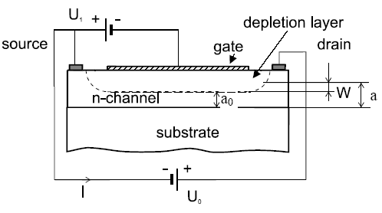
Different Types of FETs
Metal-Semiconductor FET (MESFET)
The gate is formed by Schottky barrier to the semiconductor layer. The gate-channel insulator consists of the DEPLETION REGION, i.e. the same material as the channel. Very similar to the JFET

Slide 8
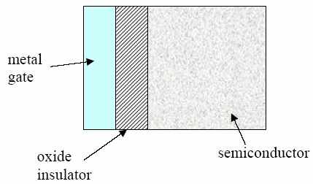
MOS (Metal-Oxide-Semiconductor)
Assume work function of metal and semiconductor are same.

Slide 9
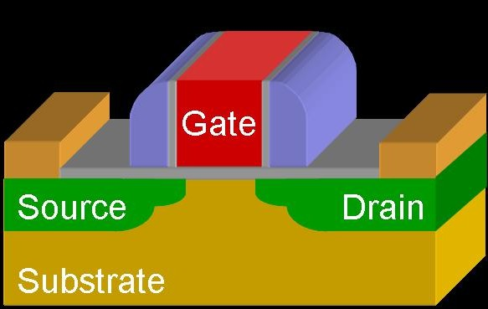
Metal Oxide Semiconductor Field Effect Transistors
MOSFET

Slide 10
Circuit Symbol (NMOS)
Enhancement-Type
D
I_{D}= I_{S}
G
B (I_{B}=0, should be reverse biased)
I_{G}= 0
G-Gate
D-Drain
S-Source
B-Substrate or Body
I_{S}
S

Slide 11
MOSFET
Voltage Controlled Current Device
MOS: Physical Structure-Metal Oxide Semiconductor
    FET: Device Operation-Field Effect Transistor
    The current controlled mechanism is based on an electric field
    established by the voltage applied to the control terminal – GATE.
    Uni-polar: Current is conducted by only one type of carrier.

Slide 12
Introduction
Silicon is the main choice of semiconductor used. Some other more common semiconductors such as GaAs are not useful in MOSFETs because they do not form good gate oxides.
In most modern MOSFETs, the gate material is heavily doped polycrystalline silicon, sometimes referred to as “polysilicon” or “poly-Si”.
  Note that the gate is usually doped the same type as the source/drain, i.e. the gate and the substrate are of opposite types.
Another name for the MOSFET is the insulated-gate FET
or IGFET.

Slide 13
MOSFET-Structure
N-Channel MOSFET
The physical structure of the n-channel enhancement-type MOSFET is shown Slide 16.
  The transistor is fabricated on a p-type substance, which is a single-crystal silicon wafer that provides physical support for the device.
  Two heavily doped n-type regions, are created in the substrate, indicated in the figure as:
    n⁺ Source (‘S’)
    n+ Drain (‘D’)

Slide 14
MOSFET-Structure
Enhancement Type-NMOSFET
Gate: metal or heavily doped poly-Si
G
(bulk or
substrate)
Body
B
Source
S
I_{G}=0
Drain
D
y
I_{D}=I_{S}
I_{S}
Metal
oxide
p
n+
n+
x
W
L

Slide 15
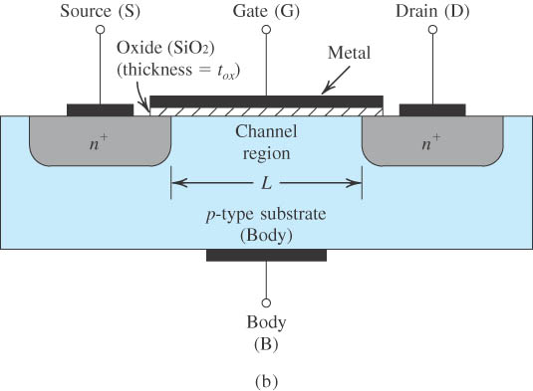
MOSFET-Physical Structure
Figure 4.1: Cross-Section. Typically L = 0.1 to 3 μm, W = 0.2 to 100 μm, and the thickness of the oxide layer (t_{ox}) is in the range of 2 to 50 nm.

Slide 16
MOSFET-Structure (contd.)
A thin layer of silicon dioxide (SiO₂) of thickness t_{ox}(typically 2-50 nm) is grown on the surface of the substrate, covering the area between the source and drain regions.
Metal is deposited on top of the oxide layer to form the gate electrode.
Metal contacts are also made to the source region, the drain region, and the substrate, also known as the body.
Thus four terminals are brought out: the gate terminal (G), the source terminal (S), the drain terminal (D), and the substrate or body terminal (B).
To minimize current flow between the substrate (or “body”) and the source/drain regions, the p-type substrate is grounded.

Slide 17
n-Channel MOSFET –p Channel MOSFET
In an n-channel MOSFET, the channel is made of n-type semiconductor, so the charges free to move along the channel are negatively charged (electrons).
In a p-channel device the free charges which move from end-to-end are positively charged (holes).
N-channel and P-channel MOSFETs operate in a complimentary manner.
  CMOS = Complementary MOS

Slide 18
MOSFET-Operation

Slide 19

N-Channel MOSFET Operation
Source
Gate
Drain
Gate Oxide
n⁺
L
p-Si
Gate Length
Bulk (Substrate)
Current flowing through the Channel, between Source and Drain is controlled by the Gate Voltage.
Notes:
Structure
p-type Silicon substrate
n⁺ ion implanted source and drain regions
High quality (thin) gate oxide (dry process)
Overlaps slightly source and drain regions
Thick field oxide
Protection + carries contact tracks
Channel
Region between source and drain and under gate.
Enhancement Mode MOSFET
n-channel with V_{G}>V_{T}
Semiconductors: Si; Ge; GaAs
Insulators: SiO₃; Si₃N₄; Al₂O₃
Most Important Combination: Si/SiO₂
Typical Dimensions
Long channel MOSFET
L>>W_{S}, W_{D}
L ~ 5μm
Oxide Thickness
50-100nm

Slide 20
Principle of Operation
To understand the different modes of operation for an NMOS, we consider 3 different gate bias voltages.
  (1) below the flatband voltage, V_{FB}
  (2) between the flatband and the threshold voltage, V_{T},
  (3) larger than the threshold voltage.
These bias regimes are called the accumulation, and depletion mode of operation.

Slide 21
MOSFET-Operation
The applied positive gate voltage controls the current flow between source and drain.
This current will flow in the longitudinal direction from drain to source in the “n-channel region.”
Note that this region has a length L and a width W. Typically, L is in the range of 0.1 μm to 3 μm, and W is in the range of 0.2 μm to 100 μm.
MOSFET is a symmetrical device; thus its source and drain can be interchanged with no change in the device characteristics.

Slide 22
N-Channel MOSFET Operation
VGS applied (positive)
Both VGS and VDS applied
S
G
D
Gate Oxide
n⁺
L
Gate Length
p-Si
(Substrate)
The applied positive gate voltage controls the current flow between source and drain.
Notes:
Structure
p-type Silicon substrate
n⁺ ion implanted source and drain regions
High quality (thin) gate oxide (dry process)
Overlaps slightly source and drain regions
Thick field oxide
Protection + carries contact tracks
Channel
Region between source and drain and under gate.
Enhancement Mode MOSFET
n-channel with V_{G}>V_{T}
Semiconductors: Si; Ge; GaAs
Insulators: SiO₃; Si₃N₄; Al₂O₃
Most Important Combination: Si/SiO₂
Typical Dimensions
Long channel MOSFET
L>>W_{S}, W_{D}
L ~ 5μm
Oxide Thickness
50-100nm

Slide 23
MOSFET-Operation
Operation with No Gate Voltage:
(1) V_{GS} = 0, and V_{S} = V_{D} =0
With no voltage applied to the gate, two back-to-back diodes exist in series between drain and source.
No current flows even if v_{DS} is applied. These back-to-back diodes prevent current conduction from drain to source.
In fact, the path between drain and source has a very high resistance (of the order of 10¹²Ω).

Slide 24
MOSFET-Operation
Operation with Applied Gate Voltage:
Formation of n-Channel for Current Flow:
(2) V_{GS} > 0, and V_{S} = V_{D} =0
Formation of an N-Channel is shown in slide 27 – Fig.4.2.
A positive voltage is applied to the gate. We have grounded the source and the drain initially (slide 26-a). Since the source is grounded, the gate voltage appears between gate and source and thus is denoted as V_{GS} .

Slide 25
MOSFET-Operation (contd.)
Operation with Applied Gate Voltage:
(2) V_{GS} > 0, and V_{S} = V_{D} =0
First, the holes are repelled by the positive gate voltage, leaving behind negative acceptor ions and forming a depletion region (slide 26-b).
The positive gate voltage also attracts electrons from the n+ source and drain regions , creating a channel, an "inversion layer”.
Due to electrons accumulated under the gate, an n region is in effect created, and connects the source and drain regions, as indicated in Slide 26-c. ‘n’ region forms a channel – N-channel MOSET (NMOSFET)

Slide 26
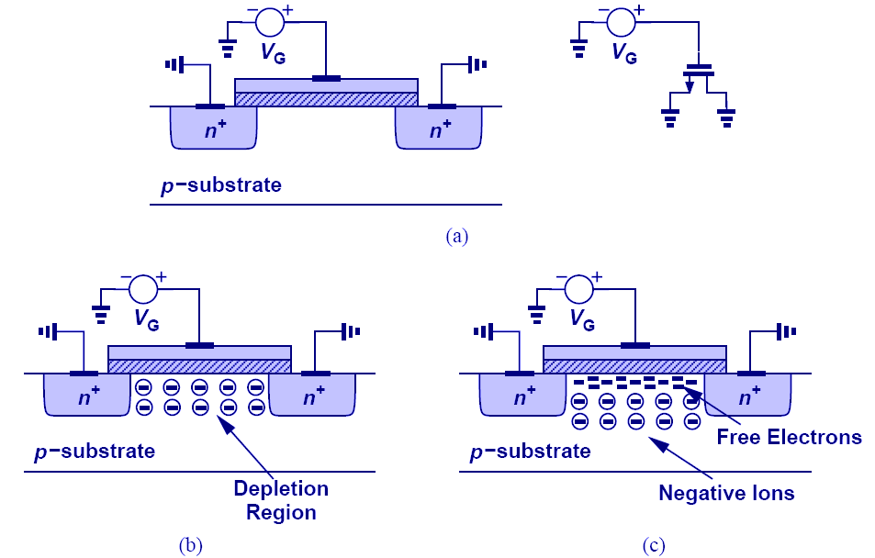
Formation of Channel for Current Flow:

Slide 27
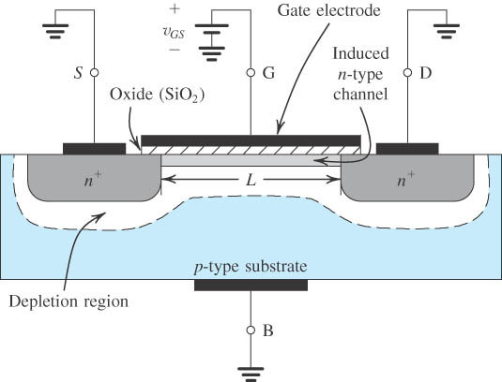
An Induced N-Channel
Figure 4.2: The Enhancement-Type NMOSFET Transistor . A positive voltage applied to the gate. An n channel is induced at the top of the substrate beneath the gate.

Slide 28
MOSFET-Operation (contd.)
(2) V_{GS} > 0, V_{DS} = +ve and V_{S} =0
Now if a voltage V_{DS} is applied between drain and source, current flows through this “induced n region”. , due to mobile electrons between drain & source.
The induced channel is also called an inversion layer.
The value of V_{GS} at which a sufficient number of mobile electrons accumulate in the channel region to form a conducting channel is called the threshold voltage “Vt”
Vt for n-channel is positive and has a range of 0.5 V to 1V.

Slide 30
Channel for Current Flow
The Gate and channel region of MOSFET form a parallel plate capacitor, with oxide layer as the capacitor dielectric.
Positive charge is accumulated on the gate electrode and negative charge on channel electrode.
An electric field thus develops in the vertical direction.
Capacitor charge controls the current flow through the channel when a voltage V_{DS} is applied.
Gate
Channel

Slide 31
MOSFET-Operation
Applying a Small VDS
V_{DS} –Small (~ 50 mV):
We now apply a small positive voltage V_{DS} between drain and source, as shown in Fig. 4.3.
The voltage V_{DS} causes a current i_{D} to flow through the induced n-channel. Current is carried by free electrons traveling from source to drain.
Direction is opposite to that of electrons
Magnitude of i_{D} depends on the density of electrons in the channel, which in turn depends on the magnitude of V_{GS}.

Slide 32
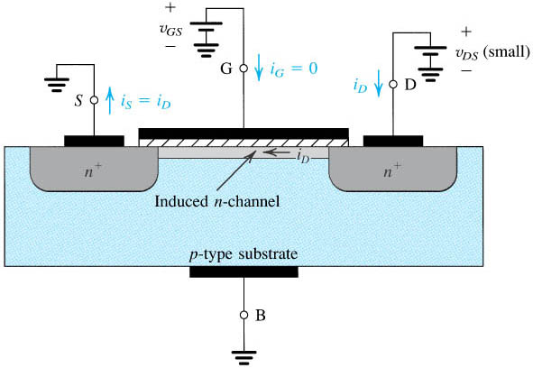
NMOS with V_{GS} > V_{t} and a small V_{DS} applied.
Figure 4.3: The device acts as a resistance whose value is determined by V_{GS}. Specifically, the channel conductance is proportional to V_{GS} – Vt’ and thus iD is proportional to (V_{GS} – Vt) V_{DS}.
Notes:
sedr42021_0403.jpg

Slide 33
Modes of MOSFET Operation
MOSFET can be categorized into three separate modes when in operation, depending on V_{GS}:
V_{GS} < Vt: The cut-off Mode
V_{GS} > Vt and V_{DS} < (V_{GS} − Vt): The Linear Region
V_{GS} > Vt and V_{DS} > V_{GS} − Vt: The Saturation Mode

Slide 34
Modes of MOSFET Operation
1. V_{GS} < Vt: The cut-off Mode
The first is the sub-threshold or cut-off mode; VGS < Vt:
where Vt is the threshold voltage. In this mode the device is essentially off, and in the ideal case there is no current flowing through the device.

Slide 35
MOSFET-Operation (contd.)
(2) V_{GS} > Vt and V_{DS} < (V_{GS} − Vt): The Linear Region
  When V_{GS} > V_{t} more electrons are attracted into the channel.
  i_{D} current increases, conductance of the channel increases.
  equivalently, resistance reduces.
  The conductance of the channel is proportional to excess gate voltage (v_{GS}-Vt).
  v_{GS} - V_{t} is known as Excess gate Voltage or Effective Voltage.
  The current i_{D} will be proportional to (v_{GS}-Vt) and, of course, to the voltage v_{DS} that causes i_{D} to flow
  Figure 4.4 shows a relation between i_{D} versus V_{DS} for various values of V_{GS}. In this mode, MOSFET operates as a linear resistance whose value is controlled by v_{GS}.

Slide 36
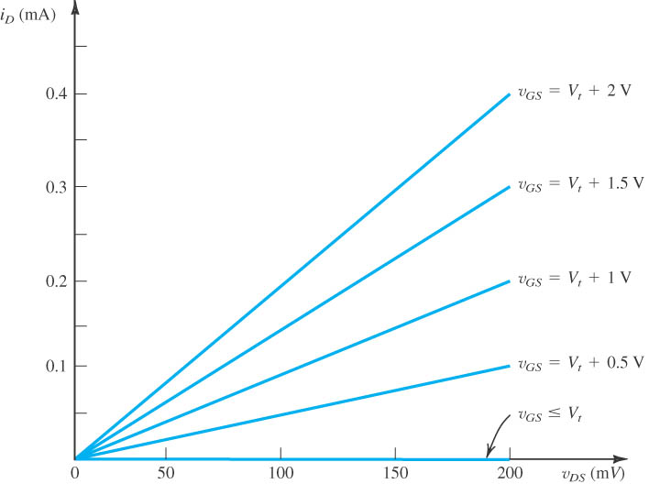
The i_{D}–V_{DS} Characteristics-(Small V_{DS})
Figure 4.4: When the voltage applied between drain and source, V_{DS}, is kept small. The device operates as a linear resistor whose value is controlled by V_{GS.}
Notes:
sedr42021_0404.jpg

Slide 37
Enhancement Mode Operation
For MOSFET to conduct:
A channel has to be induced by applying V_{GS}.
Increasing V_{GS} above the threshold voltage Vt, enhances the channel width, hence the name enhancement-mode operation.
The devices is termed as enhancement type MOSFET.
Finally, we note that the current that leaves the source terminal (i_{S}) is equal to the current that enters the drain terminal (i_{D}), and the gate current i_{G}= 0.

Slide 38
Operation of NMOS as V_{DS} is Increased.
Along the channel from source to drain, the voltage (measured relative to the source) increases from 0 to V_{DS.}
Thus the voltage between gate and points along the channel decreases from V_{GS} at the source end to V_{GS}–V_{DS} at the drain end.
Since the channel depth depends on this voltage, we find that the channel is no longer of uniform depth. It will be tapered as shown in Figure 4.5.

Slide 39
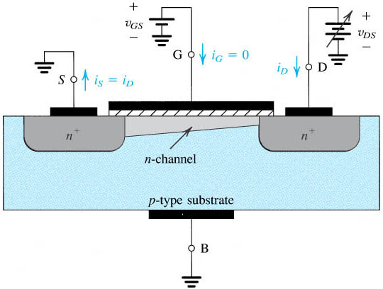
Operation of NMOS as V_{DS} is Increased.
Figure 4.5: The induced channel acquires a tapered shape. Its resistance increases as V_{DS} is increased. Here, V_{GS} is kept constant at a value > Vt.

Slide 40
Operation of NMOS as V_{DS} is Increased.
When V_{DS}is increased to the value that reduces the voltage between gate and channel at the drain end to,
V_{GD}= Vt or
V_{GS}–V_{DS}= Vt or
V_{DS}= V_{GS}–Vt
The channel depth at the drain end decreases to almost zero, and the channel is said to be pinched off.

Slide 41
Operation of NMOS as V_{DS} is Increased.
At the value reached for V_{DS}= V_{GS}–Vt. The drain current thus saturates at this value, and the MOSFET is said to have entered the saturation region of operation.
V_{DSsat} = V_{GS}–Vt
The region of the i_{D}–V_{DS} characteristic obtained for v_{DS}< v_{DSsat} is called the triode region.

Slide 42
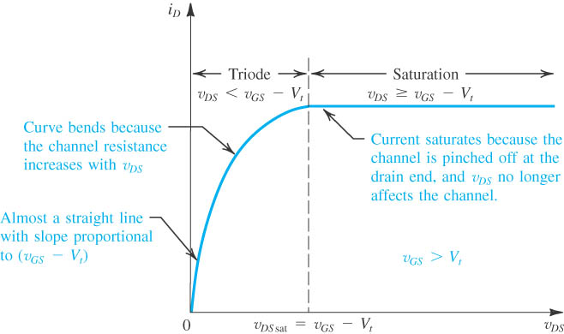
Figure 4.6: The drain current iD versus the drain-source voltage V_{DS} for an NMOS transistor operated with V_{GS} > Vt.
Notes:
sedr42021_0406.jpg

Slide 43
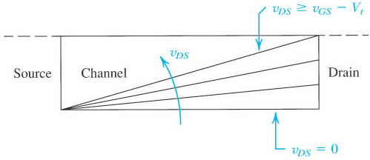
Effects of V_{DS} on Channel Shape
Figure4.7: Increasing V_{DS} causes the channel to acquire a tapered shape. Eventually, as v_{DS} reaches v_{GS} – Vt the channel is pinched off at the drain end. Increasing V_{DS} above V_{GS} – Vt has little effect (theoretically, no effect) on the channel’s shape.

Slide 44
Summary: NMOS Operation
The MOSFET can be categorized into three separate modes when in operation:
V_{GS} < Vt: The cut-off Mode
The first is the sub-threshold or cut-off mode; VGS < Vt:
where Vt is the threshold voltage. In this mode the device is essentially off, and in the ideal case there is no current flowing through the device.
V_{GS} > Vt and V_{DS} < (V_{GS} − Vt): The Linear Region
The second mode of operation is the linear region when VGS > Vt and
VDS < VGS − Vt. Essentially, the MOSFET operates similar to a resistor in this mode, with a linear relation between voltage and current.

Slide 45
Summary: NMOS Operation
V_{GS} > Vt and V_{DS} > V_{GS} − Vt: The Saturation Mode
The saturation mode occurs when VGS > Vt and VDS > VGS − Vt. In this mode the switch is on and conducting, however since drain voltage is higher than the gate voltage, part of the channel is turned off. This mode corresponds to the region to the right of the dotted line, which is called the pinch-off voltage. Pinch-off occurs when the MOSFET stops operating in the linear region and saturation occurs.
In digital circuits MOSFETS are only operated in the linear mode, while the saturation region is reserved for analogue circuits.

Slide 46
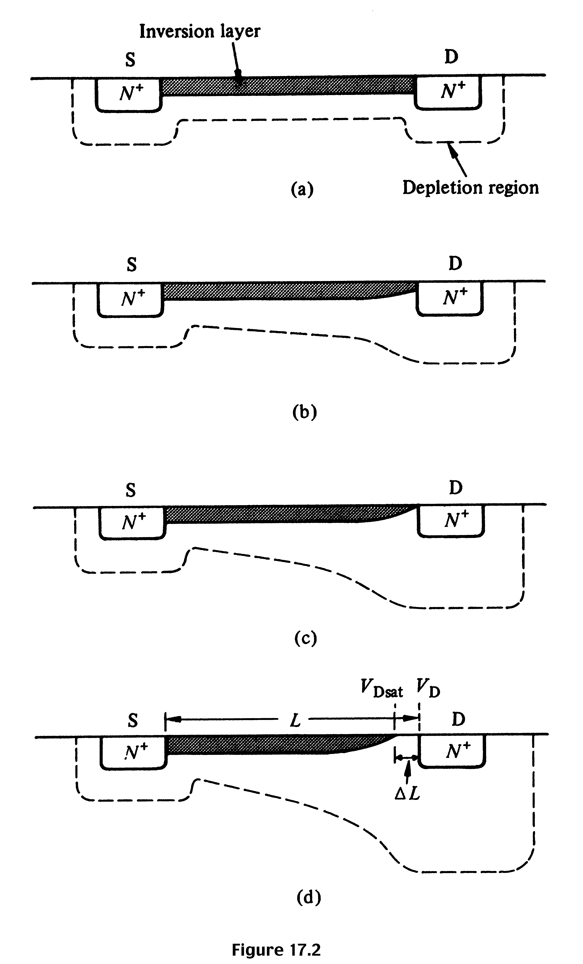
Summary: NMOS Operation
V_{G} > V_{T} ; V_{DS} ≈ 0
I_{D} increases with V_{DS}
V_{G} > V_{T}; V_{DS} small, > 0
I_{D} increases with V_{DS} , but rate of increase decreases.
V_{G} > V_{T}; V_{DS} ≈ pinch-off
I_{D} reaches a saturation value, I_{D,sat} The V_{DS} value is called V_{DS,sat}
V_{G} > V_{T}; V_{DS} > V_{DS,sat}
I_{D} does not increase further, saturation region.

