Slide 1

COMSATS Institute of Information Technology
Virtual campus
Islamabad
Dr. Nasim Zafar
Electronics 1 - EEE 231
Fall Semester – 2012

Slide 2
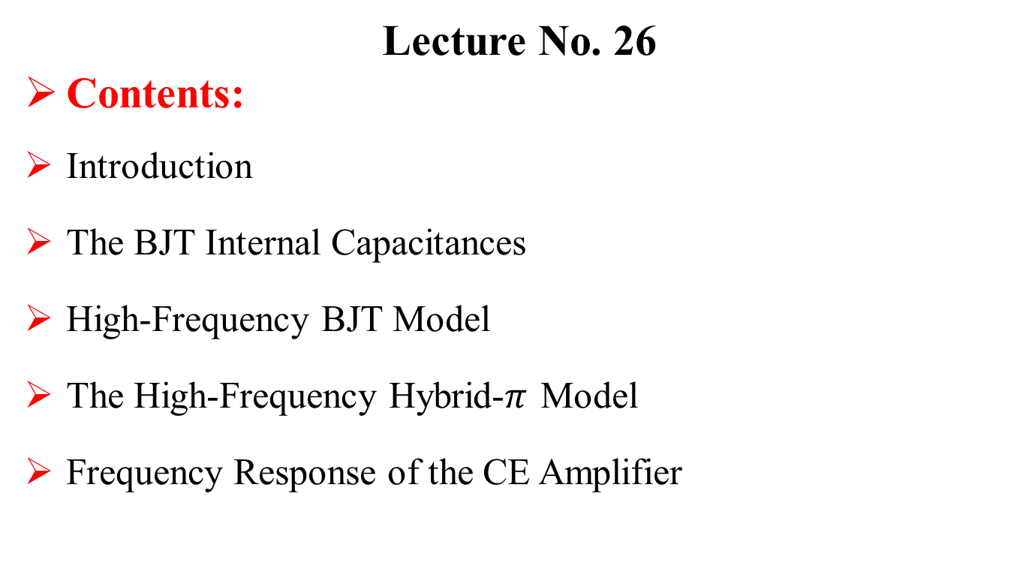
The BJT Internal Capacitance and
High Frequency Model
Lecture No. 26
Contents:
Introduction
The BJT Internal Capacitances
High-Frequency BJT Model
The High-Frequency Hybrid-$π$Model
Frequency Response of the CE Amplifier

Slide 3
Lecture No. 26
Reference:
The BJT Internal Capacitance and
High-Frequency Model
Chapter-5.8
Microelectronic Circuits
Adel S. Sedra and Kenneth C. Smith.

Slide 4
The BJT Internal Capacitances

Slide 5
Introduction
So far, we have assumed transistor action to be instantaneous.
The models we have developed, do not include any elements like capacitors or inductors, that would cause time or frequency dependence.

Slide 6
Introduction
Actual transistors, however, exhibit charge storage phenomena that limit the speed and frequency of their operation.
In this lecture, we study the charge-storage effects that take place in the BJT
and take them into account by adding capacitances to the hybrid-π model.

Slide 7
BJT: Small Signal Model
We now again, define some quantities:

Slide 8
BJT: Small Signal Model
So
The output resistance is:

Slide 9
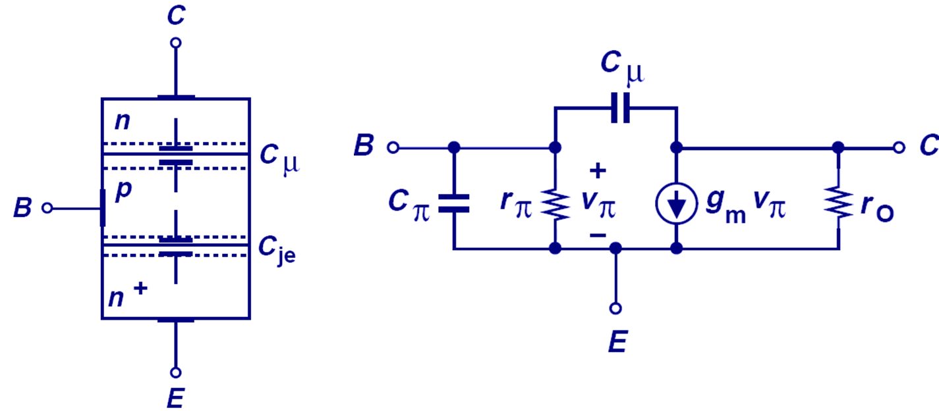
High-Frequency BJT Model

Slide 10
High-Frequency BJT Model
The BJT inherently has junction capacitances which affect its performance at high frequencies. C_{b} represents the base charge.
  Collector Junction: depletion capacitance, Cμ
  Emitter Junction: depletion capacitance, C_{je}, and also diffusion capacitance, C_{b}.

Slide 11
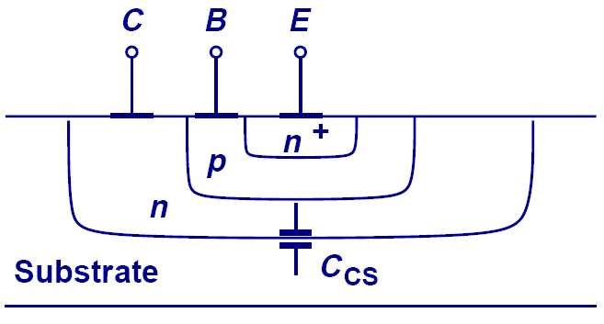
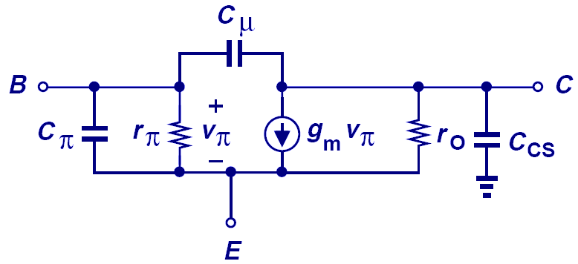
BJT High-Frequency BJT Model
(cont’d)
In an integrated circuit, the BJTs are fabricated in the surface region of a Si wafer substrate; another junction exists between the collector and substrate, resulting in substrate junction capacitance, C_{CS}.
BJT Cross-Section
BJT Small-Signal Model

Slide 12
The PN Junction Capacitance
The following expressions apply for a PN junction diode:
How do we apply this to BJTs?

Slide 13

The Base-Charging or Diffusion Capacitance C_{de}
When the transistor is operating in the active or saturation mode, minority-carrier charge, Q_{n} , is stored in the base region.
We can express Q_{n} in terms of the collector current i_{C} as

Slide 14
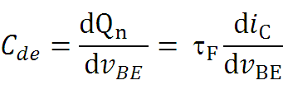
The Base-Charging or Diffusion Capacitance
Diffusion capacitance almost entirely exists in the forward-biased pn junction.
For small signals we can define the small-signal diffusion capacitance Cde,
Expression of the small-signal diffusion capacitance

Slide 15
Junction Capacitances
The Base-Emitter Junction Capacitance C_{JE}
The base-emitter junction or depletion layer capacitance C_{je} can be expressed as:
where C_{je0} is the value of C_{je} at zero voltage, V_{0e} is the EBJ built-in voltage (typically, 0.9 V), and m is the grading coefficient of the EBJ junction (typically, 0.5).

Slide 16
Junction Capacitances
The Collector-Base junction Capacitance Cμ,
In active-mode operation, the CBJ is reverse biased, and its junction or depletion capacitance, usually denoted Cμ, can be found from
where C_{μ0} is the value of C_{μ} at zero voltage, V_{0c} is the CBJ built-in voltage (typically, 0.75 V), and m is its grading coefficient (typically, 0.2–0.5).

Slide 17
Junction Capacitances
  Collector Junction: depletion capacitance, Cμ
  Emitter Junction: depletion capacitance, C_{π}
and

Slide 18

The High-Frequency Hybrid-$π$ Model

Slide 19

The High-Frequency Hybrid-$π$ Model
The hybrid-π model of the BJT, including capacitive effects, is shown in Slide 20.
Specifically, there are two capacitances:
the emitter–base capacitance Cπ = Cb + Cje
and the collector–base capacitance Cμ.
Typically, Cπ is in the range of a few picofarads to a few tens of picofarads, Cμ is in the range of a fraction of a picofarad to a few picofarads.

Slide 20
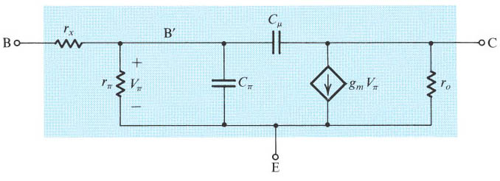
The High-Frequency Hybrid-π Model
Two capacitances C_{π} and C_{μ} , where
One resistance r_{x} . Accurate value is obtained form high frequency measurement.

Slide 21
The Cutoff and Unity-Gain Frequency: f_{T}
The “cut-off” frequency, f_{T}, is a measure of the intrinsic speed of a transistor, and is defined as the frequency when the common-emitter current gain falls to 1.
Sometime this is referred to as the transition frequency, or unity-current-gain frequency.
This is the most important parameter for a MODERN BJT

Slide 22
The Cutoff Frequency
The transistor data sheets do not usually specify the value of Cπ.
Rather, the behavior of β or hfe versus frequency is normally given.
In order to determine Cπ and Cμ we shall derive an expression for hfe, the CE short-circuit current gain, as a function of frequency in terms of the hybrid-π components.
For this purpose consider the circuit shown in slide24, in which the collector is shorted to the emitter.

Slide 23
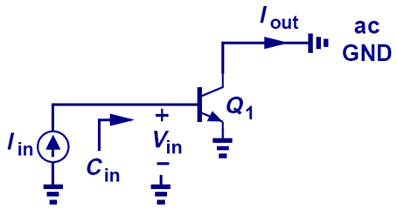
Transit Frequency, f_{T}
Conceptual Set-up to measure f_{T}

Slide 24
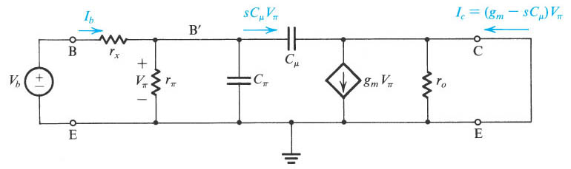
The Cutoff and Unity-Gain Frequency
Circuit for deriving an expression for
According to the definition, output port is short circuit.

Slide 25
The Cutoff Frequency
A node equation at C provides the short-circuit collector current I_{c} .
Ic = (gm – sCμ )Vπ

Slide 26
The Cutoff and Unity-Gain Frequency
(cont’d)
Expression of the short-circuit current transfer function
Characteristic is similar to the one of first-order low-pass filter

Slide 27
The Cutoff and Unity-Gain Frequency
(cont’d)
Slide 28 shows a Bode plot for h_{fe .}
From the –6-dB/octave slope it follows that the frequency at which h_{fe} drops to unity, which is called the unity-gain bandwidth ωT, is given by:
ω_{T} = β ₀ω_{β}

Slide 28
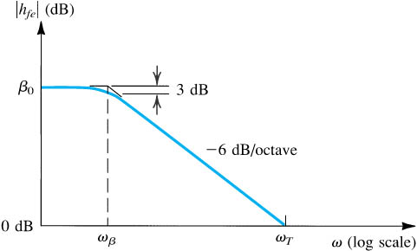
The Cutoff and Unity-Gain Frequency (cont’d)

Slide 29
The Cutoff and Unity-Gain Frequency
(cont’d)

Slide 30
The Cutoff and Unity-Gain Frequency
(cont’d)
Typically, f_{T} is in the range of :
100 MHz to tens of GHz.

Slide 31
Maximum Oscillation Frequency (f_{max}).
One final important figure of merit is the MAXIMUM OSCILLATION FREQUENCY (f_{max}).
Frequency at which unilateral power gain becomes 1.

Slide 32
Frequency Response of the CE Amplifier

Slide 33
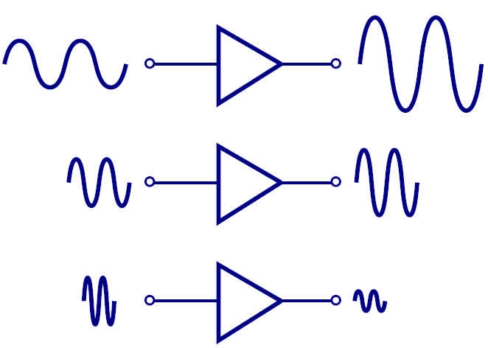
High Frequency “Roll-Off” in A_{v}
Typically, an amplifier is designed to work over a limited range of frequencies.
  At “high frequencies”, the gain of an amplifier decreases.

Slide 34
Frequency Response of a CE Amplifier
The voltage gain of an amplifier is typically flat over the mid-frequency range, but drops drastically for low or high frequencies. A typical frequency response is shown below.

Slide 35
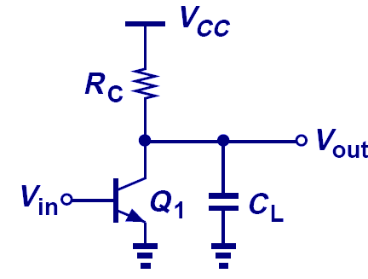
Frequency Response of a CE Amplifier
A_{v} Roll-Off due to C_{L}
High Frequency Band: A capacitive load (C_{L}) causes the gain to decrease at high frequencies.
  The impedance of C_{L} decreases at high frequencies, so that it shunts some of the output current to ground.

Slide 36
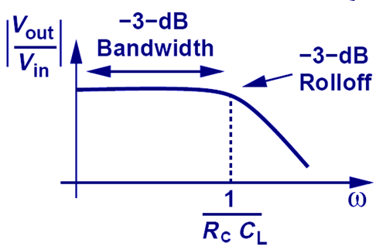
Frequency Response of a CE Amplifier
(contd.)
Low Frequency Band: At low frequencies, the capacitor is effectively an open circuit, and A_{v} vs. ω is flat. At high frequencies, the impedance of the capacitor decreases and hence the gain decreases. The “breakpoint” frequency is 1/(R_{C}C_{L}).

Slide 37
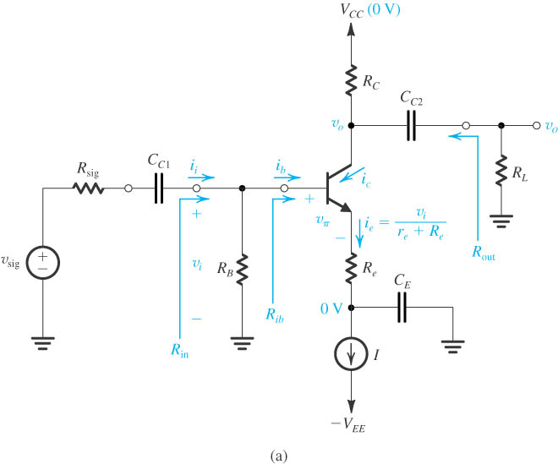
The Common-Emitter Amplifier

Slide 38
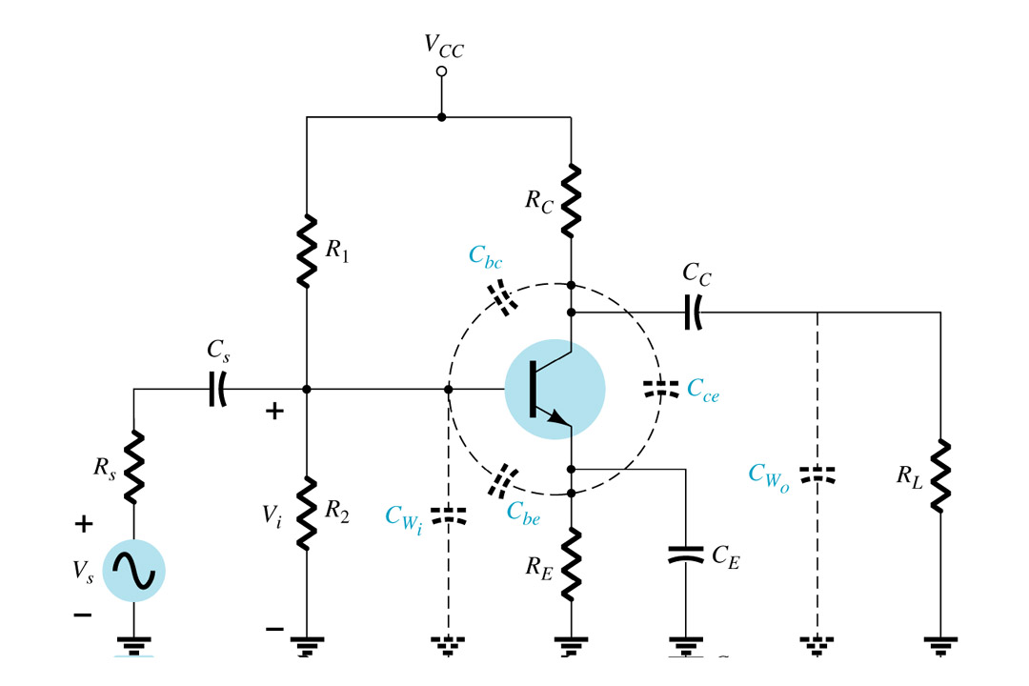
Frequency Response of a CE Amplifier

Slide 39
Frequency Response of a CE Amplifier
Low frequency Band:
For a Common-Emitter BJT: gain falls off due to the effects of capacitors C_{C1}, C_{C2}, and C_{E.}
High-frequency Band:
is due to device capacitances Cπ and Cμ (combined to form C_{total}).

Slide 40
Frequency Response of a CE Amplifier
(contd.)
Each capacitor forms a break point (simple pole or zero) with a break frequency of the form f=1/(2πR_{Eq}C), where R_{Eq} is the resistance seen by the capacitor.
C_{E} usually yields the highest low-frequency break which establishes f_{Low}.

Slide 41
Amplifier Figure of Merit (FOM)
The gain-bandwidth product is commonly used to benchmark amplifiers.
  We wish to maximize both the gain and the bandwidth.
Power consumption is also an important attribute.
  We wish to minimize the power consumption.
  Operation at low T, low V_{CC}, and with small C_{L} → superior FOM

