Slide 1

COMSATS Institute of Information Technology
Virtual campus
Islamabad
Dr. Nasim Zafar
Electronics 1 - EEE 231
Fall Semester – 2012

Slide 2
Basic Single-Stage BJT Amplifiers
Lecture No. 25
Contents:
Characteristic Parameters
The Basic Structure
Configurations
  Common-Emitter Amplifier
    Emitter directly connects to ground
    Emitter connects to ground by resistor R_{E}
  Common-Base Amplifier
  Common-Collector Amplifier(emitter follower)

Slide 3
Lecture No. 25
Reference:
Single-Stage BJT Amplifier
Chapter-5.7
Microelectronic Circuits
Adel S. Sedra and Kenneth C. Smith.

Slide 4
Introduction
The large-signal operation of the BJT amplifier, discussed in lecture 20 (Section 5.3), identifies the region over which a properly biased transistor can be operated as a linear amplifier for small signals.
Methods for dc biasing the BJT were studied in lecture 22 (Section 5.5), and a detailed study of the small-signal amplifier operation was also presented (Section 5.6).
We are now ready to consider practical transistor amplifiers, and we will do so in this lecture for circuits suitable for discrete-circuit fabrication.

Slide 5
Introduction (contd.)
There are basically three configurations for implementing single-stage BJT amplifiers:
  The common-emitter
  The common-base and
  The common-collector configurations
All three will be discussed in this lecture, using the same basic structure, with the same biasing arrangements.

Slide 6
Introduction (contd.)
The basic circuit that we shall use, to implement the various configurations of BJT amplifiers, is shown in slide 8, Ref. Sedra-Smith (Figure 5.59).
Among the various biasing schemes possible for discrete BJT amplifiers, we have selected for simplicity and effectiveness, the one employing constant-current biasing (Section 5.5).
Slide 8 indicates the dc currents in all branches and the dc voltages at all nodes.

Slide 7
Introduction (contd.)
We would want to select a large value for R_{B} in order to keep the input resistance at the base large (slide 8).
However, we also want to limit the dc voltage drop across R_{B} and the variability of this dc voltage, resulting from the variation in β values.
The dc voltage V_{B} determines the allowable signal swing at the collector.

Slide 8
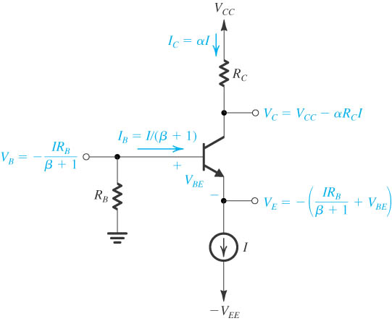
The Basic Structure
Basic structure of the circuit used to realize single-stage, discrete-circuit BJT amplifier configurations.

Slide 9
Characterizing BJT Amplifiers
To study the BJT amplifier circuits, it is important to know how to characterize the performance of amplifiers as circuit building blocks.
During the introduction to this subject, the initial material was limited to unilateral amplifiers.
A number of the amplifier circuits however, are not unilateral; that is, they have internal feedback that may cause their input resistance to depend on the load resistance. Similarly, internal feedback may cause the output resistance to depend on the value of the resistance of the signal source feeding the amplifier.

Slide 10
Characterizing BJT Amplifiers
For nonunilateral amplifiers, we present here a general set of parameters and equivalent circuits that we will employ in characterizing and comparing transistor amplifiers.

Slide 11
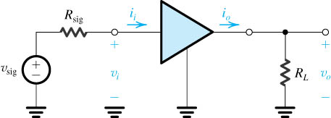
Characteristic Parameters of Amplifier
This is the two-port network of amplifier.
open-circuit voltage signal source v_{sig} and an internal resistance R_{sig.}
Output signal is obtained from the load resistor.

Slide 12
Definitions
Input Resistance with no Load:
Input Resistance:
Open-Circuit Voltage Gain:
Voltage Gain:

Slide 13
Definitions(cont’d)
Short-Circuit Current Gain:
Current Gain:
Short-Circuit Transconductance:

Slide 14
Definitions(cont’d)
Open-Circuit overall Voltage Gain:
Overall Voltage Gain:

Slide 15
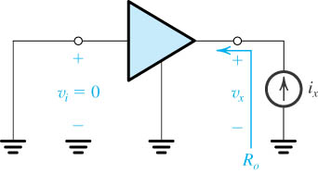
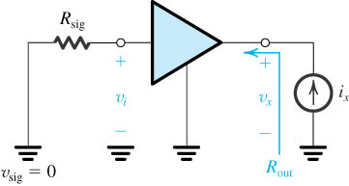
Definitions(cont’d)
Output resistance of amplifier proper
Output resistance

Slide 16
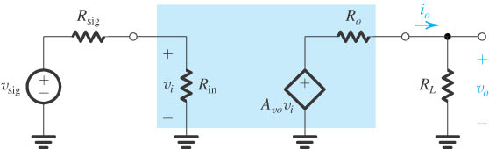
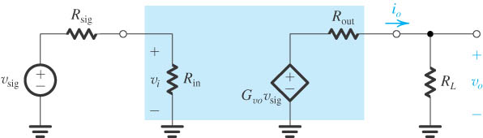
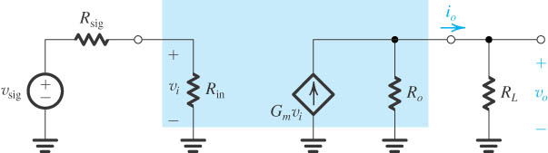
Equivalent Circuits
Voltage Amplifier
Voltage Amplifier
Transconductance Amplifier

Slide 17
Relationships
Voltage Divided Coefficient:

Slide 18
The BJT Amplifier Configurations

Slide 19
The Common-Emitter (CE) Amplifier
The CE configuration is the most widely used of all BJT amplifier circuits.
Slide 21 (Figure 5.60) shows a CE amplifier implemented using the circuit of slide 8 (Fig. 5.59).
To establish a signal ground (or an ac ground, as it is sometimes called) at the emitter, a large capacitor CE, usually in the μF or tens of μF range, is connected between emitter and ground.

Slide 20
The Common-Emitter (CE) Amplifier
This capacitor is required to provide a very low impedance to ground (ideally, zero impedance; i.e., in effect, a short circuit) at all signal frequencies of interest. In this way, the emitter signal current passes through C_{E} to ground and thus bypasses the output resistance of the current source I (and any other circuit component that might be connected to the emitter);
Hence C_{E} is called a bypass capacitor. Obviously, the lower the signal frequency, the less effective the bypass capacitor becomes. We shall assume that C_{E} is acting as a perfect short circuit and thus is establishing a zero signal voltage at the emitter.

Slide 21
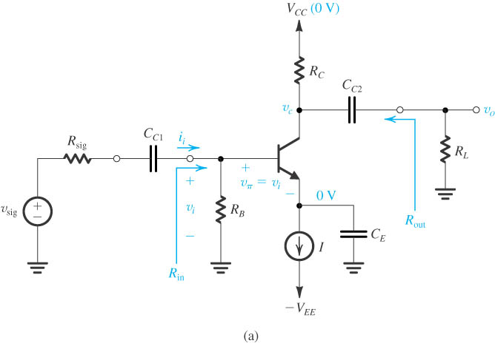
The Common-Emitter (CE) Amplifier

Slide 22
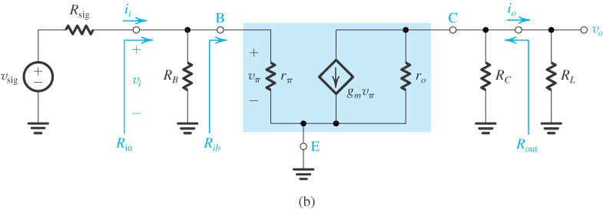
Common-Emitter Amplifier
Equivalent circuit obtained by replacing the transistor with its hybrid-pi model.

Slide 23
Common-Emitter Amplifier
The Common-Emitter Amplifier
Equivalent circuit

Slide 24
Characteristics of CE Amplifier
Input resistance
Overall voltage gain
Output resistance
Short-circuit current gain

Slide 25
Summary of C-E amplifier
Large voltage gain
Inverting amplifier
Large current gain
Input resistance is relatively low
Output resistance is relatively high
Frequency response is rather poor

Slide 26
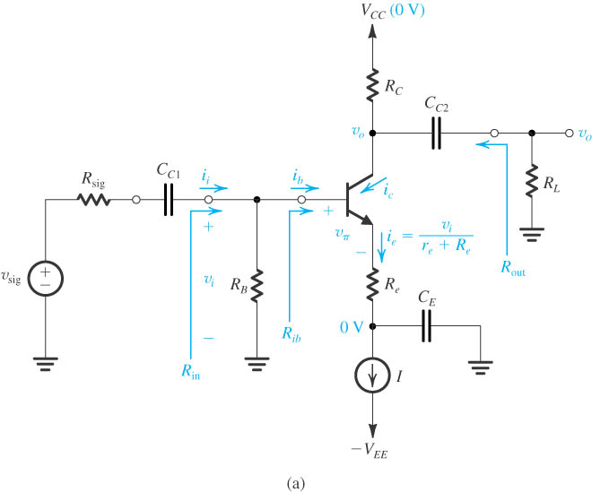
The Common-Emitter Amplifier with a Resistance in the Emitter

Slide 27
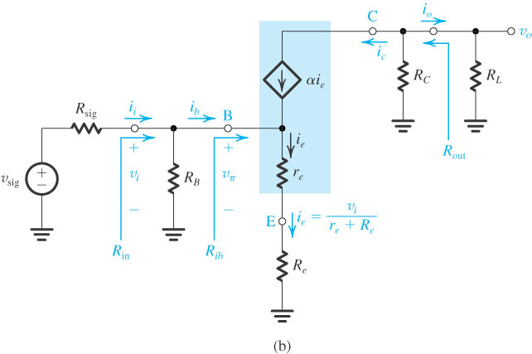
The Common-Emitter Amplifier with a Resistance in the Emitter

Slide 28
Characteristics of the CE Amplifier with a Resistance in the Emitter
Input resistance
Voltage gain
Overall voltage gain
Output resistance
Short-circuit current gain

Slide 29
Summary of CE Amplifier with R_{E}
The input resistance R_{in} is increased by the factor (1+g_{m}R_{e}).
The voltage gain from base to collector is reduced by the factor (1+g_{m}R_{e}).
For the same nonlinear distortion, the input signal v_{i} can be increased by the factor (1+g_{m}R_{e}).
The overall voltage gain is less dependent on the value of β.

Slide 30
Summary of CE Amplifier with R_{E}
The reduction in gain is the price for obtaining the other performance improvements.
Resistor R_{E} introduces the negative feedback into the amplifier.
The high frequency response is significantly improved.

Slide 31
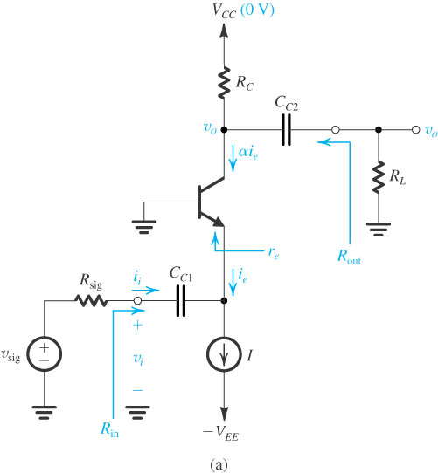
The Common-Base (CB) Amplifier

Slide 32
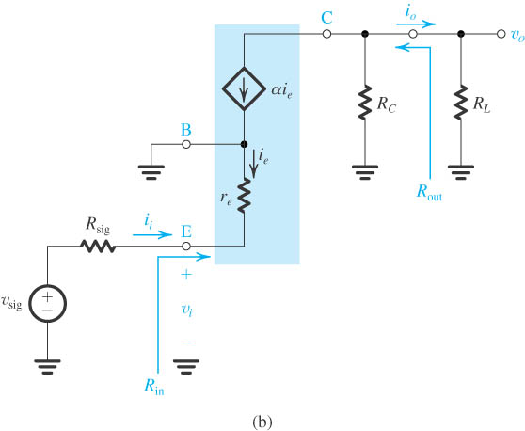
The Common-Base Amplifier

Slide 33
Characteristics of CB Amplifier
Input resistance
Voltage gain
Overall voltage gain
Output resistance
Short-circuit current gain

Slide 34
Summary of the CB Amplifier
Very low input resistance
High output resistance
Short-circuit current gain is nearly unity
High voltage gain
Non-inverting amplifier
Excellent high-frequency performance

Slide 35
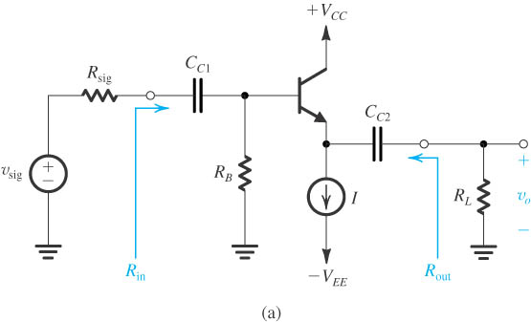
The Common-Collector (CC) Amplifier or Emitter-Follower

Slide 36
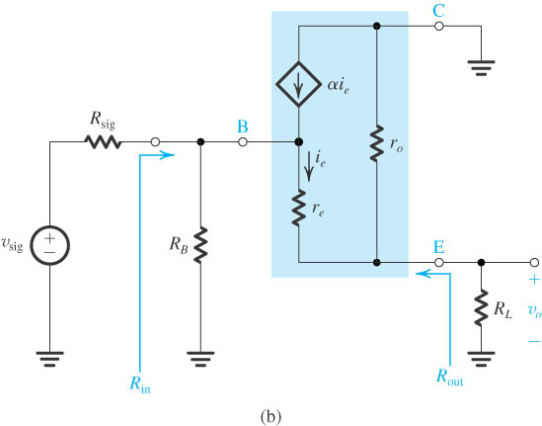
The Common-Collector Amplifier or Emitter-Follower

Slide 37
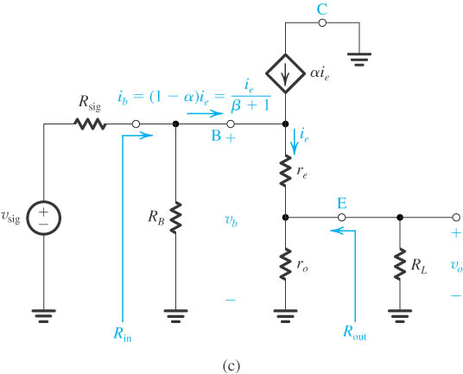
The Common-Collector Amplifier or Emitter-Follower

Slide 38
Characteristics of CC Amplifier
Input resistance
Voltage gain
Overall voltage gain
Output resistance
Short-circuit current gain

Slide 39
Summary for CC Amplifier or
Emitter-Follower
High input resistance
Low output resistance
Voltage gain is smaller than but very close to unity
Large current gain
The last or output stage of cascade amplifier
Frequency response is excellent well

Slide 40
Summary and Comparisons
The CE configuration is the best suited for realizing the amplifier gain.
Including R_{E} provides performance improvements at the expense of gain reduction.
The CB configuration only has the typical application in amplifier. Much superior high-frequency response.
The emitter follower can be used as a voltage buffer and exists in output stage of a multistage amplifier.

Slide 41
Example: 5.41
Consider the circuit of Fig. 5.59 for the case V_{CC} = V_{EE} =10 V, I = 1 mA, R_{B}=100 kΩ, R_{C}=8 kΩ, and β =100.
Find all dc currents and voltages. What are the allowable signal swings at the collector in both directions? How do these values change as β is changed to 50? To 200?
Evaluate the values of the BJT small-signal parameters at the bias point (with β = 100). The Early voltage VA = 100 V.

Slide 42
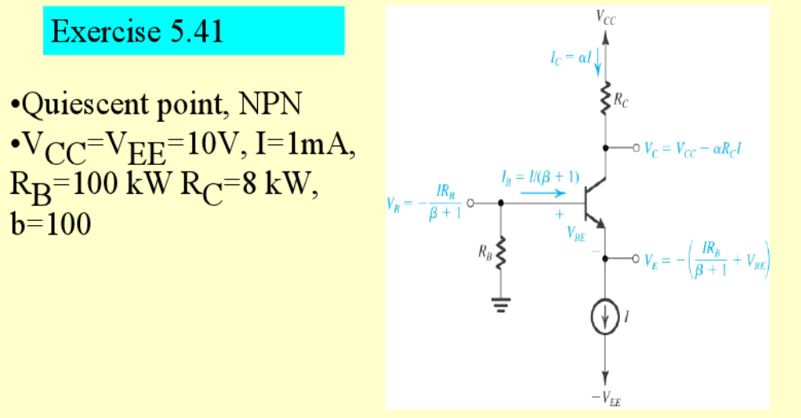
Example: 5.41

Slide 43
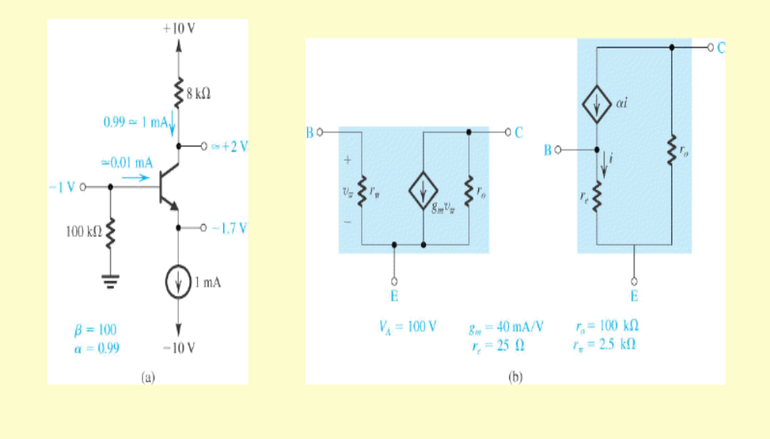
Example: 5.41

