Slide 1

COMSATS Institute of Information Technology
Virtual campus
Islamabad
Dr. Nasim Zafar
Electronics 1 - EEE 231
Fall Semester – 2012

Slide 2
Application of the Small-Signal Equivalent Circuits: Examples
Lecture No. 24
Contents:
Examples: BJT as an Amplifier.
Examples: Small-Signal Equivalent Circuit Models.

Slide 3
Lecture No. 24
Reference:
Application of the Small-Signal Equivalent Circuits
Chapter-5.6.8
Microelectronic Circuits
Adel S. Sedra and Kenneth C. Smith.

Slide 4
Introduction
The availability of the small-signal BJT circuit models makes the analysis of transistor amplifier circuits a systematic process.
The process consists of the following steps:
  Determine the dc operating point of the BJT and in particular the dc collector current I_{C}.
  Calculate the values of the small-signal model parameters:
  g_{m} = I_{C} ⁄ V_{T} ,
  r_{π} = β ⁄ g_{m}, and
  r_{e} = V_{T} /I_{E} ≅ 1 ⁄ gm.

Slide 5
Introduction
  3. Draw ac circuit path. Eliminate the dc sources by replacing each dc voltage source with a short circuit and each dc current source with an open circuit.
  Replace the BJT with one of its small-signal equivalent circuit models.
  Analyze the resulting circuit to determine the required quantities e.g., voltage gain, input resistance.

Slide 6
DC Analysis of BJT
Using simple constant-voltage drop model, assuming , irrespective of the exact value of currents.
Assuming the device operates at the active region, we can apply the relationship between I_{B}, I_{C}, and I_{E}, to determine the voltage V_{CE} or V_{CB.}

Slide 7
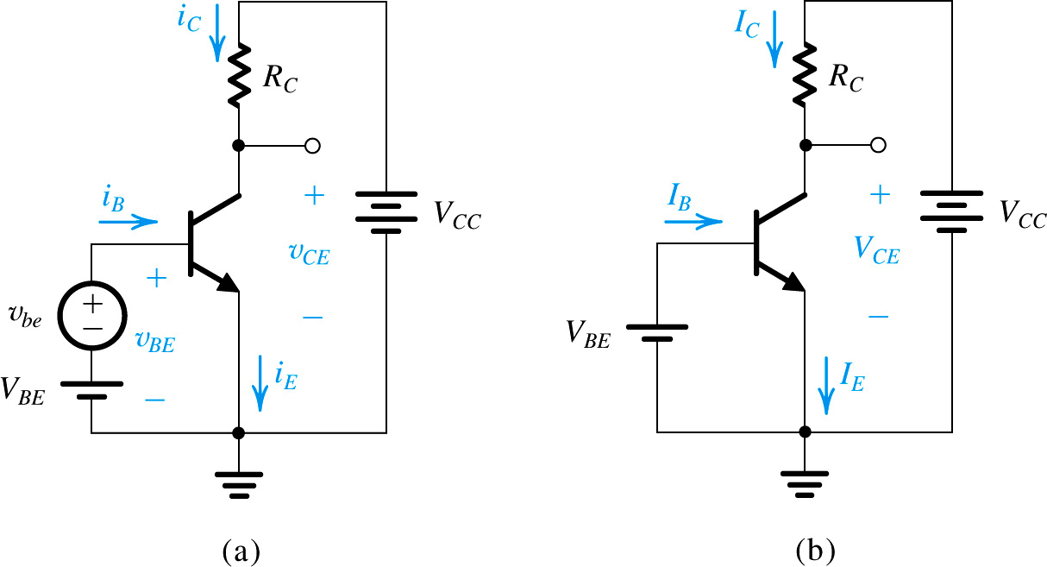

DC Analysis of BJT
The AC signal, v_{be} , is removed for dc bias analysis
(a) Transistor Amplifier Circuit
(b) Circuit for DC Analysis
Figure 5.48

Slide 8
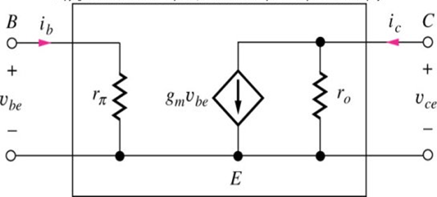
The Hybrid-π Model
A transistor hybrid-π model: - a voltage controlled current source.

Slide 9
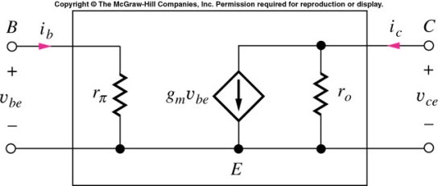
Hybrid-Pi Model for the BJT
Transconductance:
Input resistance: R_{in}
The small-signal parameters are controlled by the Q-point and are independent of the geometry of the BJT.
Output resistance:

Slide 10
Application of the Small Signal Operation
Example 5.14

Slide 11
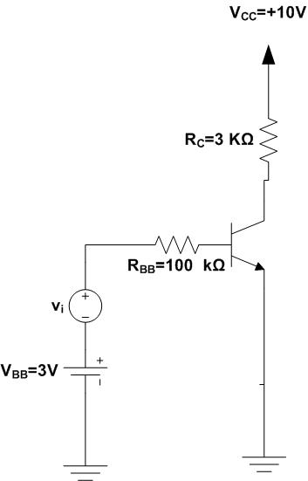
Application of the Small Signal Operation
Example 5.14
We wish to analyze the transistor amplifier shown in Fig. 5.53(a)
to determine its voltage gain. Assume β=100
Fig. 5.53(a)

Slide 12
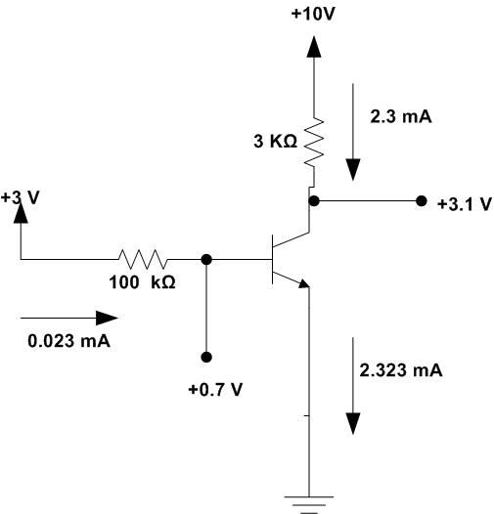
Example 5.14
Example 5.14: (a) circuit; (b) dc analysis;
(a) an Amplifier Circuit
(b) DC Analysis of Amplifier
Figure 5.53

Slide 13


Solution:
Example 5.14 (Step 1)
Step-1 Determination of the Q-Point:
Input Loop: I_{B} , V_{BE}
The first step in the dc analysis consists of determining the quiescent operating point. For this purpose we assume that v_{i} =0. The dc base current will be given by:

Slide 14
Example 5.14 (Step 1)
Step-1 Determination of the Q-Point:
Input Loop: I_{B} , V_{BE}
(b) DC Analysis of Amplifier

Slide 15
Example 5.14 (Step 2)
Step-2 Determination of the Q-Point:
Output Loop: I_{C} , V_{CE}
The dc collector current I_{C} will be:
The dc voltage V_{CE} at the collector will be:
Since at + 0.7V is less than V_{CE}, it follows that in the quiescent condition, the transistor will be operating in the active mode. The dc analysis is illustrated by Fig. 5.53(b) in slide 14.

Slide 16

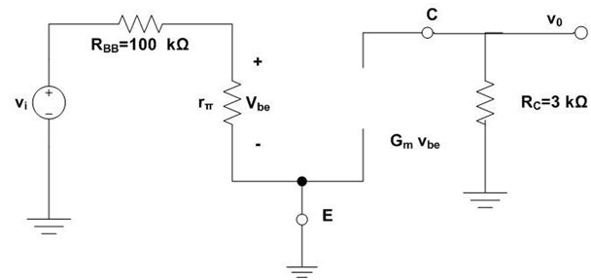



Example 5.14 (Step-3)
Step-3 Determination of the Small Signal Model Parameters:
Having determined the operating point, we may now proceed to determine the small-signal model parameters:
5.53(c) Small-Signal Model.

Slide 17
Example 5.14:Small-Signal Model (cont.)
To carry out the small-signal analysis it is equally convenient to employ either of the two hybrid-π equivalent circuit models of Fig. 5.51.
Using the first results in the amplifier equivalent circuit given in Fig. 5.53(c). Note that no dc quantities are included in this equivalent circuit.
It is most important to note that the dc supply voltage V_{CC} has been replaced by a short circuit in the small signal equivalent circuit because the circuit terminal connected to V_{CC} will always have a constant voltage; that is, the signal voltage at his terminal will be zero. In other words, a circuit terminal connected to a constant dc source can always be considered as a signal ground.

Slide 18



Example 5.14:Small-Signal Model (cont.)
Analysis of the equivalent circuit in Fig. 5.53(c) proceeds as follows:
The output voltage v_{o} and the voltage gain A_{v} are given by:
, the minus sign indicates a phase reversal.

Slide 19
Application of the Small Signal Operation
Example 5.16

Slide 20
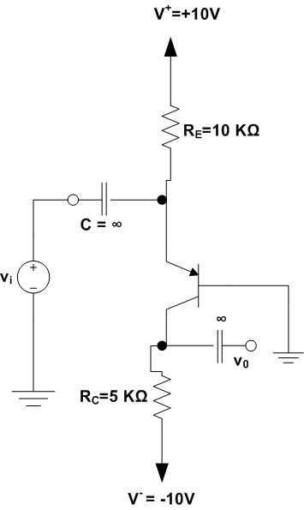
Example 5.16
Consider the circuit of Fig. 5.55(a) to determine the voltage gain and the signal wave forms at various points.
Fig. 5.55 (a)

Slide 21
Fig. 5.55 : Example 5.16
Let us analyze the circuit of Fig. 5.55(a) to determine the voltage gain and the signal wave forms at various points.
The capacitor C is a coupling capacitor whose purpose is to couple the signal v_{i} to the emitter while blocking dc. In this way the dc bias established by V ⁺ and V ⁻ together with R_{E} and R_{C} will not be disturbed when the signal v_{i} is connected.

Slide 22
Fig. 5.55 : Example 5.16
In this example, C will be assumed to be very large and ideally infinite – that is, acting as a perfect short circuit at signal frequencies of interest.
Similarly, another very large capacitor is used to couple the output signal to other parts of the system.

Slide 23
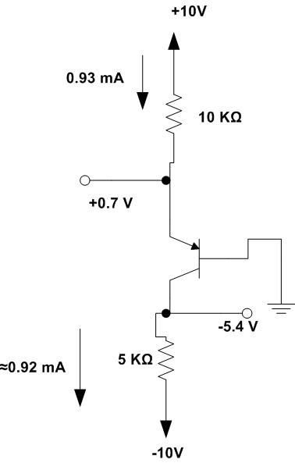
Fig. 5.55 : Example 5.16
(a) Circuit
(b) dc Analysis

Slide 24
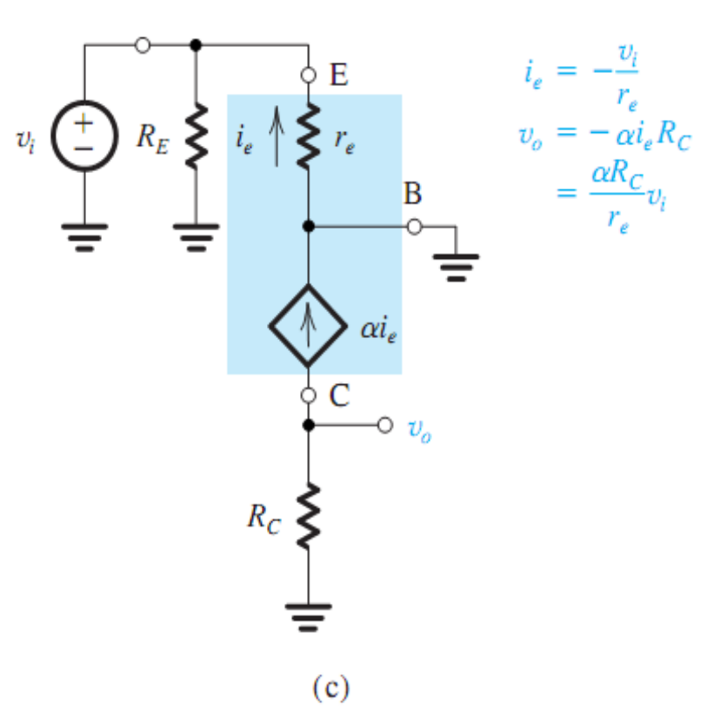
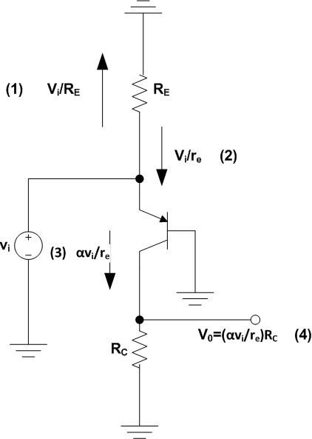
Fig. 5.55 : Example 5.16
(c) Small-Signal Model.
(d) Small-Signal analysis performed directly on the circuit.

Slide 25

Fig. 5.55 : Example 5.16
Solution
The dc Operating Point:
Assuming β =100, then α=0.99, and
Thus the transistor is in the active mode.

Slide 26
Fig. 5.55 : Example 5.16
The transistor is in the active mode. Furthermore, the collector signal can swing from -5.4 V to +0.4 V (which is 0.4 v above the base voltage) without the transistor going into saturation.
However, a negative 5.8-V swing in the collector voltage will (theoretically) cause the minimum collector voltage to be -11.2 V,
which is more negative than the power supply voltage.
It follows that if we attempt to apply an input that results in such an output signal, the transistor will cut off and the negative peaks of the output signal will be clipped off.

Slide 27

Fig. 5.55 : Example 5.16
Let us now proceed to determine the small signal voltage gain. To do that, we eliminate the dc sources and replace the BJP with its T - equivalent circuit of Fig. 55.2(b). Note that because the base is grounded, the T model is somewhat more convenient than the hybrid-π model. Nevertheless, identical results can be obtained using the latter.
Figure 5.55(c) shows the resulting small-signal equivalent circuit of the amplifier. The model parameters are

Slide 28

Fig. 5.55 : Example 5.16
Analysis of the circuit in Fig. 5.55(c) to determine the output voltage and hence the voltage gain is straightforward and is given in the figure. The result is
The voltage gain is positive, indicating that the output is in phase with the input signal.
This property is due to the fact that the input signal is applied to the emitter rather than to the base.

Slide 29
Fig. 5.55 : Example 5.16
Returning to the question of allowable signal magnitude, we observe from Fig. 5.55(c) that v_{eb}=v_{i}.
Thus, if small-signal operation is desired (for linearity), then the peak of should be limited to approximately 10 mV. With V_{i} set to this value, as shown for a sine-wave input in Fig. 5.57, the peak amplitude at the collector, , will be
And the total instantaneous collector voltage will be shown in Fig. 5.57

Slide 30
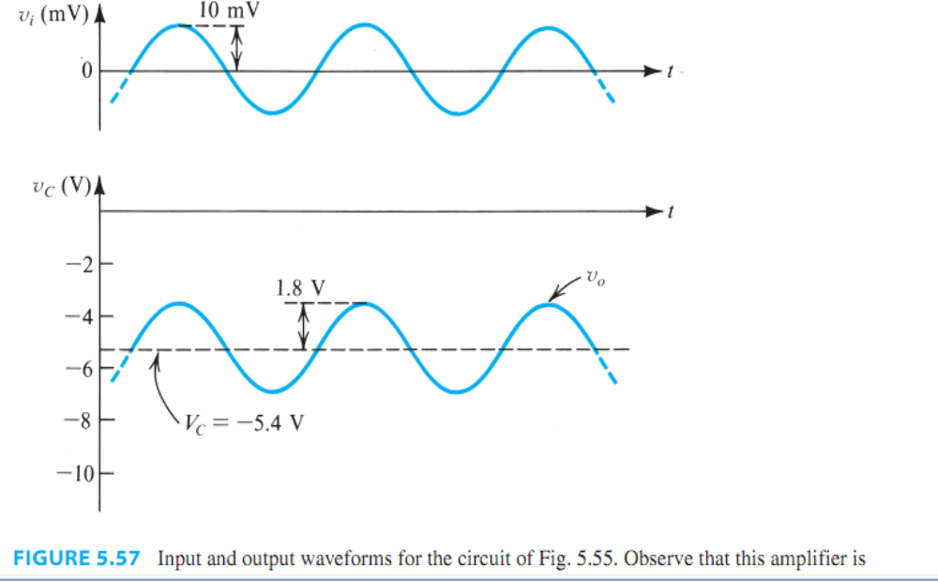
Fig. 5.57 : Example 5.16

Slide 31
Exercise 5.39
Exercise 5.39
To increase the voltage gain of the amplifier analyzed in Example 5.16, the collector resistance is increased to 7.5 kΩ. Find the new values of , , and the peak amplitude of the output sine wave corresponding to an input sine wave of 10 mV peak.
Ans. -3.1 V; 275 V/V; 2.75 V

Slide 32
Lecture No. 24
Reference:
Chapter-5.3.2
Amplifier Gain
Microelectronic Circuits
Adel S. Sedra and Kenneth C. Smith.

Slide 33
Example 5.2

Slide 34
Example 5.2 (Ref. Sedra-Smith)
Consider a common-emitter circuit with a BJT having
I_{S} = 10⁻¹⁵ A, a collector resistance R_{C} = 6.8 kΩ, and a power supply V_{CC} = 10 V.
(a) Determine the value of the bias voltage V_{BE} required to operate the transistor at V_{CE} = 3.2 V. What is the corresponding value of I_{C}?
(b) Find the voltage gain A_{v} at this bias point.
If an input sine-wave signal of 5-mV peak amplitude is superimposed on V_{BE}, find the amplitude of the output sine-wave signal (assume linear operation).

Slide 35
Example 5.2
(c) Find the positive increment in v_{BE} (above V_{BE}) that drives the transistor to the edge of saturation with v_{CE} = 0.3 V.
(d) Find the negative increment in v_{BE} that drives the transistor to within 1% of cutoff (i.e., v_{O} = 0.99V_{CC})

Slide 36



Solution-Example5.2
(a) Determine the bias voltage V_{BE} :
Using the relation for I_{C}:

Slide 37


Solution-Example5.2
Which gives V_{BE}

Slide 38






Solution-Example 5.2
(b) Find the voltage gain A_{v} at this bias point:
Where V_{RC} is the dc voltage drop across R_{C}:

Slide 39
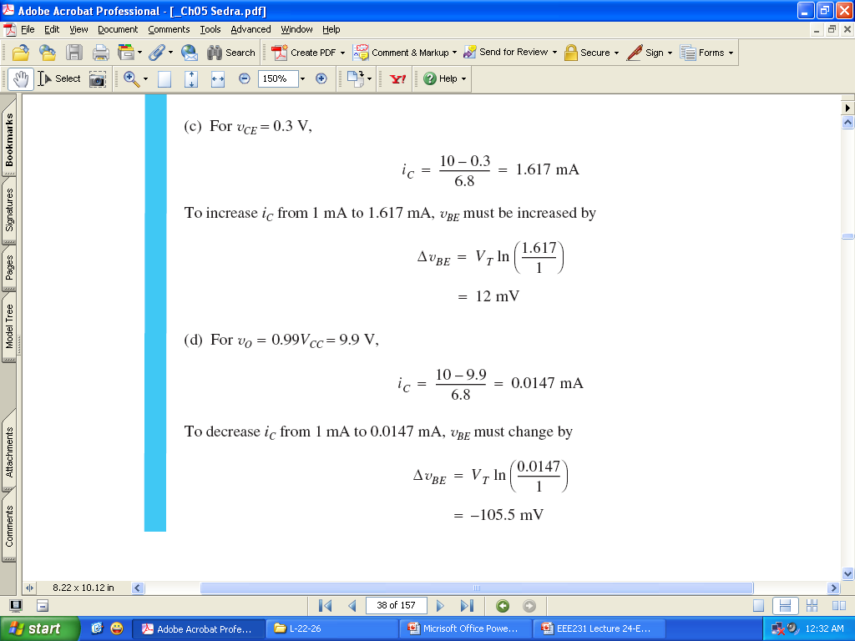
Solution-Example 5.2
(c) Find the positive increment in v_{BE} (above V_{BE}) that drives the transistor to the edge of saturation with v_{CE} = 0.3 V.

Slide 40

Solution-Example 5.2
(d) Find the negative increment in v_{BE} that drives the transistor to within 1% of cutoff (i.e., v_{O} = 0.99V_{CC})

Slide 41
Exercise:5.19
For the circuit of 5.2, While keeping I_{C} unchanged at 1 mA, find the value of R_{C} that will result in a voltage gain of –320 V/V.
What is the largest negative signal swing allowed at the output (assume that v_{CE} is not to decrease below 0.3 V)? What approximately is the corresponding input signal amplitude? (Assume linear operation).
Ans. 8 kΩ; 1.7 V; 5.3 mV

Slide 42
More Examples

Slide 43
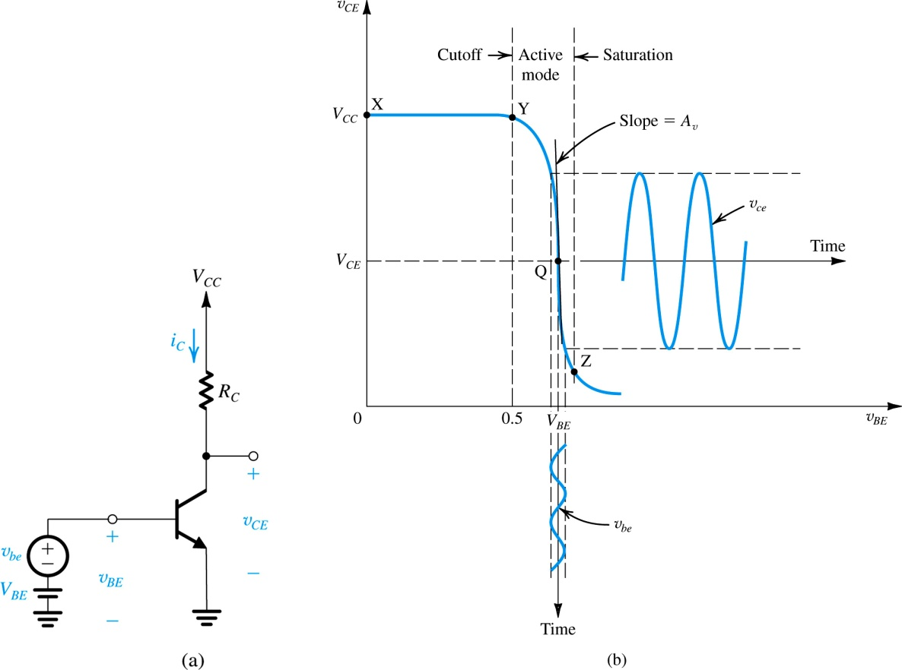
Amplifiers-Example24.1
A BJT amplifier is to be operated with :
V_{CC} = +5 V and biased at V_{CE} = +1 V.
Find the voltage gain, A_{v}.
Given:
A_{v} = DV_{o} / DV_{i}
where v_{o} = v_{CE} and v_{i} = v_{BE}

Slide 44
Example 24.1(cont.)
The Principle of BJT operation is that a change in v_{BE} produces a change in i_{C}. By keeping Dv_{BE} small, Di_{C} is approximately linearly-related to Dv_{BE} such that Di_{C} = g_{m} ⋅ Dv_{BE}. By passing Di_{C} through R_{C}, an output voltage signal v_{o} is obtained.
Use the expression for the small-signal voltage gain to derive an expression for g_{m}. What is g_{m} if I_{C} = 1 mA?

Slide 45
Example 24.1 (Solution):

Slide 46
Solution (Cont’d):

