Slide 1
Application of the Small Signal Operation
Example 5.14
We wish to analyze the transistor amplifier shown in Fig. 5.53(a)
to determine its voltage gain. Assume β=100

Slide 2
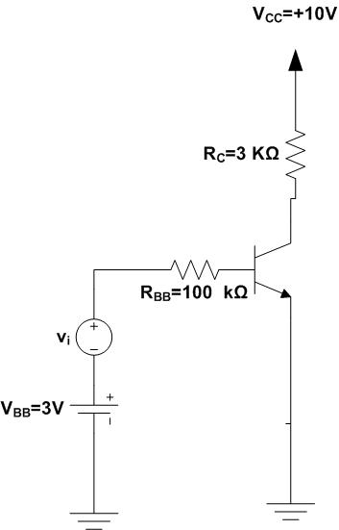
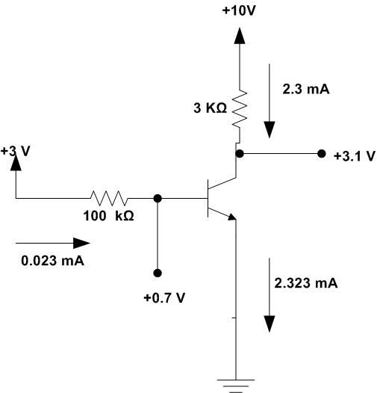
Example 5.14
(a)
(b)

Slide 3
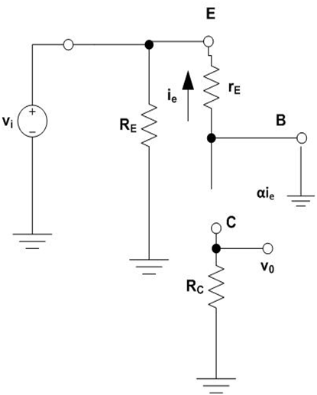

Example 5.16 (c)

Slide 4
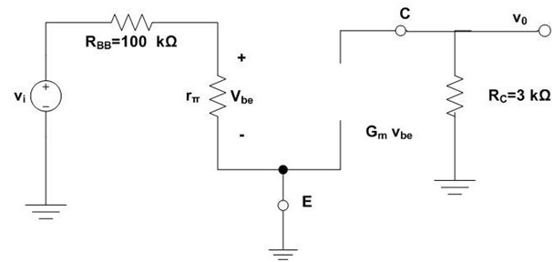

Example 5.14 (c)

Slide 5
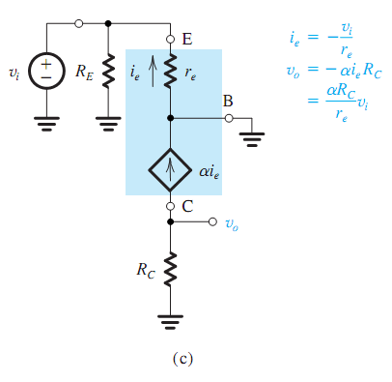
Fig 5.55 C

