Slide 1

COMSATS Institute of Information Technology
Virtual campus
Islamabad
Dr. Nasim Zafar
Electronics 1 - EEE 231
Fall Semester – 2012

Slide 2
Biasing in BJT Amplifier Circuits and Small-Signal Operation and Models
Lecture No. 22
Contents:
Graphical Analysis of the BJT Amplifier Circuits.
Biasing the BJT for Discrete-Circuit Design.
Small-Signal Operation and Models.

Slide 3
Graphical Analysis of the BJT Amplifier Circuits
Reference:
Chapter-5.3.3
Microelectronic Circuits
Adel S. Sedra and Kenneth C. Smith.

Slide 6
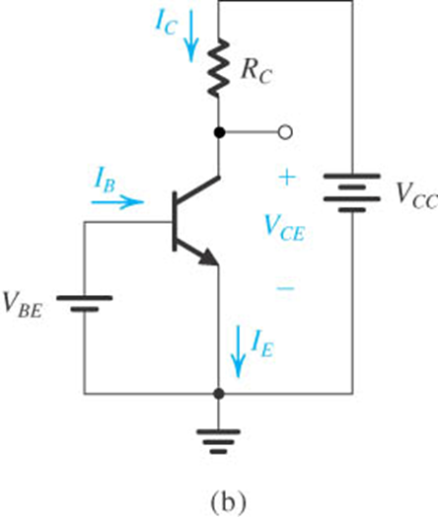
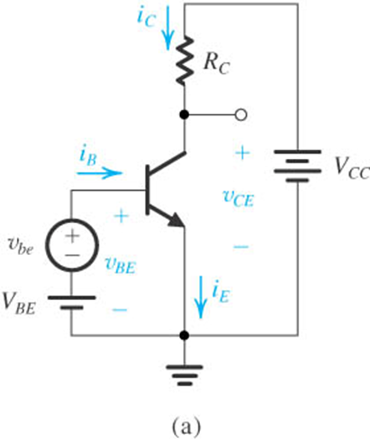
The BJT Circuits
The DC Biased BJT Circuit
The BJT Amplifier Circuit

Slide 7
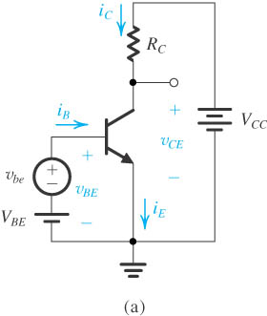

The Transistor Amplifier Circuit
(a) Conceptual circuit to illustrate the operation of the transistor as an amplifier.
(b) The circuit of (a) with the signal source v_{be} eliminated for dc (bias) analysis.

Slide 8
Transistor Biasing as an Amplifier Circuit:
The purpose of dc biasing is to establish the Q-point for operation.
The collector curves and load lines help us to relate the Q-point and its proximity to cutoff and saturation.
The Q-point is best established where the signal variations do not cause the transistor to go into saturation or cutoff.
What we are most interested in is, the ac signal itself. Since the dc part of the overall signal is filtered out in most cases, we can view a transistor circuit in terms of just its ac component.

Slide 9
Review: Sinusoidal Analysis
Any voltage or current in a linear circuit with a sinusoidal source is a sinusoid of the same frequency (ω).
  We only need to keep track of the amplitude and phase, when determining the response of a linear circuit to a sinusoidal source.
Any time-varying signal can be expressed as a sum of sinusoids of various frequencies (and phases).
→ Applying the principle of superposition:
  The current or voltage response in a linear circuit due to a time-varying input signal can be calculated as the sum of the sinusoidal responses for each sinusoidal component of the input signal.

Slide 10
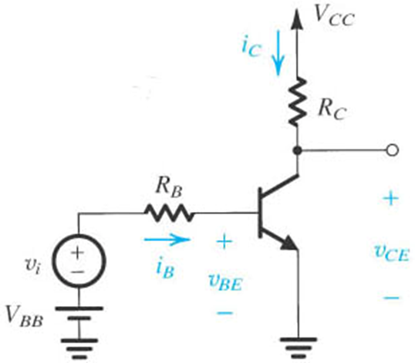
Graphical Analysis of the BJT Amplifier
Let us consider the graphical analysis of the operation the BJT
amplifier circuit:

Slide 11
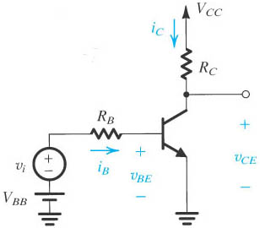
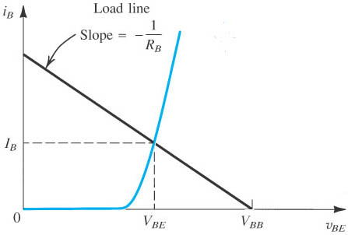
Graphical Analysis of the BJT Amplifier
(a) Graphical construction for the determination of the dc base current in the circuit.
(b) Load line intersects with the input characteristic curve.

Slide 12

Graphical Analysis of the BJT Amplifier
The dc Bias Point.
For the graphical analysis of the operation the BJT amplifier circuit; determine the dc bias point.
For this:
Set ac signal vi =0
Determine the dc Bias Point; I_{B}

Slide 13
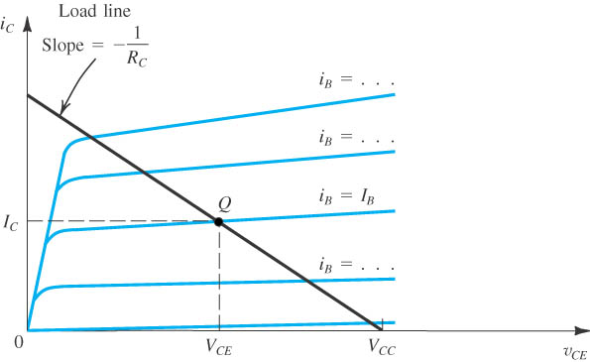
Graphical Analysis(contd.)
Graphical construction for determining the dc collector current I_{C} and the collector-to-emitter voltage V_{CE} in the circuit.

Slide 14

Graphical Analysis of the BJT Amplifier
The collector current is given by:
  V_{CC} = v_{CE} + i_{C}R_{C}
  v_{CE} = V_{CC} – i_{C}R_{C}
  i_{C}R_{C} = V_{CC} – v_{CE}
  Which represents a linear relationship between v_{CE} and i_{C.}
$$i_{c}=\frac{V_{CC}}{R_{C}}−\frac{v_{CE}}{R_{C}}$$

Slide 15
Transistor Amplifier Basics:
i_{b}
0
+
I_{B}
=
i_{B}

Slide 16
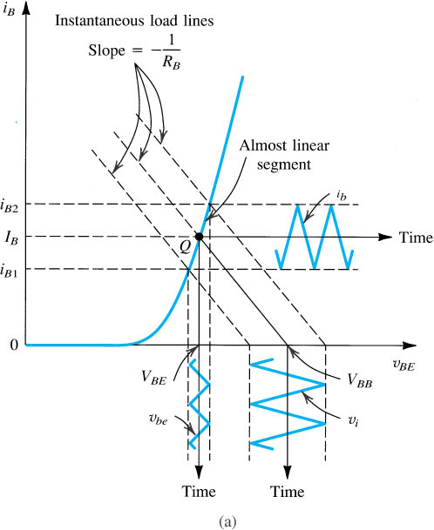
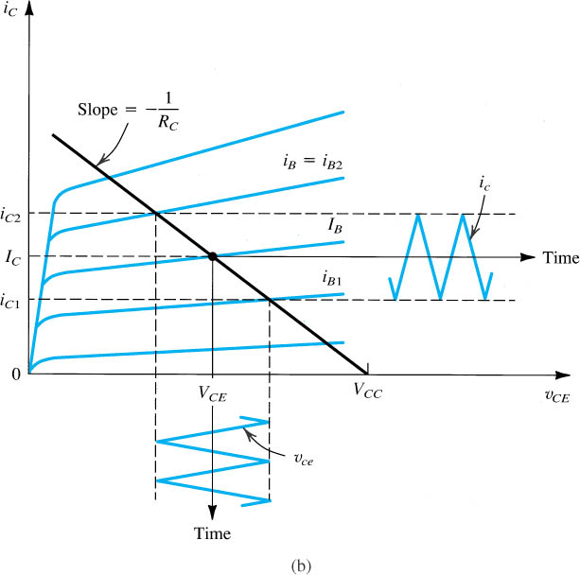
Graphical Analysis(contd.)
Graphical determination of the signal components v_{be}, i_{b}, i_{c}, and v_{ce} when a signal component v_{i} is superimposed on the dc voltage V_{BB}

Slide 17
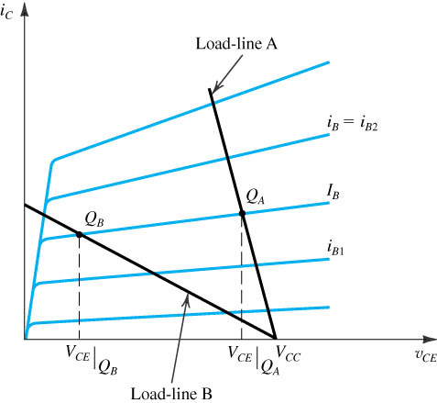
Effect of Bias-Point Location on Allowable
Signal Swing
Load-line A results in bias point Q_{A} with a corresponding V_{CE} which is too close to V_{CC} and thus limits the positive swing of v_{CE}.
At the other extreme, load-line Q_{B} results in an operating point too close to the saturation region, thus limiting the negative swing of v_{CE}.

Slide 18
Biasing in BJT Amplifier Circuit
Section 5.5

Slide 19
Biasing in BJT Amplifier Circuit
Biasing with voltage
  Classical discrete circuit bias arrangement
    Single power supply
    Two-power-supply
  With feedback resistor
Biasing with current source

Slide 20
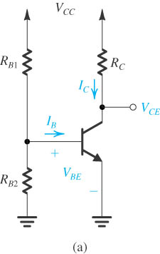
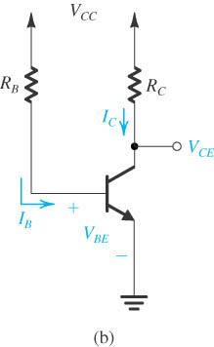
The Classical Discrete-Circuit Bias Arrangement
  by fixing V_{BE} by fixing I_{B}.

Slide 21
The Classical Discrete Circuit Bias Arrangement
Both result in wide variations in I_{C} and hence in V_{CE} and therefore are considered to be “bad.”
Neither scheme is recommended.

Slide 22
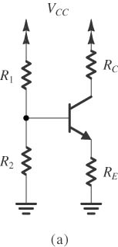
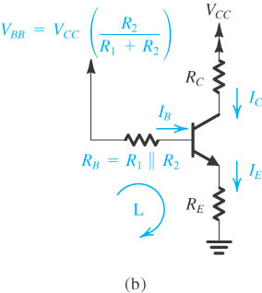
Classical Biasing for BJTs Using a Single Power Supply
Circuit with the voltage divider supplying the base replaced with its Thévenin equivalent.
Stabilizing the DC emitter current is obtained by considering the negative feedback action provided by R_{E}

Slide 23
Classical Biasing for BJTs Using a Single Power Supply
Two constraints
Rules of thumb

Slide 24
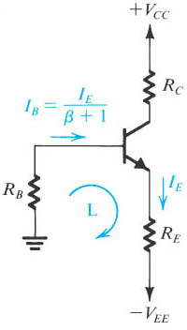
A Two-Power-Supply Version
Resistor R_{B} can be eliminated in common base configuration.
Resistor R_{B} is needed only if the signal is to be capacitively coupled to the base.
Two constraints should apply.

Slide 25
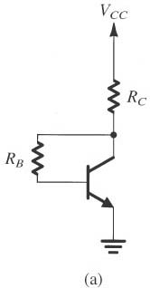
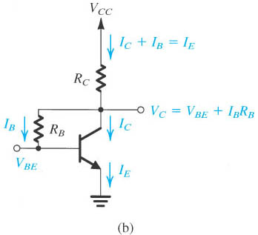
Biasing with Feedback Resistor
Resistor R_{B} provides negative feedback.
I_{E} is insensitive to β provided that
The value of R_{B} determines the allowable signal swing at the collector.

Slide 26
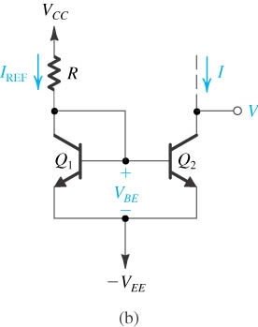
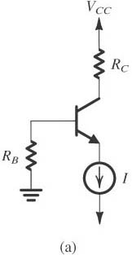
Biasing Using Current Source
Q₁ and Q₂ are required to be identical and have high β.
Short circuit between Q₁’s base and collector terminals.
Current source isn’t ideal due to finite output resistor of Q₂

Slide 27
Small Signal Operation and Models
Reference:
Chapter-5.6
Microelectronic Circuits
Adel S. Sedra and Kenneth C. Smith.

Slide 28
Small-Signal operation and Models
The Conceptual Amplifier Circuit.
Small-Signal Equivalent Circuits.
Application of the Small-Signal Equivalent Circuits.
Augmenting the hybrid π model.

Slide 29
The Conceptual Amplifier Circuit
(a) Conceptual circuit to illustrate the operation of the transistor as an amplifier.
(b) The circuit of (a) with the signal source v_{be} eliminated for dc (bias) analysis.

Slide 30
Conceptual Amplifier Circuit (contd.)
The DC Bias Conditions
The DC Bias Conditions by Setting the AC Signal Source v_{be} =0

Slide 31
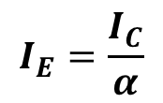


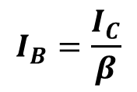
Small Signal Operation
The DC Bias Conditions
The DC Bias Conditions: by Setting the Signal Source v_{be} =0
The dc currents and voltages are given by:
$$I_{C}=I_{S}e^{\frac{V_{BE}}{V_{T}}}$$
$$I_{E}=\frac{I_{C}}{α}$$
$$I_{B}=\frac{I_{C}}{β}$$
$$V_{C}=V_{CE}=V_{CC}−I_{C}R_{C}$$

Slide 32
Conceptual Amplifier Circuit (contd.)
Current Equations:
Collector current
Base current
Emitter current

Slide 33
Small-Signal Operation and Models
The Collector current and the Transconductance.
The Base Current and the Input Resistance at the Base.
The Emitter Current and the Input Resistance at the Emitter.

Slide 34

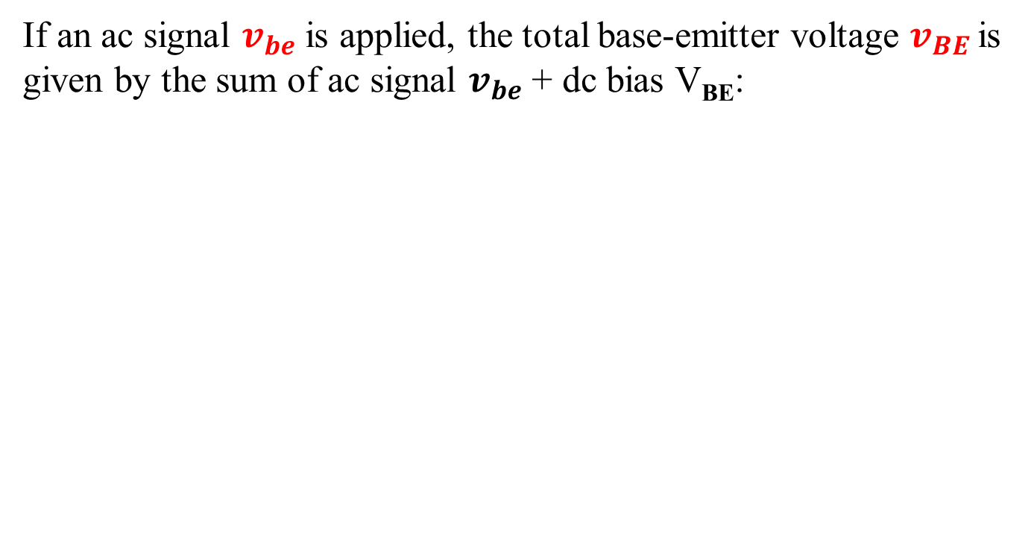
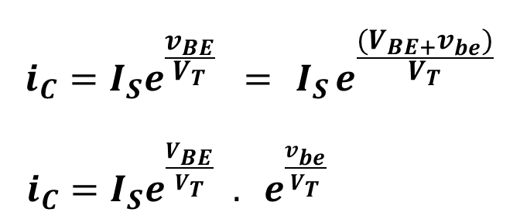
The Collector Current and the Transconductance
If an ac signal $v_{be}$is applied, the total base-emitter voltage $v_{BE}$ is given by the sum of ac signal $v_{be}$+ dc bias V_{BE}:
$$v_{BE}=V_{BE}+v_{be}$$
$$i_{C}=I_{S}e^{\frac{v_{BE}}{V_{T}}} ={ I}_{S}e^{\frac{{(V_{BE+}v}_{be})}{V_{T}}}$$
$i_{C}=I_{S}e^{\frac{V_{BE}}{V_{T}}}{ . e}^{\frac{v_{be}}{V_{T}}}$

Slide 35
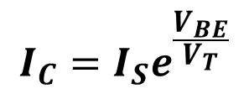
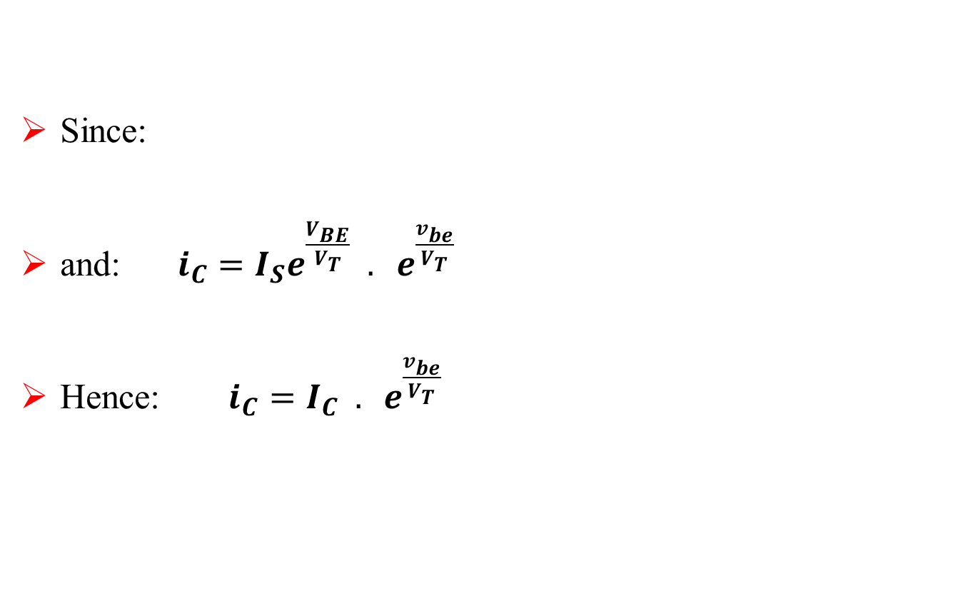
The Collector Current and the Transconductance
Since:
and: ${i_{C}=I_{S}e^{\frac{V_{BE}}{V_{T}}}{ . e}^{\frac{v_{be}}{V_{T}}} }_{}$
Hence: $i_{C}=I_{C}{ . e}^{\frac{v_{be}}{V_{T}}}$
$$I_{C}=I_{S}e^{\frac{V_{BE}}{V_{T}}}$$

Slide 36
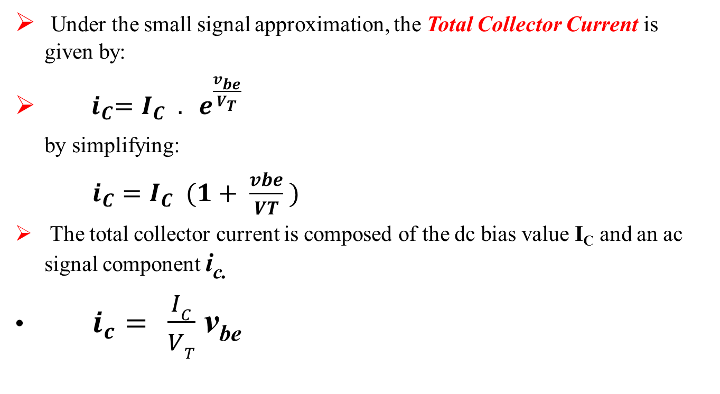
The Small Signal Approximation
Under the small signal approximation, the Total Collector Current is given by:
${ i}_{C}=I_{C}{ . e}^{\frac{v_{be}}{V_{T}}}$
by simplifying:
$i_{C}=I_{C}{ (1+ \frac{vbe}{VT} )}^{}$
The total collector current is composed of the dc bias value I_{C} and an ac signal component i_{c.}
$i_{c}=$ $\frac{IC}{VT}$ v_{be}

Slide 37

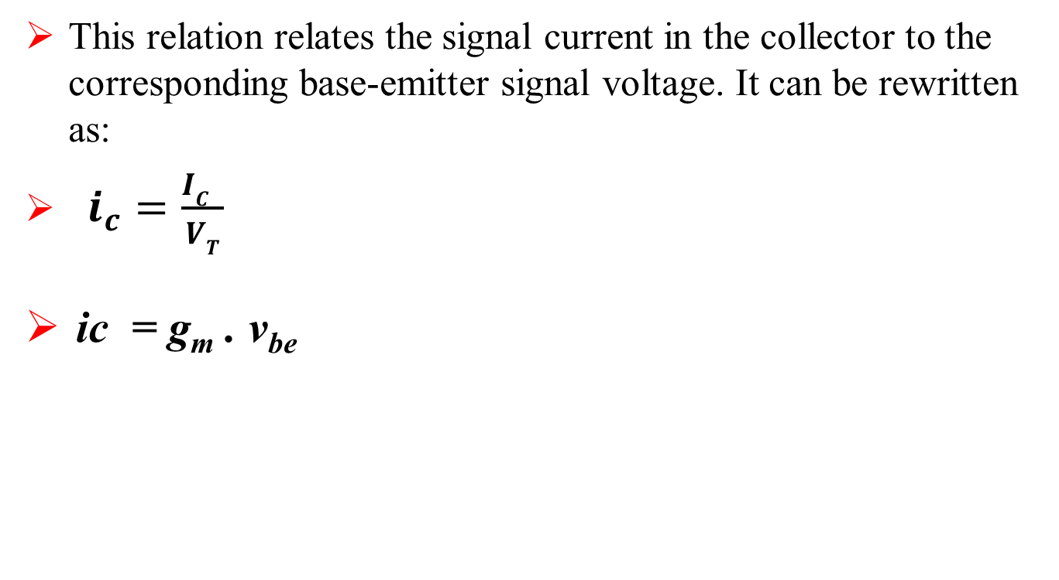
Transconductance
This relation relates the signal current in the collector to the corresponding base-emitter signal voltage. It can be rewritten as:
$i_{c}=\frac{IC }{VT}$
ic = g_{m} . v_{be}

Slide 38
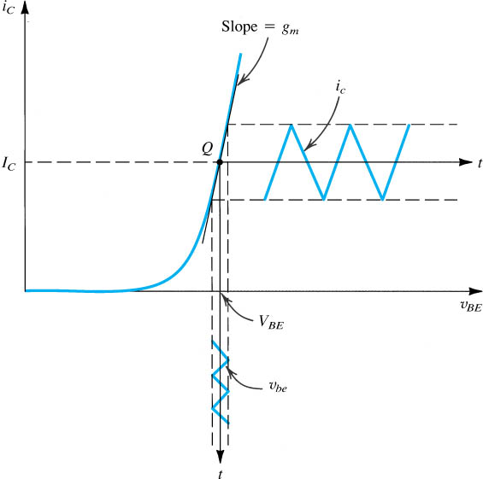
Transconductance
Expression
Physical meaning
g_{m} is the slope of the
i_{C}–v_{BE} curve at the bias point Q.
At room temperature,

Slide 39
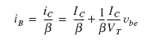

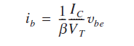
Base Current and Input Resistance at the Base
To determine the resistance seen by v_{be}, we first evaluate the total base current i_{B} using Eq. (5.84), as follows:
Thus,
where I_{B} is equal to I_{C}/_{β} and the signal component i_{b} is given by:

Slide 40
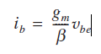


Base Current and Input Resistance at the Base
Substituting I_{C} /V_{T} for by g_{m} gives
The small-signal input resistance between base and emitter, looking into the base, is denoted by r_{π} and is defined as
Using Eq. (5.91) gives:

Slide 41
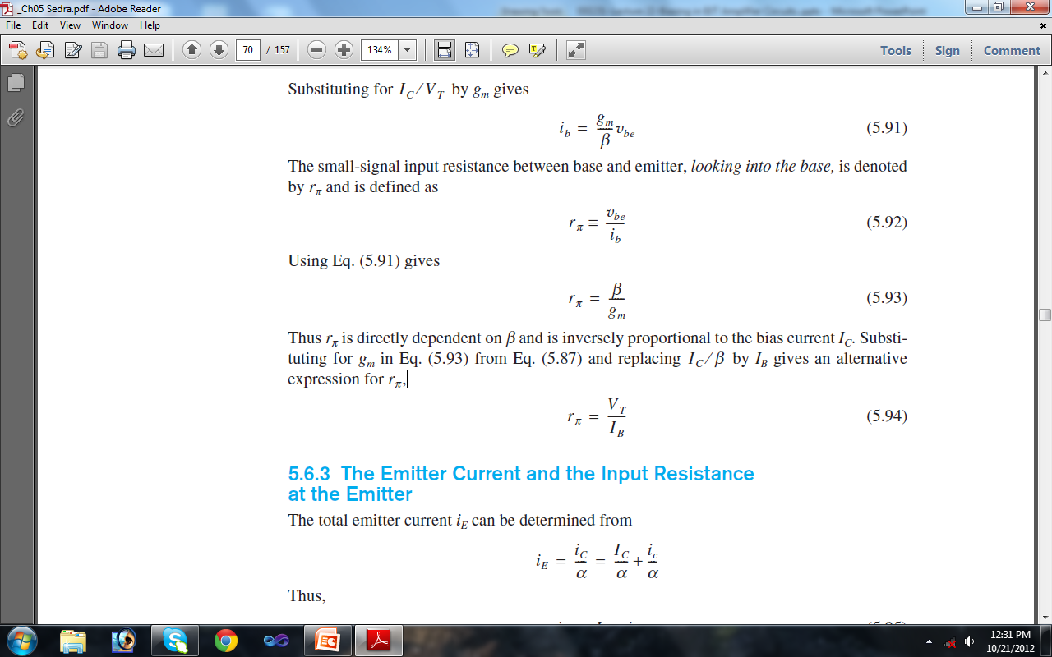
Base Current and Input Resistance at the Base
Thus r_{π} is directly dependent on ß and is inversely proportional to the bias current I_{C}. Substituting for g_{m} in Eq. (5.93) from Eq. (5.87) and replacing I_{C /} by I_{B} gives an alternative expression for r_{π} ,

Slide 42
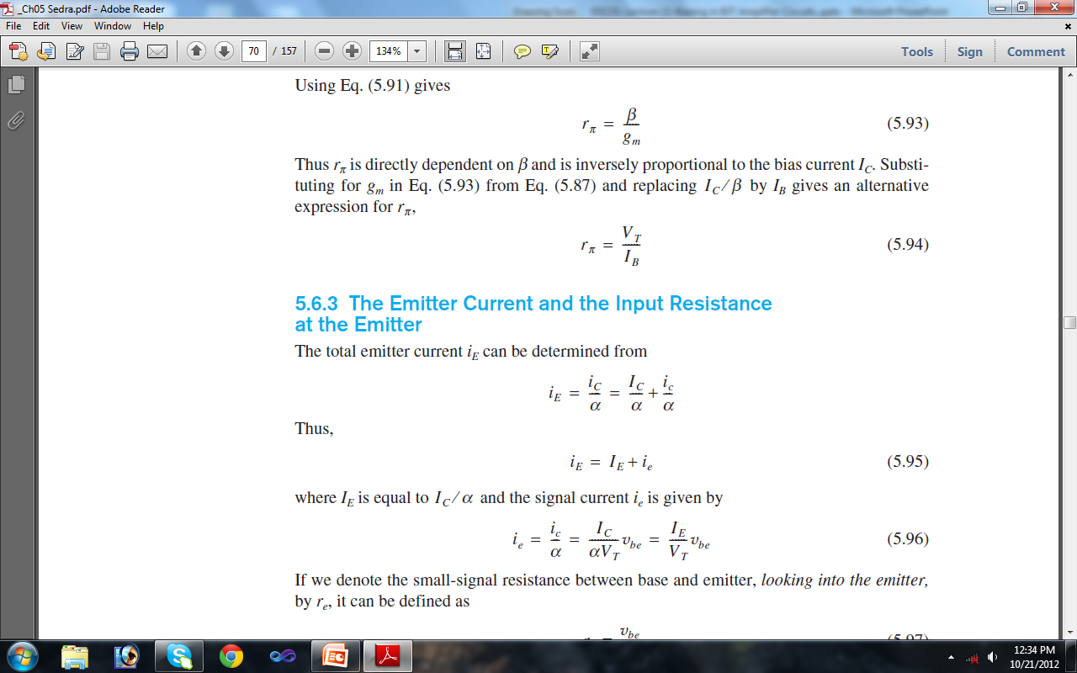

The Emitter Current and the Input Resistance at the Emitter
The total emitter current i_{E} can be determined from
where I_{E} is equal to I_{C} ⁄ α and the signal current i_{e} is given by

Slide 43
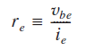
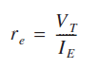
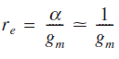
The Emitter Current and the Input Resistance at the Emitter
If we denote the small-signal resistance between base and emitter, looking into the emitter, by r_{e}, it can be defined as
Thus, we find that r_{e}, called the emitter resistance, is given by:

Slide 44
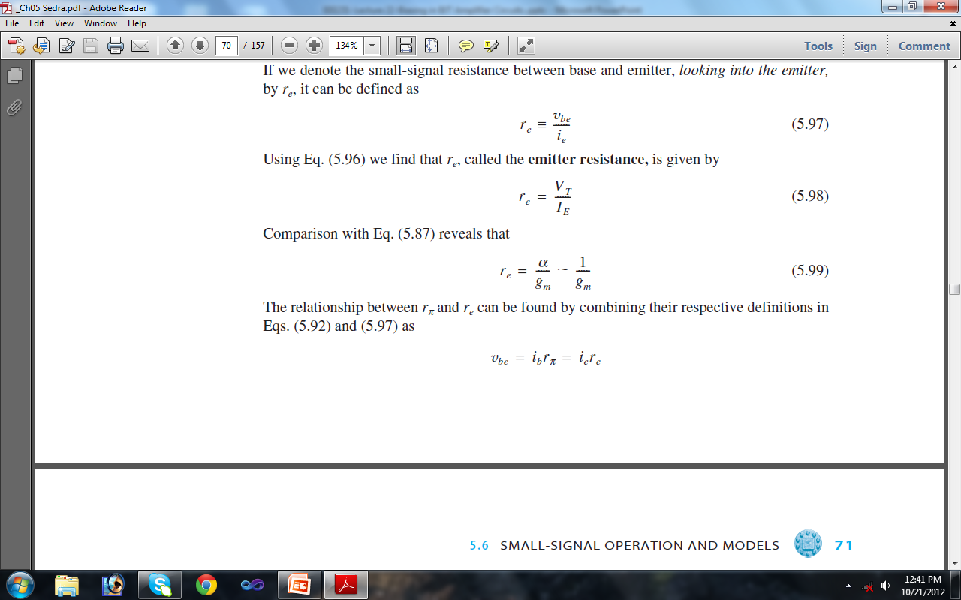
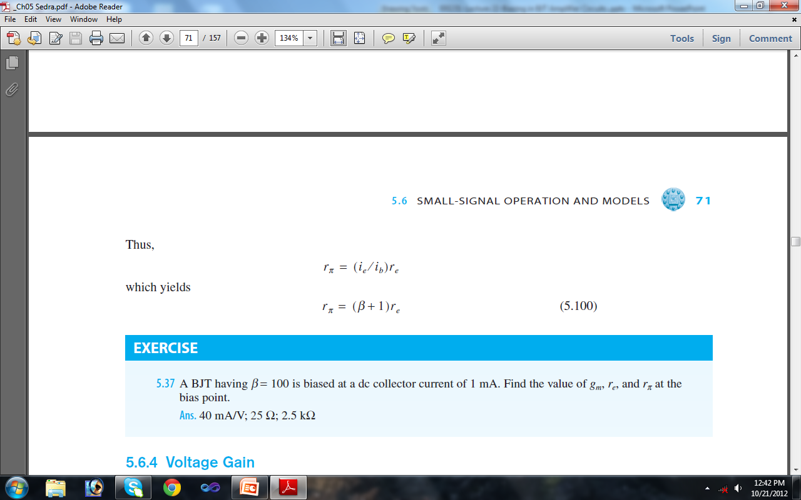
The Emitter Current and the Input Resistance at the Emitter
Thus,
Which yields

Slide 45
Summary
Input Resistance at Base and Emitter
Input resistance at base
Input resistance at emitter
Relationship between these two resistances

