Slide 1

COMSATS Institute of Information Technology
Virtual campus
Islamabad
Dr. Nasim Zafar
Electronics 1 - EEE 231
Fall Semester – 2012

Slide 2
BJT as an Amplifier.
Small-Signal Operation and Equivalent Circuits:
Lecture No. 21
Contents:
Common-Emitter Characteristics.
BJT as an Amplifier.
Small Signal Operation.
BJT Amplifiers using Coupling and Bypass Capacitors.
BJT Amplifiers-DC Equivalent Circuits.

Slide 3
References:
Microelectronic Circuits:
Adel S. Sedra and Kenneth C. Smith.
Integrated Electronics :
Jacob Millman and Christos Halkias (McGraw-Hill).
Introductory Electronic Devices and Circuits
Robert T. Paynter
Electronic Devices :
Thomas L. Floyd ( Prentice Hall ).

Slide 4
Lecture No. 21
Reference:
Microelectronic Circuits:
Adel S. Sedra and Kenneth C. Smith.

Slide 5
Introduction
Common-Emitter Characteristics-I:
We had discussed Common Emitter Current-Voltage characteristic curves extensively to understand:
How the transistor operates as a linear signal amplifier
for the ac signals.
The basis for the amplifier application is the fact that when
the BJT is operated in the active-mode, it acts as the voltage-controlled-current source: Changes in the base-emitter voltage VBE give rise to changes in the collector current Ic.
Thus, in the active-mode, the BJT can be used to implement a transconductance amplifier.

Slide 6
Introduction
Common-Emitter Characteristics-II:
Once these basics are understood we will understand:
How we can replace the transistor by a small ac-signal equivalent circuit.
How to derive a simple ac equivalent circuit from the characteristic curves.
Some of the limitations of our simple equivalent circuit.

Slide 7
The Common-Emitter Amplifier Circuit:

Slide 8
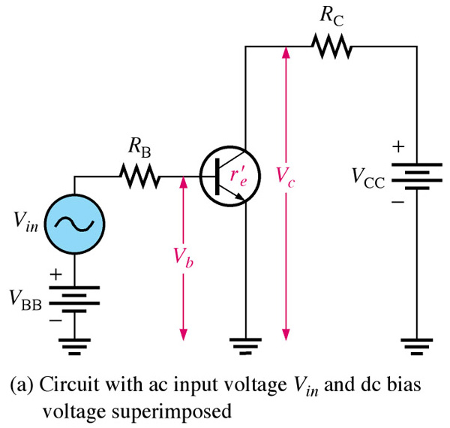
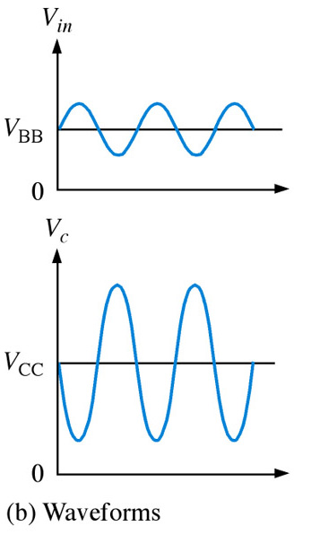
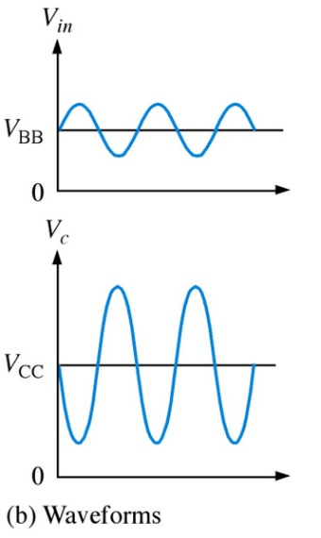
Common-Emitter Amplifier Circuit:
The common-emitter amplifier exhibits high voltage and current gain.
The output signal is 180º out of phase with the input.
Notes:
Fig. 6-8 ce amp

Slide 9
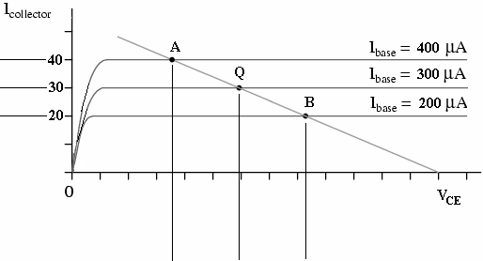


Characteristic Curves with DC Load Line:
Active Region:
Q-point, and current gain.
Point A corresponds to the positive peak.
Point B corresponds to the negative peak.

Slide 10
Summary
Common Emitter Amplifiers:
In Cut-off:
  All currents are zero and V_{CE} = V_{CC}
In Saturation:
  I_{B} big enough to produce I_{C(sat)}  βI_{B}
Using Kirchhoff’s Voltage Law through the ground loop:
  V_{CC} = V_{CE(sat)} + I_{C(sat)}R_{C}
  but V_{CE(sat)} is very small (few tenths), so
  I_{C(sat)} V_{CC}/R_{C}

Slide 11
Small Signal Operation:
The Amplifier Circuits are Biased Such That:
Transistor amplifier is biased at its Q-Point.
and a small voltage signal vi is superimposed on the dc bias voltage VBE.
The resulting output signal vo appears superimposed on the dc collector voltage VCE .
The amplitude of the output signal vo is larger than that of the input signal vi by the voltage gain Av .

Slide 12
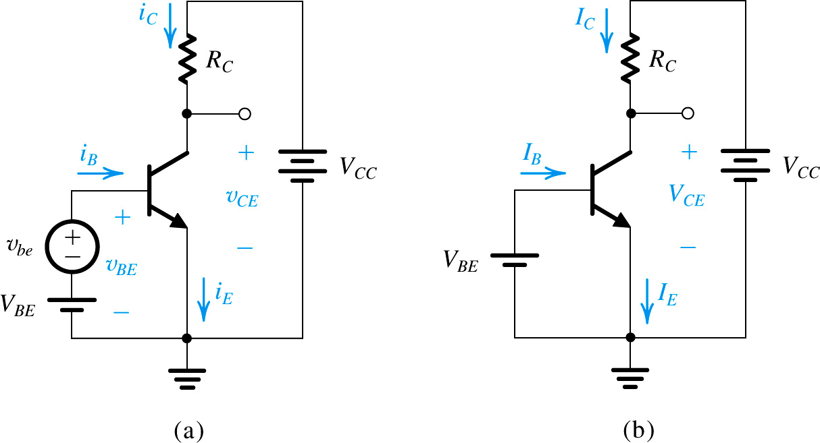

Small Signal Operation:
The signal source vbe removed
for dc-bias-analysis.

Slide 13



Small Signal Operation:
The amplifier output voltage vo (bias + signal) and output current iC is given by:
=

Slide 14


Small Signal Operation:
Thus the total output voltage vo is given by:

Slide 15
Small Signal Operation:
The Signal Source, vbe, removed for DC Bias Conditions

Slide 16
Amplifier Gain:
If changes in the operating currents and voltages are small,
then I_{C} and V_{CE} waveforms are undistorted replicas of the input signal.
A small voltage change at the base causes a large voltage change at the collector. The voltage gain is given by:
“A” is the amplifier gain.

Slide 17
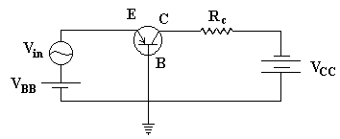
Voltage Amplifiers:
Common Base PNP - with an ac Signal
Voltage amplification can be obtained simply by passing the collector current I_{C} through a resistance RC.
The biasing of the junctions are:
BE is forward biased by V_{BB} - thus a small resistance
BC is reverse biased by V_{CC} – and a large resistance
Since I_{B} is small, I_{C}  I_{E}

Slide 18
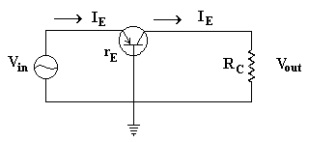
Voltage Amplifiers:
Common Base PNP - with an ac Signal
r_{E} = internal ac emitter
resistance
I_{E} = V_{in}/r_{E} (Ohm’s Law)
V_{Out} = I_{C}R_{C}  I_{E}R_{C}
, Since I_{B} is small, I_{C}  I_{E}
Recall the name – transfer resistor.

Slide 19
Operating Limits:
There will be a limit on the dissipated power:
  P_{D(max)} = V_{CE}I_{C}
  V_{CE} and I_{C} were the parameters plotted on the characteristic curve.
    If there is a voltage limit (V_{CE(max)}), then we can compute the I_{C} that results
    If there is a current limit (I_{C(max)}), then we can compute the V_{CE} that results

Slide 20
Operating Limits-Example:
Assume P_{D(max)} = 0.5 W
V_{CE(max)} = 20 V
I_{C(max)} = 50 mA
P_{D(max)} | V_{CE} | I_{C}
0.5 W | 5 V | 100 mA
 | 10 | 50
 | 15 | 33
 | 20 | 25

Slide 21
The Collector Current and Transconductance:
Transconductance, for a bipolar device, is defined as the ratio of the change in collector current to the change in base voltage over a defined, arbitrarily small interval, on the collector current-versus-base voltage curve.
The symbol for transconductance is g_{m}. The unit is thesiemens, the same unit that is used for direct-current (DC) conductance.
The transconductance (g_{m}) of a transistor is a measure of how well it converts a voltage signal into a current signal.

Slide 22
Transconductance, g_{m}
It will be shown later that g_{m} is one of the most important parameters in integrated circuit design.
If dI represents a change in collector current caused by a small change in base voltage dE, then the transconductance is approximately:
g_{m} = dI / dE

Slide 23
BJT Transconductance Curve:
NPN Transistor
Collector Current:
I_{C} = α I_{ES} e^{VBE/ηVT}
Transconductance:
(slope of the curve)
g_{m} = I_{C} / V_{BE}
I_{ES} = The reverse saturation current
of the B-E Junction.
V_{T} = kT/q = 26 mV (@ T=300ºK)
η = the emission coefficient and is
usually ~1
I_{C}
8 mA
6 mA
4 mA
2 mA
V_{BE}
0.7 V

Slide 24
I_{C} and g_{m}
Observe: We arrive at this by expressing e^{x} as a Taylor Series and truncating it after the 2nd term.

Slide 25

Transconductance, g_{m}

Slide 26
BJT Amplifiers using Coupling and Bypass Capacitors

Slide 27
BJT Amplifiers using Coupling and Bypass Capacitors:
AC coupling through capacitors is used to inject an ac input signal and extract the ac output signal without disturbing the DC Q-point
Capacitors provide negligible impedance at frequencies of interest and provide open circuits at dc.

Slide 28
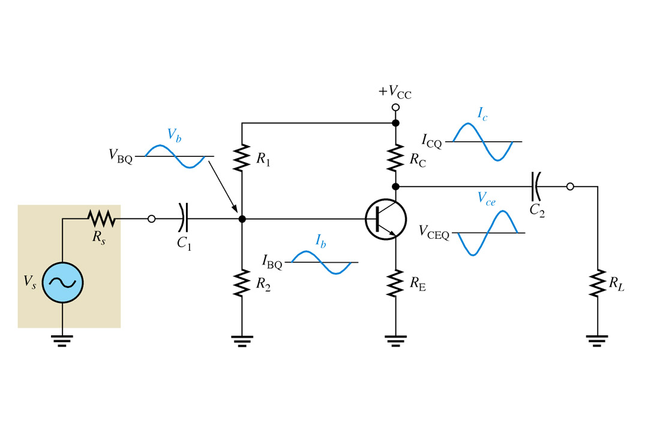
BJT Amplifiers using Coupling Capacitors:
In this type of Circuit, only the ac component reaches the load because of the capacitive coupling.
and that the output is 180º out of phase with input.
Notes:
Fig 6-2 amplifier circuit

Slide 29
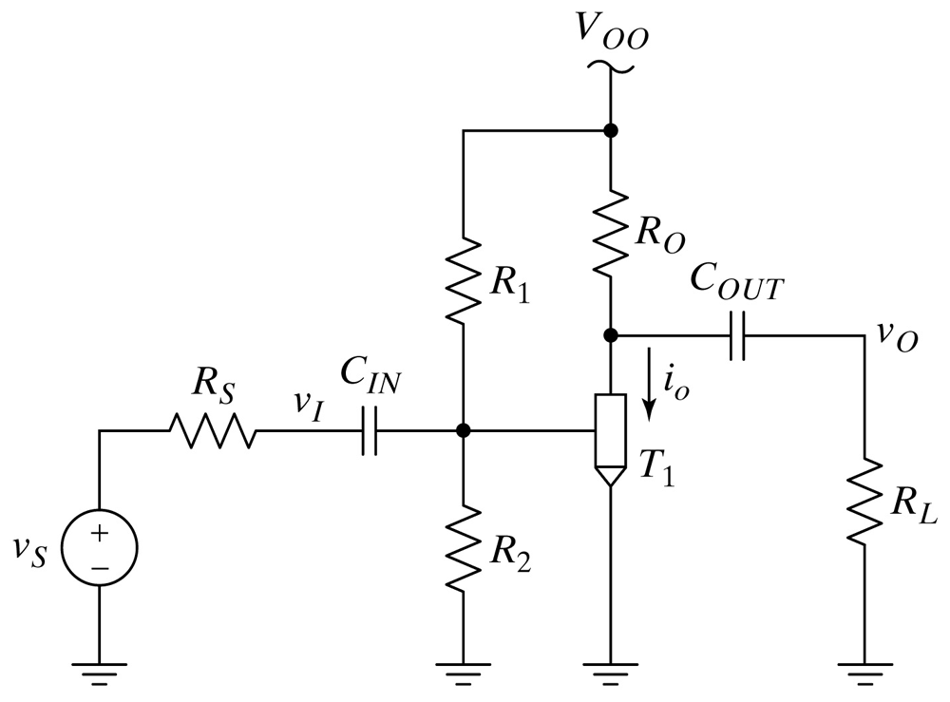
BJT Amplifiers using Coupling Capacitors:
A complete Amplifier Circuit using the Generic Transistor.

Slide 30
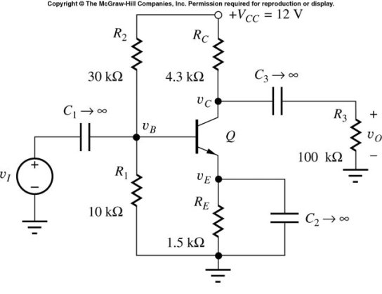
A BJT Amplifier using Coupling and Bypass Capacitors:
In a practical amplifier design, C₁ and C₃ are large coupling capacitors or
dc blocking capacitors.
Their reactance (X_{C} = |Z_{C}| = 1/wC), at signal frequency is negligible.
They are effective open circuits for the circuit when DC bias is considered.

Slide 31
A Practical BJT Amplifier using Coupling and Bypass Capacitors (cont):
C₂ is a bypass capacitor. It provides a low impedance path for ac current from emitter to ground. It effectively removes R_{E} (required for good Q-point stability) from the circuit when ac signals are considered.

Slide 32
BJT Amplifiers-DC Equivalent Circuits:

Slide 33
D C Equivalent for the BJT Amplifier (Step1)
All capacitors in the original amplifier circuit are replaced by open circuits, disconnecting v_{I}, R_{I}, and R₃ from the circuit.
and leaving R_{E} intact.
The transistor Q will be replaced by its DC model.

Slide 34
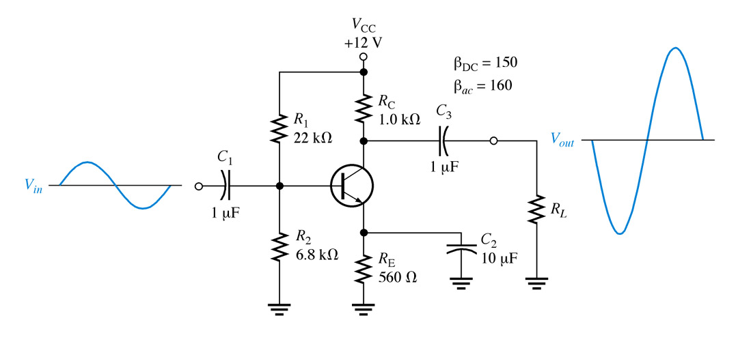
BJT Amplifiers using Coupling Capacitors:
Now let us use our dc and ac analysis methods to view this type of transistor circuit:
Voltage-Divider Bias
180⁰ phase-Shift
Capacitive coupling: i/p, o/p & bypass
Notes:
Fig. 6-8 ce amp

Slide 35
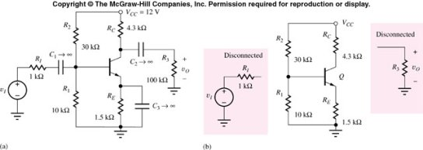
D C Equivalent for the BJT Amplifier (Step1)
DC Equivalent Circuit

Slide 36
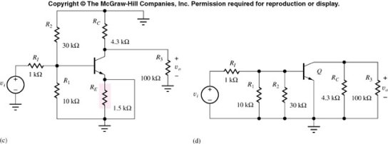
A C Equivalent for the BJT Amplifier :(Step 2)
R₁IIR₂=R_{B}
R_{o}
R_{in}
Coupling capacitor C_{C} and Emitter bypass capacitor C_{E}
are replaced by short circuits.
DC voltage supply is replaced with short circuits, which in this case is connected to ground.

Slide 37
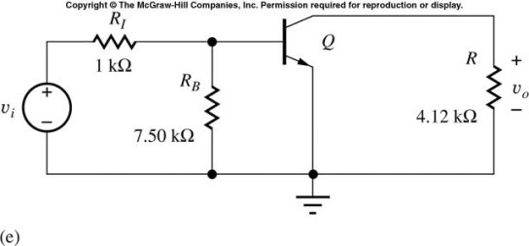
A C Equivalent for the BJT Amplifier (continued)
All externally connected capacitors are assumed as short circuited elements for ac signal.
By combining parallel resistors into equivalent R_{B} and R, the equivalent AC circuit above is constructed.
Here, the transistor will be replaced by its equivalent small-signal AC model (to be developed).

Slide 38
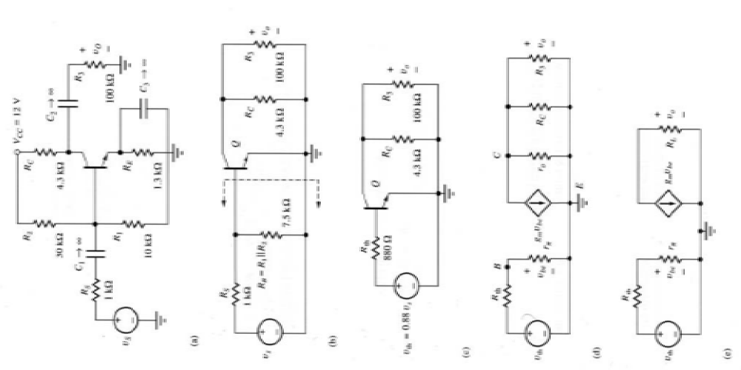
A C Analysis of CE Amplifier:
Step 1
1) Determine DC operating point and
calculate small signal parameters.
2) Draw the AC equivalent circuit of Amp.
• DC Voltage sources are shorted to ground
• DC Current sources are open circuited
• Large capacitors are short circuits
• Large inductors are open circuits
3) Use a Thevenin circuit (sometimes a
Norton) where necessary. Ideally the
base should be a single resistor + a single
source. Do not confuse this with the DC
Thevenin we did in step 1.
4) Replace transistor with small signal model.
5) Simplify the circuit as much as necessary.
Steps to Analyze a Transistor Amplifier
6) Calculate the small signal parameters and gain etc.
Step
2
Step
3
Step
4
Step
5
π-model used

Slide 39
Summary:
1- Small-Signal Operation:
The ac base voltage has a dc component and an ac component. These set up dc and ac components of emitter current. One way to avoid excessive distortion is to use small-signal operation. This means keeping the peak-to-peak ac emitter current less than one-tenth of the dc emitter current.
2- AC Beta:
The ac beta of a transistor is defined as the ac collector current divided by the ac base current. The values of the ac beta usually differ only slightly from the values of the dc beta. When troubleshooting, you can use the same value for either beta. On data sheets, h_{FE} is equivalent to β _{dc}, and h_{fe} is equivalent to β .

Slide 40
Summary:
3- AC Resistance of the Emitter Diode:
The base-emitter voltage of a transistor has a dc component V_{BEQ} and an ac component v_{be}. The ac base-emitter voltage sets up an ac emitter current of i_{e}. The ac resistance of the emitter diode is defined as vbe divided by ie. With mathematics, we can prove that the ac resistance of the emitter diode equals 25 mV divided by dc emitter current.
4-Two Transistor Models:
As far as ac signals are concerned, a transistor can be replaced by either of two equivalent circuits: the ð model or the T model. The ð model indicates that the input impedance of the base is β r'_{e}.

Slide 41
Summary:
5-Analyzing an Amplifier:
The simplest way to analyze an amplifier is to split the analysis into two parts: a dc analysis and an ac analysis. In the dc analysis, the capacitors are open. In the ac analysis, the capacitors are shorted and the dc supply points are ac grounds.
6-AC Quantities on the data Sheet:
The h parameters are used on data sheets because they are easier to measure than r' parameters. The r. parameters are easier to use in analysis because we can use Ohm’s law and other basic ideas. The most important quantities are the data sheet are h_{fe} and h_{ie}. They can be easily converted into >β and r'e.

