Slide 1

COMSATS Institute of Information Technology
Virtual campus
Islamabad
Dr. Nasim Zafar
Electronics 1 - EEE 231
Fall Semester – 2012

Slide 2
Transistor as an Amplifier Circuit:
.
Lecture No: 20
Contents:
Introduction.
Amplifier Gain.
Common Emitter Amplifier.

Slide 3
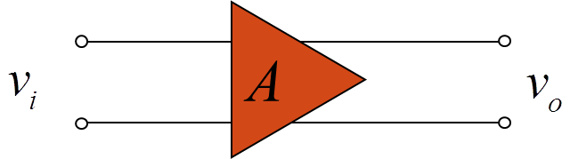


Amplifier Gain:
Amplifiers are 2-port networks:
input port
output port
A is called the amplifier gain.
If the gain is constant, we call this a linear amplifier.

Slide 4
Transistor Specifications:
Maximum collector current, I_{C} .
Maximum power dissipated, P_{D}
P_{D} = I_{C} * V_{CE}

Slide 5
Transistor Specifications:
Minimum C-E voltage for breakdown, V_{(BR)CEO}
Carefully examine absolute max ratings.
DC current gain
  variable
  β = h_{FE} in specs.

Slide 6
Amplifier Gain in Decibels:
Amplifier gain is expressed in decibels (dB)
  Originally it was expressed as “Bels” (named after Alexander Graham Bell), but these proved to be of insufficient size so we multiply “Bels” by 10 → “decibels.”
Decibels are a log-based ratio and are therefore dimensionless.
Purpose: We want to measure the ratio of some value relative to another (e.g. sound power in a stereo amplifier).
Derivation of dB…(Cont.)

Slide 7
Derivation of Decibels (Contd.):
Ratio of power of interest (call it “p₁”) to some other reference power (say, p₂):
However, these values are generally quite huge and tend to be logarithmically related; thus, creation of “the Bel:”

Slide 8
Derivation of Decibels (Contd.):
However, the Bel is a bit too small, so let’s multiply it by 10 and call it a decibel (10 x Bel = 1 dB).
Which gives us the decibel expression for power:

Slide 9
Exercise: dB for Voltage:
First, let’s relate voltage to power:

Slide 10
Exercise: dB for Voltage:
Upon substitution:
Which gives us the decibel expression for voltage:

Slide 11
Some Physical Conclusions:
If dB is positive, then v₁ > v₂, ⇒ the signal is amplified.
If dB is negative, then v₁ < v₂, ⇒ the signal is attenuated.
If dB is 0, then v₁ = v₂.

Slide 12
BJT Transistor Amplifiers:

Slide 13
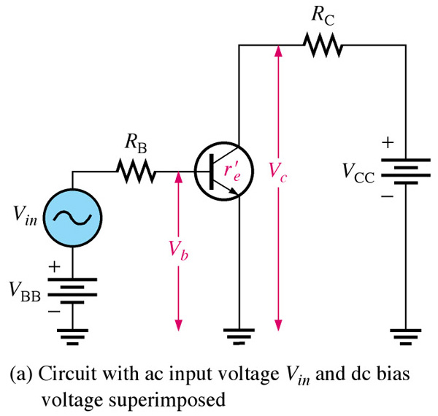
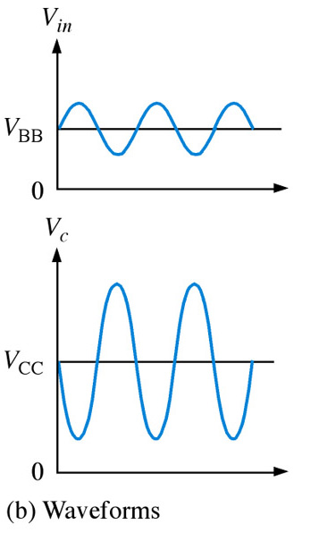
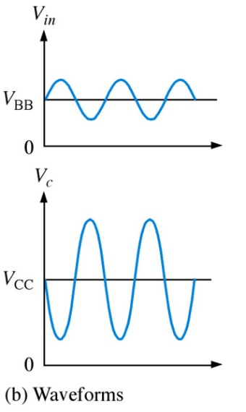
Common-Emitter Amplifiers:
The common-emitter amplifier exhibits high voltage and current gain.
The output signal is 180º out of phase with the input.
Notes:
Fig. 6-8 ce amp

Slide 14
Common-Emitter Amplifiers:
Transistor Biasing as an Amplifier Circuit:
For this discussion, we consider DC behaviour and assume that we are working in the normal linear amplifier region with the:
BE junction forward biased and
CB junction reverse biased.

Slide 15
Common-Emitter Characteristics:
Treating the transistor as a current node:
Also:

Slide 16
Common-Emitter Characteristics:
Hence:
which after some rearrangement gives:

Slide 17
Common-Emitter Characteristics:
Define a common emitter current-transfer ratio β:
Such that:

Slide 18
Common-Emitter Characteristics:
Since reverse saturation current is negligible the second term on the right hand side of this equation can usually be neglected (even though (1- α) is small)
Thus

Slide 19
Gain Factors-Summary:
Usually given for common base amplifier
Usually given for common emitter amplifier
Usually given for common collector amplifier

Slide 20
The Common-Emitter Amplifiers:
Transistor Biasing as an Amplifier Circuit:
  B-E junction forward biased.
    V_{BE} ≈ 0.7 V for Si
  C-B junction reverse biased.
  KCL: I_{E} = I_{C} + I_{B}

Slide 21
Transistor Biasing as an Amplifier Circuit:
The purpose of dc biasing is to establish the Q-point for operation.
The collector curves and load lines help us to relate the Q-point and its proximity to cutoff and saturation.
The Q-point is best established where the signal variations do not cause the transistor to go into saturation or cutoff.
What we are most interested in is, the ac signal itself. Since the dc part of the overall signal is filtered out in most cases, we can view a transistor circuit in terms of just its ac component.

Slide 22
Characteristic Curves with DC Load Line:
Drawn on the output characteristic curves.
Component values in a bias circuit.
  Determine quiescent point, Q
  Q is between saturation and cutoff
Best Q for a linear amplifier.
  Midway between saturation and cutoff

Slide 23
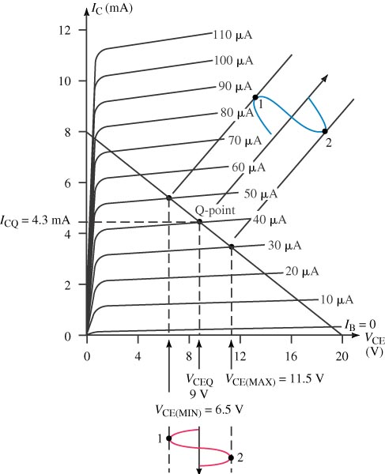
Characteristic Curves with DC Load Line:
Active Region:
Q-point, and current gain.

Slide 24
Common Emitter Characteristics-Summary:
β_{dc} not constant
β_{dc} dependent on dc operating point
Quiescent point = operating point
Active region limited by
  Maximum forward current, I_{C(MAX)}
  Maximum power dissipation, P_{D}

Slide 25
Transistor Amplifier Basics:
We will use a capital (upper case) letter for a DC quantity
(e.g. I, V).
We will use a lower case letter for a time varying (a.c.) quantity (e.g. i, v)

Slide 26
Transistor Amplifier Basics:
These primary quantities will also need a subscript identifier (e.g. is it the base current or the collector current?).
For dc levels this subscript will be in upper case.
We will use a lower case subscript for the a.c. signal bit
(e.g. i_{b}).
And an upper case subscript for the total time varying signal (i.e. the a.c. signal bit plus the d.c. bias) (e.g. i_{B}).This will be less common.

Slide 27
Transistor Amplifier Basics:
i_{b}
0
+
I_{B}
=
i_{B}

Slide 28
Transistor Amplifier-Operation:
Amplification of a relatively small ac voltage can be achieved by placing the ac signal source in the base circuit.
We know that small changes in the base current circuit cause large changes in collector current circuit.
The small ac voltage causes the base current to increase and decrease accordingly and with the small change in base current ,the collector current will mimic the input only with greater amplitude.
Notes:
Fig 4-20a & b (stacked)

Slide 29
Transistor Amplifier-Operation:
The region between cutoff and saturation is called the linear region.
A transistor which operates in the linear region is called a linear amplifier.
Note that only the ac component reaches the load because of the capacitive coupling and that the output is 180º out of phase with input.
Notes:
Fig 6-2 amplifier circuit

Slide 30
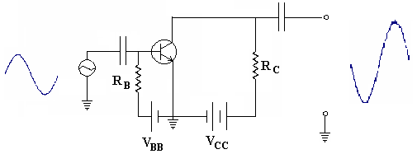
Amplifier Operation-NPN Transistor-1:
In this circuit, V_{BB} forward biases the emitter-base junction
and dc current flows through the circuit at all times.
The class of the amplifier is determined by V_{BB} with respect to the input signal.
Signal that adds to V_{BB} causes transistor current to increase.
Signal that subtracts from V_{BB} causes transistor current to decrease.

Slide 31
Amplifier Operation-NPN Transistor-2:
During the positive peak of the ac input signal, V_{BB} is added to the input.
Resistance in the transistor is reduced. Current in the circuit increases.
Larger current means more voltage drop across R_{C} (V_{RC} = IR_{C}).
Larger voltage drop across R_{C} leaves less voltage to be dropped across the transistor.
We take the output V_{CE} – as input increases, V_{CE} decreases.

Slide 32
Amplifier Operation-NPN Transistor-3:
As the input goes to the negative peak:
  Transistor resistance increases
  Less current flows
  Less voltage is dropped across R_{C}
  More voltage can be dropped across C-E
The result is a phase reversal.
  Feature of the common emitter amplifier
The closer V_{BB} is to V_{CC}, the larger the transistor current.

Slide 33
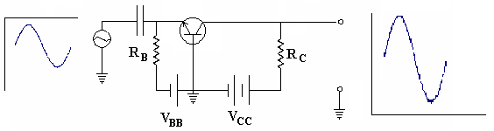
NPN Common Base Transistor Amplifier-1:
Signal that adds to V_{BB} causes transistor current to increase.
Signal that subtracts from V_{BB} causes transistor current to decrease.

Slide 34
NPN Common Base Transistor Amplifier-2:
At positive peak of input, V_{BB} is adding to the input.
Resistance in the transistor is reduced.
Current in the circuit increases.
Larger current means more voltage drop across R_{C} (V_{RC} = IR_{C}).
Collector current increases.
No phase reversal.

Slide 35
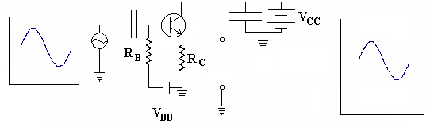
NPN Common Collector Transistor Amplifier:
Also called an Emitter Follower circuit – output on emitter is almost a replica of the input
Input is across the C-B junction – this is reversed biased and the impedance is high
Output is across the B-E junction – this is forward biased and the impedance is low.
Current gain is high but voltage gain is low.

Slide 36
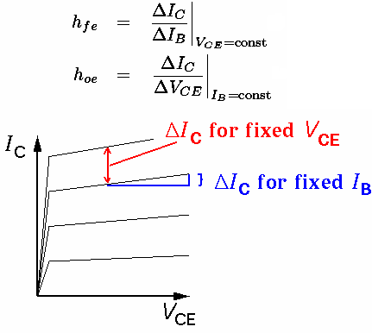
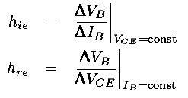
Hybrid Parameters:
= β
= Slope of curve

Slide 37
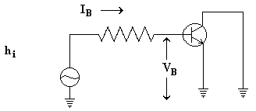
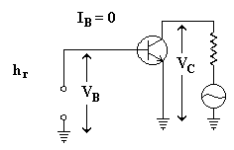
Hybrid Parameters:
h_{ie} = V_{B}/I_{B} Ohm’s Law
h_{ie} =input impedance
h_{re} = V_{B}/V_{C}

Slide 38
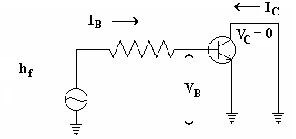
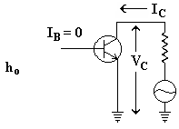
Hybrid Parameters:
h_{fe} = I_{C}/I_{B}
Equivalent of b
h_{oe} = I_{C}/V_{C}

Slide 39
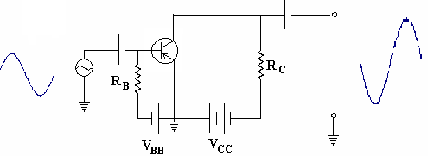
PNP Common Emitter Amplifier:

Slide 40
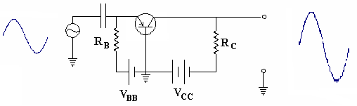
PNP Common Base Amplifier:

Slide 41
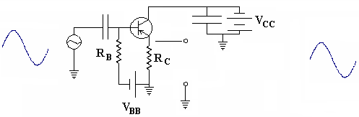
PNP Common Collector Amplifier:

Slide 42
Summary:
Most transistors amplifiers are designed to operate in the linear region.
The common-emitter amplifier has high voltage and current gain.
The common-collector has a high current gain and voltage gain of 1. It has a high input impedance and low output impedance.

