Slide 1

COMSATS Institute of Information Technology
Virtual campus
Islamabad
Dr. Nasim Zafar
Electronics 1
EEE 231 – BS Electrical Engineering
Fall Semester – 2012

Slide 2
Electrons and Holes
Lecture No: 2
Charge Carriers
in
Semiconductors

Slide 3
Charge Carriers in Semiconductors:
Electrons and Holes in Semiconductors:
    Intrinsic Semiconductors
    Doped – Extrinsic Materials
    Effective Mass Approximation
    Density of States
    Fermi-Dirac Distribution Function
    Temperature Dependence
    Generation-Recombination

Slide 4
    Revision:
1. Semiconductor Materials:
• Elemental semiconductors
• Intrinsic and Extrinsic Semiconductor
• Compound semiconductors
III – V Gap, GaAs
II – V e.g ZnS, CdTe
• Mixed or Tertiary Compounds
e.g. GaAsP
2. Applications:
Si ⇒ diodes, rectifiers, transistors and integrated circuits etc
GaAs, GaP ⇒ emission and absorption of light
ZnS ⇒ fluorescent materials

Slide 5
Intrinsic Semiconductors:
  Thermal ionization:
    Valence electron---each silicon atom has four valence electrons
    Covalent bond---two valence electrons from different two silicon atoms form the covalent bond
      Be intact at sufficiently low temperature
      Be broken at room temperature
    Free electron---produced by thermal ionization, move freely in the lattice structure.
    Hole---empty position in broken covalent bond, can be filled by free electron, positive charge

Slide 6
Extrinsic-Doped Semiconductors:
To produce reasonable levels of conduction, we have to dope the intrinsic material with appropriate dopants and concentration.
  silicon has about 5 x 10²² atoms/cm³
  typical dopant levels are about 10¹⁵ atoms/cm³
In intrinsic silicon, the number of holes and number of free electrons is equal, and their product equals a constant
  actually, n_{i} increases with increasing temperature
  n.p= ni2
This equation holds true for doped silicon as well, so increasing the number of free electrons decreases the number of holes

Slide 7
In Thermal Equilibrium:
n= number of free electrons
p=number of holes
ni=number of electrons in intrinsic silicon=10¹º/cm³
pi-number of holes in intrinsic silicon= 10¹º/cm³
  Mobile negative charge = -1.6*10⁻¹⁹ Coulombs
Mobile positive charge = 1.6*10⁻¹⁹ Coulombs
At thermal equilibrium (no applied voltage)
(room temperature approximation)
n.p=(ni)²

Slide 8
Thermal Energy :
Thermal energy = k x T = 1.38 x 10⁻²³ J/K x 300 K =25 meV
Excitation rate = constant x exp(-Eg / kT)
Although the thermal energy at room temperature, RT, is very small, i.e. 25 meV, a few electrons can be promoted to the CB.
Electrons can be promoted to the CB by means of thermal energy.
This is due to the exponential increase of excitation rate with increasing temperature.
Excitation rate is a strong function of temperature.

Slide 9
Charge Carriers in Semiconductors:
Important notes:
  is a strong function of temperature.
  At room temperature only one of every billion atoms
  is ionized.
  Silicon’s conductivity is between that of conductors and insulators. Actually the characteristic of intrinsic silicon approaches to insulators.

Slide 10
Charge Carriers in Semiconductors:
Intrinsic Semiconductors:
Carrier concentration in thermal equilibrium:
At room temperature(T=300K)
carriers/cm³

Slide 11
Charge Carriers in Doped Semiconductors:
Because the majority carrier concentration is much larger
than the minority, we can get the approximate equations shown below:
for n type for p type

Slide 12
Charge Carriers in Doped Semiconductors:
Carrier concentration for n type
  Thermal-equilibrium equation
  Charge-Electro neutrality equation

Slide 13
Charge Carriers in Doped Semiconductors:
Carrier concentration for p type
  a) Thermal equilibrium equation
  b) Charge-Electro neutrality equation

Slide 14
Charge Carriers in Semiconductors:
Recombination:
Some free electrons filling the holes results in the disappearance of free electrons and holes.
Thermal equilibrium:
At a certain temperature, the recombination rate is equal to the ionization rate. So the concentration of the carriers can be calculated.

Slide 15
    Effective Mass Approximation

Slide 16
The Concept of Effective Mass:
This is an important approximation for the understanding of electron motion in crystals.
  Under some conditions (often found in devices) electrons behave like free particles with an effective mass that is different than the electron mass in vacuum.
  We want to understand this approximation.
  We also want to understand under what conditions this approximation occurs in devices.

Slide 17
The Concept of Effective Mass :
Comparing
Free e⁻ in vacuum
If the same magnitude of electric field is applied to both electrons in vacuum and inside the crystal, the electrons will accelerate at a different rate from each other due to the existence of different potentials inside the crystal.
The electron inside the crystal has to try to make its
own way.
So the electrons inside the crystal will have a different mass than that of the electron in vacuum.
This altered mass is called as an effective-mass.
In an electric field
m_{o} =9.1 x 10⁻³¹
Free electron mass
An e⁻ in a crystal
In an electric field
In a crystal
m = ?
m* effective mass

Slide 18
What is the expression for m*
Particles of electrons and holes behave as a wave under certain conditions. So one has to consider the de Broglie wavelength to link partical behaviour with wave behaviour.
Partical such as electrons and waves can be diffracted from the crystal just as X-rays .
Certain electron momentum is not allowed by the crystal lattice. This is the origin of the energy band gaps.
n = the order of the diffraction
λ = the wavelength of the X-ray
d = the distance between planes
θ = the incident angle of the X-ray beam

Slide 19
(1)
By means of equations (1) and (2)
certain e⁻ momenta are not allowed
by the crystal. The velocity of the electron at these momentum values is zero.
The waves are standing waves
is the propogation constant
The momentum is
Energy
(2)
The energy of the free electron
can be related to its momentum
free e⁻ mass , m₀
k
momentum
E versus k diagram is a parabola.
Energy is continuous with k, i,e, all energy (momentum) values are allowed.
E versus k diagram
or
Energy versus momentum diagrams
The energy of the free e⁻
is related to the k

Slide 20

To find Effective Mass , m*
We will take the derivative of energy with respect to k ;
m* is determined by the curvature of the E-k curve
m* is inversely proportional to the curvature
Change m* instead of m
This formula is the effective mass of
an electron inside the crystal.

Slide 21
Interpretation
The electron is subject to internal forces from the lattice (ions and core electrons) and external forces such as electric fields
In a crystal lattice, the net force may be opposite the external force, however:
F_{ext} =-qE
F_{int} =-dE_{p}/dx
-
E_{p}(x)
+
+
+
+
+

Slide 22
Interpretation
electron acceleration is not equal to F_{ext}/m_{e}, but rather:
a = (F_{ext} + F_{int})/m_{e} == F_{ext}/m*
The dispersion relation E(K) compensates for the internal forces due to the crystal and allows us to use classical concepts for the electron as long as its mass is taken as m*
F_{ext} =-qE
F_{int} =-dE_{p}/dx
-
E_{p}(x)
+
+
+
+
+

Slide 23
Effective Mass Approximation and Hydrogenic Model:

Slide 24
    Density of States
    Fermi-Dirac Distribution Function

Slide 25
Density of Charge Carriers:
  Majority carrier concentration is only determined by the dopant impurity.
  Minority carrier density is strongly affected by temperature.
  If the temperature is high enough, characteristics of the doped semiconductor will decline to the one of intrinsic semiconductor.
To obtain carrier densities → investigate the distribution
of charge carriers over the available energy states.

Slide 26
Density of charge carries:
→ Statistical Methods:
(i) Maxwell-Boltzmann → Classical particles (e.g. gas)
(ii) Bose-Einstein Statistics → photons
(iii) Fermi-Dirac Statistics → fermions, electrons.

Slide 27
Maxwell – Boltzmann Distribution:

Slide 28
Fermi – Dirac Distribution Function:
(i) Wave nature; Quntum Mechanics → indistinguishability
(ii) Fermions → Paulis Exclusion Principle
The energy distribution of electrons in solids obeys
“Fermi-Dirac-Statistics”.
⇒ The distribution of electrons over a range of allowed energy levels at thermal equilibrium is given by:

Slide 29
The function f (E), the Fermi-Dirac distribution function,
gives the probability that an available energy state at E will
be occupied by an electron at absolute temperature T.
The quantity E_{F}, is called the Fermi level and the Fermi level is that energy at which the probability of occupation of an energy state by an electron is exactly one-half i.e.
⇒ The Fermi – Dirac distribution function is symmetrical around the Fermi-level E_{F}.
⇒ Intrinsic Fermi level ⇒ E_{i} = E_{F}

Slide 30
For energies that are several kT units above or below Fermi level,
the Fermi–Dirac distribution function can be approximated by:
for E > E_{F}
                for E < E_{F}
                ⇓
                hole probability!!
Thus Fermi – Dirac statistics ⇒ Boltzmann statistics.
for E >> kT

Slide 31
(a) Electron and Hole Concentrations at Equilibrium:
Similarly

Slide 32
Another useful expression for the electron and hole densities:
Degenerate Semiconductors ⇒ N_{D}/N_{A} ≈ 10¹⁹ cm⁻³

Slide 33
(b) The pn Product in Equilibrium:
The Law of Mass Action:
Equilibrium condition!!

Slide 34
(c) Space Charge Neutrality

Slide 35


(c) Space Charge Neutrality
Simplifying:
And
minority

Slide 36
    Temperature dependence of carriers

Slide 37
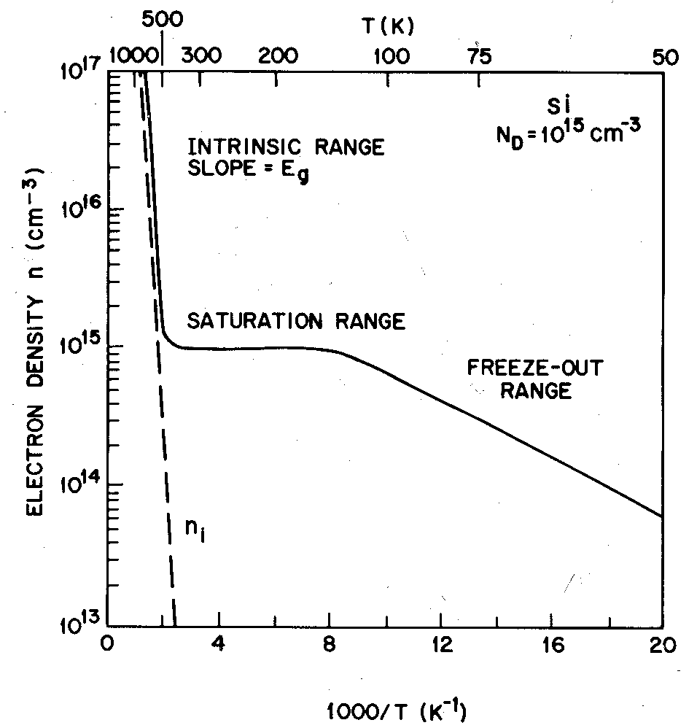
Carrier Concentration vs. Temperature
At room temperature, all the shallow dopants are ionized. (extrinsic region)
When the temperature is decreased sufficiently (~100 K), some of the dopants are not ionized. (Freeze out region)
When the temperature is increased so high that the intrinsic carrier concentration approaches the dopant conc. (T → T_{i}, > 450K for Si), the semiconductor is said to
enter the intrinsic region.

Slide 38
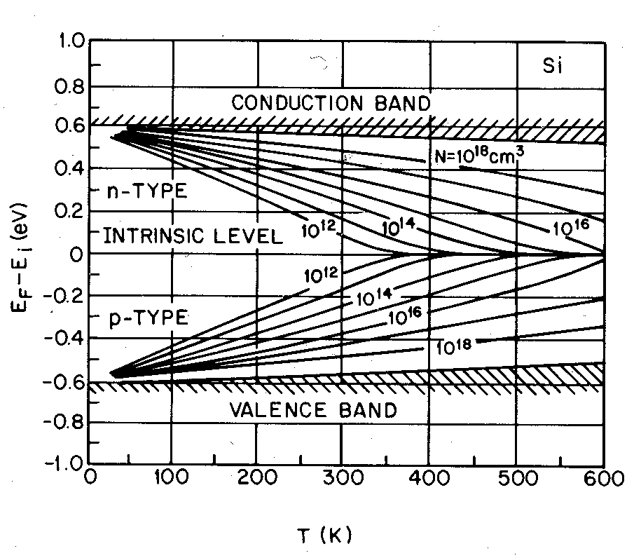
Fermi Level vs. Temperature
When the temperature is decreased, the Fermi level rises towards the donor level (N-type) and eventually gets above it.
When the temperature is increased, the Fermi level moves towards the intrinsic level.

Slide 39
    Generation-Recombination

Slide 40
Equilibrium and Recombination/Generation:
So far, we have discussed the charge distributions in equilibrium. The end result was np = n_{i}²
When the system is perturbed, the system tries to restore
itself towards equilibrium through recombination-generation
• We will calculate the steady-state rates
This rate will be proportional to the deviation from
equilibrium, R = A(np-n_{i}²)

Slide 41
Generation and Recombination:
In semiconductors, carrier generation and recombination are processes by which “mobile” charge carriers (electrons and holes) are produced and eliminated.
Charge carrier generation and recombination processes are fundamental to the operation of many optoelectronic semiconductor devices, such as:
Photo Diodes
LEDs and Laser Diodes.
They are also critical to a full analysis of PN junctions devices such as Bipolar Junction Transistors et.

Slide 42
Generation and Recombination:
Generation = break up of covalent bonds to form electrons and holes; Electron-Hole Pair generation
  Electron-Hole Pair generation requires energy in the following forms:
  Thermal Energy ( thermal generation/excitation)
  Optical (optical generation/excitation)
  or other external sources ( e.g. particle bombardment).
Recombination = formation of bonds by bringing together electron and holes
  Releases energy in thermal or optical form
  A recombination event requires 1 electron + 1 hole

Slide 43
Band Gap and Generation/Recombination: Energy Bands
The ease with which electrons in a semiconductor can be excited
from the valence band to the conduction band depends on the
band gap, and it is this energy gap that serves as an arbitrary dividing line
(≅ 5 eV) between the semiconductors and insulators.
In terms of covalent bonds, an electron moves by hopping to a neighboring bond. Because of the Pauli exclusion principle it has to be lifted into the higher anti-bonding state of that bond. In the picture of delocalized states, for example in one dimension - that is in a nanowire, for every energy there is a state with electrons flowing in one direction and one state for the electrons flowing in the other.

Slide 44
Recombination:
Recombination is the opposite of generation, which means this isn't a good thing for PV cells, leading to voltage and current loss.
Recombination is most common when impurities or defects are present in the crystal structure, and also at the surface of the semiconductor. In the latter case energy levels may be introduced inside the energy gap, which encourages electrons to fall back into the valence band and recombine with holes.
In the recombination process energy is released in one of the following ways:
Non-radiative recombination - phonons, lattice vibrations
Radiative recombination - photons, light or EM-waves
Auger recombination - which is releasing kinetic energy to another free carrier

Slide 45
Recombination:
The non-radiative recombination is due to the imperfect material (impurities or crystal lattice defects).
Radiative and Auger recombination, we call unavoidable recombination processes. These two are recombinations, due to essential physical processes and release energy larger than the bandgap.

Slide 46
Direct Band-to-Band Recombination
hν
hν
Energy Band Diagram
Applications: Lasers, LEDs.

Slide 47
Direct Band-to-Band Recombination
When an electron from the CB recombines with a hole in the VB, a photon is emitted.
The energy of the photon will be of
the order of Eg.
If this happens in a direct band-gap semiconductor, it forms the basis for LED’s and LASERS.
Conduction Band
e⁻
photon
+
Valance Band

Slide 48
Photo Generation:
An important generation process in device operation is
photo generation
If the photon energy (hν) is greater than the band gap energy,
then the light will be absorbed thereby creating electron-hole pairs
hν
E_{g}
Notes:
Photo-Generation

Slide 49
Some Calculations!!
Thermal Energy
Thermal energy = k x T = 1.38 x 10⁻²³ J/K x 300 K =25 meV
Although the thermal energy at room temperature, RT, is very small,
i.e. 25 meV, a few electrons can be promoted to the Cconduction Band.
Electrons can be promoted to the CB by means of thermal energy.
Excitation rate = constant x exp(-Eg / kT)
Excitation rate is a strong function of temperature.

Slide 50
Electromagnetic Radiation:
h = 6.62 x 10⁻³⁴ J-s
c = 3 x 10⁸ m/s
1 eV=1.6x10⁻¹⁹ J
Near
infrared
To excite electrons from VB to CB Silicon , the wavelength
of the photons must 1.1 μm or less

Slide 51
Summary
The band gap energy is the energy required to free an electron from a covalent bond.
  E_{g} for Si at 300K = 1.12eV
In a pure Si crystal, conduction electrons and holes are formed in pairs.
  Holes can be considered as positively charged mobile particles which exist inside a semiconductor.
  Both holes and electrons can conduct current.
Substitution dopants in Si:
  Group-V elements (donors) contribute conduction electrons
  Group-III elements (acceptors) contribute holes
  Very low ionization energies (<50 meV)

