Slide 1

COMSATS Institute of Information Technology
Virtual campus
Islamabad
Dr. Nasim Zafar
Electronics 1 - EEE 231
Fall Semester – 2012

Slide 2
Potential-Divider-Biasing Circuits:
Examples and Exercises.
.
Lecture No: 19
Contents:
Base-Biased (Fixed Bias) Transistor Circuits.
Voltage-Divider-Bias transistor Circuits.
Examples and Exercises.

Slide 3
References:
Microelectronic Circuits:
Adel S. Sedra and Kenneth C. Smith.
Integrated Electronics :
Jacob Millman and Christos Halkias (McGraw-Hill).
Introductory Electronic Devices and Circuits
Robert T. Paynter
Electronic Devices :
Thomas L. Floyd ( Prentice Hall ).

Slide 4
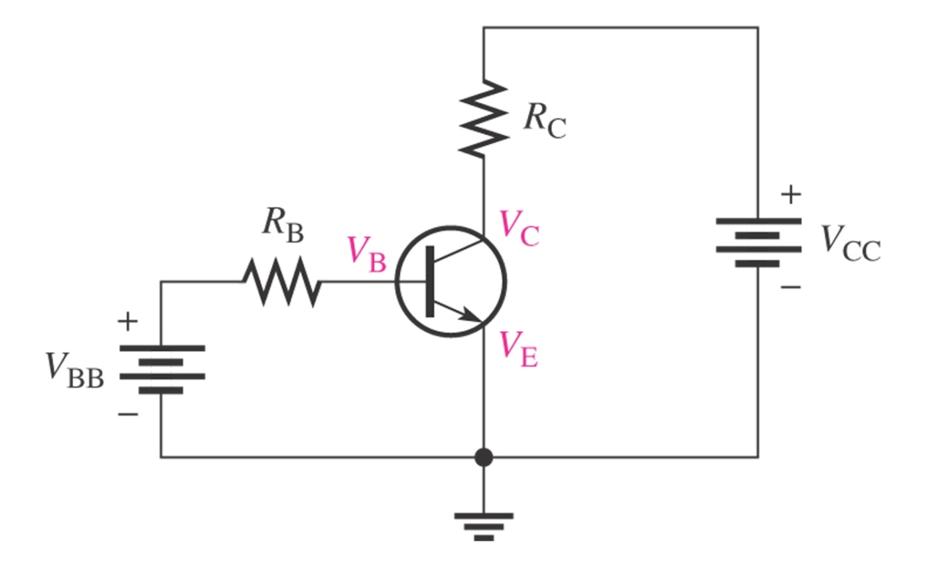
Basic Circuits of BJT:
NPN Transistor
I_{E} = I_{C} + I_{B}

Slide 5
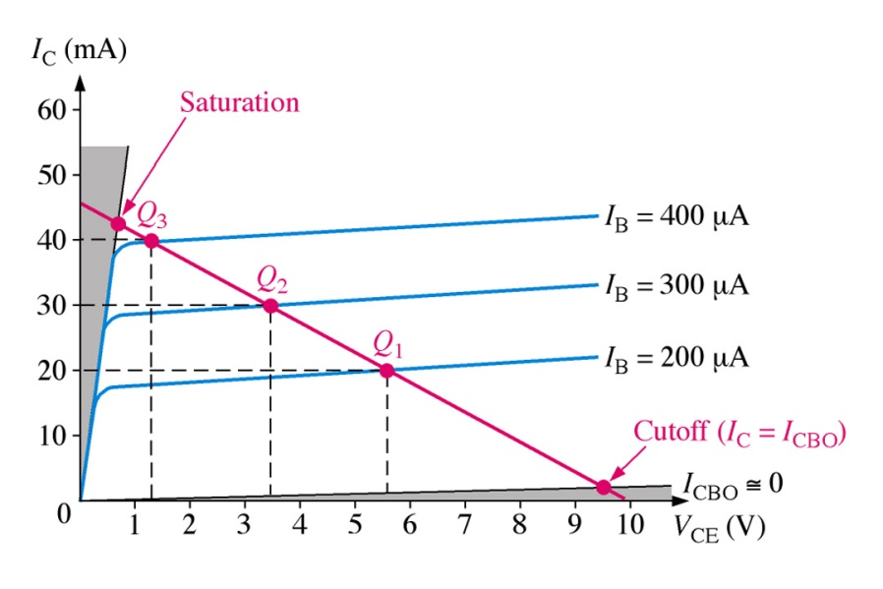
Transistor Output Characteristics:
Notes:
Fig 5-2a & Fig 5-4

Slide 6
Transistor Output Characteristics:
Load Line – Biasing and Stability:
Active region:
  BJT acts as a signal amplifier.
  B-E junction is forward biased and C-B junction is reverse biased.
Graphical construction for determining the dc collector current I_{C} and the collector-to-emitter voltage V_{CE} .
The requirement is to set the Q-point such that that it does not go into the saturation or cutoff regions when an a ac signal is applied.
Maximum signal swing depends on the bias voltage.

Slide 7
The DC Operating Point:
Biasing and Stability
Active region - Amplifier: BJT acts as a Signal Amplifier.
  1. B-E Junction Forward Biased
    V_{BE} ≈ 0.7 V for Si
  2. B-C Junction Reverse Biased
  3. KCL: I_{E} = I_{C} + I_{B}
C
C
I_{C}
I_{C}
B
B
I_{B}
I_{B}
I_{E}
I_{E}
E
E

Slide 8
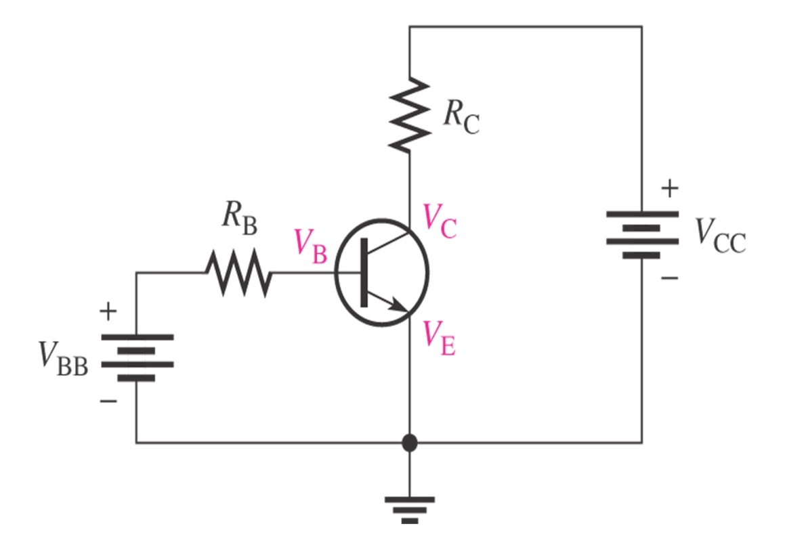
The DC Operating Point:
Biasing and Stability
Slope of the Load Line:
V_{CC} = V_{CE} + V_{RC}
V_{CE} = V_{CC} - V_{RC}
V_{CE} = V_{CC} - I_{C} R_{C}

Slide 9
Current Equations in a BJT:
NPN Transistor
Collector Current
Base Current
Emitter Current
9

Slide 10
  1. Fixed-Biased Transistor Circuits.
  Base-Biased (Fixed Bias) Transistor Circuit:
          Single Power Supply

Slide 11
Base-Biased (Fixed Bias) Transistor Circuit:
Circuit Characteristics - 1:
Circuit Recognition: A single resistor R_{B} between the base terminal and V_{CC}. No emitter resistor.
Advantage: Circuit simplicity.
Disadvantage: Q-point shifts with temp.
Applications: Switching circuits only.

Slide 12
Base-Biased (Fixed Bias) Transistor Circuit:
Circuit Characteristics - 2:
Load line equations:
Q-point equations:

Slide 13
Base-Biased (Fixed Bias) Transistor Circuit:
Q-point equations:
1. Base–Emitter Loop:
V_{CC} = V_{BE} + I_{B} R_{B}

Slide 14

Base-Biased (Fixed Bias) Transistor Circuit:
2. Collector–Emitter Loop:
V_{CC} = V_{CE} + V_{RC}
V_{CE} = V_{CC} - I_{C} R
β = dc current gain = h_{FE}

Slide 15
Circuit 19.1; Example 19.1

Slide 16
Example 19.2
Construct the DC Load line for circuit 19.1; shown in slide 12, and plot the Q-point from the values obtained in Example 19.1. Determine whether the circuit is midpoint biased.
The circuit is midpoint biased.

Slide 17
Example 19.3 (Q-point Shift.)
The transistor of Circuit 19.1, has values of h_{FE} = 100 when T = 25 °C and
h_{FE} = 150 when T = 100 °C. Determine the Q-point values of I_{C} and V_{CE} at both of these temperatures.
Temp(°C) | I_{B} (mA) | I_{C} (mA) | V_{CE} (V)
25 | 20.28 | 2.028 | 3.94
100 | 20.28 | 3.04 | 1.92

Slide 18
  3.
  2. Voltage-Divider-Bias Circuits.

Slide 19
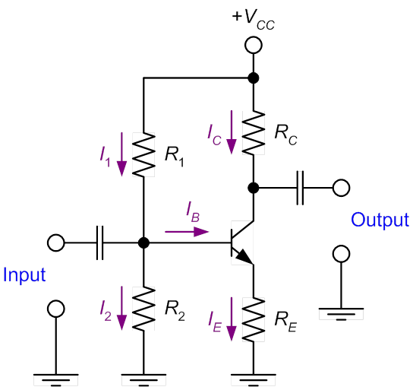
Voltage-Divider Bias Circuits:
NPN Transistor.
Voltage-divider biasing is the most common form of transistor biasing used. A thorough understanding of the dc analysis of this circuit is essential for an electronic technician.
In the Circuit, R1 and R2 set up a voltage divider on the base. Notice the similarity to the emitter-biased circuit.

Slide 20
Voltage-Divider Bias Characteristics-(1)
Circuit Recognition: The voltage divider in the base circuit.
Advantages: The circuit Q-point values are stable against changes in h_{FE}.
Disadvantages: Requires more components than most other biasing circuits.
Applications: Used primarily to bias linear amplifier.

Slide 21

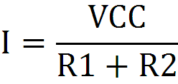


Voltage-Divider Bias Characteristics-(2)
The Thevenin voltage:

Slide 22
Voltage-Divider Bias Characteristics-(3)
Load line equations:
Q-point equations (assume that h_{FE}R_{E} > 10R₂):

Slide 23
Circuit 19.2; Example 19.4 (a).
Determine the values of I_{CQ} and V_{CEQ} for the circuit 19.2 shown in Fig below:
Because I_{CQ} @ I_{E} (or h_{FE} >> 1),

Slide 24
Circuit 19.2; Example 19.4 (b).
Verify that I₂ > 10 I_{B}.

Slide 25
Example 19.5
A voltage-divider bias circuit has the following values: R₁ = 1.5 kW, R₂ = 680 W, R_{C} = 260 W, R_{E} = 240 W and V_{CC} = 10 V. Assuming the transistor is a 2N3904, determine the value of I_{B} for the circuit.

Slide 26
Load Line for Voltage Divider Bias Circuit.
Example 19.5

Slide 27
Which value of h_{FE} do we use?
Transistor specification sheet may list any combination of the following h_{FE}: max. h_{FE}, min. h_{FE}, or typ. h_{FE}. Use typical value if there is one. Otherwise, use

Slide 28
Stability of Voltage Divider Bias Circuit:
The Q-point of voltage divider bias circuit is less dependent on h_{FE} than that of the base bias (fixed bias).
For example, if I_{E} is exactly 10 mA, the range of h_{FE} is 100 to 300. Then
I_{CQ} hardly changes over the entire range of h_{FE}.

Slide 29
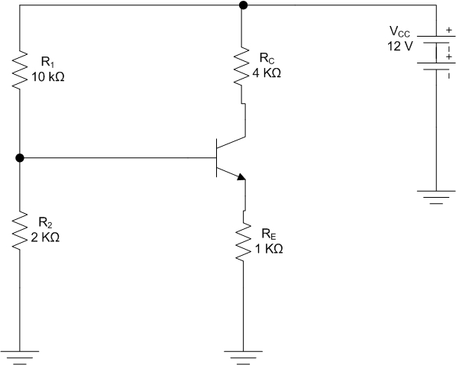
Voltage-Divider Bias Circuit:
Circuit-19.3; Problem 19.6 (a).
Find the operating point Q for this circuit.
The use of Thevenin equivalent circuit for the base makes the circuit simpler.

Slide 30
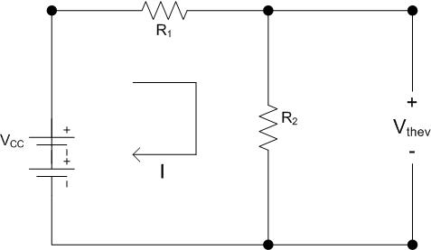



Determination of V_{BB} – The Thevenin Voltage
V_{CC} = I.(R₁ + R₂)
-- Eq. (1)
V_{Thev} = I.R₂ Eq. (2)
-- Eq. (3)

Slide 31
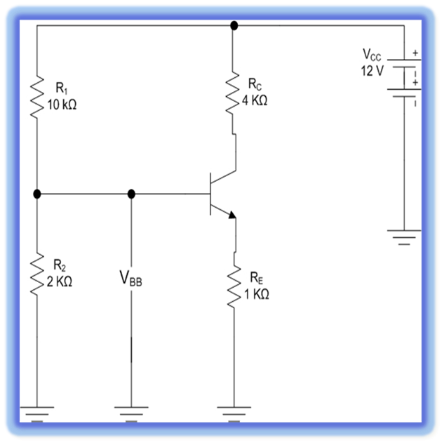
Circuit-19.3; Problem 19.6 (a)
Determination of V_{BB}
From Eq (3)
V_{Thev} = 2 Volts

Slide 32

Circuit-19.3; Problem 19.6 (b).
Determination of V_{RE}
Input Loop with R_{E}
V_{BB} = V_{BE} + V_{RE}
V_{RE} = V_{BB} – V_{BE}
V_{RE} = 2V - 0.7V
V_{RE} = 1.3V

Slide 33
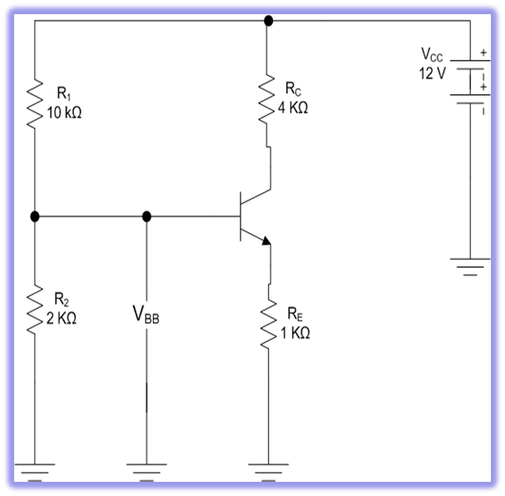


Circuit-19.3; Problem 19.6 (c).
Determination of I_{E}
V_{RE} = I_{E}R_{E}

Slide 34
Circuit-19.3; Problem 19.6 (d).
Determination of V_{RC}
Since
I_{E} ≈ I_{C}
I_{E} = 1.3mA
Therefore,
I_{C} = 1.3mA
V_{RC} = I_{C}R_{C}
= (1.3mA)(4x10³Ω)
V_{RC} = 5.2V

Slide 35
Circuit-19.3; Problem 19.6 (e).
Determination of V_{CE}
Output Loop
V_{CC}=V_{RC}+V_{CE}+V_{RE}
V_{CE} = V_{CC}-V_{RC}-V_{RE}
V_{CE} = 12V - 5.2V - 1.3V
V_{CE} = 5.5V

Slide 36
Results of Problem 19.6
I_{E} = I_{C} = 1.3mA
V_{RC} = 5.2V
V_{CE} = 5.5V
V_{RE} = 1.3V
V_{BB} = 2V
β_{dc} was never used in a calculation. Hence, voltage-divider biased circuits are immune to changes in β_{dc}.
A single voltage source supplies both voltages, V_{CC} and V_{BB}

Slide 37


Review of equations:
In Review
V_{RE} = V_{BB} – V_{BE}
I_{E} ≈ I_{C}

Slide 38
Summary:
Voltage-divider biased circuits are immune to changes in β_{dc}.
A single voltage source supplies both voltages, V_{CC} and V_{BB}
The circuit Q-point values are stable against changes in h_{FE}.
Use of the Thevenin equivalent circuit for the base makes the circuit simpler.
Make the current in the voltage divider about 10 times IB,
to simplify the analysis.
For design, solve for the resistor values (IC and VC specified).

Slide 40
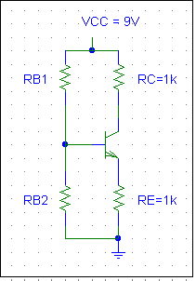
Circuit 19.4; Problem 19.7 (a).
Given: VB = 3V and I = 0.2mA.
(a) RB1 and RB2 form a voltage divider.
Assume I >> IB
I = VCC/(RB1 + RB2)
0.2mA = 9 /(RB1 + RB2)
I
IB

Slide 41
Circuit 19.4; Problem 19.7 (b).
Given: VB = 3V and I = 0.2mA.
RB1 = 30KΩ, and RB2 = 15KΩ.
(b) Determination of the Thevenin voltage:
VB = VCC[RB2/(RB1 + RB2)]
3 = 9 [RB2/(RB1 + RB2)],
Solve for RB1 and RB2.
I
IB

Slide 42
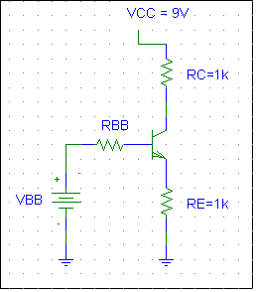
Prob. 19.7 (c).
Find the operating point
The use of Thevenin equivalent circuit for the base makes the circuit simpler.
VBB = VB = 3V
RBB = RB1|| RB2 = 30KΩ || 15KΩ = 10KΩ

Slide 43
Problem 19.7 (d).
Write B-E loop and C-E loop
B-E Voltage Loop:
VBB = VRBB + VBE + VRE
VBB = IBRBB + VBE + IERE
IE =2.09 mA
C-E Voltage Loop:
VCC = ICRC + VCE + IERE
VCE =4.8 V
This is how all DC circuits are analyzed
and designed!
C-E loop
B-E
loop

Slide 45
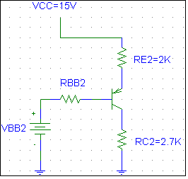
Example 19.7
Stage 2
C-E loop
IE2
VCC = IE2RE2 + VEC2 +IC2RC2
15 = 2.8(2) + VEC2 + 2.8 (2.7)
solve for VEC2
VCE2 = 1.84V
IC2

Slide 46
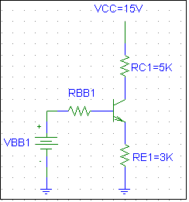
Example 19.7
C-E loop
neglect IB2 because it is IB2 << IC1
VCC = IC1RC1 + VCE1 +IE1RE1
15 = 1.3(5) + VCE1 +1.3(3)
VCE1= 4.87V
IC1
IE1

Slide 47
Example 19.7
Stage 2
B-E loop
IE2
VCC = IE2RE2 + VEB +IB2RBB2 + VBB2
15 = IE2(2K) + .7 +IB2 (5K) + 4.87 + 1.3(3)
Use IB2 ≈ IE2/ β, solve for IE2
IE2 = 2.8mA
IB2

Slide 48
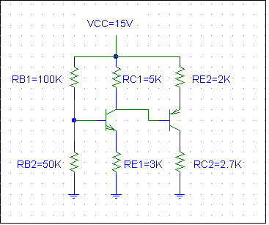
Example 19.7
2-stage amplifier, 1st stage has an npn transistor; 2nd stage has an pnp transistor.
IC = βIB
IC ≈ IE
VBE = 0.7(npn) = -0.7(pnp)
β = 100
Find IC1, IC2, VCE1, VCE2
Use Thevenin circuits.

Slide 49
Example 19.7
RBB1 = RB1||RB2 = 33K
VBB1 = VCC[RB2/(RB1+RB2)]
VBB1 = 15[50K/150K] = 5V
Stage 1
B-E loop
VBB1 = IB1RBB1 + VBE +IE1RE1
Use IB1 ≈ IE1/ β
5 = IE133K / 100 + .7 + IE13K
IE1 = 1.3mA
IB1
IE1

