Slide 1

COMSATS Institute of Information Technology
Virtual campus
Islamabad
Dr. Nasim Zafar
Electronics 1: EEE 231
Fall Semester – 2012

Slide 2
Transistor Biasing Circuits and Thermal Stability.
Lecture No: 18
Contents:
Introduction
The Operating Point and Biasing Stability
Fixed-Bias Circuits
Fixed Bias with Emitter Resistance
Voltage-Divider Bias Circuits

Slide 3
References:
Microelectronic Circuits:
Adel S. Sedra and Kenneth C. Smith.
Electronic Devices :
Thomas L. Floyd ( Prentice Hall ).
Integrated Electronics
Jacob Millman and Christos Halkias (McGraw-Hill).
Electronic Devices and Circuit Theory:
Robert Boylestad & Louis Nashelsky ( Prentice Hall ).
Introductory Electronic Devices and Circuits:
Robert T. Paynter.

Slide 4
References for this Lecture:
Chapter No. 9
Microelectronic Circuits:
Adel S. Sedra and Kenneth C. Smith.
Integrated Electronics :
Jacob Millman and Christos Halkias (McGraw-Hill).

Slide 5
Objectives:
Discuss the concept of dc biasing of a transistor for the linear operation in the active region.
Establish an operating point Q in this active region to provide appropriate potentials and currents.
Analyze the voltage-divider bias, base bias, and collector-feedback bias circuits.
Establish a criterion for comparing the stability of different biasing circuits.

Slide 6
Transistor Biasing Circuits: an Introduction
Biasing refers to the establishment of suitable dc values of different currents and voltages of a given transistor.
Through proper biasing, a desired DC operating point or quiescent point;
Q-Point of the transistor amplifier, in the active region (linear region) of the characteristics is obtained.
The goal of amplification, in most cases, is to increase the amplitude of an ac signal without distortion or clipping the wave form.

Slide 7
Transistor Biasing Circuits: an Introduction
The selection of a proper DC operating point or quiescent point, generally depends on the following factors:
(a) The amplitude of the ac signal to be handled by the amplifier and distortion level in signal. Applying large ac voltages to the base would result in driving the collector current into saturation or cutoff regions resulting in a distorted or clipped wave form.
(b) The load to which the amplifier is to work for a corresponding supply
voltage.

Slide 8
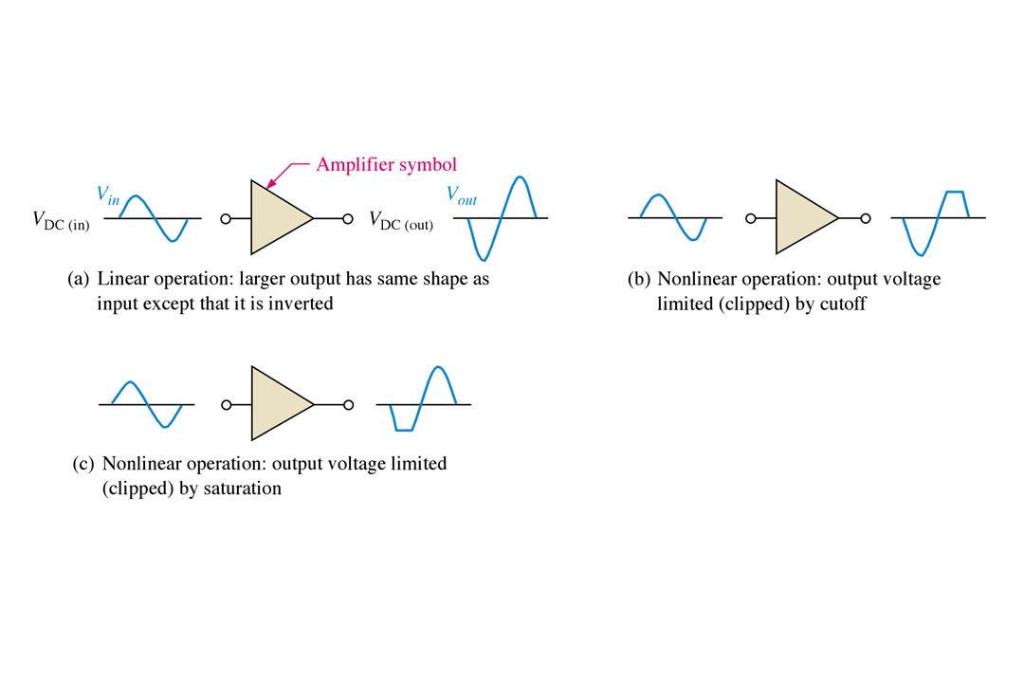
The DC Operating Point:
Biasing and Stability
The goal of amplification, in most cases, is to increase the amplitude of an ac signal without distortion or clipping the wave form.
Notes:
Fig 5-1a, b, & c

Slide 9
Transistor Output Characteristics:
IC
IC
IB = 40μA
IB = 30μA
IB = 20μA
IB = 10μA
VCE
Early voltage
Cutoff
region
At a fixed IB, IC is not dependent on VCE

Slide 10
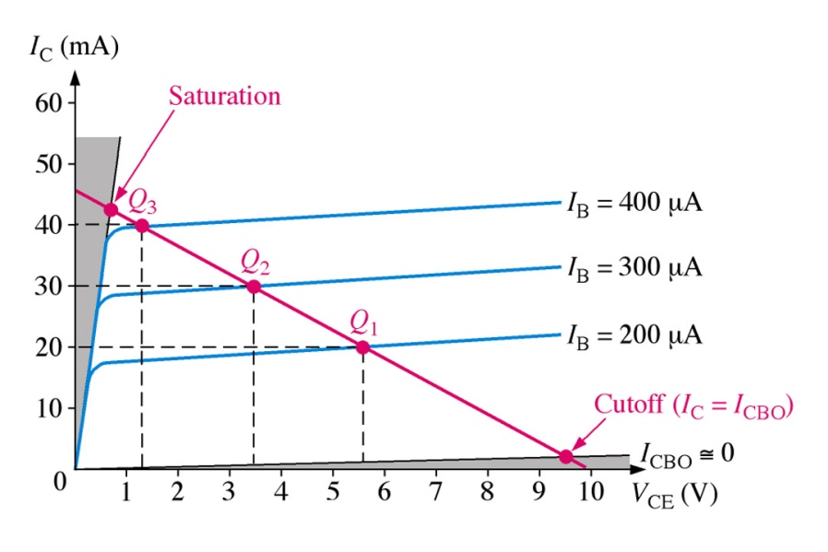
Transistor Output Characteristics:
Load Line – Biasing and Stability
The requirement is to set the Q-point such that that it does not go into the saturation or cutoff regions when an a ac signal is applied.
Notes:
Fig 5-2a & Fig 5-4

Slide 11
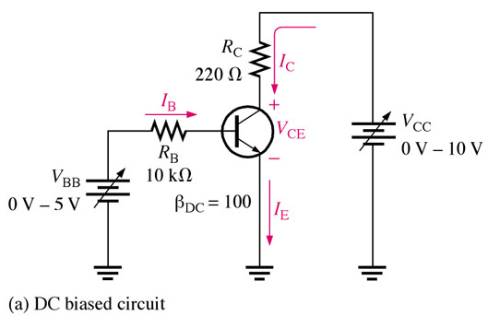
The DC Operating Point:
Biasing and Stability
Slope of the Load Line:
V_{CC} = V_{CE} + V_{RC}
V_{CE} = V_{CC} -- V_{RC}
V_{CE} = V_{CC} -- I_{C} R_{C}

Slide 12
The DC Operating Point:
Biasing and Stability
Load Line drawn on output characteristic curves.
  Determines quiescent point, Q
  Q is between saturation and cutoff
Best Q for a linear amplifier:
  Midway between saturation and cutoff.

Slide 13
The DC Operating Point:
Biasing and Stability
For this particular transistor we see that 30 mA of collector current is best for maximum amplification, giving equal amount above and below the Q-point.
Notes:
Fig 5-2a & Fig 5-4

Slide 14
The DC Operating Point:
Biasing and Stability
Q-Point and Current Gain β_{dc}
β_{dc} not a constant
β_{dc} Dependent on:
  Operating Point Q
  Temperature
Active region limited by
  Maximum forward current, I_{C(MAX)}
  Maximum power dissipation, P_{D}

Slide 15
The DC Operating Point:
Biasing and Stability
The DC operating point of a transistor amplifier shifts mainly due to changes in the temperature, since the transistor parameters:
— β, I_{CO} and V_{BE} —are functions of temperature.
100 < β_{dc} < 300
We will discuss some of the methods used for biasing the transistor circuits.

Slide 16
Transistor Biasing Circuits.

Slide 17
  Transistor Biasing Circuits:
Biasing - Circuit Configurations:
  1. Fixed-Biased Transistor Circuits.
  2. Fixed-Biased with Emitter Resistance Circuits.
  3. Voltage-Divider-Biased Transistor Circuits.

Slide 18
Transistor Biasing Circuits:
1. Fixed-Biased Transistor Circuits.
- Highly dependent on β_{dc}
2. Fixed-Bias with Emitter Resistance Circuits.
  Add emitter resistor
  Greatly reduces effects of change of β
  Equations
  highly dependent on β_{dc}

Slide 19
  1. Fixed-Biased Transistor Circuits.
          Single Power Supply

Slide 20
DC Voltages and Currents in a BJT:
Active region - Amplifier: BJT acts as a signal amplifier.
  1. B-E Junction Forward Biased
    V_{BE} ≈ 0.7 V for Si
  2. B-C Junction Reverse Biased
  3. KCL: I_{E} = I_{C} + I_{B}
C
C
I_{C}
I_{C}
B
B
I_{B}
I_{B}
I_{E}
I_{E}
E
E

Slide 21
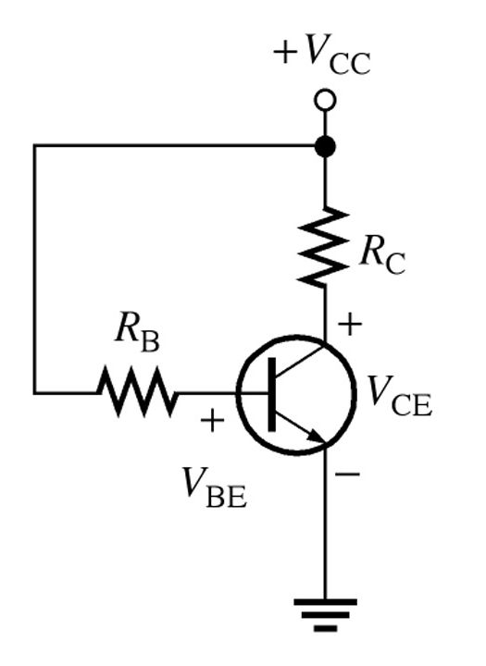
1. Fixed-Biased Transistor Circuits:
  Single Power Supply

Slide 22
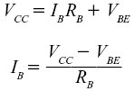


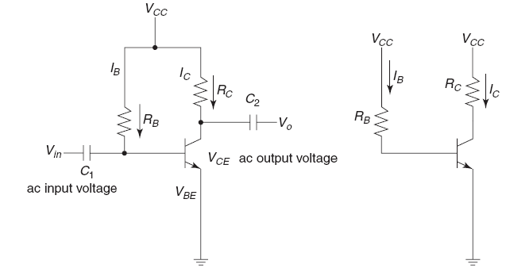
1. Transistor Fixed-Bias Circuits:
Base–Emitter Loop:
  Collector–Emitter Loop:
V_{CE} = V_{CC} -- I_{C} R_{L}
(a) Fixed-Bias Circuit. (b) Equivalent Circuit.

Slide 23
1. Transistor Fixed-Bias Circuits:
Current-Voltage Equations for Fixed-Bias circuits:

Slide 24
  2. Fixed-Bias with Emitter Resistance
          Single Power Supply

Slide 25
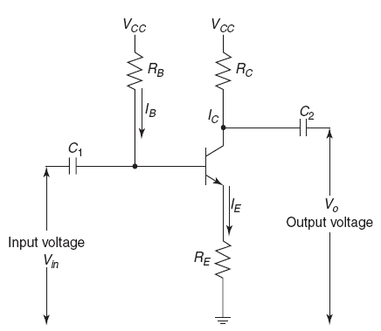

  2. Fixed-Bias with Emitter Resistance:
  1. Base-Emitter Loop:
  KCL: I_{E} = I_{C} + I_{B}
The emitter current can be written as:
From the above two equation we get:
Fixed-Bias Circuit with Emitter Resistance

Slide 26

  2. Fixed-Bias with Emitter Resistance.
  2. Collector-Emitter Loop
with the base current known, I_{C} can be easily calculated by the relation I_{C} = β I_{B}.
Fixed-Bias Circuit with Emitter Resistance

Slide 27
  3.
  3. Voltage-Divider-Bias Circuits.

Slide 28
3. Voltage-Divider-Bias Circuits:
Voltage-Divider Bias Circuits:
  Sometimes referred to as Universal-Bias Circuit:
  Most stable
  Need I_{B} << I_{C}
  Make
  Simple Voltage divider between V_{CC}, Base, and ground.

Slide 29
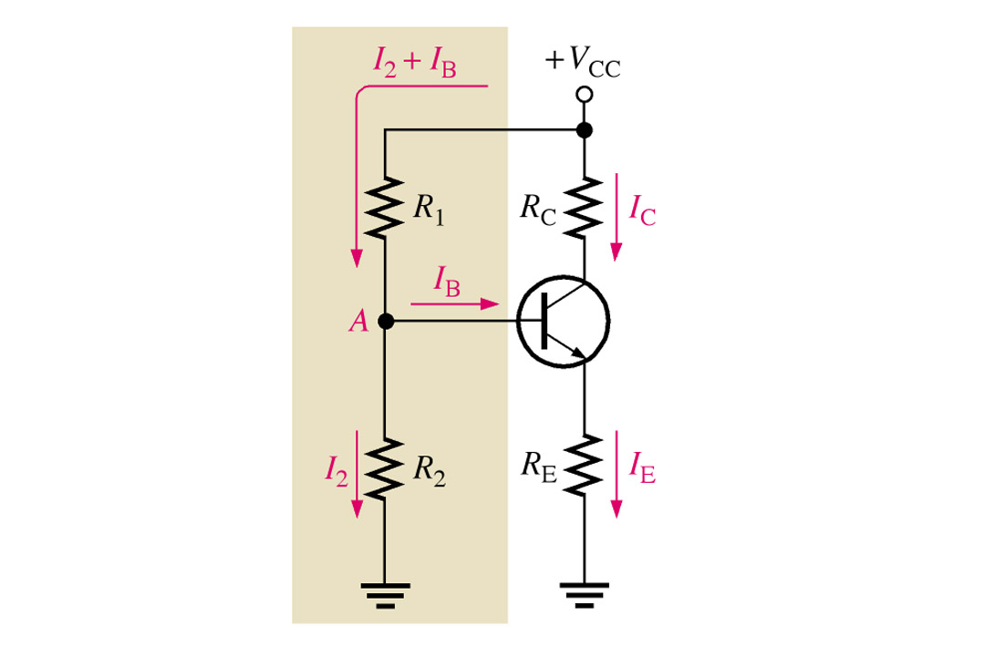
3. Voltage-Divider-Bias Circuits:
Voltage-divider biasing circuit is the most widely used type of transistor biasing circuit.
Only one power supply is needed.
and voltage-divider bias is more stable (β independent) than other bias types.
Notes:
Fig 5-9 Voltage-Div. Bias

Slide 30
3. Voltage-Divider-Bias Circuits:
For the transistor circuit shown here, R₁ and R₂ set up a voltage divider on the base, voltage to the point A (base).
The resistance to ground from the base is not significant enough to consider in most cases.
Remember, the basic operation of the transistor has not changed.
Notes:
Fig 5-9 Voltage-Div. Bias

Slide 31
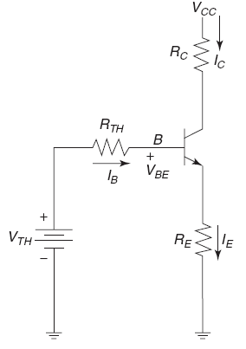
3. Voltage-Divider-Bias Circuits:
Voltage-Divider Bias circuit
Simplified Voltage-Divider circuit

Slide 32


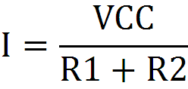

3. Voltage-Divider-Bias Circuits:
Determination of VTh – the Thevenin Voltage.

Slide 33


3. Voltage-Divider-Bias Circuits:
  1. Base Emitter Loop:
The Thevenin equivalent Voltage
for the input circuit is given by:
and Resistance for the input circuit:

Slide 34

  3. Voltage-Divider Bias Circuits:
  1. Base-Emitter Loop:
The KVL equation for the input circuit:

Slide 35
3. Voltage-Divider Biasing Circuits:
  2. Collector-Emitter Loop:

Slide 36
3. Voltage-Divider Biasing Circuits:
Voltage Divider Equations:

Slide 37
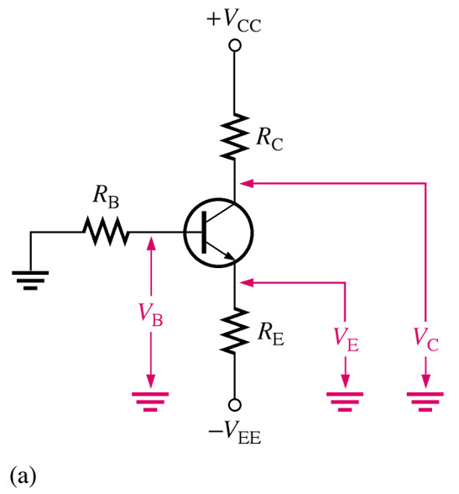
Emitter Biased Transistor Circuits:
This type of circuit is independent of β making it as stable as the voltage-divider type,
The drawback is that it requires two power supplies.
Two key equations for analysis of this type of bias circuit are given below.
With these two currents known we can apply Ohm’s law and Kirchhoff's law to solve for the voltages.
I_{B} ≈ I_{E}/β
I_{C} ≈ I_{E} ≈( -V_{EE}-V_{BE})/(R_{E} + R_{B}/β_{DC})
Notes:
Fig 5-21a npn emitter bias

Slide 38
Summary:
β_{dc} Dependent on:
  Operating Point Q
  Temperature
  For stability of the Q-point:
  Make

