Slide 1

COMSATS Institute of Information Technology
Virtual campus
Islamabad
Dr. Nasim Zafar
Electronics 1 - EEE 231
Fall Semester – 2012

Slide 2
DC Analysis of Transistor Circuits-II
Lecture No: 17
Contents:
DC Current and Voltage Analysis.
Examples and Exercises.

Slide 3
References:
Microelectronic Circuits:
Adel S. Sedra and Kenneth C. Smith.
Electronic Devices :
Thomas L. Floyd ( Prentice Hall ).
Integrated Electronics
Jacob Millman and Christos Halkias (McGraw-Hill).
Electronic Devices and Circuit Theory:
Robert Boylestad & Louis Nashelsky ( Prentice Hall ).
Introductory Electronic Devices and Circuits:
Robert T. Paynter.

Slide 4
Lecture No. 17
DC Analysis of Transistor Circuits-II
Reference:
Chapter 5.4
Microelectronic Circuits
Adel S. Sedra and Kenneth C. Smith.

Slide 5
DC Analysis of Transistor Circuits

Slide 6
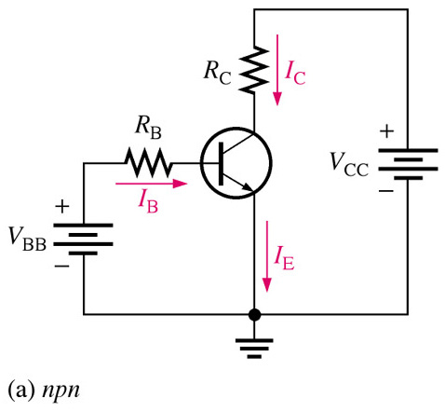
Basic Transistor Operation
Consider this circuit as two separate circuits:
The Base-Emitter Circuit
The Collector-Emitter Circuit
The amount of current flow in the base-emitter circuit controls the amount of current that flows in the collector circuit.
Small changes in base-emitter current yields a large change in collector-current.
Notes:
Fig 4-6a

Slide 7
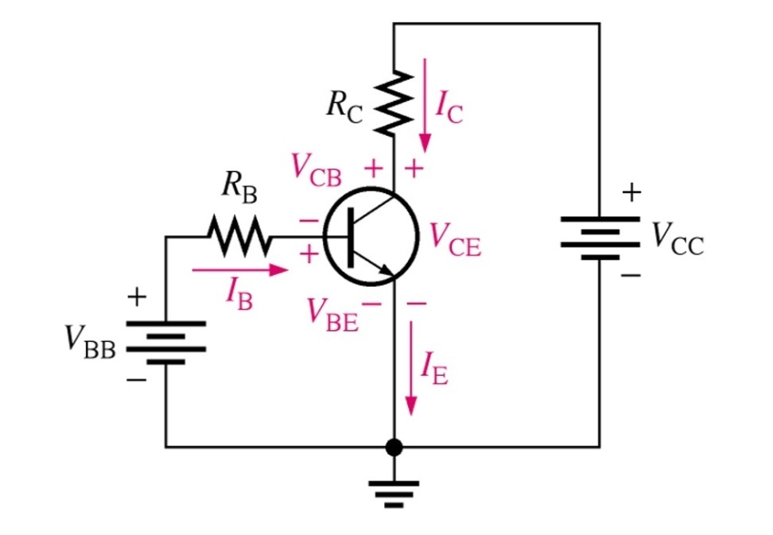
DC Analysis of Transistor Circuits
Analysis of this transistor circuit to predict:
DC Voltages and
Currents requires use of :
Ohm’s law,
Kirchhoff’s voltage law
and the ß for the transistor.
Notes:
Fig 4-7

Slide 8
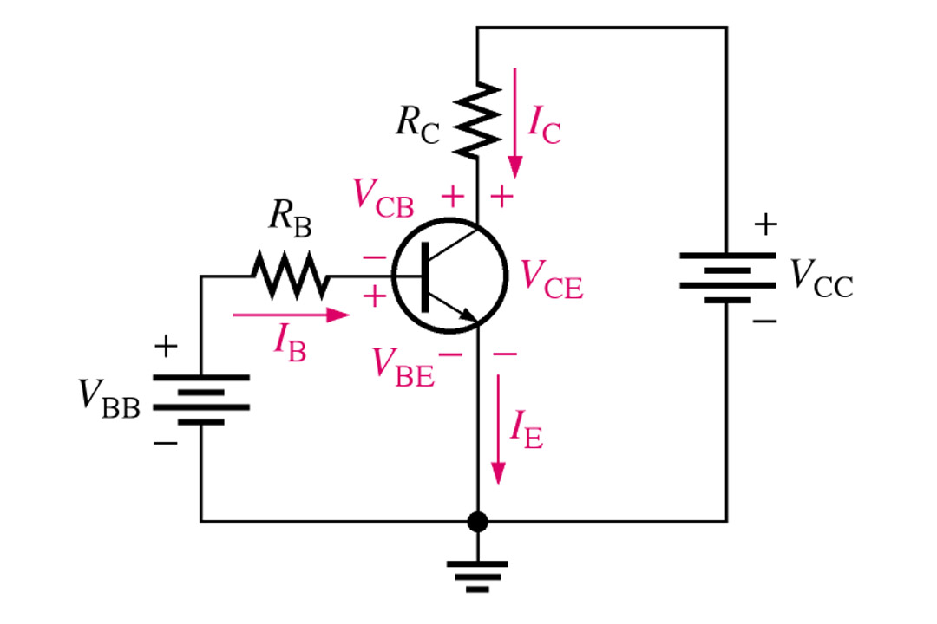
DC Analysis of Transistor Circuits
Kirchhoff’s voltage law:
In the Base Circuit:
V_{BB} is distributed across the base-emitter junction and R_{B}
In the collector circuit:
We determine that V_{CC} is distributed proportionally across R_{C} and the transistor, V_{CE}.
Notes:
Fig 4-7

Slide 9
Transistor Characteristics and Parameters
There are three dc voltages and three dc currents to be considered.
I_{B}: dc base current
I_{E}: dc emitter current
I_{C}: dc collector current
V_{BE}: dc voltage across base-emitter junction
V_{CB}: dc voltage across collector-base junction
V_{CE}: dc voltage from collector to emitter
Notes:
Fig 4-7

Slide 10
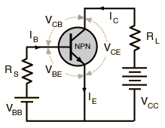
BJT-Current and Voltage Analysis
For all circuits: Assume the NPN transistor operates in the linear region:
        write B-E voltage loop
        write C-E voltage loop
When the base-emitter junction, in an NPN transistor is forward biased,
it is like a forward biased diode and has a forward-voltage drop of:
V_{BE} = 0.7 V
NPN

Slide 11
BJT-Current and Voltage Analysis:
Input Circuit: Forward Biased E-B Junction.
Since the emitter is grounded, by Kirchhoff’s voltage law, the voltages
in the input circuit are:
V_{BB} = V_{RS} + V_{BE}
V_{RS} = V_{BB} -- V_{BE}
Using Ohm’s law:
V_{RS} = I_{B} R_{S}
I_{B} R_{S} = V_{BB} -- V_{BE}
I_{B} = (V_{BB} – V_{BE})/R_{S}
NPN

Slide 12
BJT-Current and Voltage Analysis:
Output Circuit: Reverse Biased B-C Junction.
Using Kirchhoff’s voltage law, the voltages in the Output Circuit are:
V_{CC} = V_{CE} + V_{RL}
V_{CE} = V_{CC} -- V_{RL}
The voltage drop across R_{L} is:
V_{RL} = I_{C} R_{L}
The collector voltage is:
V_{CE} = V_{CC} -- I_{C} R_{L}

Slide 13
DC Voltages for the Biased Transistor
Collector voltage:
V_{CE} = V_{CC} - I_{C}R_{C}
Base voltage:
V_{BE} = V_{CE} – V_{CB}
  I_{B} = (V_{BB} – V_{BE})/R_{B}
  for silicon transistors, V_{BE} = 0.7 V
  for germanium transistors, V_{BE} = 0.3 V

Slide 14
DC Analysis of Transistor Circuits
Transistor Currents: I_{E} = I_{C} + I_{B}
alpha (α_{DC}): I_{C} = α_{DC}I_{E}
beta (β_{DC}): I_{C} = β_{DC}I_{B}
  β_{DC} typically has a value between 20 and 200

Slide 15
Examples and Exercises:

Slide 16
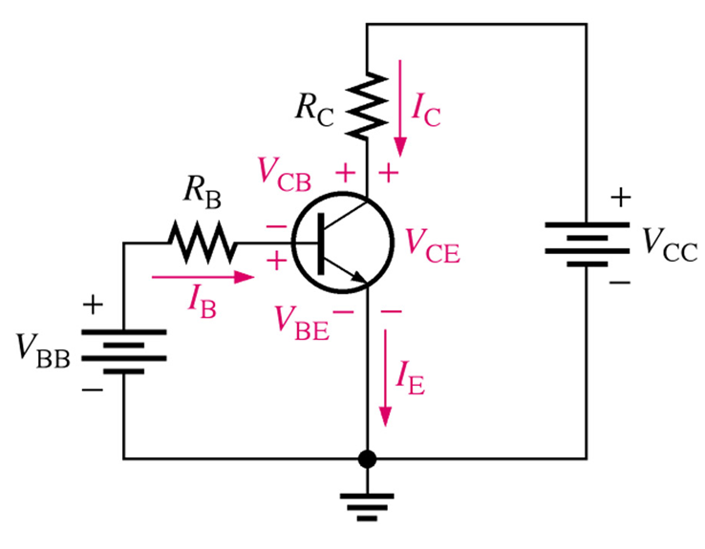
DC Analysis of Transistor Circuits
Q: What is I_{B}, I_{C}, I_{E} and also V_{CE}, V_{CB}, V_{BE} ??
A: I don’t know ! But, we can find out—IF we complete each of the four steps required for BJT DC analysis.

Slide 17
DC Analysis of Transistor Circuits
Step 1 – Assume an operating mode.
Let’s assume the BJT is in the linear region ! Remember, this is just a guess; we have no way of knowing for sure what mode the BJT is in at this point.
Step 2 - Enforce the conditions of the assumed mode.
Step 3 – ANALYZE the circuit.
Step 4 -“Write KVL equations for the base-emitter “leg”.

Slide 18
Modes of BJT Operation:
Active: BJT acts like an amplifier (most common use).
Saturation: BJT acts like a short circuit.
Cutoff: BJT acts like an open circuit.

Slide 19
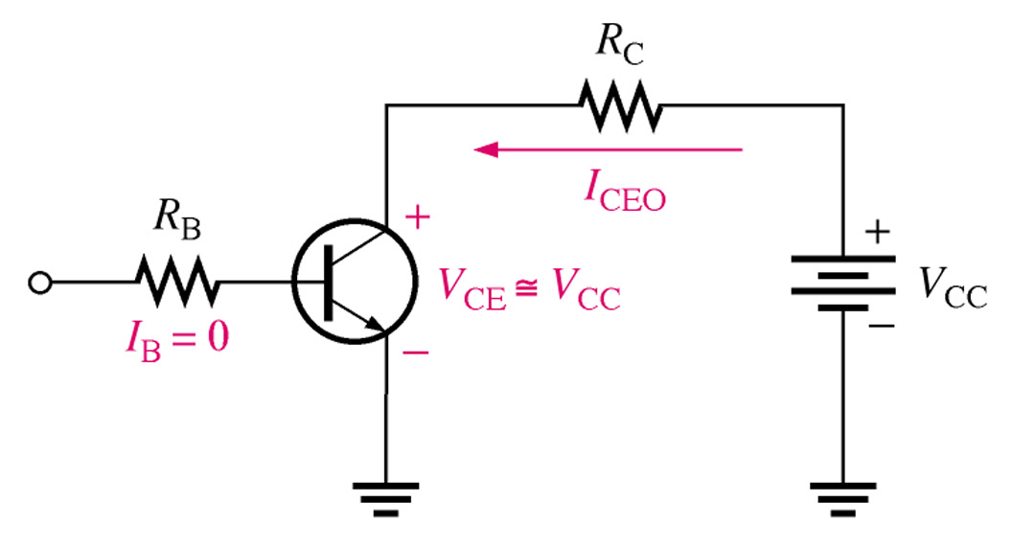
Transistor Characteristics and Parameters
The Cutoff Region
With no I_{B} the transistor is in the cutoff region and just as the name implies there is practically no current flow in the collector part of the circuit. With the transistor in a cutoff state the full V_{CC} can be measured across the collector and emitter(V_{CE})
Notes:
Fig 4-12 cutoff ex.

Slide 20
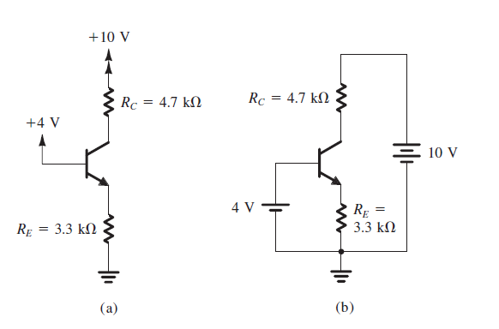
Example 5.4 - Figure 5.34
Consider the circuit shown in Fig. 5.34(a), which is redrawn in Fig. 5.34(b)

Slide 21
Example 5.4
Example: 5.4
We wish to analyze this circuit to determine:
all node voltages
and branch currents.
We will assume that β is specified to be 100.

Slide 22
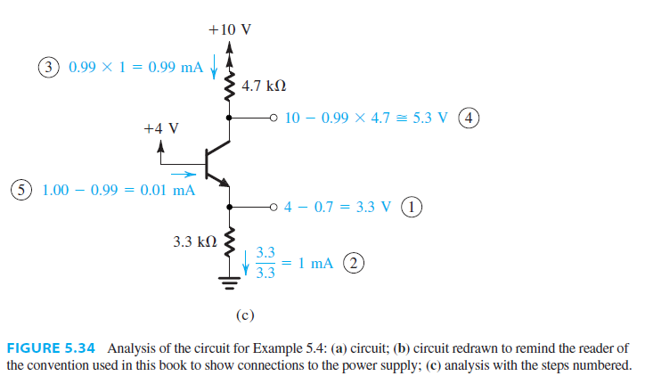
Example 5.4 - Figure 5.34

Slide 23
Solution - Example 5.4

Slide 24
Solution - Example 5.4
Input Circuit: Forward Biased E-B Junction:
Step 1:
The circuit in Fig. 5.34(b) shows that the base is connected to +4 V and the emitter is connected to ground through a resistance R_{E}.
The base–emitter junction will be forward biased.
Since the emitter is grounded, by Kirchhoff’s voltage law, the voltages in the input circuit are:
V_{BB} = V_{RE} + V_{BE}
V_{RE} = V_{BB} -- V_{BE}

Slide 25


Solution - Example 5.4
Assuming that V_{BE} is approximately 0.7 V, it follows that the emitter voltage will be:
Step 2:
We know the voltages at the two ends of R_{E} and thus can determine the current I_{E} through it,

Slide 26

Solution - Example 5.4
Step 3:
We can evaluate the collector current from:

Slide 27

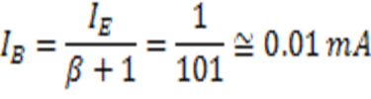
Solution - Example 5.4
Step 4: We are now in a position to use Ohm’s law to determine the collector voltage :
Since the base is at +4 V, the collector–base junction is reverse biased by 1.3 V, and the transistor is indeed in the active mode as assumed.
Step 5: It remains only to determine the base current I_{B}, as follows:

Slide 28
Example 5.5

Slide 29
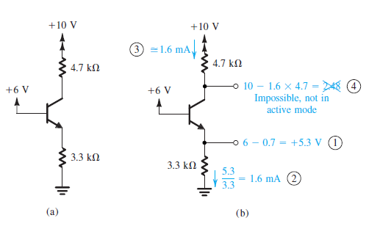
Example 5.5 - Figure 5.35

Slide 30
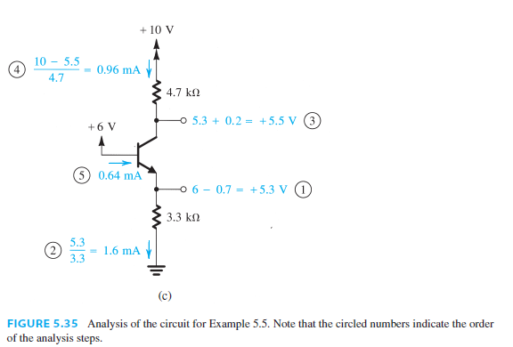
Example 5.5 - Figure 5.35

Slide 31



Solution: Example 5.5
Assuming active-mode operation, we have:

Slide 32



Solution: Example 5.5
Since the collector voltage calculated, appears to be less than the base voltage by 3.52 V, it follows that our original assumption of active-mode operation is incorrect. In fact, the transistor has to be in the saturation mode. Assuming this to be the case, we have:

Slide 33


Solution: Example 5.5
Also:

Slide 34
Some More Examples

Slide 35
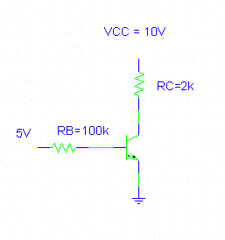
Example17-1
Input Circuit: Forward Biased Junction.
B-E Voltage Loop:
V_{BB} = V_{RB} + V_{BE}
V_{BB} = IBRB + VBE
Solve for IB, I_{C}, V_{CC}:
I_{B} R_{B} = V_{BB} -- V_{BE}
IB = (5 - VBE)/RB = (5-0.7)/100k = 0.043mA
IC = βIB = (100)0.043mA = 4.3mA
VCC = 10 - ICRC = 10 - 4.3(2) = 1.4V
β = 100
IC
IB
IE

Slide 36
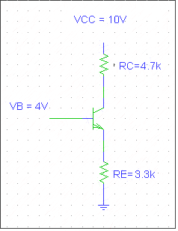
Example 17-2
The voltages in the input circuit are:
VE = VB - VBE = 4V - 0.7V = 3.3V
IE = (VE - 0)/RE = 3.3/3.3K = 1mA
IC ≈ IE = 1mA
VC = 10 - I_{C}R_{C} = 10 - 1(4.7) = 5.3V
IC
IE

Slide 37
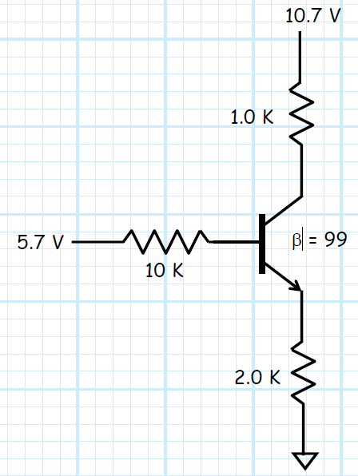
Exercise

Slide 38
Summary of DC Analysis
Bias the transistor so that it operates in the linear region
B-E junction forward biased, C-E junction reversed biased.
Use VBE = 0.7 (NPN), IC ≈ IE, IC = βIB
Write B-E, and C-E voltage loops.
For DC analysis, solve for IC, and VCE.
For design, solve for the resistor values (IC and VCE specified).

