Slide 1

COMSATS Institute of Information Technology
Virtual campus
Islamabad
Dr. Nasim Zafar
Electronics 1
EEE 231 – BS Electrical Engineering
Fall Semester – 2012

Slide 2
DC Analysis of Transistor Circuits-I
Lecture No: 16
Contents:
DC Current and Voltage Analysis.
Examples and Exercises.

Slide 3
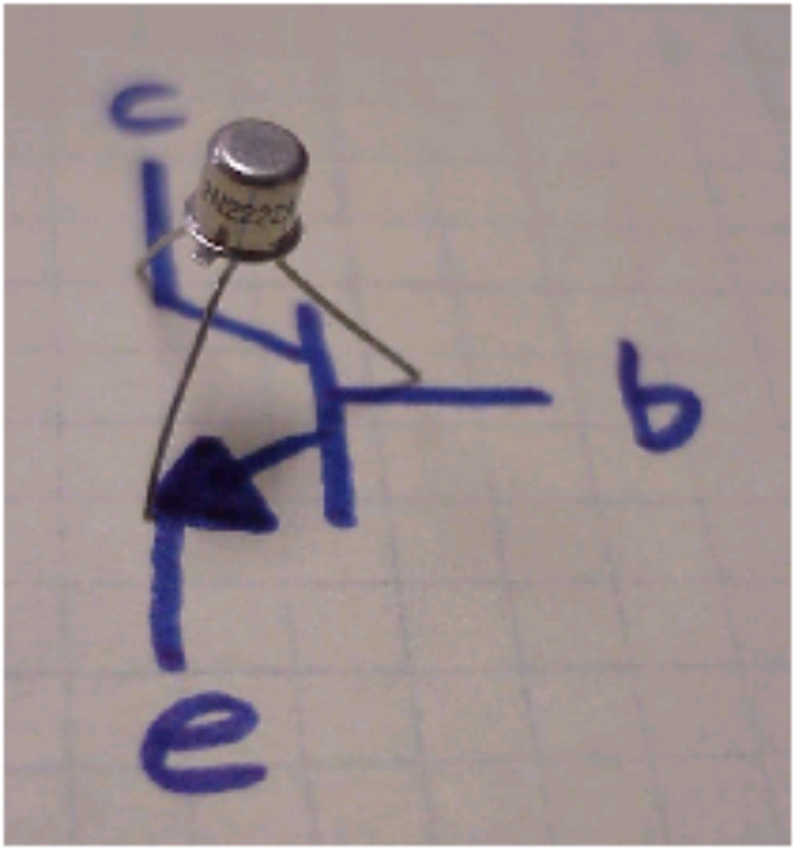
NPN Transistor

Slide 4
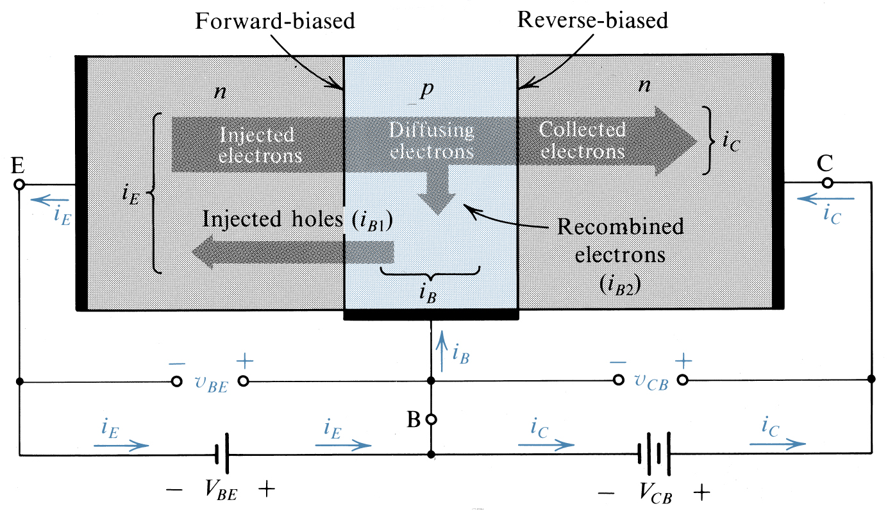
Operation of an NPN Transistor:
Large current

Slide 5
Modes of Operation of a BJT Transistor:
Mode: B-E Junction: B-C Junction:
cutoff reverse biased reverse biased
Active(linear) Forward Biased Reverse Biased
saturation forward biased forward biased

Slide 6
Transistor Characteristics:
IC
IB
Output
Circuit
Input
Circuit
IE

Slide 7
DC Current and Voltage Analysis:
NPN
IC
collector
base
Large current
IB
+
VBE
-
emitter
IE
Small Current

Slide 8
DC Current and Voltage Analysis:
PNP
IC
collector
base
Large current
IB
+
VBE
-
emitter
IE
Small Current

Slide 9
DC Analysis of Transistor Circuits.

Slide 10
DC Analysis of Transistor Circuits:
The DC Analysis of the transistor circuits involves solving for all
(or most of) the currents and voltages in the circuit.
The most important DC parameters to solve are I_{C} and V_{CE}.
The “Q-point” of a transistor, gives the values of I_{C} and V_{CE} that are present in the given transistor circuit.
The first step in the DC analysis, of any transistor circuit, is to solve for one of the unknown currents, I_{B}, I_{C}, or I_{E.}

Slide 11
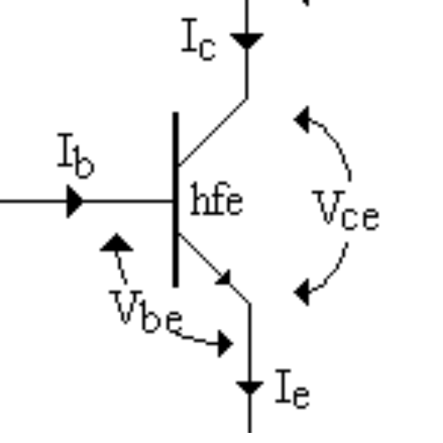
DC Analysis of Transistor Circuits:
We need a set of equations – a model of the transistor – to be used in transistor circuit theory.
In a basic transistor circuit, we have three terminals - collector, base and the emitter.

Slide 12
DC Analysis of Transistor Circuits:
In a basic transistor circuit, we have three terminals - collector, base and emitter; and correspondingly we have:
Three possible DC voltages: V_{BE}, V_{CB,} V_{CE} - but only two are independent due to KVL; and
Three transistor DC currents: I_{B}, I_{C}, I_{E­} - but only two are independent
due to KCL.

Slide 13
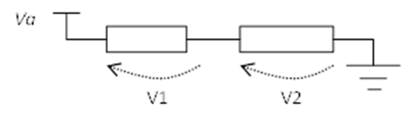
DC Analysis of Transistor Circuits:
If we solve for one of these unknowns, the other two can be found by using the current gain equations and the given value of β.
The recommended way of solving for one of the currents is to write a Kirchhoff's Voltage Law (KVL) loop.
The KVL states the sum of all voltages around a closed loop equals zero.
Va = V1 + V2

Slide 14
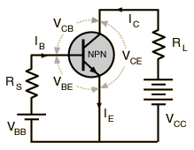
BJT-Current and Voltage Analysis:
When the base-emitter junction, in an NPN transistor is forward biased,
it is like a forward biased diode and has a forward-voltage drop of:
V_{BE} = 0.7 V
Since the emitter is grounded, by Kirchhoff’s voltage law, the voltages in the input circuit are:
V_{BB} = V_{RS} + V_{BE}
V_{RS} = V_{BB} -- V_{BE}
NPN

Slide 15
BJT-Current and Voltage Analysis:
Using Ohm’s law: V_{RS} = I_{B} R_{S}
I_{B} R_{S} = V_{BB} -- V_{BE}
The drop across RL is:
V_{RL} = I_{C} R_{L}
The collector voltage is:
V_{CE} = V_{CC} -- I_{C} R_{L}
NPN

Slide 16
DC Analysis of Transistor Circuits
Examples and Exercises:

Slide 17
Summary of equations for a BJT:
I_{E} ≈ I_{C}
I_{C} = β I_{B}
β is the current gain of the transistor ≈ 100-200
VBE = 0.7V(NPN)
VBE = -0.7V(PNP)

Slide 18
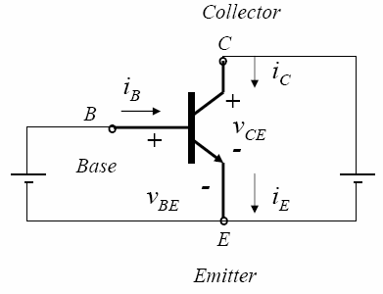
Example 4-1: Common-Emitter Configuration:
Given: I_{B} = 50 μ A , I_{C} = 3.65 mA
Determine: I_{E} , β_{dc} and α_{dc}
Solution:
I_{E}= I_{B}+ I_{C}= 50 μ A + 3.65 mA= 3.7 mA
β_{dc} = I_{C} / I_{B} = 3.65 mA / 0.05 mA = 73
α_{dc} = I_{C} / I_{E} = 3.65 mA/ 3.7 mA = 0.986

Slide 19
Exercise 4-1
A certain transistor has a β_{dc} of 200. When the base current I_{B} = 50 μ A. Determine the collector current. Also calculate α_{dc} .

Slide 20
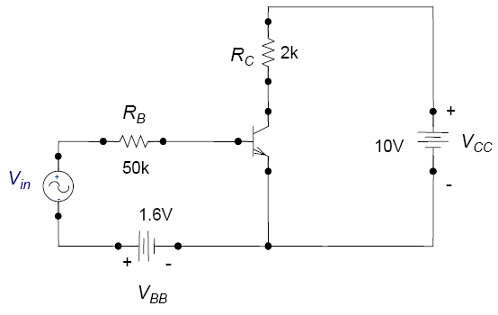
Example 4-2
A given NPN transistor has β_{dc} = 150. Determine I_{B}, I_{C} , I_{E} , V_{CB} , V_{CB} and V_{BE} in the circuit shown below (ignore ac signal):

Slide 21
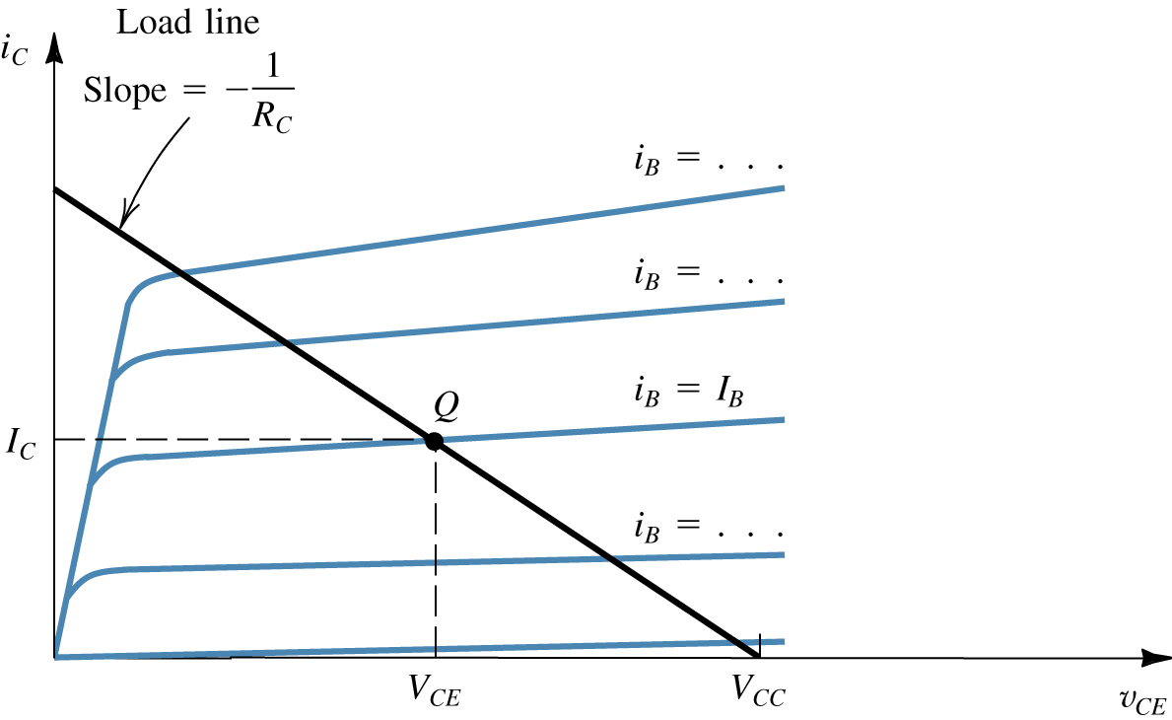
BJT-Output Characteristics:
Common Emitter Configuration.
Graphical construction for determining the dc collector current I_{C}
and the collector-to-emitter voltage VCE.

Slide 22
BJT-Output Characteristics:
Common Emitter Configuration
    We must operate the transistor in the linear region.
A transistor’s operating point (Q-point) is defined by IC, VCE, and IB.

Slide 23
Example 4.3
From the output characteristics of the common emitter configuration shown below, find β_{ac} and β_{dc} with an Operating point at I_{B}=25 μA and V_{CE} =7.5V.

Slide 24
Summary of DC Analysis:
Bias the transistor so that it operates in the linear region
B-E junction forward biased, C-E junction reversed biased.
Use VBE = 0.7 (NPN), IC ≈ IE, IC = βIB
Write B-E, and C-E voltage loops.
For DC analysis, solve for IC, and VCE.
For design, solve for the resistor values (IC and VCE specified).

