Slide 1

COMSATS Institute of Information Technology
Virtual campus
Islamabad
Dr. Nasim Zafar
Electronics 1
EEE 231 – BS Electrical Engineering
Fall Semester – 2012

Slide 2
BJT-Transistor Characteristics and Parameters:
Lecture No: 15
Contents:
Transistor Characteristics and Parameters.
The Gain Factors: DC Beta( ) and DC Alpha (α ).
Relationship of  and α .
Early Effect.
Maximum Transistor Ratings.

Slide 3
References:
Microelectronic Circuits:
Adel S. Sedra and Kenneth C. Smith.
Electronic Devices :
Thomas L. Floyd ( Prentice Hall ).
Integrated Electronics:
Jacob Millman and Christos Halkias (McGraw-Hill).
Electronic Devices and Circuit Theory:
Robert Boylestad & Louis Nashelsky ( Prentice Hall ).
Introductory Electronic Devices and Circuits:
Robert T. Paynter.

Slide 4
Reference:
Chapter 4 – Bipolar Junction Transistors:
Figures are redrawn (with some modifications) from
Electronic Devices
By
Thomas L. Floyd

Slide 5
Bipolar Junction Transistors
BJTs-Circuits
C
B
E

Slide 6
Transistor Types:
MOS - Metal Oxide Semiconductor
FET - Field Effect Transistor
BJT - Bipolar Junction Transistor
◄

Slide 7
Transistor Characteristics
and
Hybrid Parameters

Slide 8
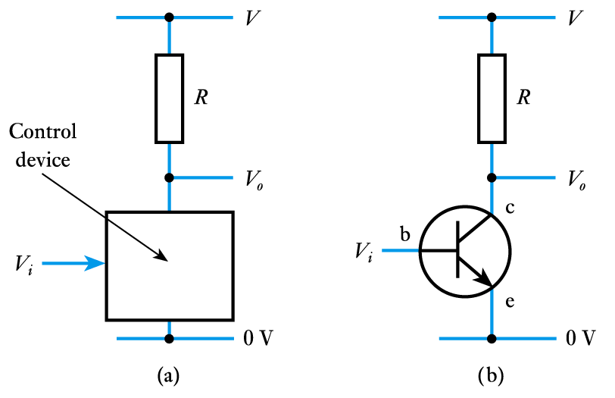
An Overview of Bipolar Transistors:
While control in an FET is due to an electric field.
Control in a bipolar transistor is generally considered to be due to an electric current.
  current into one terminal
  determines the current
  between two others
  as with an FET, a
  bipolar transistor
  can be used as a
  ‘control device’

Slide 9
Transistor Characteristics:
Transistor Geometry.
Carrier motion (mobility).
Collector “collection efficiency” (Alpha).
Asymmetry: Efficiency / Breakdown voltages.
NPN transistors are normally better than PNP since electron mobility is better than hole mobility.

Slide 10
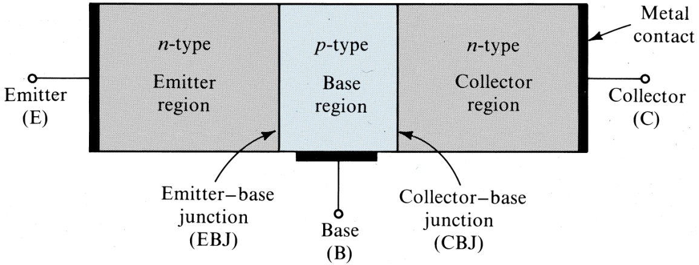
Transistor Biasing Configurations and Operation Modes:

Slide 11
Transistor Biasing Configurations:
Common-Base Configuration (CB) :
input = V_{EB} & I_{E} ; output = V_{CB} & I_{C}
2. Common-Emitter Configuration (CE):
input = V_{BE} & I_{B} ; output = V_{CE} & I_{C}
Common-Collector Configuration (CC):
input = V_{BC} & I_{B} ; output = V_{EC} & I_{E}

Slide 12
Modes of BJT Operation:
Active: BJT acts like an amplifier (most common use).
Saturation: BJT acts like a short circuit.
Cutoff: BJT acts like an open circuit.

Slide 13
Modes of BJT Operation:
Active Region: Region where current curves are practically flat.
In Active Region, the transistor is on. The collector current is proportional to and controlled by the base current I_{C} (I_{C} = βI_{B}) and relatively insensitive to V_{CE}.
In this region the transistor can be used as an amplifier.
Cutoff Region: Current reduced to zero.
  The transistor is off. There is no conduction between the collector and the emitter. (I_{B} = 0 therefore I_{C} = 0).
  ‏Equivalent to an off-state and the transistor behaves like an open switch. Low current flow, High Voltage.

Slide 14
Modes of BJT Operation:
Saturation Region:
  In Saturation region: The transistor is on. The collector current varies very little with a change in the base current in the saturation region.
  The output voltage V_{CE} is small, a few tenths of a volt.
  The collector current is strongly dependent on V_{CE} unlike in the active region.
  Ideal transistor behaves like a closed switch.

Slide 15
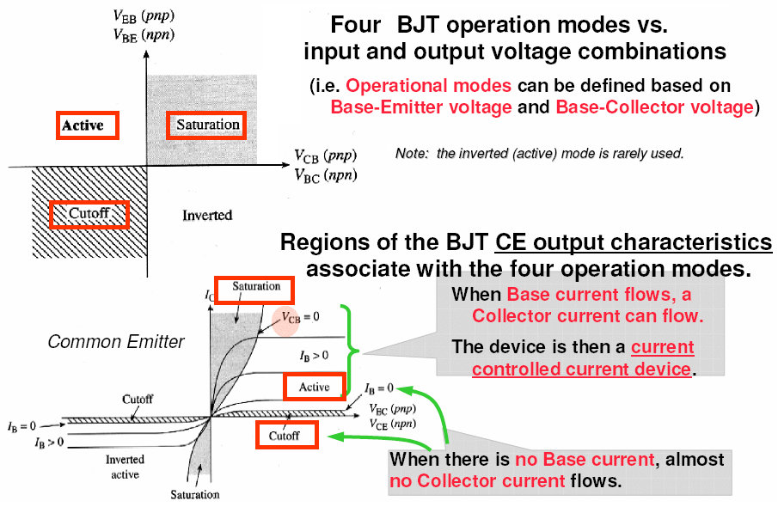
Modes of BJT Operation:

Slide 16
Transistor Characteristics
and
Hybrid Parameters

Slide 17
1. DC-Current Gain Parameters:
DC Beta (_{dc}) and DC Alpha (α_{dc} ):
Two quantities of great importance in the characterization of the transistors are:
common-base current gain α .
common-emitter current gain .
 = Common-emitter current gain
α = Common-base current gain

Slide 18
DC Common-Emitter Current Gain :
Current gain β, usually designated as an equivalent
hybrid (h) parameter h_{FE}, is defined by:
h_{FE} = _{DC}
The ratio of the dc collector current I_{C} to the dc base current
I_{B} is defined as the dc gain factor Beta (_{dc}) of a transistor.
    Thus:  = I_{C}/I_{B}

Slide 19
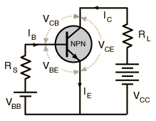
DC Common-Emitter Current Gain :
 = Common-emitter-current gain (typical 50-200)

Slide 20
DC Common-Base Current Gain α :
Current gain α , is also referred to as h_{FB} and is defined by:
  h_{FB} = α_{DC}
The ratio of the dc collector current I_{C} to I_{E}, due to the majority carriers, are related by a quantity called dc Alpha (α_{dc} ):
α = I_{C} / I_{E}
  Also:

Slide 21
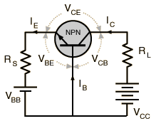
DC Common-Base Current Gain α :
α = Common-Base Current Gain (typical 0.99)

Slide 22
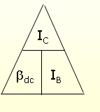
Beta (β) or Amplification Factor:
I_{C} and I_{B} are determined at a particular
operating point, Q-point (quiescent point).
Typical values of _{dc} range from:
30 < βdc < 200 → 2N3904
On data sheet, β_{dc}= h_{FE} with h is derived from ac hybrid equivalent circuit. h_{FE} are derived from forward-current amplification and common-emitter configuration respectively.

Slide 23
AC Common-Base Current Gain α :
For ac situations, where the point of operation moves on the characteristics curve, an ac alpha is defined by:
Alpha, a common base current gain factor, gives the efficiency of the transistor for a current flow from the emitter to the collector.
The value of α is typical from 0.95 ~ 0.99.

Slide 24
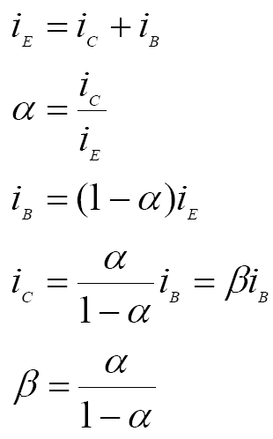
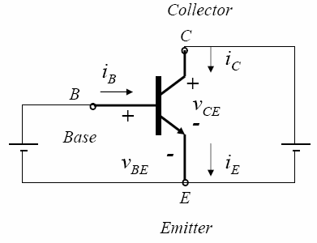
2. Relationship of _{DC} and α_{DC}:

Slide 25
2. Relationship of _{DC} and α_{DC}:
α = Common-base current gain (0.95-0.99)
 = Common-emitter current gain (typical 50-200)
The relationship between the two parameters are:

Slide 26
3. Performance Parameters for PNP:
Emitter Efficiency:
Fraction of emitter current carried by holes.
We want γ close to 1.
Base Transport Factor:
Fraction of holes collected by the collector.
We want α_{T} close to 1.
Common Base dc Current Gain:

Slide 27
The Early Effect (Early Voltage)

Slide 28
Early Effect (base width modulation):
In a Common Emitter Configuration, I_{C} depends on V_{CE.}
An increase in V_{CE} means that the CB junction becomes more reverse biased.
The depletion layer width increases into the base, reducing the effective base width.
Hence the base transport efficiency (α) and β increase with increasing V_{CE.}
This effect is known as base width modulation or the Early Effect.

Slide 29
The Early Effect (Early Voltage)
I_{C}
I_{B}
-V_{A}
Common-Emitter Configuration
V_{CE}
Green = Ideal I_{C}
Orange = Actual I_{C} (I_{C}’)

Slide 30
Actual Output Characteristics
Salient features are:
The finite slope of the plots (I_{C} depends on V_{CE}).
A limit on the power that can be dissipated.
The curves are not equally spaced (i.e β varies with base current, I_{B}).
Note: The finite slope of the (I_{C}-V_{CE}) plot would manifest itself as an output resistance. This would appear in a more detailed a.c. equivalent circuit of the transistor than the one we shall derive from the ideal curve.

Slide 31
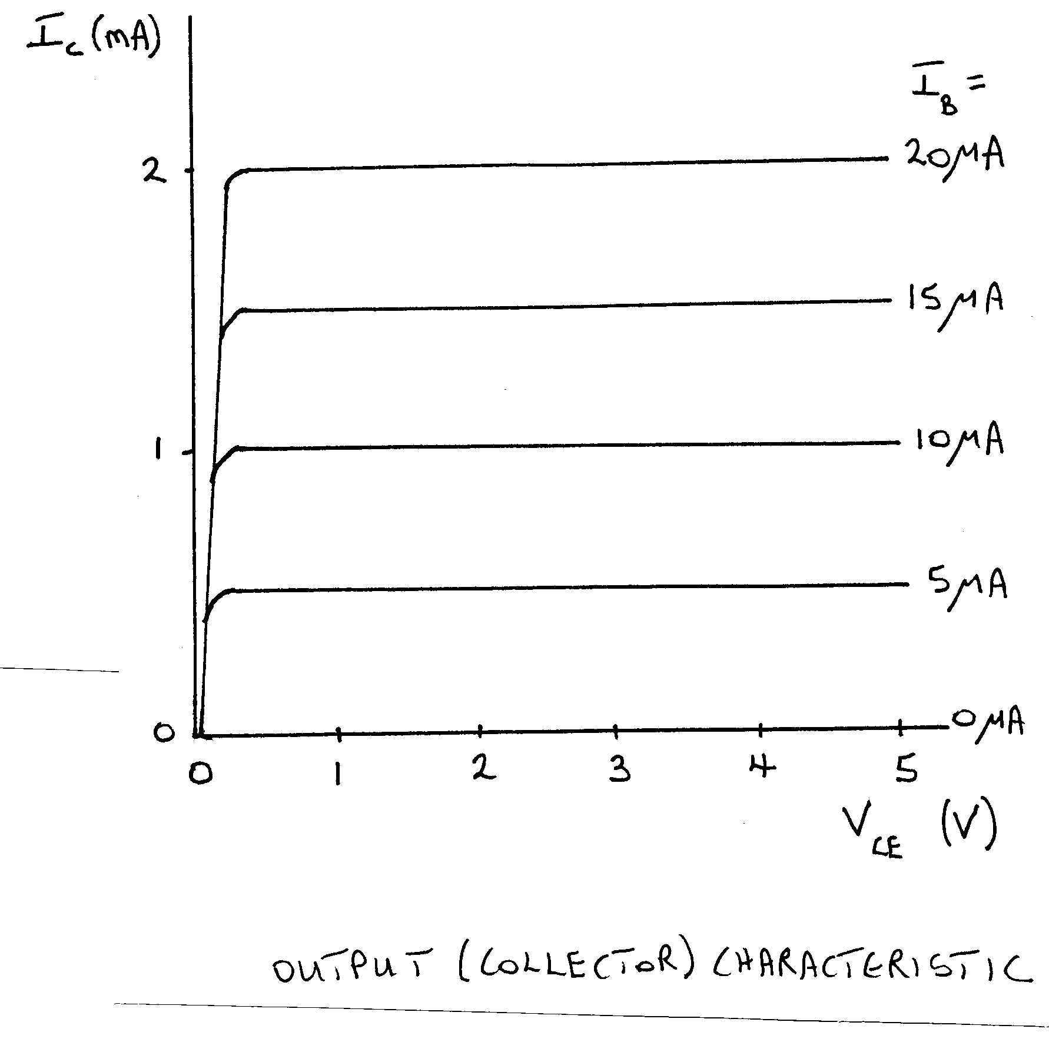
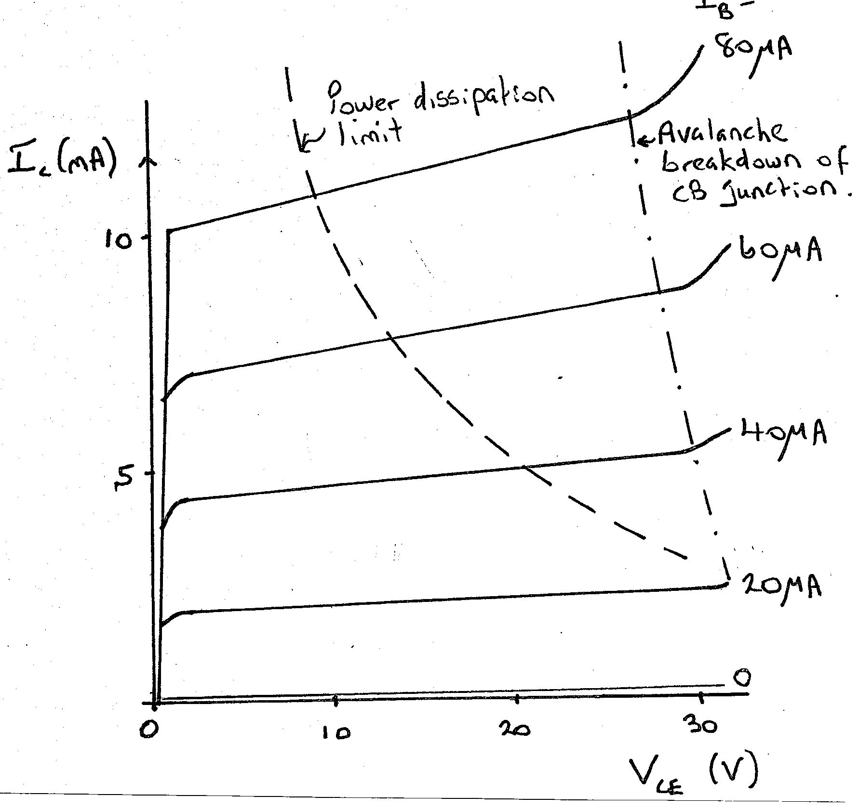
Output Characteristics:
Ideal C-E Output Characteristics:
Actual C-E Output Characteristics:
I_{B} =

Slide 32
an Example-The Early Effect:
Given: The common-emitter circuit below with
I_{B} = 25μA, V_{CC} = 15V,  = 100 and V_{A} = 80.
Find: a) The ideal collector current
b) The actual collector current

Slide 33
Power Across BJT:
P_{BJT} = V_{CE} * i_{CE}
Should be below the rated transistor power.
Should be kept in mind when considering heat dissipation.
Reducing power increases efficiency.

Slide 34
Derating P_{Dmax}
P_{Dmax} is usually specified at 25°C.
The higher temperature goes, the less is P_{dmax}
Example:
  A derating factor of 2mW/°C indicates the power dissipation is reduced 2mW each degree centigrade increase of temperature.

Slide 35
Summary of Bipolar Transistors:
Bipolar transistors have three terminals:
collector, base and emitter.
The base is the control input.
Two polarities of device: npn and pnp
The collector current is controlled by the base voltage/current I_{C} = h_{FE}I_{B.}

Slide 36
Summary of Bipolar Transistors:
Bipolar transistors are widely used in both analogue and digital circuits.
They can be considered as either voltage-controlled or current-controlled devices.
Their characteristics may be described by their gain or by their transconductance.
The majority of circuits use transistors in a common-emitter configuration where the input is applied to the base and the output is taken from the collector
Common-collector circuits make good buffer amplifiers
Bipolar transistors are used in a wide range of applications

