Slide 1

COMSATS Institute of Information Technology
Virtual campus
Islamabad
Dr. Nasim Zafar
Electronics 1
EEE 231 – BS Electrical Engineering
Fall Semester – 2012

Slide 2
Bipolar Junction Transistors-BJTs
Lecture No: 14
Contents:
Introduction
Bipolar Transistor Currents
Bipolar Transistor Characteristics and Parameter
Early Effect

Slide 3
References:
Microelectronic Circuits:
Adel S. Sedra and Kenneth C. Smith.
Electronic Devices :
Thomas L. Floyd ( Prentice Hall ).
Integrated Electronics
Jacob Millman and Christos Halkias (McGraw-Hill).
Electronic Devices and Circuit Theory:
Robert Boylestad & Louis Nashelsky ( Prentice Hall ).
Introductory Electronic Devices and Circuits:
Robert T. Paynter.

Slide 4
Reference:
Chapter 4 – Bipolar Junction Transistors:
Figures are redrawn (with some modifications) from
Electronic Devices
By
Thomas L. Floyd

Slide 5
Bipolar Junction Transistors
BJTs-Circuits
C
B
E

Slide 6
Transistor Types
MOS - Metal Oxide Semiconductor
FET - Field Effect Transistor
BJT - Bipolar Junction Transistor
◄

Slide 7
Transistor Current Characteristics

Slide 8
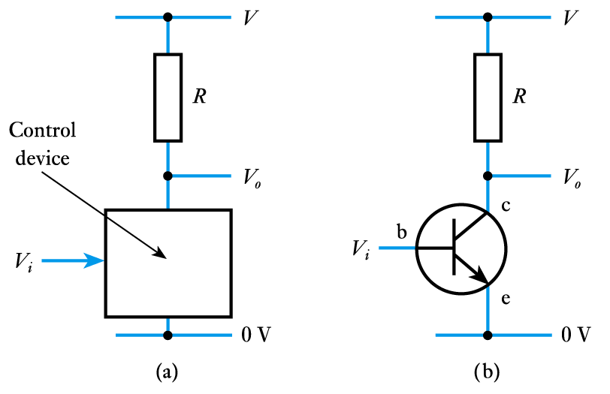
An Overview of Bipolar Transistors:
While control in a FET is due to an electric field.
Control in a bipolar transistor is generally considered to be due to an electric current.
  current into one terminal
  determines the current
  between two others
  as with an FET, a
  bipolar transistor
  can be used as a
  ‘control device’

Slide 9
Transistor Biasing Configurations:
Common-Base Configuration (CB) :
input = V_{EB} & I_{E} ; output = V_{CB} & I_{C}
2. Common-Emitter Configuration (CE):
input = V_{BE} & I_{B} ; output = V_{CE} & I_{C}
Common-Collector Configuration (CC):
input = V_{BC} & I_{B} ; output = V_{EC} & I_{E}

Slide 10
Operation Modes:
Active:
  Most importance mode, e.g. for amplifier operation.
  The region where current curves are practically flat.
Saturation:
  Barrier potential of the junctions cancel each other out causing a virtual short.
  Ideal transistor behaves like a closed switch.
Cutoff:
  Current reduced to zero
  Ideal transistor behaves like an open switch.

Slide 11
Operation Modes:
Active: BJT acts like an amplifier (most common use).
Saturation: BJT acts like a short circuit.
Cutoff: BJT acts like an open circuit.

Slide 12
Common Emitter Characteristics:
We consider DC behaviour and assume that we are working in the normal linear amplifier regime with the BE junction forward biased and the CB junction reverse biased.

Slide 13
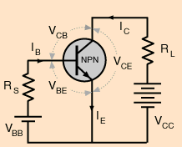
Common-Emitter Output Characteristics
I_{C}
Output Characteristic Curves - (V_{c}- I_{c}
Active Region
I_{B}
Region of Operation | Description
Active | Small base current controls a large collector current
Saturation | V_{CE(sat)} ~ 0.2V, V_{CE} increases with I_{C}
Cutoff | Achieved by reducing I_{B} to 0, Ideally, I_{C} will also equal 0.
V_{CE}
Saturation Region
Cutoff Region
I_{B} = 0

Slide 14
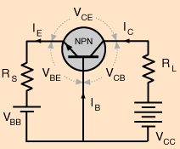
Common-Base-Configuration (CBC)
NPN Transistor
Circuit Diagram: NPN Transistor

Slide 15
Common-Base Output Characteristics:
Although the Common-Base configuration is not the most common configuration, it is often helpful in understanding the operation of BJT
Output Characteristic Curves - (V_{c}- I_{c}
)
I_{C}
mA
Breakdown Region
6
Active Region
4
I_{E}
Saturation Region
I_{E}=2mA
2
I_{E}=1mA
Cutoff
I_{E} = 0
0.8V
2V
4V
6V
8V
V_{CB}

Slide 16
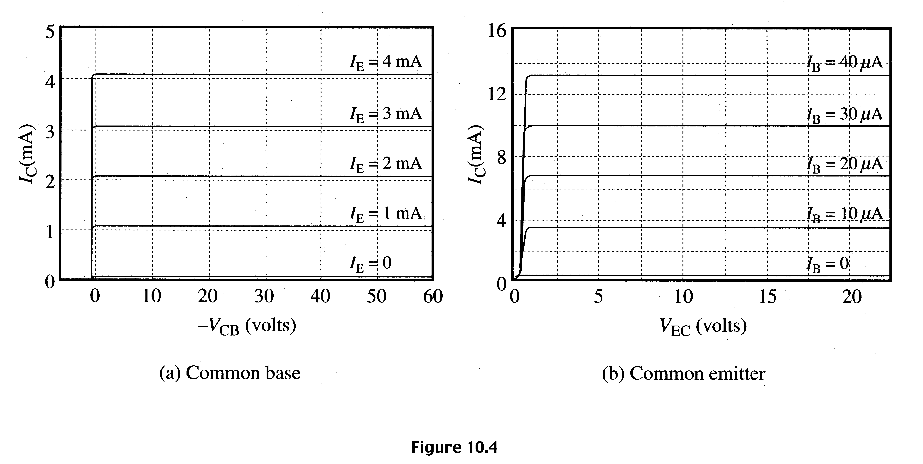
Transistor Currents - Output characteristics:

Slide 17
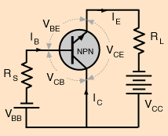
Common-Collector Output Characteristics:
Emitter-Current Curves
I_{E}
Active Region
I_{B}
V_{CE}
Saturation Region
Cutoff Region
I_{B} = 0

Slide 18
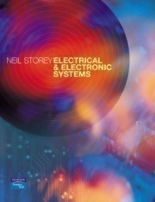
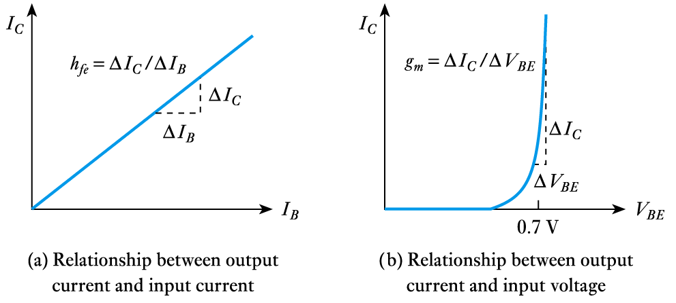
Bipolar Transistor Characteristics
21.4
Behaviour can be described by the current gain, h_{fe} or by the transconductance, g_{m} of the device

Slide 19
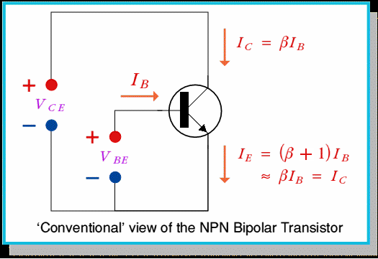
Conventional View & Current Components:
NPN Transistor-CEC

Slide 20
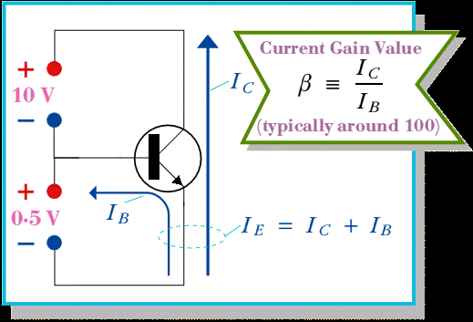
Current Components:
NPN Transistor-CEC

Slide 21
BJT Characteristics and Parameters

Slide 22
BJT-Current Gain Parameters:
Two quantities of great importance in the characterization of transistors are the so-called common-base current gain α..
and the so-called common-emitter gain .
DC  and DC α
 = Common-emitter current gain
α = Common-base current gain
    Note: α and  are sometimes referred to as α_{dc} and _{dc}
    because the relationships being dealt within the BJT are DC.

Slide 23
BJT-Current Gain Parameters:
Common-base current gain α , is also referred to as h_{FB} and is defined by:
  α = h_{FB} = I_{C} / I_{E}
Common-emitter current gain β, is also referred as h_{FE} and
is defined by:
     = I_{C}/I_{B}
Thus:

Slide 24
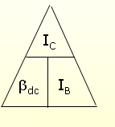
Beta (β) or amplification factor:
The ratio of dc collector current (IC) to the dc base current (IB) is dc beta (βdc ) which is dc current gain where IC and IB are determined at a particular operating point, Q-point (quiescent point).
It’s define by the following equation:
30 < βdc < 300 → 2N3904
On data sheet, β_{dc}=h_{FE} with h is derived from ac hybrid equivalent circuit. FE are derived from forward-current amplification and common-emitter configuration respectively.

Slide 25
In the dc mode the level of I_{C} and I_{E} due to the majority carriers are related by a quantity called alpha:
α=
I_{C} = αI_{E} + I_{CBO}
It can then be summarize to I_{C} = αI_{E} (ignore I_{CBO} due to small value)
For a.c situations where the point of operation moves on the characteristics curve, an a.c alpha defined by
Alpha a common base current gain factor that shows the efficiency by calculating the current percent from current flow from emitter to collector. The value of α is typical from 0.9 ~ 0.998.

Slide 26
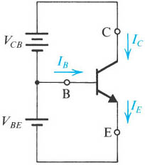
BJT-Current Gain Parameters:
α = Common-Base Current Gain (typical 0.99)

Slide 27
BJT-Current Gain Parameters:
 = Common-emitter current gain (10-1000; typical 50-200)

Slide 28
DC  and DC α
α = Common-base current gain (0.9-0.999; typical 0.99)
 = Common-emitter current gain (10-1000; typical 50-200)
The relationship between the two parameters are:

Slide 29
Performance Parameters for PNP:
Common emitter dc current gain, β_{dc}:
But,
Note that β is large (e.g. β = 100)
For NPN transistor, similar analysis can be carried out. However,
the emitter current is mainly carried by electrons.
Example:

Slide 30
Performance Parameters for PNP:
Emitter efficiency:
Fraction of emitter current carried by holes.
We want γ close to 1.
Base transport factor:
Fraction of holes collected by the collector.
We want α_{T} close to 1.
Common base dc current gain:

Slide 31
Example: NPN Common-Base Configuration:
C
Given: I_{B} = 50 μ A , I_{C} = 1 mA
Find: I_{E} ,  , and α
Solution:
I_{E} = I_{B} + I_{C} = 0.05 mA + 1 mA = 1.05 mA
= I_{C} / I_{B} = 1 mA / 0.05 mA = 20
α = I_{C} / I_{E} = 1 mA / 1.05 mA = 0.95238
V_{CB}
+
_
I_{C}
B
I_{B}
I_{E}
V_{BE}
+
_
E

