Slide 1

COMSATS Institute of Information Technology
Virtual campus
Islamabad
Dr. Nasim Zafar
Electronics 1
EEE 231 – BS Electrical Engineering
Fall Semester – 2012

Slide 2
Bipolar Junction Transistors
Lecture No: 13
Contents:
Introduction
Basic Transistor Operation
Transistor Biasing Configurations
Transistor Currents
Transistor Characteristics and Parameter

Slide 3
Reference:
Chapter 4 – Bipolar Junction Transistor:
Figures are redrawn (with some modifications) from
Electronic Devices
By
Thomas L. Floyd

Slide 4
Bipolar Junction Transistors
BJTs-Device
C
B
E

Slide 5
Objectives:
To study the basic structure of the Bipolar Junction Transistor (BJT) and to determine its operating characteristics.
One of the important objective of this topic is to gain an understanding of the mechanism of the current flow and the transistor operation.
To analyze the properties of the transistor with proper biasing for an Amplifier Circuit.
To relate the properties of the device to certain circuit parameters.

Slide 6
BJT- an Introduction:
The basis of electronic systems now a days is a semiconductor device.
The famous and commonly used device is BJTs
(Bipolar Junction Transistors).
Invented in 1948 by Bardeen, Brattain and Shockley.
Two kinds of BPJ transistors: npn and pnp

Slide 7
BJT- an Introduction:
A bipolar junction transistor consists of three adjoining, alternately doped, regions of semiconductors.
→emitter : E
→ base: B
→ collector : C
The middle region of the transistor, base B, is very thin compared to the diffusion length of the minority carriers.

Slide 8
BJT- an Introduction:
In “normal operation” of a PNP transistor, positive voltage is applied to the emitter and negative voltage to the collector.
A small current in the base region can be used to control a larger current flowing between the emitter and the collector regions.
The device can be characterized as a current amplifier, having many applications for amplification and switching.

Slide 9
BJT- an Introduction:
  Transistors as an Amplifier for the base current, since small changes in the base current cause big changes in the collector current.
  Transistors as a Switch: if voltage applied to the base is such that emitter-base junction is reverse-biased, no current flows through the transistor -- transistor is “off”.
  Transistor can be used as a Voltage-Controlled Switch; computers use transistors in this way.

Slide 10
BJT- an Introduction:
Field-Effect Transistors (FET)
  In a pnp FET, current flowing through a thin channel of
  n-type material is controlled by the voltage (electric field) applied to two pieces of p-type material on either side of the channel (current depends on electric field).
  Many different kinds of FETs.
  FETs are the kind of transistors most commonly used in computers.

Slide 11
Basic Transistor Operation
&
BJT Circuits

Slide 12
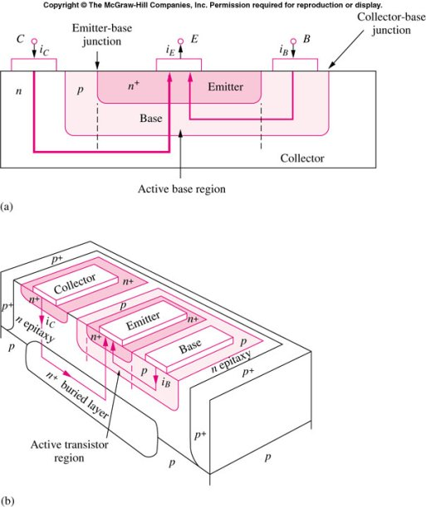
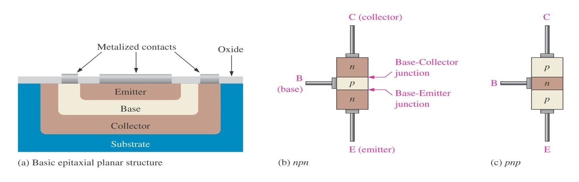
Structure of a BJT:

Slide 13
BJTs are usually constructed vertically:
  Controlling depth of the emitter’s doping sets the base width
The structure contains two p-n diodes, one between the base and the emitter, and one between the base and the collector.

Slide 14
Bipolar Junction Transistors – BJTs:
The NPN and PNP BJT Transistors:
npn
pnp
n
p
n
p
n
p
E
C
E
C
C
C
B
B
B
B
Schematic Symbol
E
Schematic Symbol
E

Slide 15
Bipolar Junction Transistors – BJTs:
Emitter is heavily doped compared to the collector. So, emitter and collector are not interchangeable.
The base width is narrow compared to the minority carrier diffusion length. If the base is much larger, then the device will behave like back-to-back diodes.
Emitter doping is much higher ~ 10¹⁵
Base doping is slightly higher ~ 10⁷ – 10⁸
Collector doping is usually ~ 10⁶

Slide 16
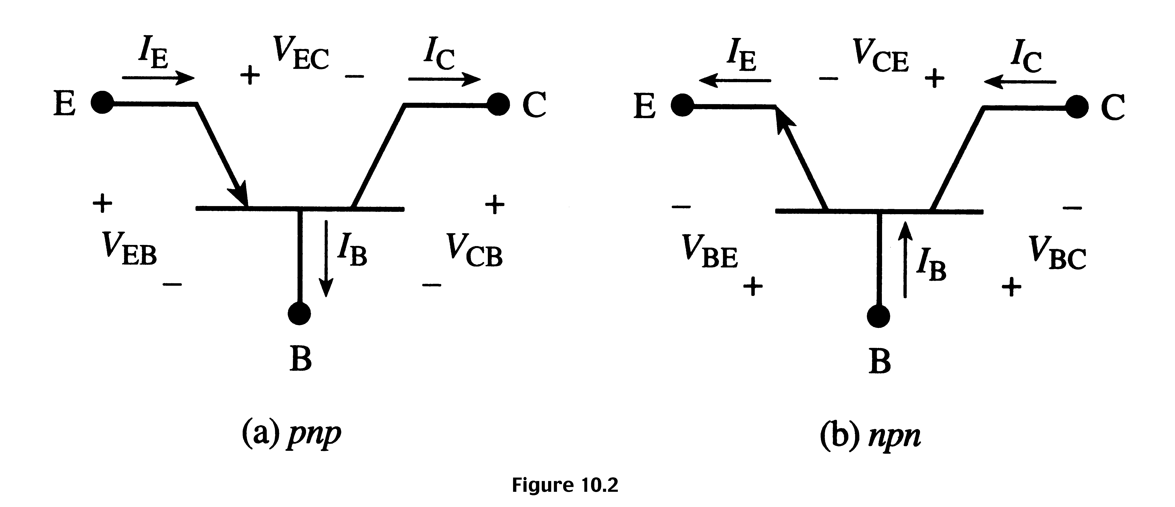
BJT – Circuit Symbols:
I_{E} = I_{B} + I_{C} and V_{EB} + V_{BC} + V_{CE} = 0 V_{CE} = − V_{EC}
The currents are positive quantities when the transistor is operated in forward active mode.

Slide 17
Qualitative –Transistor Action:
Consider two diodes, one forward biased and one reverse biased.
reverse
forward

Slide 18
Qualitative – Transistor Action:
Combine the two diodes!
V_{F}
V_{R}

Slide 19
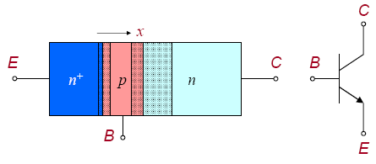
Basic Transistor Operation:
Normal operation (linear or active region):
  E-B junction forward biased
  B-C junction reverse biased.

Slide 20
Basic Transistor Operation:
PNP Transistor
For a forward biased PNP emitter-base junction, the emitter emits (injects) majority charges, holes, into the base region.
Some holes recombine with electrons in the n-type base, but base is thin and lightly doped. Thus, most holes make it through the base into the collector region.

Slide 21
Basic Transistor Operation:
PNP Transistor
This hole current is collected into negative terminal of battery; and is called the “collector current”. The magnitude of this collector current depends on how many holes have been captured by electrons in the base region.
This, in turn, depends on the number of n-type carriers in the base which can be controlled by the size of the current, the base current, that is allowed to flow from the base to the emitter.

Slide 22
Transistor Biasing Configurations

Slide 23
Transistor Biasing:
For the transistor to operate properly it must be biased.
There are several methods to establish the DC operating point.
We will discuss some of the methods used for biasing the transistors.

Slide 24
Transistor Biasing Configurations:
Common-Base Configuration (CB) :
input = V_{EB} & I_{E} ; output = V_{CB} & I_{C}
2. Common-Emitter Configuration (CE):
input = V_{BE} & I_{B} ; output = V_{CE} & I_{C}
Common-Collector Configuration (CC):
input = V_{BC} & I_{B} ; output = V_{EC} & I_{E}

Slide 25
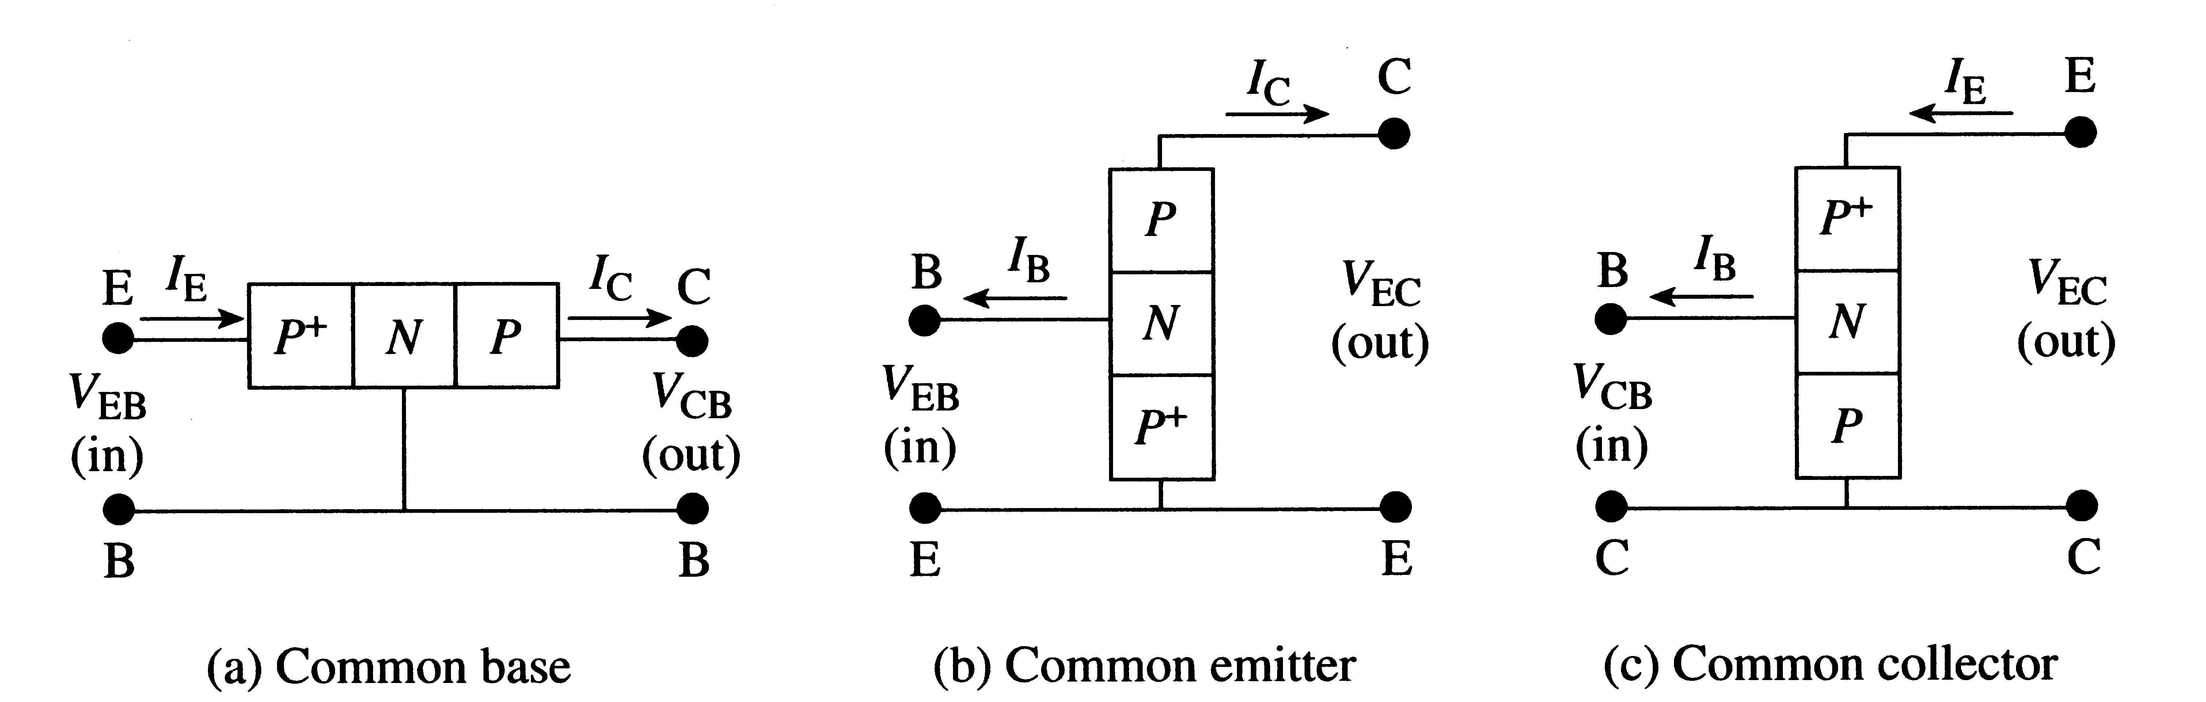
Transistor Biasing – Circuit Diagrams :

Slide 26
Common-Base-Configuration:
Common-base terminology is derived from the fact that:
  The base is common to both input and output in the circuit.
  base is usually the terminal closest to or at ground potential.
The directions of all current components will refer to the hole flow and the arrows in all electronic symbols have a direction defined by this convention.

Slide 27
Common-Emitter-Configuration:
It is called common-emitter configuration since :
  - emitter is common or reference to both input and output terminals.
  emitter is usually the terminal at ground potential.
Two set of characteristics are necessary to describe the behavior for CE; input (base terminal) and output (collector terminal).
Most amplifier designs use CE configuration due to the high gain of current and voltage.

Slide 28
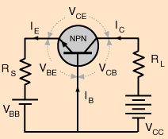
Common-Base-Configuration (CBC)
NPN Transistor
Circuit Diagram: NPN Transistor

Slide 29
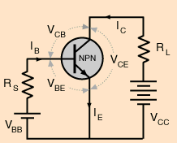
Common-Emitter-Configuration (CEC)
NPN Transistor

Slide 30
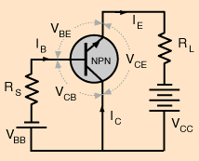
Common-Collector -Configuration(CCC)
NPN Transistor

Slide 31
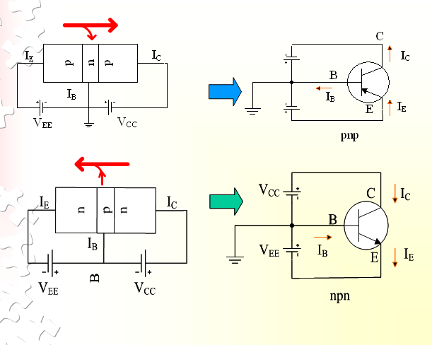
Common-Base Configuration:

Slide 32
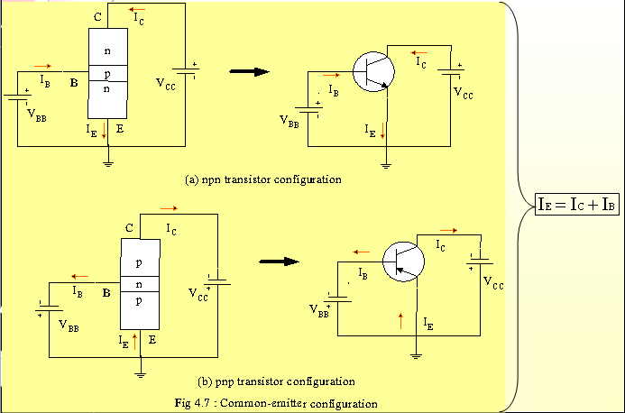
Common-Emitter Configuration:

Slide 33
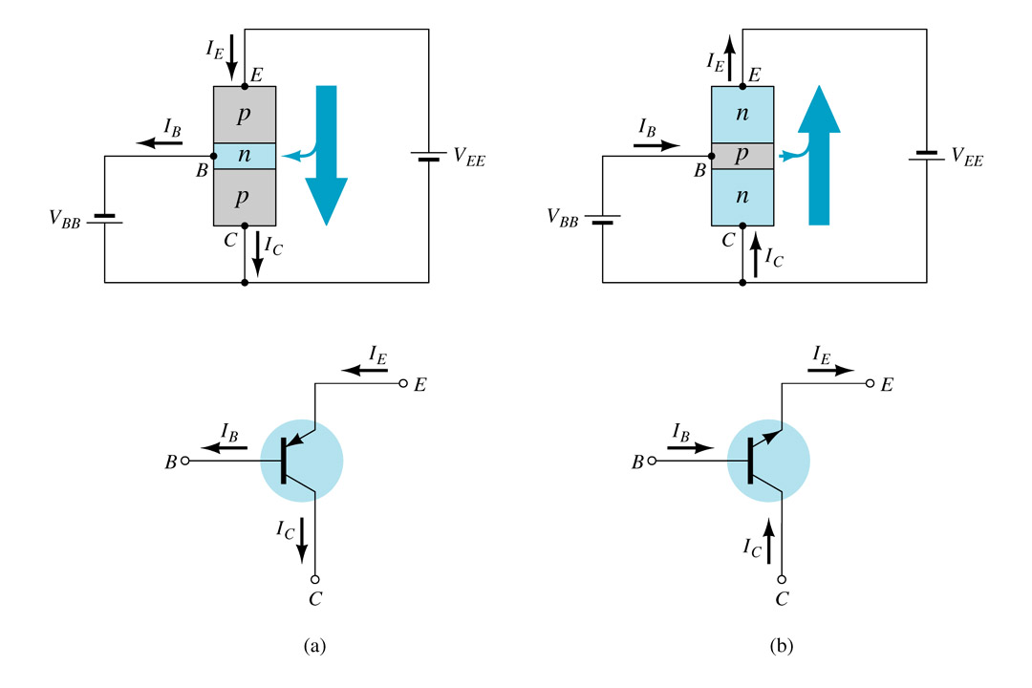
Common-Collector Configuration:
Symbols used for the common-collector configuration:
(a) PNP transistor ; (b) NPN transistor.

Slide 34
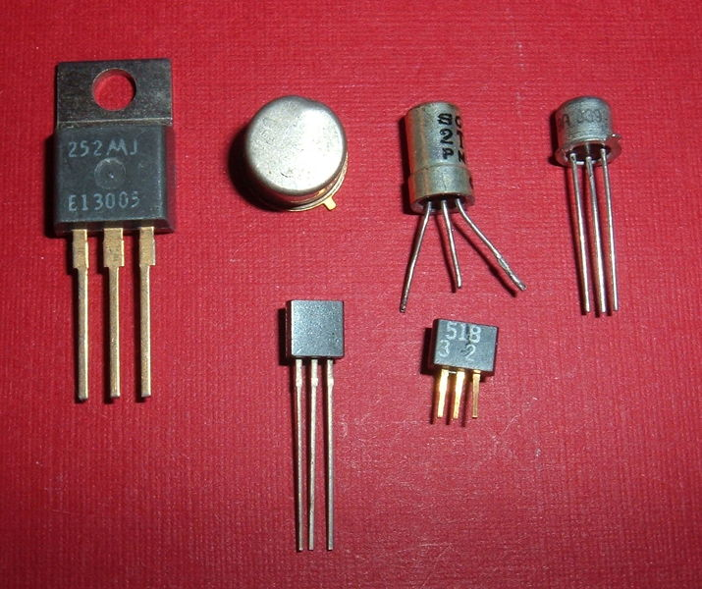
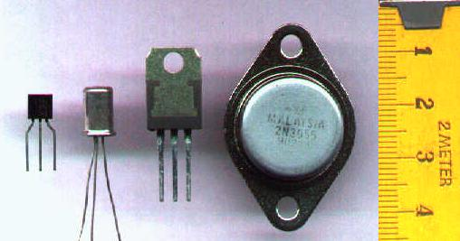
Modern Transistors:

Slide 35
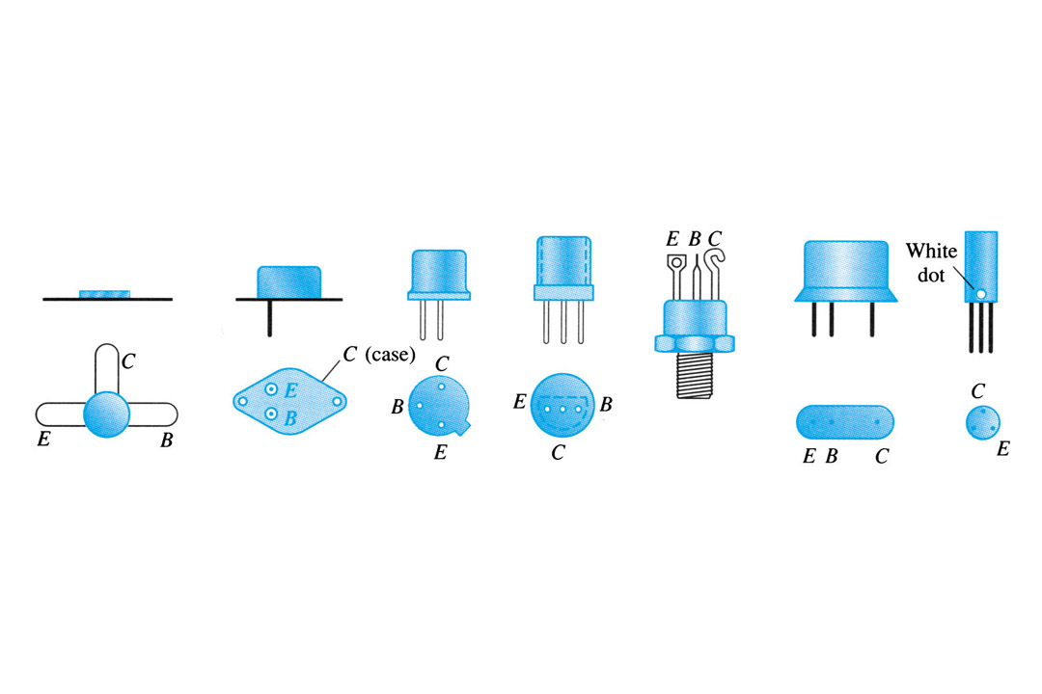
Transistor Terminal Identification:

Slide 36
Common-Base Configuration (CBC):
V_{CE}
I_{C}
I_{E}
C
E
V_{CB}
V_{BE}
I_{B}
+
_
+
_
B
V_{CB}
V_{BE}
Circuit Diagram: NPN Transistor

Slide 37
Example: NPN Common-Base Configuration:
C
Given: I_{B} = 50 μ A , I_{C} = 1 mA
Find: I_{E} ,  , and α
Solution:
I_{E} = I_{B} + I_{C} = 0.05 mA + 1 mA = 1.05 mA
= I_{C} / I_{B} = 1 mA / 0.05 mA = 20
α = I_{C} / I_{E} = 1 mA / 1.05 mA = 0.95238
α could also be calculated using the value of  with the formula from the previous slide.
α =  = 20 = 0.95238
 + 1 21
V_{CB}
+
_
I_{C}
B
I_{B}
I_{E}
V_{BE}
+
_
E

