Slide 1

COMSATS Institute of Information Technology
Virtual campus
Islamabad
Dr. Nasim Zafar
Electronics 1
EEE 231 – BS Electrical Engineering
Fall Semester – 2012

Slide 2
Special-Purpose Diodes:
Lecture No: 12
Contents:
  Zener diodes
  Opto-Electronic Diodes
  Light Emitting Diodes (LEDs)
  Laser Diodes
  Photodiodes
  Solar Cells
  Varactor Diodes

Slide 3
Reference:
Chapter 3 - Special-Purpose Diodes:
Figures are redrawn (with some modifications) from
Electronic Devices
By
Thomas L. Floyd

Slide 4
Applications of PN Junctions:
BJT (Bipolar Junction Transistor)
HBT (Heterojunction Bipolar Transistor)
Rectifiers
P
N
J
U
N
C
T
I
O
N
Zener Diode
Junction Diode
Varactor Diode
Switching Diode
Tunnel Diode
PN Junction Diode
Solar Cell
Photo-Diode
Photo Detector
Light Emitting diode & Laser Diode
JFET
FET (Field Effect Transistor)
MOSFET - memory
MESFET - HEMT

Slide 5
Common Applications of Diodes:
 | Rectifier | Zener | LED
Schematic symbol
Bias for normal operation | Switched back and forth between forward and reverse. | Reverse | Forward
Normal V_{F} | Si: V_{F} = 0.7 V Ge: V_{F} = 0.3 V | V_{F} = 0.7 V (not normally operated)
Normal V_{R} | Equal to applied voltage. | Equal to V_{Z}. | Equal to applied voltage.
Primary factors to consider for device substitution | I₀ and V_{RRM} ratings. | P_{D(max)} and V_{Z} ratings. | V_{F(min)}, I_{F(max)}, and V_{BR}

Slide 6
Types of Diodes and Their Uses
PN Junction Diodes:
Are used to allow current to flow in one direction while blocking current flow in the opposite direction. The PN junction diode is the typical diode that has been used in the previous circuits.
A
K
P
n
Schematic Symbol for a PN Junction Diode
Representative Structure for a PN Junction Diode
Zener Diodes:
Are specifically designed to operate under reverse breakdown conditions. These diodes have a very accurate and specific reverse breakdown voltage.
A
K
Schematic Symbol for a Zener Diode

Slide 7
Types of Diodes and Their Uses
Schottky Diodes:
These diodes are designed to have a very fast switching time which makes them a great diode for digital circuit applications. They are very common in computers because of their ability to be switched on and off so quickly.
A
K
Schematic Symbol for a Schottky Diode
Shockley Diodes:
The Shockley diode is a four-layer diode while other diodes are normally made with only two layers. These types of diodes are generally used to control the average power delivered to a load.
A
K
Schematic Symbol for a four-layer Shockley Diode

Slide 8
Light-Emitting Diodes:
Light-Emitting Diodes LEDs, are designed with very large band gap materials, so movement of carriers across their depletion region emits photons in the visible region.
Lower band gap LEDs emit infrared radiation, while LEDs with higher band gap energy emit visible light.
Many traffic signal are now starting to use LEDs because they are extremely bright and last longer than regular bulbs for a relatively low cost.
A
K
The arrows in the LED representation indicate emitted light.
Schematic Symbol for a Light-Emitting Diode

Slide 9
Types of Diodes and Their Uses:
Photodiodes:
While LEDs emit light, Photodiodes are sensitive to received light. They are constructed so their PN junction can be exposed to the outside through a clear window or lens.
In Photoconductive mode the saturation current increases in proportion to the intensity of the received light. This type of diode is used in CD players.
In Photovoltaic mode, when the PN junction is exposed to a certain wavelength of light, the diode generates voltage and can be used as an energy source. This type of diode is used in the production of solar power.
A
K
λ
A
K
Schematic Symbols for Photodiodes

Slide 10
I-V characteristics of the Electronic Components
The I-V plot represents the dependence of the current I, through
the component, on the voltage V across it.
Resistor
I
I = V / R;
R = V/I
R
α
ΔI
ΔV
V
The I-V Characteristic of the Resistor

Slide 11
Zener Diodes

Slide 12
Zener Effect:
Zener diodes are special diodes that permit current not only in the forward direction like a normal diodes, but also in the reverse direction if the voltage is larger than the breakdown voltage. This voltage is known as the “Zener Breakdown Voltage”.

Slide 13
Junction Breakdown or Reverse Breakdown:
An applied reverse bias (voltage) will result in a small current to flow through the device.
At a particular high voltage value, which is called as breakdown voltage V_{B}, large currents start to flow. If there is no current limiting resistor which is connected in series with the diode, the diode will be destroyed.

Slide 14
Junction Breakdown or Reverse Breakdown:
There are two physical effects which cause this breakdown:
1) Zener Breakdown or Zener Effect
2) Avalanche Breakdown

Slide 15
Zener Effect:
Zener breakdown is observed in highly doped PN junctions, with a tunneling mechanism and occurs for voltages of about 5 V or less.
In highly doped p-n junctions, conduction and valance bands on opposite side of the junction, become so close during the reverse-bias that the electrons on the p-side can tunnel directly from VB into the CB on the n-side.
Avalanche breakdown is observed in less highly doped PN junctions.

Slide 16
The Zener Diode:
Utilization of the Zener effect:
  Typical break down values of V_{Z} : -4.5 ... -15 V.
  In case of standard diode the typical values of the break down voltage V_{Z} of the Zener effect -20 ... -100V.
  Zener break down: V_{D} <= V_{Z}:
V_{D} = V_{Z}, I_{D} is determined by the circuit.

Slide 17
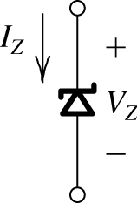
Symbol for a Zener Diode:

Slide 18
Zener Equivalent Circuits:
Ideal: Z_{Z} = 0
Prac.: Z_{Z} > 0

Slide 19
Zener Diode Characteristic:
The breakdown characteristics of diodes can be tailored by controlling the doping concentration.
Heavily doped p⁺ and n⁺ regions result in low breakdown voltage (Zener effect).
Used as reference voltage in voltage regulators.
I
V
Region of
operation

Slide 20
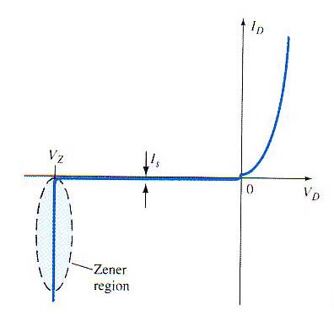

Zener Diode Characteristic:
As the reverse voltage increases the diode can breakdown (zener Effect).

Slide 21
Zener Diode Characteristics:

Slide 22
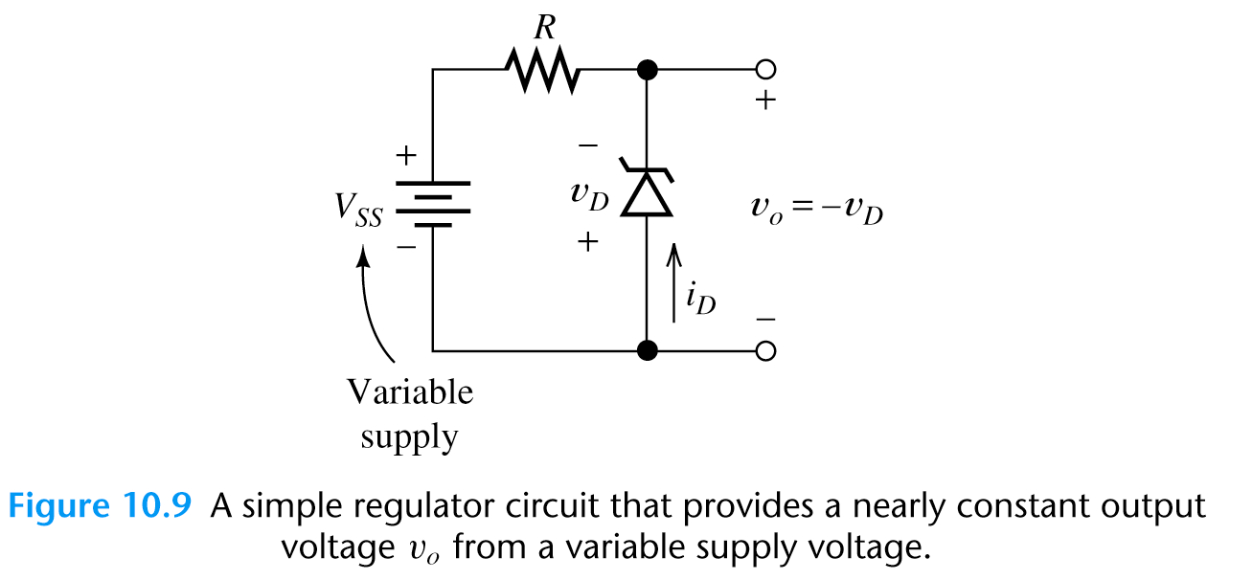
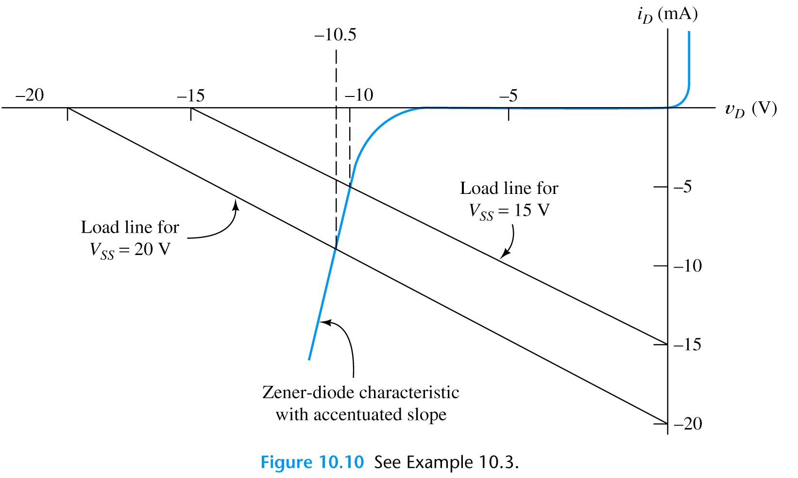
Zener Diode - Voltage Regulator Circuit:
Problem:
Find the output voltage for Vss=15V
and Vss=20V if R=1kΩ and a Zener
diode has the ch-tic shown below.
Load Line analysis
Kirchhoff’s voltage law
V_{ss}+ Ri_{D}+v_{D}=0
Slope of the load line is -1/R
Reverse bias region

Slide 23
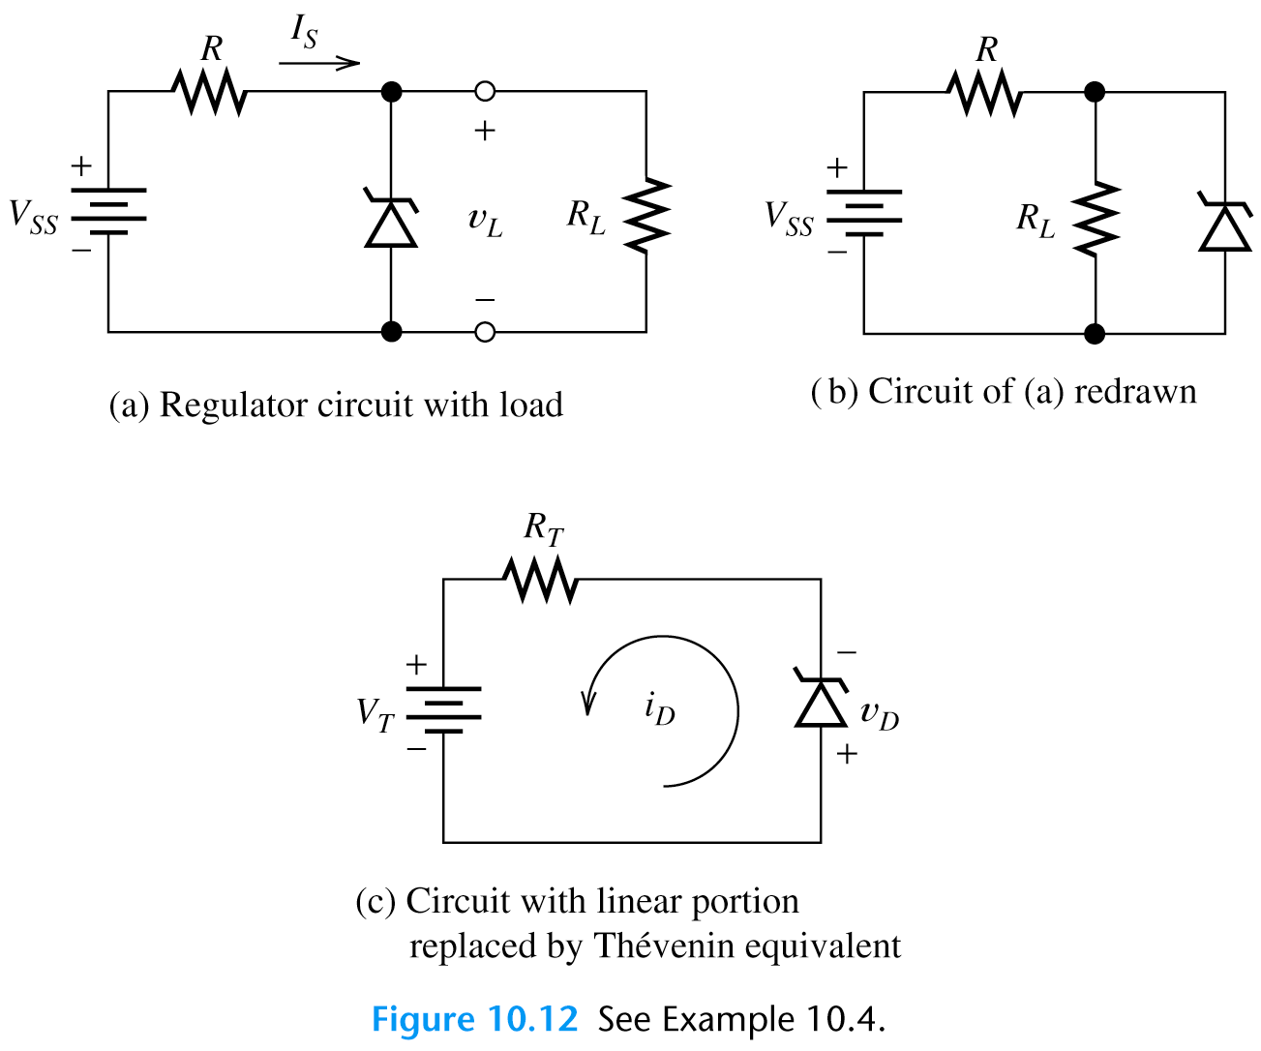
Problem:
Consider the Zener diode regulator shown in figure (a). Find the load voltage v_{L} and the source current i_{S} if Vss=24V, R=1.2kΩ and RL=6kΩ.
Exercise – find Thevenin equivalent

Slide 24
Problem:
Consider the Zener diode regulator shown in figure (a). Find the load voltage v_{L} and the source current i_{S} if Vss=24V, R=1.2kΩ and RL=6kΩ .
Thevenin equivalent
V_{T}=V_{ss}*(R_{L}/(R+R_{L}))=20V
R_{T}=(RR_{L})/(R+R_{L})=1kΩ

Slide 25
Zener Diodes – Power Dissipation P_{D}
A 1N754A Zener diode has a dc power dissipation rating of 500 mW and a nominal Zener voltage of 6.8 V. What is the value of I_{ZM} for the device?

Slide 26
Opto-Electronic Diodes

Slide 27
Opto-Electronic Diodes:
Many of these diodes involve semiconductors other than Si.
Use direct band gap semiconductors.
Devices that convert optical energy to electrical energy are:
  Photodetectors: generate electrical signal
  Solar cells: generate electrical power
Devices that convert electrical energy to optical energy are:
  Light emitting diodes (LEDs)
  Laser diodes

Slide 28
Light Emitting Diodes:
When p n junction is forward biased, large number of carriers are injected across the junctions. These carriers recombine and emit light if the semiconductor has a direct bandgap.
For visible light output, the bandgap should be between 1.8 and 3.1 eV.

Slide 29
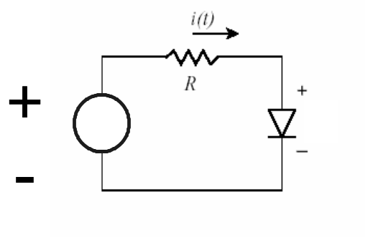
Light Emitting Diodes – LED’s:
P-N Junction can emit light when forward biased.
p-type
n-type
Electrons drift into p-material and find plenty of holes there. They
“RECOMBINE” by filling up the “empty” positions.
Holes drift into n-material and find plenty of electrons there. They also “RECOMBINE” by filling up the “empty” positions.
The energy released in the process of “annihilation” produces
PHOTONS – the particles of light

Slide 30
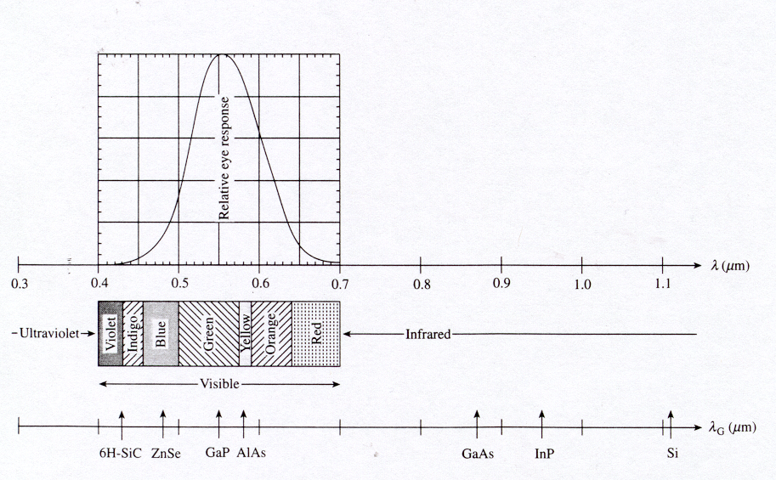
Optical Spectrum Correlated with Relative Eye Sensitivity:
Photon energy E_{ph} = h c / λ
Inserting numerical values for h and c yields E_{ph} = 1.24 eV μm / λ
Note: Our eye is very sensitive to green light

Slide 31
LED
Light emitting diode, made from GaAs
  V_{F}=1.6 V
  I_{F} >= 6 mA

Slide 32
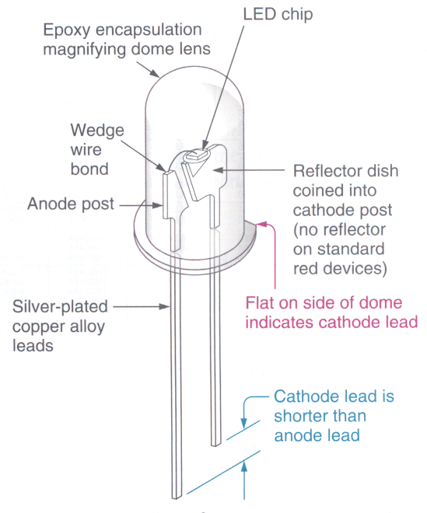
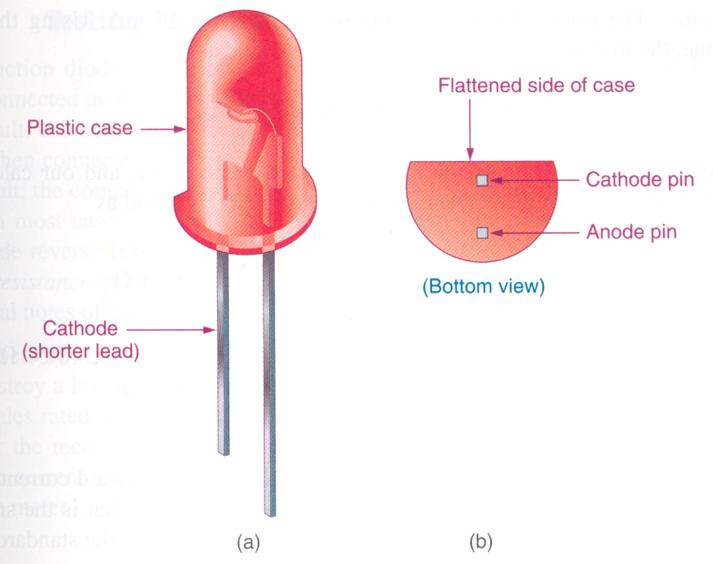
Light Emitting Diodes.
LED symbol

Slide 33
Multicolor LED:

Slide 34
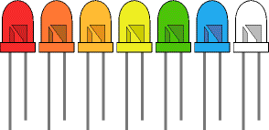
Colours of LEDs:
LEDs are made from gallium-based crystals that contain one or more additional materials such as phosphorous to produce a distinct color. Different LEDs emit light in specific regions of the visible light spectrum and produce different intensity levels.
LEDs are available in red, orange, amber, yellow, green, blue and white. Blue and white LEDs are much more expensive than the other colours. The colour of an LED is determined by the semiconductor material, not by the colouring of the 'package' (the plastic body).

Slide 35
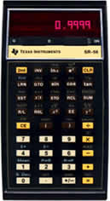

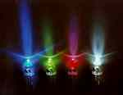

Materials for Visible Wavelength LEDs
We see them almost everyday, either on calculator displays or indicator panels.
Red LED use as “ power on” indicator
Yellow, green and amber LEDs are also widely available but very few of you will have seen a blue LED.

Slide 36
Common LEDs:
Elements | Forward voltage (V_{F}) | Color Emitted
GaAs | 1.5 V @ I_{F} = 20 mA | Infrared (invisible)
AlGaAs | 1.8 V @ I_{F} = 20 mA | Red
GaP | 2.4 V @ I_{F} = 20 mA | Green
AlGaInP | 2.0 V @ I_{F} = 20 mA | Amber (yellow)
AlGaInN | 3.6 V @ I_{F} = 20 mA | Blue

Slide 37
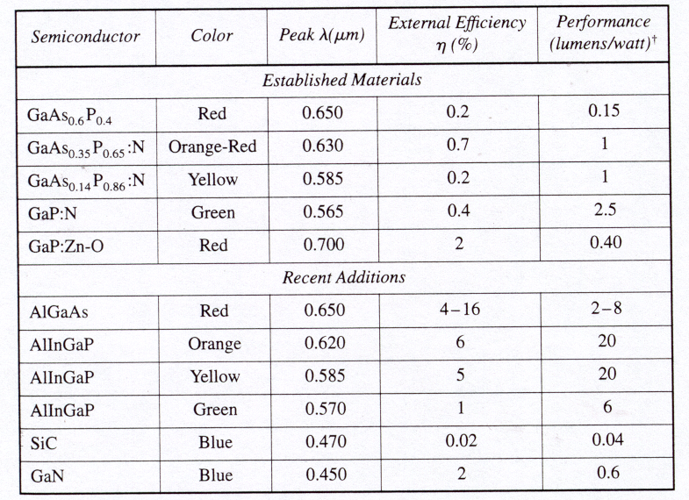
Characteristics of Commercial LEDs

Slide 38
Photo-Diodes

Slide 39
Photo-generation:
An important generation process in device operation is photo-generation
If the photon energy (hν) is greater than the band gap energy, then the
light will be absorbed and electron-hole pairs will be generated.
hν
E_{g}

Slide 40
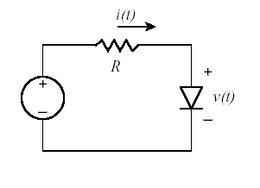
Photodetectors:
+
-
P-n junction can detect light when reverse biased
p-type
n-type
When light shines on a p-n junction, the photon energy RELEASES free electrons and holes i.e. electron-hole-pairs are generated optically.
They are referred to as PHOTO-ELECTRONS and PHOTO-HOLES
The applied voltage separates the photo-carriers attracting electrons toward “plus” and holes toward “minus”
As long as the light is ON, there is a current flowing through the p-n junction.

Slide 41
Photodiodes
Specifically designed for detector application and light penetration
I
V_{A}
I
P n
V
L_{n}
W
L_{p}
Increasing
light intensity

Slide 42
Photodiodes
Spectral response - an important characteristic of any photo-detector. Measures how the photocurrent, I_{L} varies with the wavelength of incident light.
Frequency response - measures how rapidly the detector can respond to a time varying optical signal. The generated minority carriers have to diffuse to the depletion region before an electrical current can be observed externally. Since diffusion is a slow process, the maximum frequency response is a few tens of MHz for p n junctions.
Higher frequency response (a few GHz) can be achieved using p-i-n diodes.

Slide 43
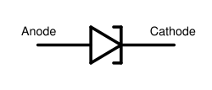
TUNNEL DIODE (Esaki Diode)
E_{V}
It was introduced by Leo Esaki in 1958.
Heavily-doped p-n junction
  Impurity concentration is 1 part in 10^3 as compared to 1 part in 10^8 in p-n junction diode
Width of the depletion layer is very small
(about 100 A).
It is generally made up of Ge and GaAs.
It shows tunneling phenomenon.
Circuit symbol of tunnel diode is :

Slide 44
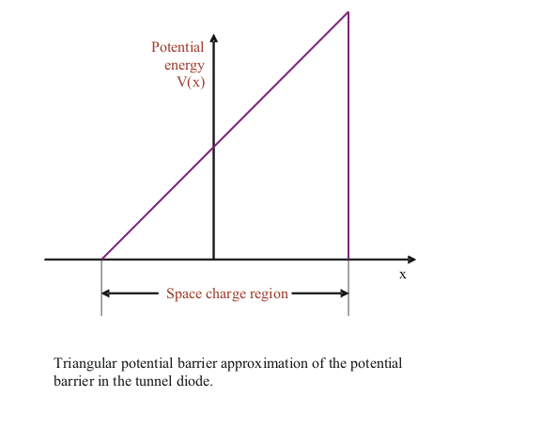
What is Tunneling?
Classically, carrier must have energy at least equal to potential-barrier height to cross the junction .
But according to Quantum mechanics there is finite probability that it can penetrate through the barrier for a thin width.
This phenomenon is
called tunneling and
hence the Esaki Diode
is know as
Tunnel Diode.

Slide 45
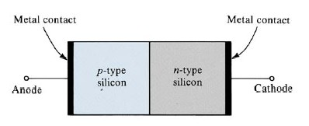
Metal Contacts
<Ohmic contact>
No rectifying action.
The current can flow in both direction
<Schottky contact>
The difference of carrier concentrations
of the two materials at the contact.
A barrier potential exists.
rectifying action occurs.
Mostly used in switching circuits.
(turn on/off switches)

Slide 46
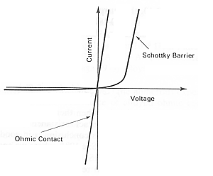
Metal Contacts I-V Characteristics

Slide 48
Solar Cells
Solar cells are large area pn-junction diodes designed specifically to avoid energy losses.
V_{oc}= the open circuit voltage
I_{sc} = current when device is
  short circuited
η = power conversion efficiency = (I_{m} V_{m})/P_{in}
I
V_{oc}
V_{m}
V_{A}
–I_{m}
– I_{sc}

