Slide 1

COMSATS Institute of Information Technology
Virtual campus
Islamabad
Dr. Nasim Zafar
Electronics 1
EEE 231 – BS Electrical Engineering
Fall Semester – 2012

Slide 2
The Diode Applications:
Lecture No: 11
Contents:
  Rectifiers:
    Half-Wave Rectifiers
    Full-Wave Rectifiers
  The Basic Power Supply
  Diode Limiting (Clipping) and Clamping Circuits.
  Switching Diodes

Slide 3
Reference:
Chapter 2 - Diode Applications:
Figures are redrawn (with some modifications) from
Electronic Devices
By
Thomas L. Floyd

Slide 4
The Diode Applications:
Lecture No: 12
Contents:
  Zener diodes
  Photo-Diode
  Light Emitting diode &
  Laser Diode
  Tunnel Diode

Slide 5
Applications of PN Junctions:
BJT (Bipolar Junction Transistor)
HBT (Heterojunction Bipolar Transistor)
Rectifiers
P
N
J
U
N
C
T
I
O
N
Zener Diode
Junction Diode
Varactor Diode
Switching Diode
Tunnel Diode
PN Junction Diode
Solar Cell
Photo-Diode
Photo Detector
Light Emitting diode & Laser Diode
JFET
FET (Field Effect Transistor)
MOSFET - memory
MESFET - HEMT

Slide 6
Common Applications of Diodes:
 | Rectifier | Zener | LED
Schematic symbol
Bias for normal operation | Switched back and forth between forward and reverse. | Reverse | Forward
Normal V_{F} | Si: V_{F} = 0.7 V Ge: V_{F} = 0.3 V | V_{F} = 0.7 V (not normally operated)
Normal V_{R} | Equal to applied voltage. | Equal to V_{Z}. | Equal to applied voltage.
Primary factors to consider for device substitution | I₀ and V_{RRM} ratings. | P_{D(max)} and V_{Z} ratings. | V_{F(min)}, I_{F(max)}, and V_{BR}

Slide 7
The Diode Applications:
Objectives:
Explain and analyze the operation of half-wave rectifiers.
Explain and analyze the operation of full-wave rectifiers.
  Define a power supply and the main components in a common linear AC to DC power supply. Explain the purpose and function of each component.

Slide 8
The Diode Applications:
Objectives:
  Define the components that transform pulsating DC into constant DC. Define ripple and identify its origins.
Understand the operation of diode limiting and clamping circuits.
Interpret and use a diode data sheet.

Slide 9
The Diode-Rectifiers:
Rectifier Circuits:
  Half-Wave Rectifier
  Full-Wave Rectifier
  The Peak Rectifier

Slide 10
Rectifier Circuits
Let us consider an Ideal Diode Model for
Diode-Rectifier-Analysis

Slide 11
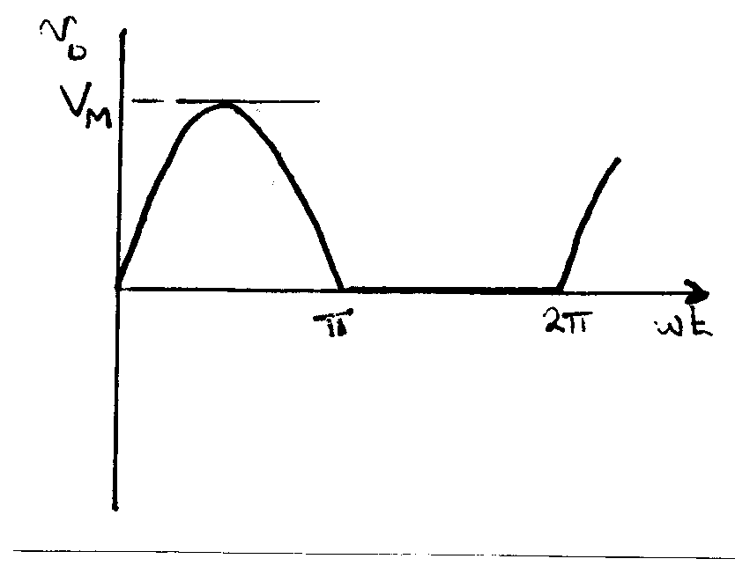
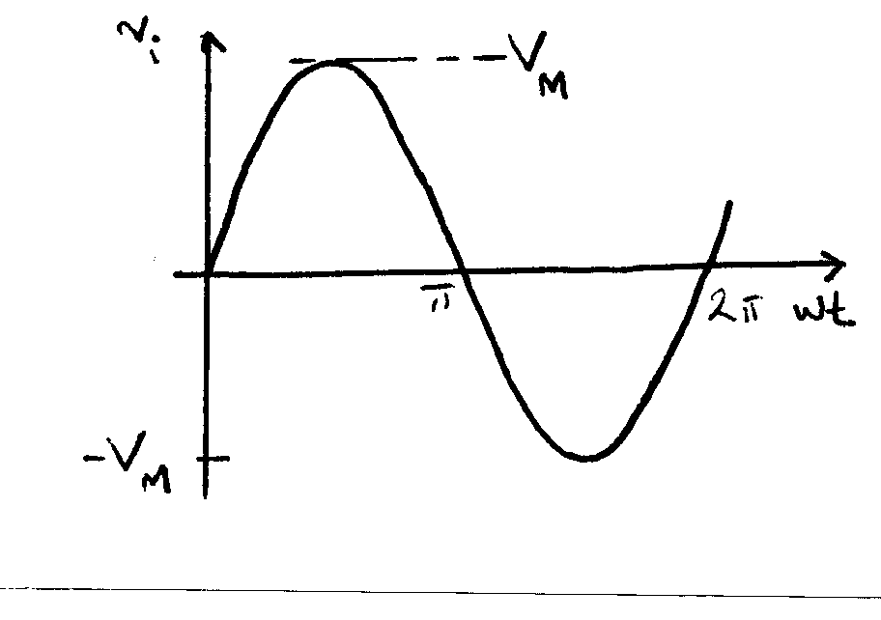
Input Signal for Rectifier Circuits:
In the simplified ideal diode case, the input and output wave forms are as shown below:

Slide 12
The Diode-Rectifiers:
One of the important application of a diode is their use in the design of the rectifiers, which converts an ac signal into a dc signal.
Diodes conduct current only in one direction and block current in the other direction. Current flows in the forward biased diode. A forward-biased diode is said to be turned-on or simply “on”. In a reverse biased diode, no current flows and the diode behaves as an open circuit. The reverse biased diode is, thus, said to be cut-off or simply off.
Diodes are thus used in circuits called “Rectifiers” that convert ac voltage into a dc voltage.
Rectifiers are found in all dc power supplies which operate from an ac voltage source.

Slide 13
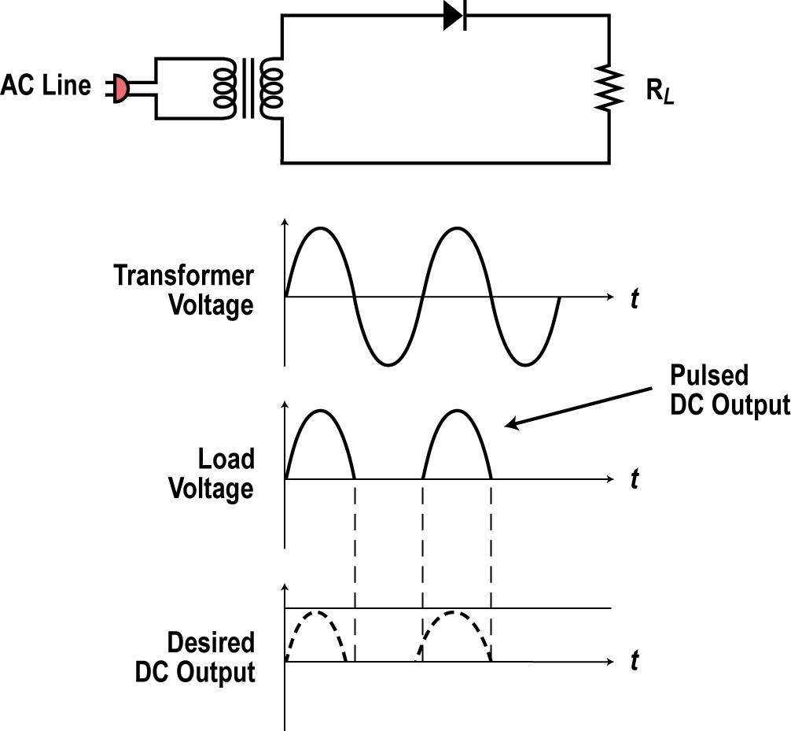
Diode Rectifier-Forward Biased;
The simplest form of rectifier is the half wave rectifier shown. Only the transformer, rectifier diode, and load (R_{L}) are shown without the filter and other components.
During the positive half cycle of the input signal, the anode of the diode is positive, thus the diode is
forward biased.
The diode conducts and acts like a closed switch letting the positive pulse of the sine wave to appear across the load resistor.

Slide 14
Diode Rectifier-Reverse Biased:
During the negative half cycle, the diode anode will be negative, so the diode will be reverse biased and no current will flows.
No negative voltage will appear across the load. The load voltage will be zero during the time of the negative half cycle.
See the waveforms that show the positive pulses across the load. These pulses need to be converted to a constant dc voltage.

Slide 15
Half-Wave Rectifier:
The ideal diode conducts for v_{i} > 0 and
since R_{f} =0
v₀ ≈ v_{i}
For v_{i} < 0 the ideal diode is an open circuit,
(it doesn’t conduct) and
v₀ ≈ 0

Slide 16
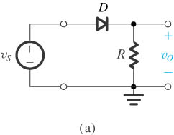
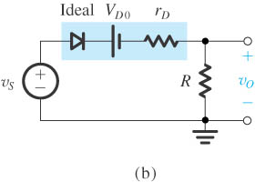
Half-Wave Rectifier Circuit:
  Half-Wave Rectifier Circuit
  Equivalent Circuit of the half-wave rectifier with the diode replaced with its barrier potential-plus-resistance model.

Slide 17
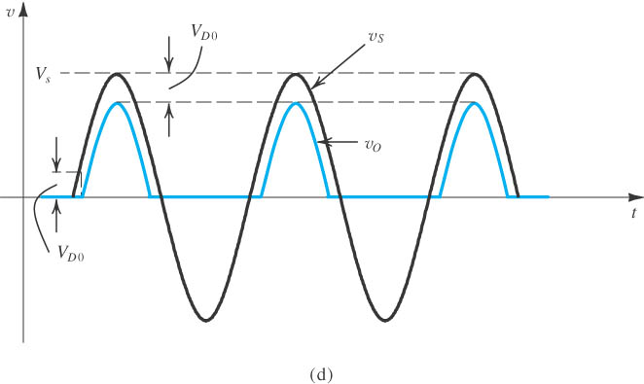
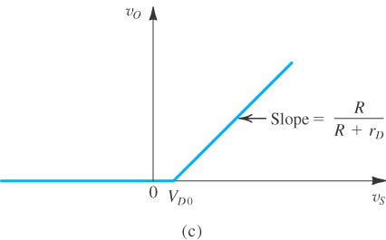
Half-Wave Rectifier Output:
(c) Transfer characteristic of the rectifier circuit.
(d) Input and output waveforms, assuming that

Slide 18
Average Value of the Output Voltage (Half-Wave) :
In the simplified (ideal diode) case, the input and output wave forms are as shown below:

Slide 19
Average Value of the Output Voltage (Half-Wave) :
Average dc value of this half-wave-rectified sine wave is:

Slide 20
Half-Wave Rectifier with a Capacitor Filter:
In the simple diode rectifier circuits shown above, though the output voltage does not change polarity, it has a lot of ripple, i.e. variations in the output voltage about a steady value.
To generate an output voltage that resembles a true dc Voltage, we can use a smoothing capacitor in parallel with the output resistance (load).
The capacitor does a good job of smoothing the pulses from the rectifier into a more constant dc.

Slide 21
Ripple:
A small variation occurs in the dc because the capacitor discharges a small amount between the positive and negative pulses. Then it recharges. This variation is called ripple.
The ripple can be reduced further by making the capacitor larger.
The ripple appears to be a saw tooth shaped AC variation riding on the DC output.
A small amount of ripple can be tolerated in some circuits but the lower the better.

Slide 22
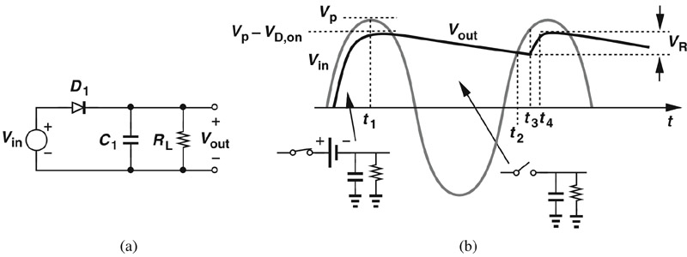
c03f34
Half-Wave Rectifier with Capacitor+Load Resistor
T_{in}
A path is available for capacitor to discharge.
Therefore, V_{out} will not be constant and a ripple exists.
Cause of ripple:

Slide 23
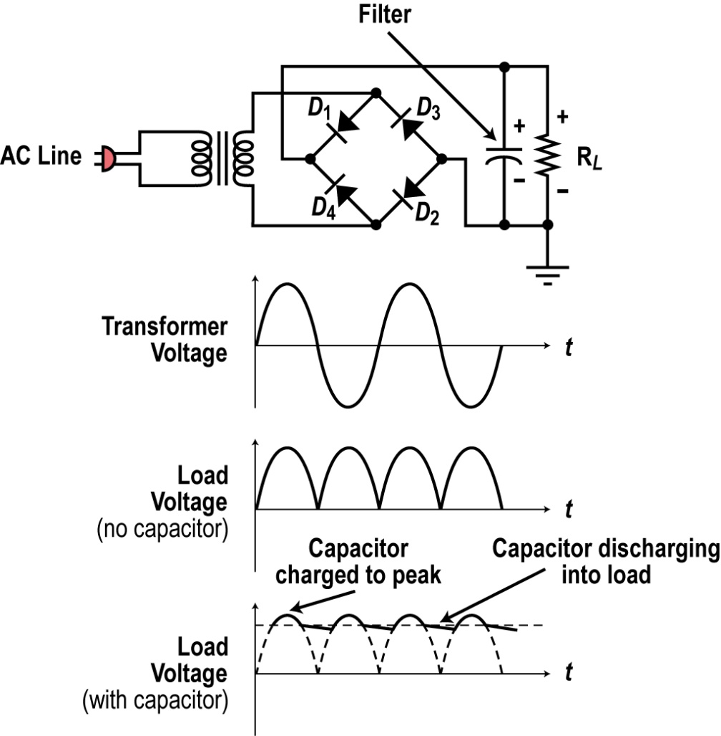
How the Capacitor Filter Works:
A large capacitor is connected across the load resistor. This capacitor filters the pulses into a more constant DC.
When the diode conducts, the capacitor charges up to the peak of the sine wave.

Slide 24
How the Capacitor Filter Works:
When the sine voltage drops, the charge on the capacitor remains. Since the capacitor is large it forms a long time constant with the load resistor. The capacitor slowly discharges into the load maintaining a more constant voltage output.
The next positive pulse comes along recharging the capacitor and the process continues.

Slide 25
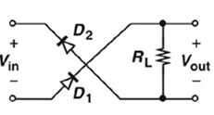
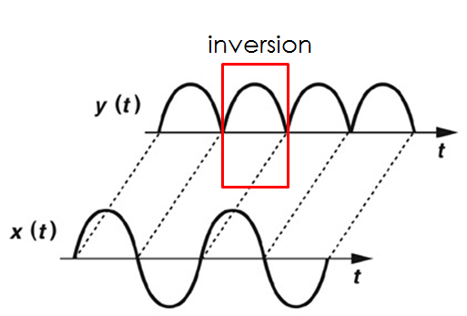
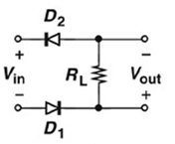
An Inverting Half-Wave Rectifier:
If V_{in} >0, D1 and D2 are off.
If V_{in} <0, D1 and D2 are on and Vout>0.

Slide 26
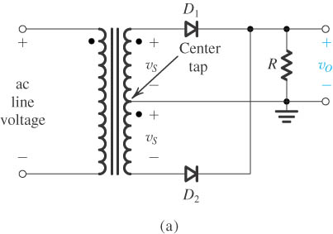
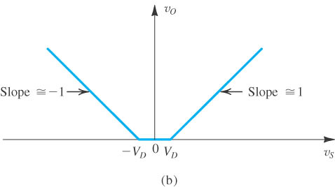
Full-Wave Rectifier:
Circuit.
Transfer characteristic assuming a constant-voltage-drop model for the diodes.

Slide 27
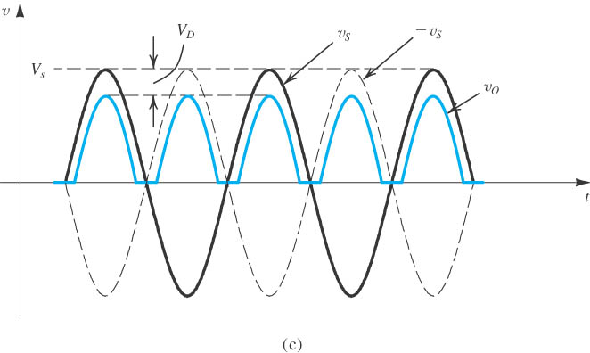
Full-Wave Rectifier:
(c) Input and output waveforms.

Slide 28
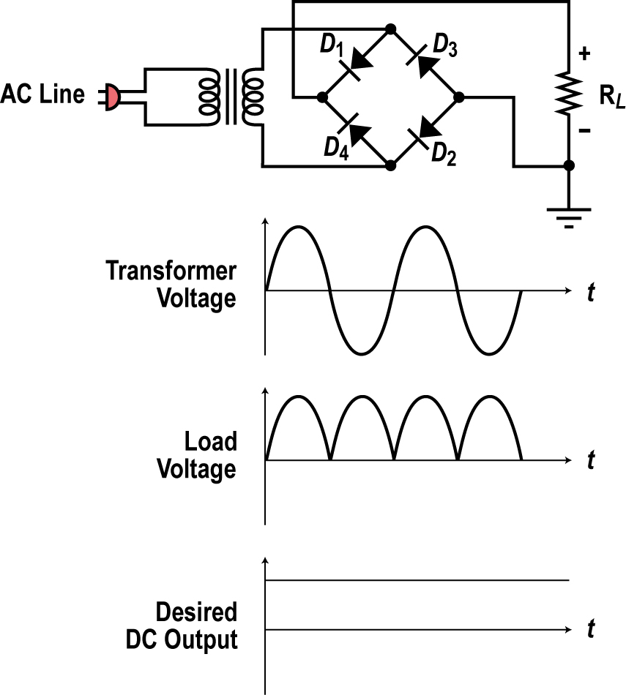
Bridge Rectifier:
Another widely used rectifier is the Bridge Rectifier. It uses four diodes.
This is called a full wave rectifier as it produces an output pulse for each half cycle of the input sine wave.
On the positive half cycle of the input sine wave, diodes D1 and D2 are forward biased so act as closed switches appearing in series with the load.
On the negative half cycle, diode D1 and D2 are reverse biased and diodes D3 and D4 are forward biased so current flows through the load in the same direction.

Slide 29
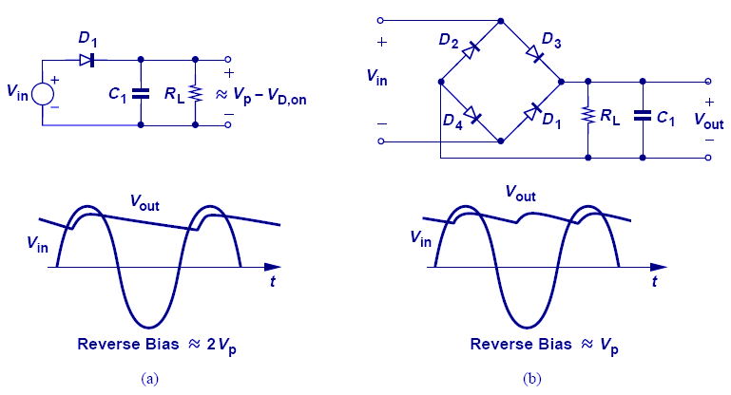
Summary of Half and Full-Wave Rectifiers
Full-wave rectifier is more suited to adapter
and charger applications.

Slide 30
DC Power Supply

Slide 31
The Basic DC Power Supply:
The dc power supply converts the standard 220 V, 50 Hz main-supply into a constant dc voltage and provides one or more DC output voltages.
Some modern electronic circuits need two or more different voltages.
Common voltages are 48, 24, 15, 12, 9, 5, 3.3, 2.5, 1.8, 1.5, and 1 volts.
A good example of a modern power supply is the one inside a PC that furnishes 12, 5, 3.3 and 1.2 volts.

Slide 32
Basic DC Power Supply:
A basic power supply circuit consists of a rectifier, a filter, a regulator and a load.
The rectifier converts the ac input voltage to a pulsating dc voltage.
The filter eliminates the fluctuations in the rectified voltage and produces a relatively smooth dc voltage.
The regulator is a circuit that maintains a constant dc voltage. The load is usually a circuit for which the power supply is producing the dc voltage and the load current.

Slide 33
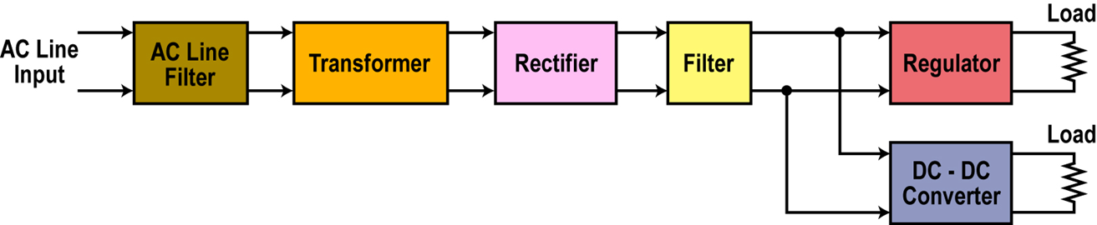
Basic Power Supply Circuit:

Slide 34
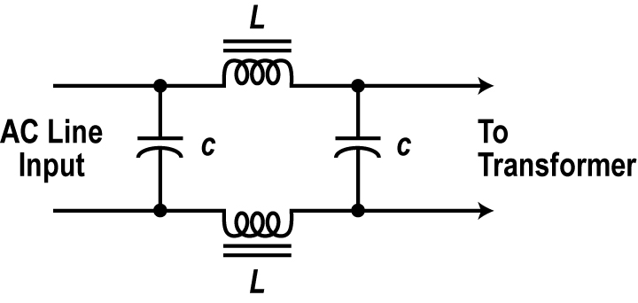
Basic Power Supply Circuit:
The AC Line Filter:
The AC Signal first passes through a low pass filter of the form shown in the Fig.
This filter eliminates the noise or any unwanted signals, in the AC line supply circuits, from being transferred back into the AC line where they might interfere with other equipment.

Slide 35

2) Transformer:
A transformer is commonly used to step the input AC voltage level down or up. Most electronic circuits operate from voltages lower than the AC line voltage so the transformer normally steps the voltage down by its turns ratio to a desired lower level.
For example, a transformer with a turns ratio of 10 to 1 would convert the 120 volt 60 Hz input sine wave into a 12 volt sine wave.

Slide 36
3) Rectifier:
The rectifier converts the AC sine wave into a pulsating DC wave.
There are several forms of rectifiers used but all are made up of diodes.
Rectifier types and operation will be covered later.

Slide 37
4) Filter:
The rectifier produces a DC output but it is pulsating, rather than a constant steady value over time, like that from a battery.
A filter is used to remove the pulsations and create a constant output.
The most common filter is a large capacitor.

Slide 38
5) Regulator:
The regulator is a circuit that helps to maintain a fixed or a constant output voltage. Most regulators are ICs .These are feedback control circuits that actually monitor the output voltage to detect variations.
Changes in the load or the AC line voltage will cause the output voltage to vary. Since ripple represents changes in the output, the regulator also compensates for these variations producing a near constant dc output.
Most electronic circuits cannot withstand the variations since they are designed to work properly with a fixed voltage.
The regulator fixes the output voltage to the desired level then maintains that value despite any output or input variations.

Slide 39
Summary: Power Supplies
All electronic circuits and equipment need a power supply, usually one that supplies very specific DC voltage.
A battery is a near perfect DC supply but it is used mainly in portable applications.
Most equipment uses an AC to DC power supply.
In most AC to DC supplies, the 120 volt AC line is first filtered then stepped up or down to the desired voltage level then rectified into pulsating DC, then filtered to a constant DC. A regulator holds the output to a desired level. A DC-DC converter may also be used to generate another DC voltage.
The two most common rectifiers are the single diode half wave rectifier and the four diode full wave bridge rectifier.

Slide 40
Switching Diodes

Slide 41
Switching Diodes:
Diodes can be used as switching devices.
Need to change from conducting to non-conducting at high speed.
Storage time or turn-off transients should be small.
Add recombination centers to reduce minority carrier lifetimes.
  For example adding 10¹⁵cm^{–3} gold (Au) to Si reduces hole lifetime to 0.01 μs from 1 μs!
  Use narrow-base diodes.
  Amount of charge stored in the neutral region of the diode will be small.

Slide 42
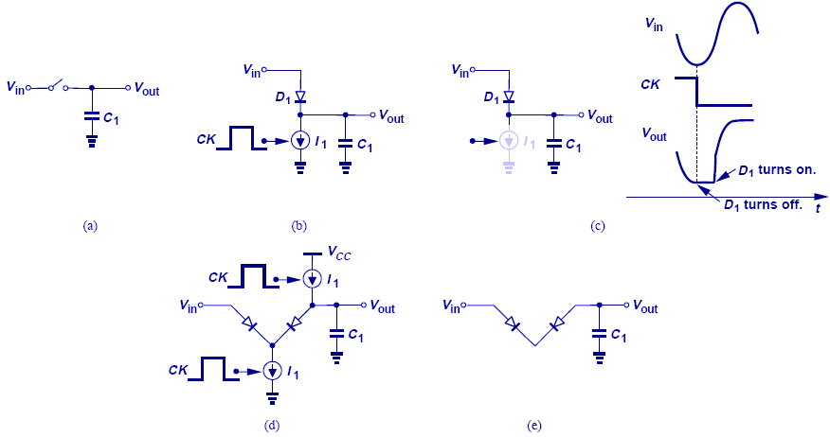
Diode as Electronic Switch
Diode as a switch finds application in logic circuits and data converters.

Slide 43
Diode Limiting and Clamping Circuits

Slide 44
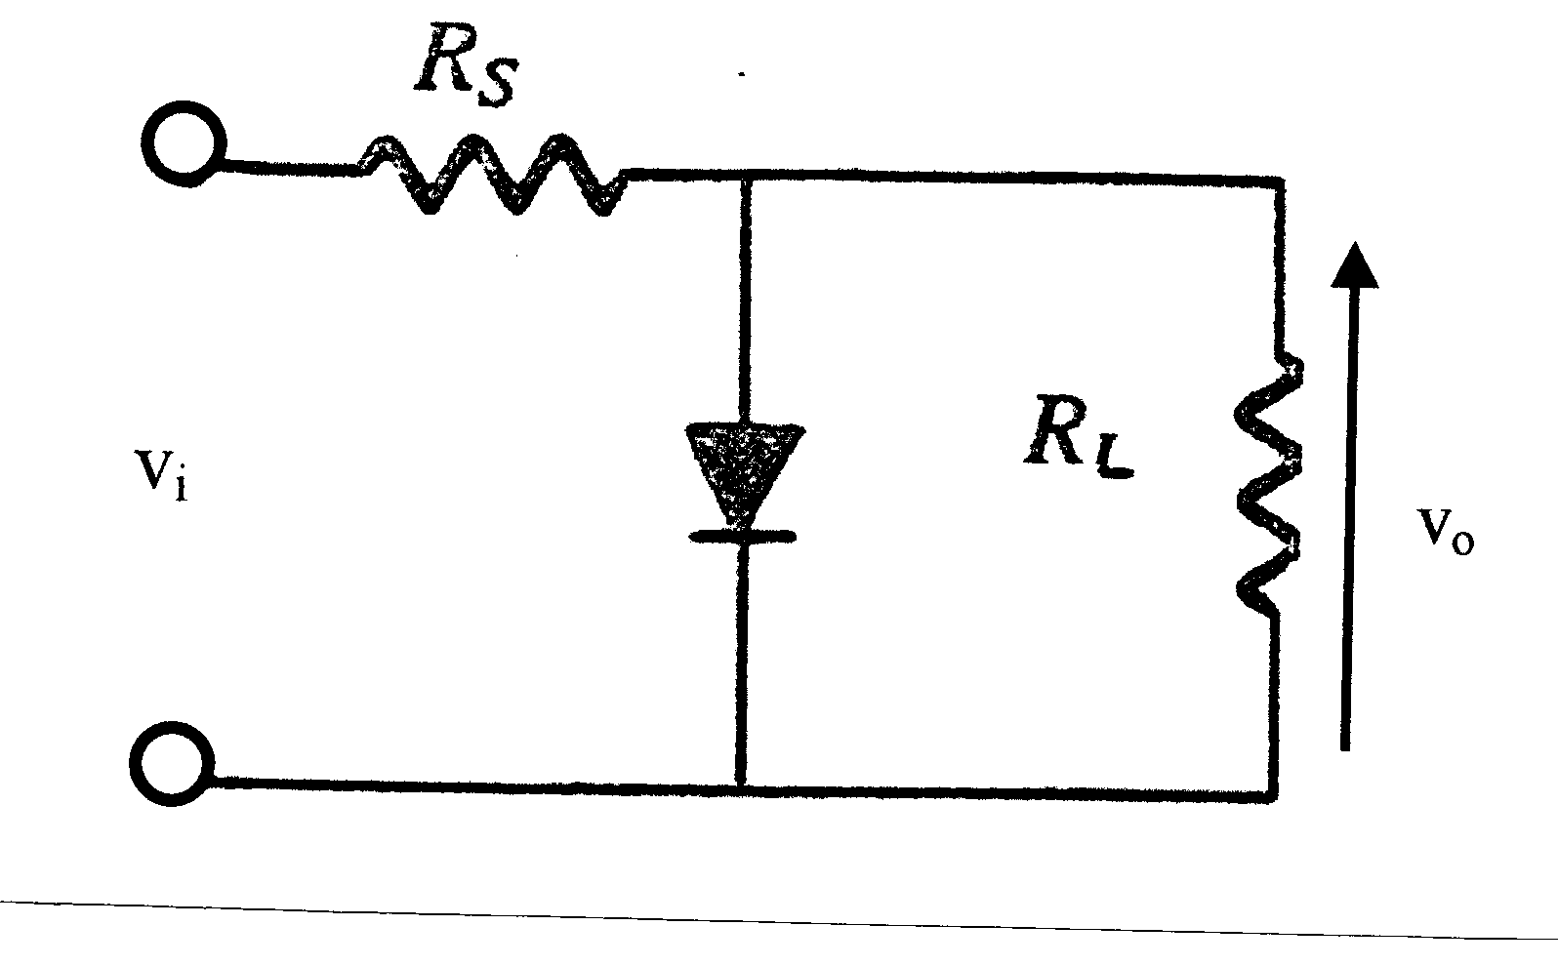
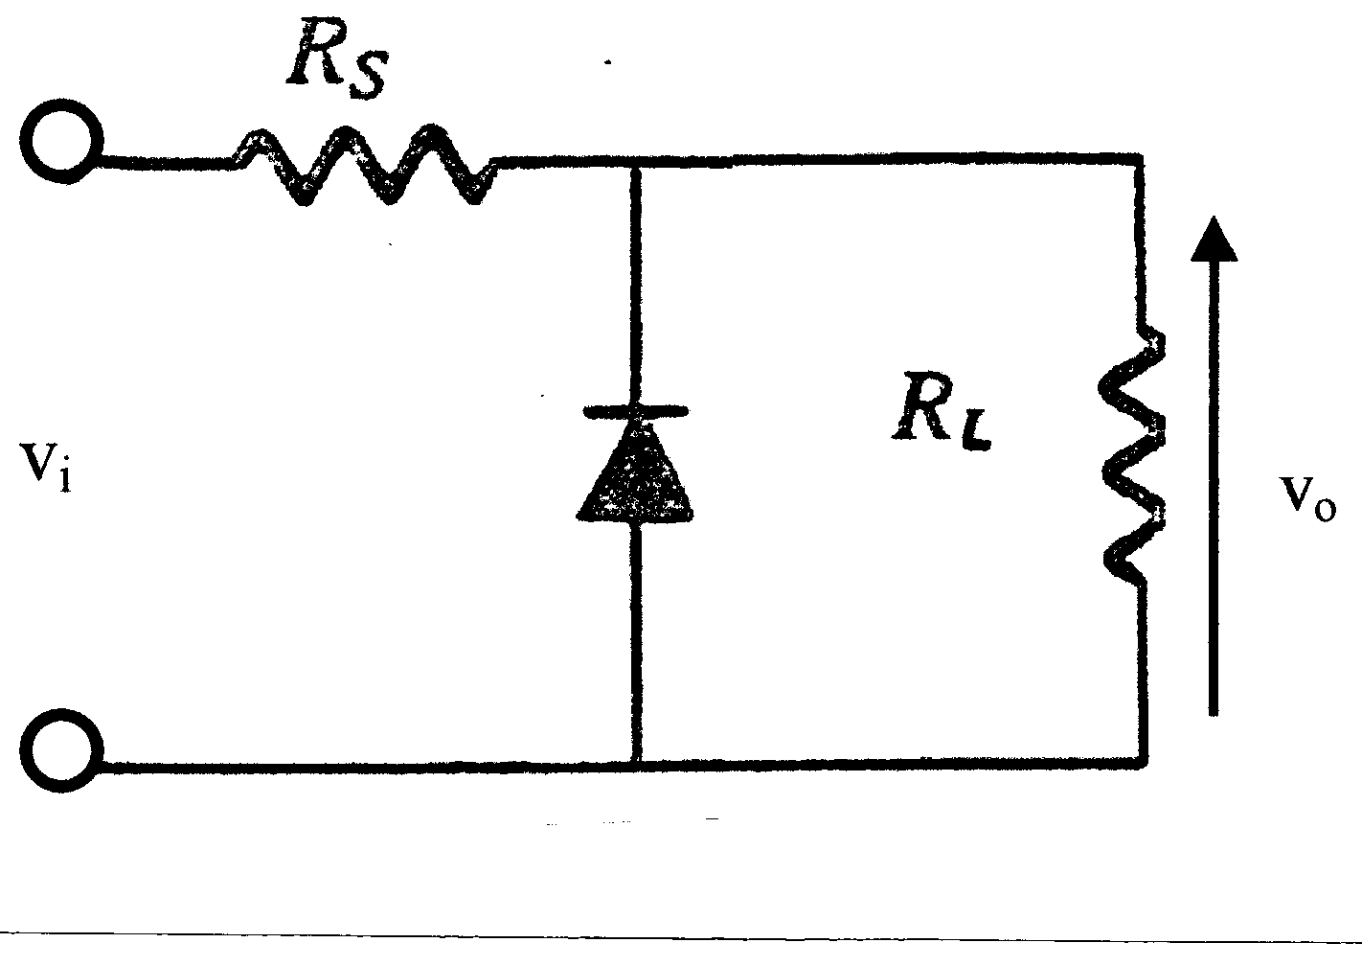
Diode Clipper Circuits:
These circuits clip-off portions of the signal voltages above or below certain limits, i.e. the circuits limit the range of the output signal.
The level at which the signal is clipped can be adjusted by adding a dc bias voltage in series with the diode.
  If R_{S} << R_{L}
V₀ ≈ V_{i}

Slide 45
Diode Clipper Circuits:
When the diode is off the output of these circuits resembles a voltage divider

Slide 46
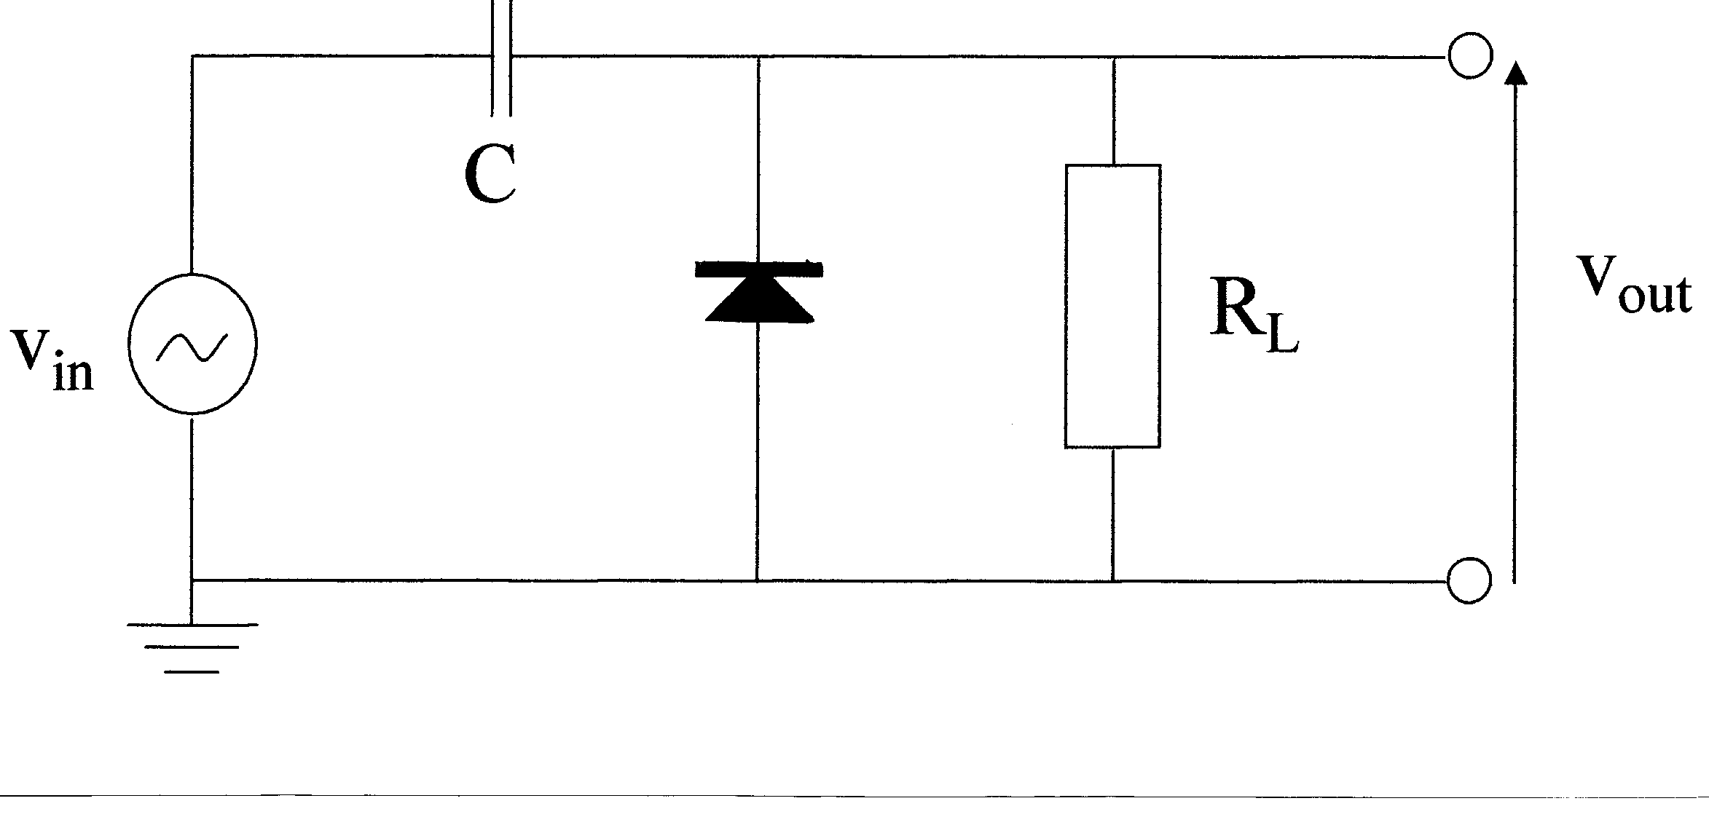
Diode Clamper Circuits:
The following circuit acts as a dc restorer.

Slide 47
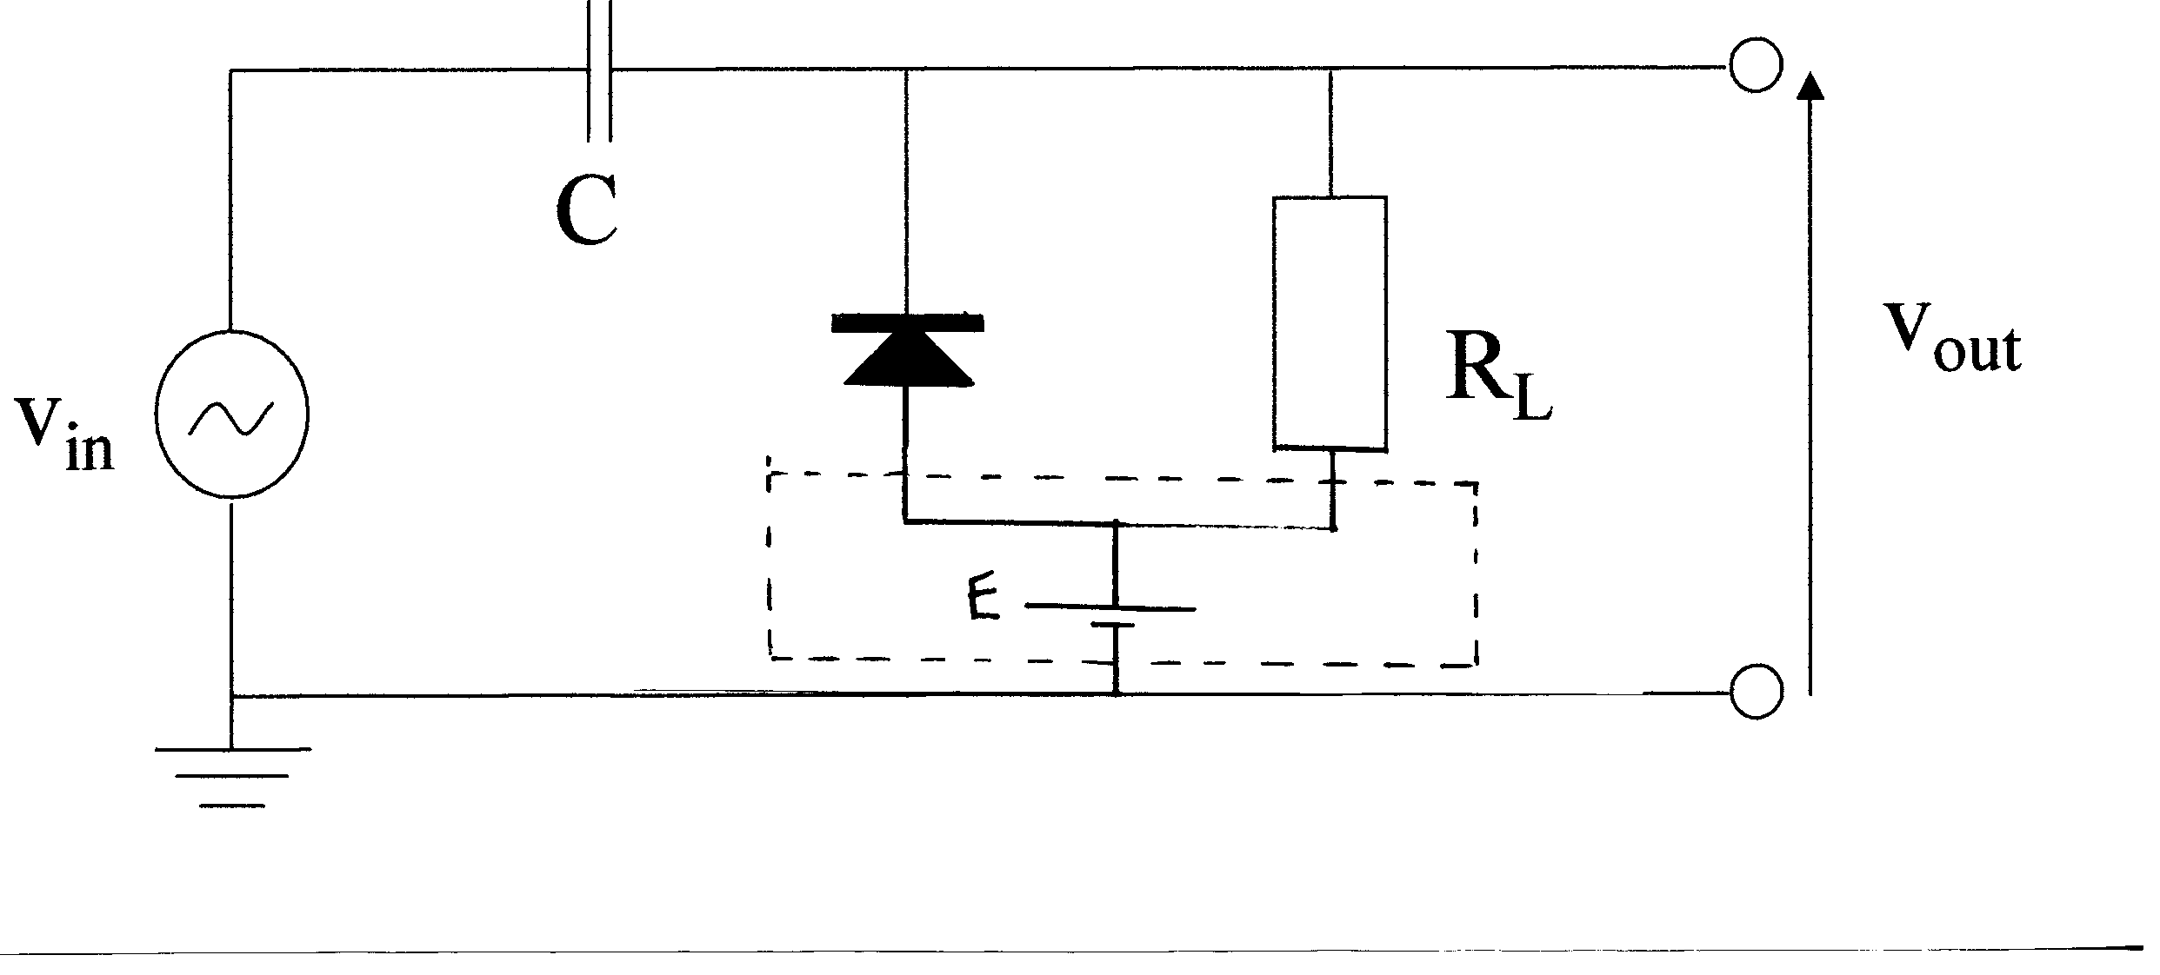
Diode Clamper Circuits
A dc bias voltage can be added to pin the output
to a level other than zero.

Slide 48
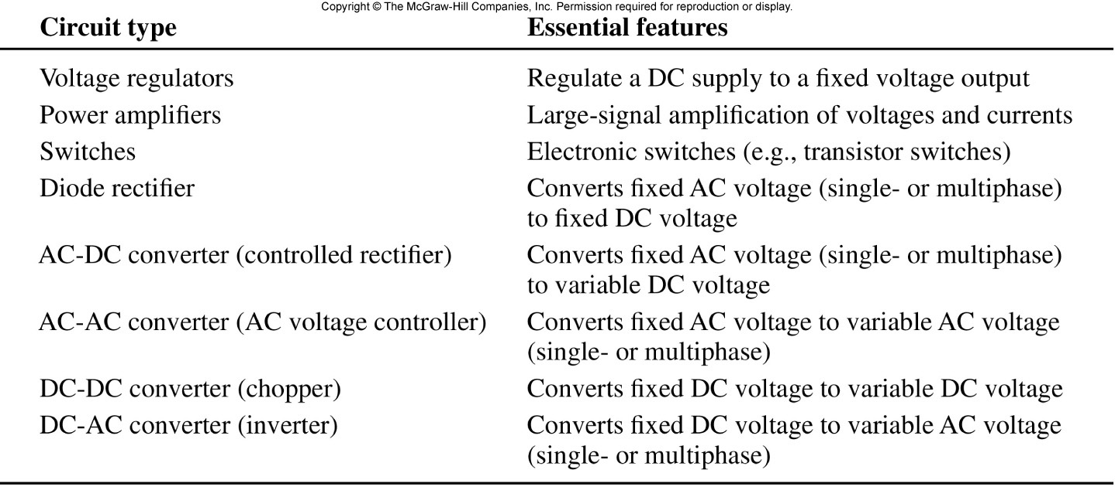
Table 12.1
Power Electric Circuits

