Slide 1

COMSATS Institute of Information Technology
Virtual campus
Islamabad
Dr. Nasim Zafar
Electronics 1
EEE 231 – BS Electrical Engineering
Fall Semester – 2012

Slide 2
The Diode Circuits-II
Lecture No: 10
Contents:
Ideal & Practical Diodes.
Terminal Characteristics of Junction Diodes.
DC Load Line and Quiescent Conditions.
Piecewise Linear Model
Small Signal Analysis of Diodes
Dynamic Resistance, AC Resistance
Capacitance and Switching Response,

Slide 3
References:
Microelectronic Circuits:
Adel S. Sedra and Kenneth C. Smith.
Electronic Devices and Circuit Theory:
Robert Boylestad & Louis Nashelsky ( Prentice Hall ).
Introductory Electronic Devices and Circuits:
Robert T. Paynter.
Electronic Devices :
Thomas L. Floyd ( Prentice Hall ).

Slide 4
References (Figures):
Chapter 2 Diodes:
Figures are redrawn (with some modifications) from
Introductory Electronic Devices and Circuits
By
Robert T. Paynter

Slide 5
The Diode Models
1. The Ideal Diode Model

Slide 6
The Diode:
P-N Junction Diode Schematic Symbol:
Anode
Cathode
p
n

Slide 7
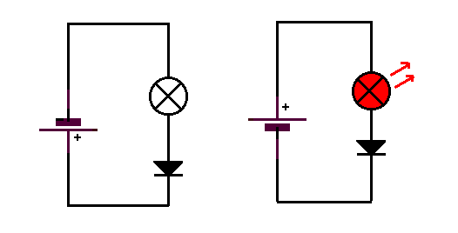
Diode Circuits:
anode
Reversed bias
+
+
Forward bias
-
-
cathode
The left hand diagram shows the reverse biased junction.
No current flows flows.
The other diagram shows forward biased junction.
A current flows.

Slide 8
Forward-Biased Diode Circuit:

Slide 9
Reverse-Biased Diode Circuit:

Slide 10
Effect of V_{F:}
Value | Ideal | Practical
V_{F} | 0 V | 0.7 V
V_{R1} | 5 V | 4.3 V
I | 5 mA | 4.3 mA

Slide 11
Example-1

Slide 12
Example-2

Slide 13
Example-3

Slide 14
Percentage Error:
where X = the measured value
X’ = the calculated value

Slide 15
Example-4

Slide 16
Power Dissipation P_{D(max)}

Slide 17
I₀ and P_{D(max)} Relationship:
where I₀ = the limit on the average forward current
P_{D(max)} = the forward power dissipation rating of the diode
V_{F} = the diode forward voltage (0.7V for Si)

Slide 18

Forward Power Dissipation P_{D(max)}:
Choose a diode with forward power dissipation P_{D(max)} at least 20% greater than actual power dissipation.

Slide 19
Example 5.
A diode has a forward power dissipation rating of 500 mW. What is the maximum allowable value of forward current for the device?

Slide 20
Complete: Model Diode Curve (Ref 3).
Forward operating region
Reverse operating region (also called the reverse breakdown region)

Slide 21
Another Example:
Determine voltage across diode in Fig. 2.19 (Ref. 3) for the values of I_{F} = 1 mA and I_{F} = 5 mA. Assume that the value for R_{B} = 5 Ω.
I_{F} = 1 mA:
I_{F} = 5 mA:
Bulk resistance has a significant effect on voltage drop across diode terminals when the forward current is large.

Slide 22
The Diode Models
4. Piecewise-Linear Diode Model
5. Constant-Voltage Diode Model
6. Dynamic Resistance, AC Resistance

Slide 23
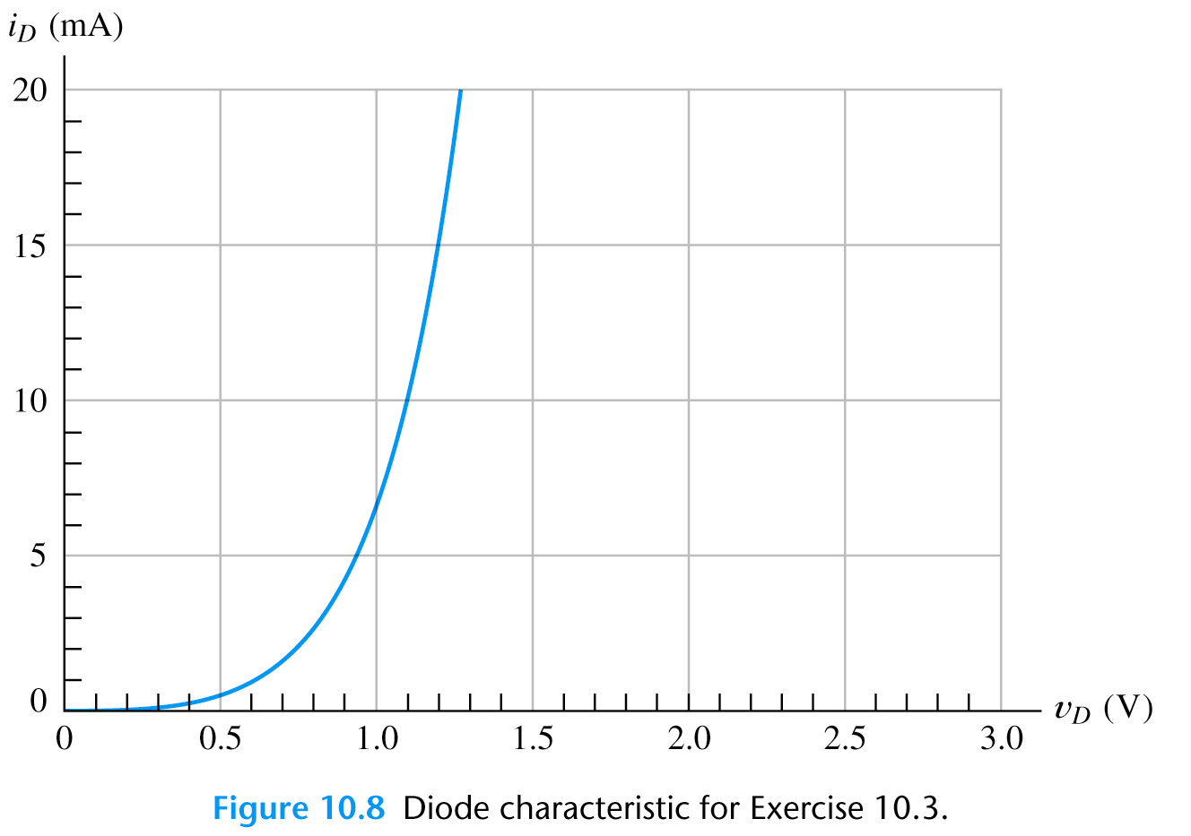
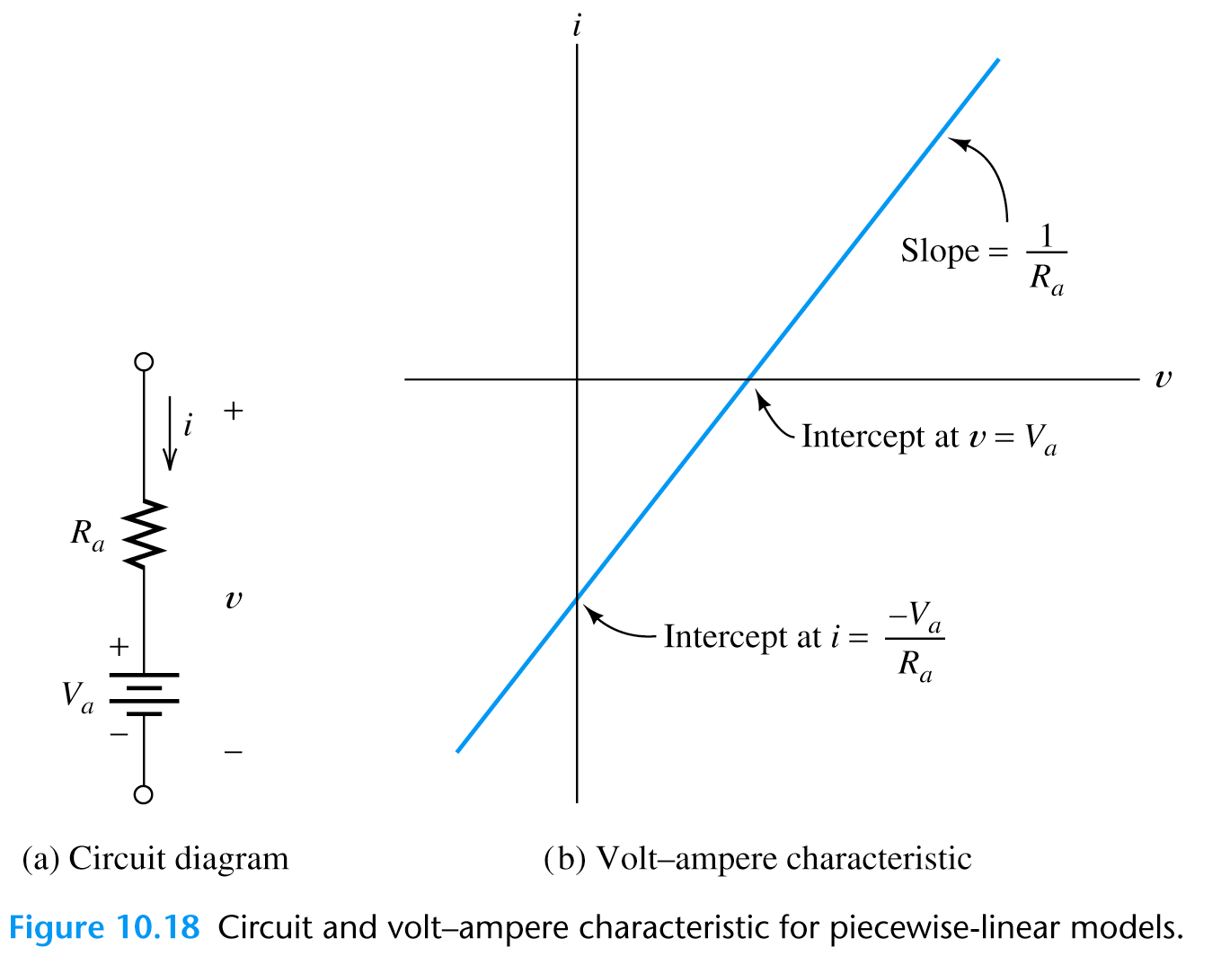

Piecewise Linear Diode Model:
More accurate than the ideal diode model and does not rely on nonlinear
equation or graphical techniques.
Diode I-V characteristic approximated
by straight line segments.
We model each section of the diode
I-V characteristic with R in series with
a fixed voltage source.
$${V_{ss}\text{=}{RI}_{D}+V_{D} }_{}$$

Slide 24
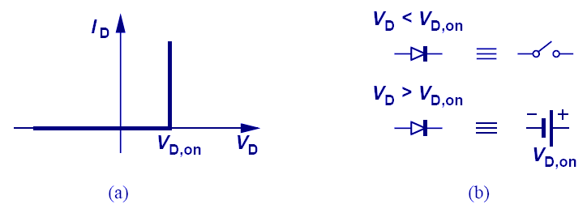
Constant-Voltage Diode Model:
If V_{D} < V_{D,on}: The diode operates as an open circuit.
If V_{D} ≥ V_{D,on}: The diode operates as a constant voltage
source with value V_{D,on}.

Slide 25
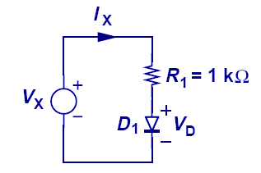
Example: Diode dc Bias Calculations
This example shows the simplicity provided by a constant-voltage model over an exponential model.
Using an exponential model, iteration is needed to solve for current. Using a constant-voltage model, only linear equations need to be solved.

Slide 26
Small-Signal Analysis of Diodes:
Small-signal analysis is performed at a DC bias point by perturbing the voltage by a small amount and observing the resulting linear current perturbation.
If two points on the I-V curve are very close, the curve in-between these points is well approximated by a straight line:

Slide 27
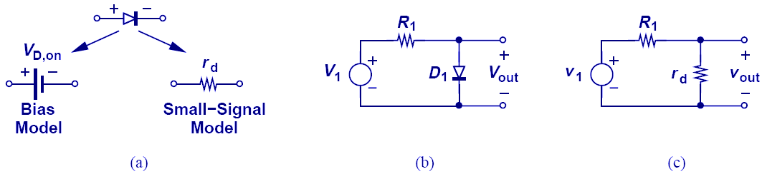
Small-Signal Analysis of Diodes:
Since there is a linear relationship between the small-signal current and small-signal voltage of a diode, the diode can be viewed as a linear resistor when only small changes in voltage are of interest.
Small-Signal Resistance
(or Dynamic Resistance)

Slide 28
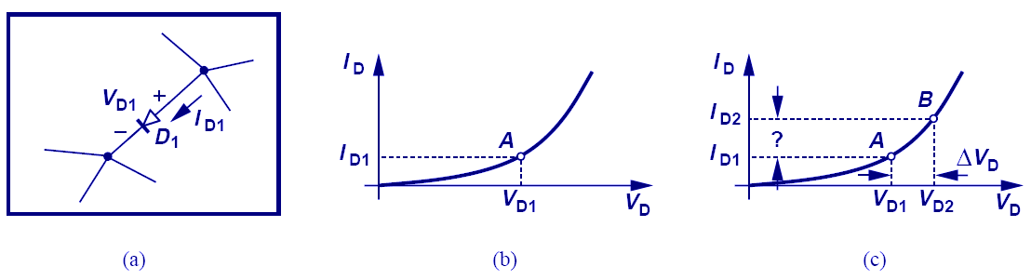
Small-Signal Analysis of Diodes:
Small-signal analysis is performed around a bias point by perturbing the voltage by a small amount and observing the resulting linear current perturbation.

Slide 29
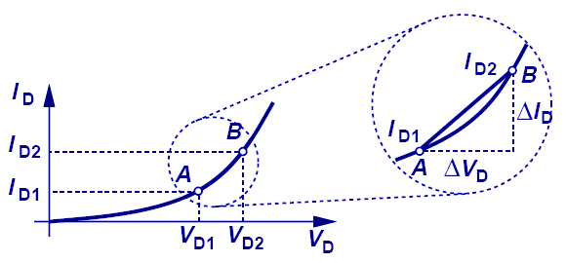
Small-Signal Analysis of Diodes:
If two points on the IV curve of a diode are close enough, the trajectory connecting the first to the second point is like a line, with the slope being the proportionality factor between change in voltage and change in current.

Slide 30
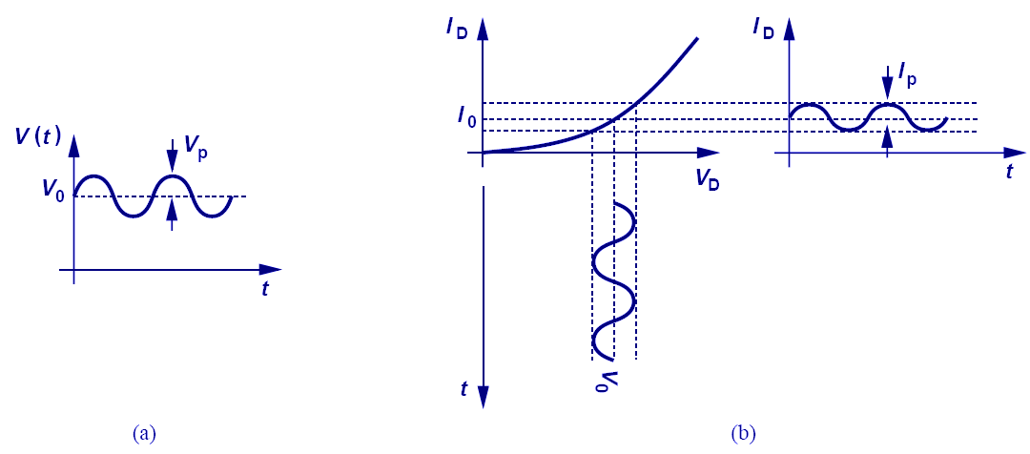
Small Sinusoidal Analysis:
If a sinusoidal voltage with small amplitude is applied, the resulting current is also a small sinusoid around a value.

Slide 31
Resistance Levels:
The operating point of a diode moves from one region to another the resistance of the diode will also change due to the nonlinear shape of the characteristic curve
The type of applied voltage or signal will define the resistance level of interest
Three different types of applied voltage
  DC or Static Resistance
  AC or Dynamic Resistance
  Average AC Resistance

Slide 32
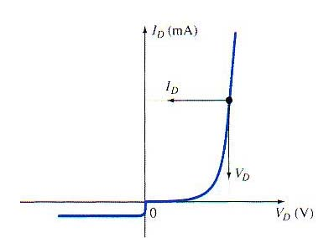
DC or Static Resistance
The application of a dc voltage to a circuit containing a semiconductor diode will result in an operating point on the characteristic curve that will not change with time
The resistance of the diode at the operating point can be found simply by finding the corresponding levels of V_{D} and I_{D}
The lower current through a diode the higher the dc resistance level

Slide 33
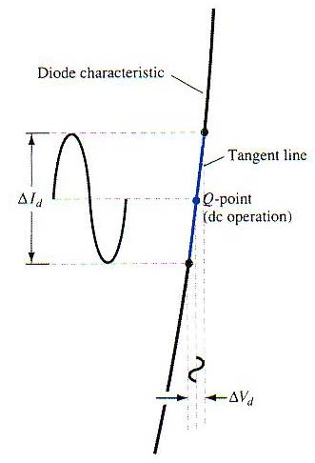
AC or Dynamic Resistance
The varying input will move the instantaneous operating point up and down a region of the characteristics and thus defines a specific change in current and voltage as shown in the Fig.

Slide 34
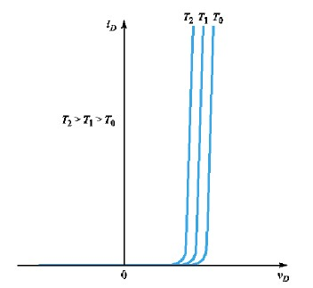

Temperature Effects:
Js : strong function of temperature

Slide 35
Temperature Effects on Diode Operation:

Slide 36
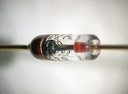
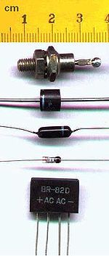
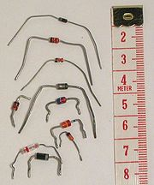
Typical Diodes

Slide 37
Diode Maximum Ratings.
Rating | Discussion
Peak repetitve reverse voltage, V_{RRM} | Maximum allowable reverse voltage.
Nonrepetitive peak reverse voltage, V_{RSM} | Maximum allowable value of a single event reverse voltage. (V_{RSM} > V_{RRM})
RMS reverse voltage, V_{R(rms)} | V_{R(rms)} = 0.707 V_{RRM}
Average rectified forward current, I₀ | Maximum average diode current.
Nonrepetitive peak surge current, I_{FSM} | Maximum allowable value of forward current surge. (30A for 1N400X)
Operating and storage junction temperature, T_{J} or T_{stg} | Temperature that diode can withstand.

Slide 38
Diode Capacitance:

Slide 39
Application of PN Junction:
BJT (Bipolar Junction Transistor)
HBT (Heterojunction Bipolar Transistor)
Rectifiers
P
N
J
U
N
C
T
I
O
N
Switching diode
Junction diode
Breakdown diode
Varactor diode
Tunnel diode
PN Junction diode
Solar cell
Photo-diode
Photodetector
Light Emitting diode & Laser Diode
JFET
FET (Field Effect Transistor)
MOSFET - memory
MESFET - HEMT

Slide 40
Summary:
Three diode models.
Diode specifications.
Diode Applications.

