Slide 1

COMSATS Institute of Information Technology
Virtual campus
Islamabad
Dr. Nasim Zafar
Electronics 1
EEE 231 – BS Electrical Engineering
Fall Semester – 2012

Slide 2
PRESENT POSITION
Advisor in the Quality Enhancement Cell
COMSATS CIIT, Islamabad
ACADEMIC QUALIFICATIONS
Ph.D. 1972 University of Cambridge, UK.
M.Sc. 1967 Govt. College Lahore.
FIELD OF SPECIALIZATION
Semiconductor Physics
Nuclear Physics

Slide 3
Introduction:
This course is an elective course for our BS students in the
Department of Electrical Engineering, CIIT, Islamabad.
Material emphasis: of the BS undergraduate education.
Electronics 1
EEE 231

Slide 4
Electronics 1: EEE 231
Course Outline:
Solid State Theory, Introduction to Semiconductors Devices, Intrinsic and Extrinsic Semiconductors, Electron Hole Pairs, Distribution of Electrons and Holes in a Semiconductors, P.N. Junction Diode, Forward and Reverse Biasing, of a Diode, V-I Characteristics, Ideal & Practical Diodes, DC Load Line & Quiescent Conditions, Small Signal Analysis of Diodes, Dynamic Resistance, AC Resistance, Capacitance and Switching Response, Diode Circuits & Applications, Rectifiers and Clipping Circuits, Special Diodes and their Applications, Zener Diodes, LED, Photo Diode, Tunnel Diode, Temperature Effects and Derating Curves, BJT Transistors, Biasing Techniques, Common Base, Common Emitter (CE) and Emitter Follower (CC) Configurations, Current Flow Mechanism, Equivalent Circuits, Current Amplification, Power Calculations, Theory of the Operation of the FETs and MOSFETs, Types of FETs, FET Amplifiers and Biasing Techniques, Temperature Effects in BJTs & FETs, Bias Stability, Q Point Variations, Stability Factor Analysis and Control.

Slide 5
Electronic 1: EEE 231
Recommended Books:
B. G. Streetman, Solid State Electronic Devices, 5th ed., Prentice-Hall.
Jasprit Singh, Semiconductor Devices–An Introduction, McGraw-Hill, Inc. (1994).
Michael Shur, Physics of Semiconductor Devices, Prentice Hall, Inc. (1990).

Slide 6
Additional Text and Reference Books:
1. A. Bar-Lev, Semiconductors and Electronic Devices, Prentice Hal
2. S.M. Sze, Physics of Semiconductor Devices, John Wiley, (1981).
3. A.S. Grove, Physics and Technology of Semiconductor Dev., John Wiley, (1967).
4. J.L. Moll, Physics of Semiconductors, McGraw-Hill, Inc. (1964).
5. R.A. Smith, Semiconductors 2nd ed., Cambridge University Press, (1979).
6. Pierret, Semiconductor Device Fundamentals, Addison Wesley, (1996).

Slide 7
Course Objectives:
Provide an introduction into the operating principles of
electronic and optical devices, the principles of semiconductor processing
Present the relevant materials science issues in semiconductor processing.
Prepare students (a) for work in semiconductor processing facilities and (b) for graduate studies related to semiconductor processing and materials science topics.

Slide 8
Course Outline:
Semiconductor Materials-Introduction:
  Band Theory of Solids
  Band Gap and Material Classification
  Semiconductor Materials
Charge Carriers and Carrier Transport in Semiconductors:
  Electrons and Holes in Equilibrium
  Carrier Densities: Fermi Dirac Distribution Function
  Generation/Recombination
  Mobility and Conductivity
  Continuity Equations
  Einstein Relation
Dr. Nasim Zafar

Slide 9
3 PN Junctions:
  Fabrication Techniques (abrupt & linearly graded junctions)
    P-N Junctions under Equilibrium Conditions:
    - depletion region width
  - built–in–potential
  - Fermi levels and band bending
  Junction Breakdown
    I -V Characteristics of a PN Junction (biased junctions)
Bipolar Junction Transistors (BJT):
  Fabrication Techniques
  Principles of Transistor Action
  Currents Flowing in a Transistor

Slide 10
Junction Field Effect Transistor (JFET):
  Basic JFET Structure
  Operation of a JFET
  Characteristics of JFET
Optoelectronic Devices:
  Solar Cells
  Photodiodes
  Semiconductor Lasers
  Light Emitting Devices (LEDs)

Slide 11
Outcome:
Upon completion of this course, the student will learn:
Understanding of the concept of band gap in semiconductors,
to distinguish direct and indirect band gap semiconductors,
and to relate the band gap with the wavelength of optical absorption
and emission.
Understanding of doping of semiconductors to determine the free carrier concentration
Knowledge of the formation of p-n junctions to explain the diode operation
and to draw its I-V characteristics.
Understanding of the operation mechanism of solar cells, LEDs, lasers and FETs, so that can draw the band diagram to explain their I-V characteristics and functionalities.

Slide 12
Understanding of the operation mechanism of solar cells, LEDs, lasers and FETs, so that can draw the band diagram to explain their I-V characteristics and functionalities.
Ability to describe major growth techniques of bulk, thin film, and
nanostructured semiconductors.
Basic knowledge of doping, purification, oxidation, gettering, diffusion, implantation, metallization, lithography and etching in semiconductor processing.

Slide 13
Electronics1: EEE231
Lecture No. 1
In this lecture we will cover the following topics:
Semiconductor Materials-Introduction:
   The quantization concept
   Band Theory of Solids
   Band Gap and Material Classification
   Semiconductor Materials
Material emphasis: of the BS undergraduate education.

Slide 14

  The quantization of Electron
  Energy States

Slide 15
Quantization Concept
Quantum Mechanics ⇒ discrete energy levels
That the radiation (i.e. electromagnetic waves) is emitted and absorbed as discrete energy quanta - photons.
The energy of each photon is related to the wavelength
of the radiation:
E = h ν = h c / λ
where
h = Planck’s constant (h = 6.63 × 10⁻³⁴ Js)
ν = frequency (Hz = s⁻¹)
c = speed of light (3 × 10⁸ m/s)
λ = wavelength (m)

Slide 16
Example
Our eye is very sensitive to green light. The corresponding wavelength is 0.555 μm or 5550 Å or 555 nm. What is the energy of each photon?
E = hν = = 3.57 × 10^{–19} J
These energies are very small and hence are usually measured using a new energy unit called electron Volts
1 eV = 1.6 × 10⁻¹⁹ CV = 1.6 × 10⁻¹⁹ J

Slide 17
A new unit of energy
Since the energies related to atoms and photons are very small,
(E_{GREEN LIGHT} = 3.57 × 10⁻¹⁹ J), we have defined a new unit of energy called “electron Volt” or “eV”
One eV is the energy acquired by an electron when accelerated by a 1.0 V potential difference.
1 eV = 1.6 ×10^{–19} J
1V
−
+
Energy acquired by the electron is qV. Since q is 1.6 × 10⁻¹⁹ C, the energy is 1.6 × 10⁻¹⁹ J. Define this as 1 eV. Therefore,
E_{GREEN LIGHT} = 2.23eV
1 eV = 1 × 1.6×10^{–19} CV = 1.6×10^{–19} J

Slide 18
Bohr in 1913 hypothesized that electrons in hydrogen was restricted to certain discrete levels. This comes about because the electron waves can have only have certain wavelengths, i. e.
nλ = 2πr, where r is the orbit radius. ➔ Quantization
Based on this, one can show that:

Slide 19
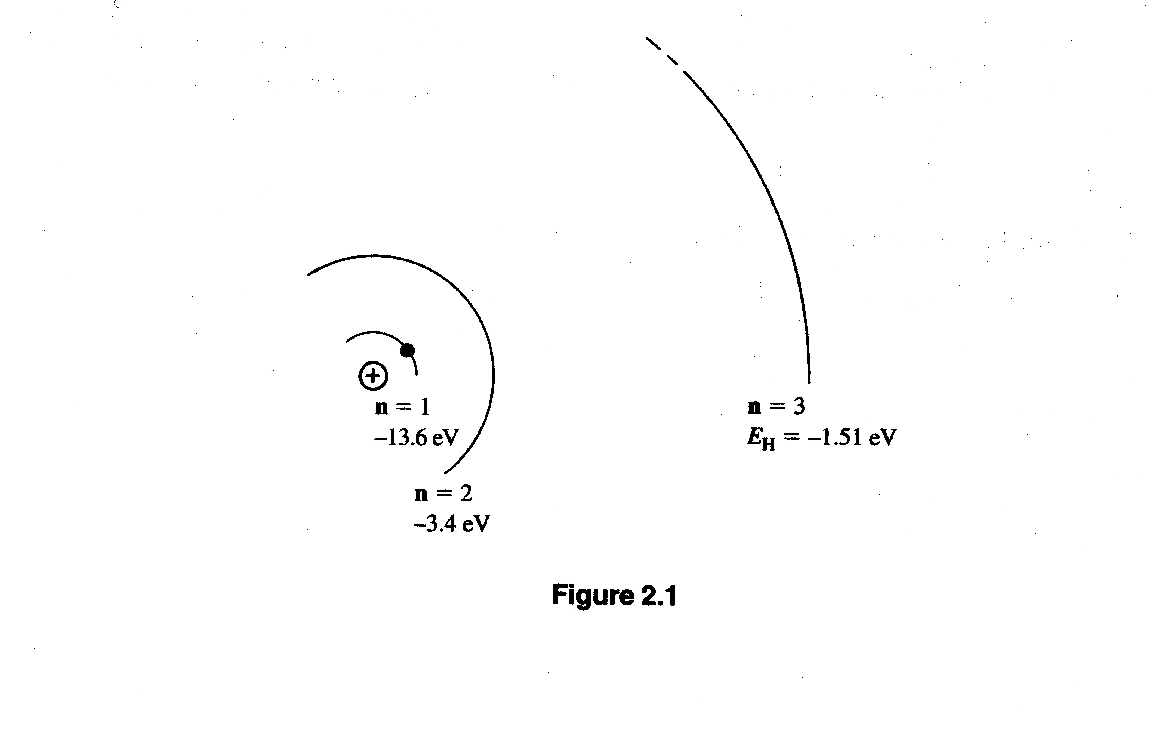
Bohr’s Hydrogen Atom Model
and Electron Energy Levels

Slide 20
  Band Theory of Solids

Slide 21
Energy Band Model
An isolated atom has its own electronic structure with n = 1, 2, 3 ... shells.
When atoms come together, their shells overlap. The energy level scheme in multi-electron atom , like Si is more complex, but intuitively similar.
Consider Silicon: Si has 4 electrons in its outermost shell. When a large number of atoms come together, as in solids to form a crystal, these shells overlap and form bands.
We do not consider the inner shell electrons since they are too tightly coupled to the inner core atom, and do not participate in anything.
Configuration for Ge is identical to that of Si, except that the core has 28 electrons.

Slide 22
Survey of the Periodic Table
Semiconductor Materials
Formed from Atoms in Various Columns

Slide 23
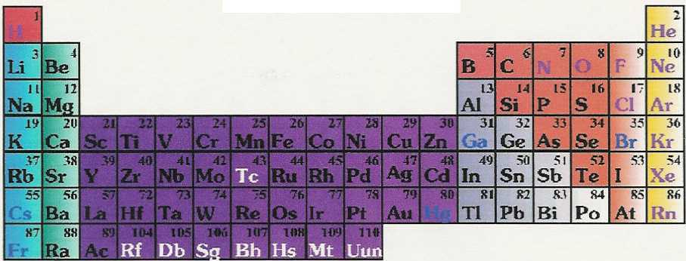
Group IV Elements
↓
Valence electron configuration: ns² np²
[n = 2, C; n = 3, Si; n = 4, Ge; n = 5, Sn]
↑
[n = 2, C; n = 3, Si; n = 4, Ge; n = 5, Sn]

Slide 24
WHAT IS A SEMICONDUCTOR?
B - Ch 1, Y - Ch 1, S - Ch 1
Conductivity/Resistivity Definition
(σ = conductivity, ρ = resistivity)
  Metals: Good Conductors!
  10³ ≤ σ ≤ 10⁸ (Ω-cm)⁻¹; 10⁻⁸ ≤ ρ ≤ 10⁻³ Ω-cm
  Semiconductor/Semimetals:
  10⁻⁸ ≤ σ ≤ 10³ (Ω-cm)⁻¹; 10⁻³ ≤ ρ ≤ 10⁸ Ω-cm
  NOTE THE HUGE RANGE!!
  Insulators: σ ≤ 10⁻⁸ (Ω-cm)⁻¹; ρ ≥ 10⁸ Ω-cm
  No rigid boundaries!

Slide 25
More Semiconductor Characteristics
In pure materials (very rare):
The electrical conductivity σ ∝ exp(cT)
T = Kelvin Temperature, c = constant
Impure materials (most):
  The electrical conductivity σ depends strongly on impurity concentrations.
    “Doping” means to add impurities to change σ
  The electrical conductivity σ can be changed by light or electron radiation & by injection of electrons at contacts
  Transport of charge can occur by the motion of electrons or holes (defined later).

Slide 26
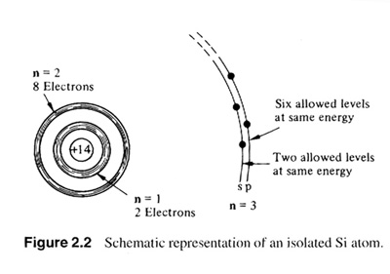

Slide 27
Bond model
Consider a semiconductor Ge, Si, or C
Ge, Si, and C have four nearest neighbors, each has 4 electrons in outer shell
Each atom shares its electrons with its nearest neighbor.
This is called a covalent bonding
No electrons are available for conduction in this covalent structure, so the material is and should be an insulator at 0K

Slide 28
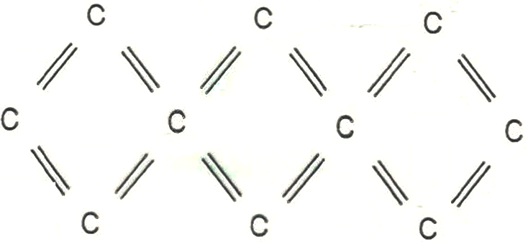
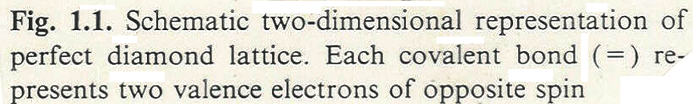
Qualitative Picture of Holes
(from Seeger’s book)
  Idealized, 2D, “diamond” lattice for e⁻ & e⁺ conduction

Slide 29
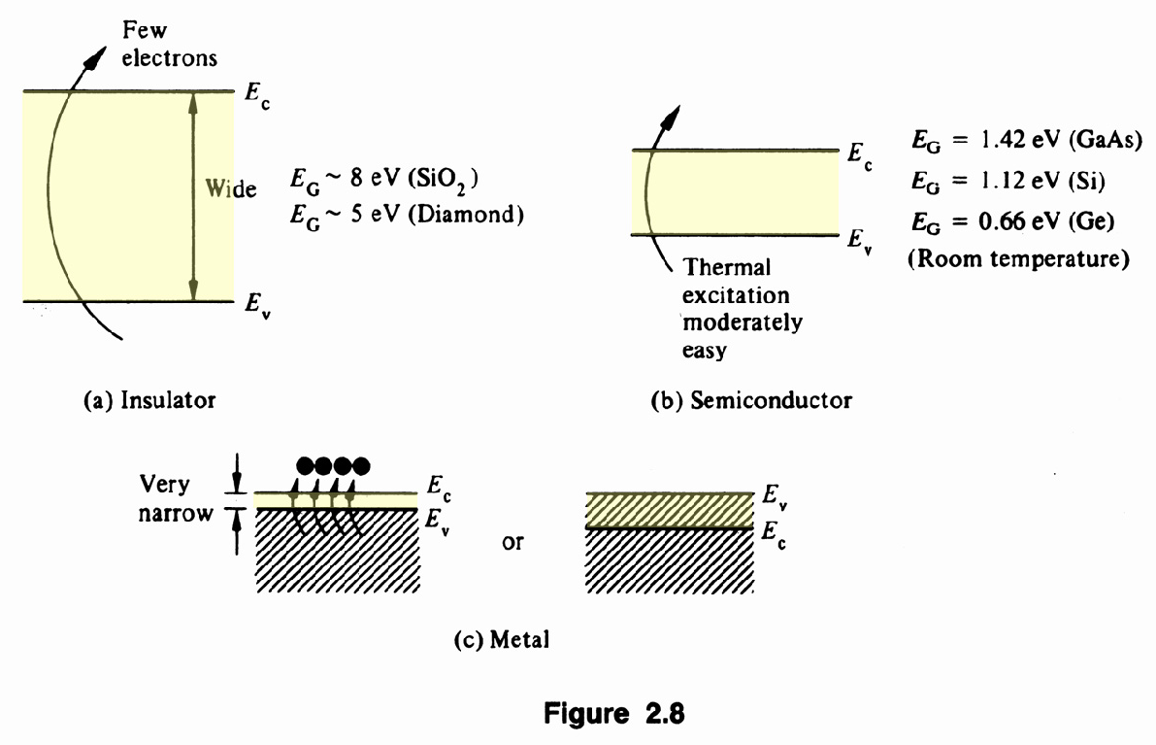
Insulators, semiconductors, and metals

Slide 30
SEMICONDUCTOR:
Bandgap Definition
Semiconductor: ~ Small bandgap insulator
(define bandgap E_{g} in detail later). Strictly speaking, it must be capable of being doped (define doping in detail later).
Typical Bandgaps
Semiconductors: 0 ~ ≤ E_{g} ≤ ~ 3 eV
Metals & Semimetals: E_{g} = 0 eV
Insulators: E_{g} ≥ 3 eV
Exception ⇒ Diamond: E_{g} = ~ 6 eV, is usually an insulator, but it can be doped & used as a semiconductor!
Also, sometimes there is confusing terminology like
GaAs: E_{g} = 1.5 eV is sometimes called semi-insulating!

Slide 31
The Best Known Semiconductor is
Silicon (Si)
However, there are HUNDREDS (maybe THOUSANDS) of others!
Elemental: Si, Ge, C (diamond)
Binary compounds: GaAs, InP, .
Organic compounds: (CH)_{n} (polyacetyline)
Magnetic semiconductors: Cd_{x}Mn_{1-x}Te, …
Ferroelectric semiconductors: SbI, …
Superconducting compounds:
GeTe, SrTiO₃, .. (“High T_{c} materials”)

Slide 32
Group IV Crystalline Materials
Elemental Semiconductors formed from atoms in Column IV
C (carbon): Different Crystal Phases
Diamond Structure: Diamond! Insulator or semiconductor
Graphite: A metal. The most common carbon solid.
Fullerenes: Based on Buckminsterfullerene. “Bucky Balls”,
Nanotubes, Insulator, Semiconductor or Metal depending on preparation.
Clathrates: Possible new forms of C solids?
Semiconductor or semimetal, compounds,… Recent Research!!
Si (silicon): Different Crystal Phases
Diamond Structure: A Semiconductor. The most common Si solid. Clathrates: “New” forms of Si solids. Semiconductor, Semimetal, Compounds,…. Recent Research

Slide 33
Group IV Crystalline Materials
Ge (germanium): Different Crystal Phases
  Diamond Structure: A Semiconductor. The most common Ge solid.
  Clathrates: “New” forms of Ge solids. Semiconductor, Semimetal, Compounds,…. Recent Research
Sn (tin): Different Crystal Phases
  Diamond Structure: Gray tin or α-Sn. A Semimetal
  Body Centered Tetragonal Structure: White tin or β-Sn.
  A Metal, The most common Sn solid.
  Clathrates: “New” forms of Sn solids. Semiconductor, Semimetal, Compounds,…. Recent Research
Pb (lead): Face Centered Cubic Structure: A Metal.

Slide 34
Group IV Materials
Bandgaps & Near-Neighbor Distances for Solids in Lattices with the Diamond Structure
Decreasing Bandgap E_{g} correlates with
Increasing Nearest Neighbor Bond Length d
Atom E_{g} (eV) d (Å)
C 6.0 2.07
Si 1.1 2.35
Ge 0.7 2.44
Sn (a semimetal) 0.0 2.80
Pb (a metal) 0.0 1.63
Not diamond structure!

Slide 35
Elemental Semiconductors
Mainly, these are from Column IV elements
  C (diamond), Si, Ge, Sn (gray tin or α-Sn)
  Tetrahedrally bonded in the diamond crystal structure.
  Each atom has 4 nearest-neighbors.
  Bonding: sp³ covalent bonds.
Also! Some Column V & Column VI elements are semiconductors!
  P, A 3-fold coordinated lattice.
  S, Se, Te 5-fold coordinated lattices.

Slide 36
Semiconductor models
The subatomic particles responsible for charge transport in metallic wires – electrons
The subatomic particles responsible for charge transport
in semiconductors – electrons & holes

Slide 37
Semiconductor Conductivity
Two charge carriers!
  Electrons ≡ e⁻ & Holes ≡ e⁺
What is a hole?
  Qualitative definition for now!
  Quantitative definition later!
Holes: Usually treated as “positively charged electrons”.
  How is this possible?
  Are holes really particles?

Slide 38
Doped Semiconductors
Intrinsic and Extrinsic Semiconductors.
Electron Hole Pairs.
Distribution of Electrons and Holes in a Semiconductors.

Slide 39
Doped Materials: Materials with Impurities!
More interesting & useful!
Consider idealized carbon (diamond) lattice
(could be any Group IV material).
C : (Group IV) valence = 4
Replace one C with a phosphorous.
P : (Group V) valence = 5
4 e⁻ ⇒ go to the 4 bonds
5th e⁻ ~ is almost free to move in the lattice
(goes to the conduction band; is weakly bound).
P donates 1 e⁻ to the material
⇒ P is a DONOR (D) impurity

Slide 40
Again, consider an idealized C (diamond) lattice.
C : (Group IV) valence = 4
Replace one C with a boron.B : (Group III) valence = 3
B needs one e⁻ to bond to 4 neighbors.
B can capture e⁻ from a C
⇒ e⁺ moves to C (a mobile hole is created)
B accepts 1 e⁻ from the material
⇒ B is an ACCEPTOR (A) impurity

Slide 41
Terminology
“Compensated material”
⇒ N_{D} = N_{A}
“n-type material”
⇒ N_{D} > N_{A}
(n dominates p: n > p )
“p-type material”
⇒ N_{A} > N_{D}
(p dominates n: p > n )

Slide 42
T Dependences of e⁻ & e⁺ Concentrations
Define: n ≡ concentration (cm⁻³) of e⁻
p ≡ concentration (cm⁻³) of e⁺
np = CT³ exp[- E_{g} /(k_{B}T)]
In a pure material: n = p ≡ n_{i} (np = n_{i}²)
n_{i} ≡ “Intrinsic carrier concentration”
n_{i} = C^{1/2}T^{3/2}exp[- E_{g} /(2k_{B}T)]
At T = 300K
Si : E_{g}= 1.2 eV, n_{i} =~ 1.5 x 10¹⁰ cm⁻³
Ge : E_{g} = 0.67 eV, n_{i} =~ 3.0 x 10¹³ cm⁻³

Slide 43
Summary:
Quantization of electron energy states
  In isolated atoms: discrete energy states.
  In solids: Energy Bands.
  Transport of charge can occur by the motion of electrons or holes.
  Doping increases electrical conductivity of semiconductors

